Slide 1
From Fragmented AI to End-to-End Radiology Reports
Scalable Clinical LLMs with TorchTitan

Slide 2
Introducing ARIES
A home-grown LLM for radiology

Slide 3
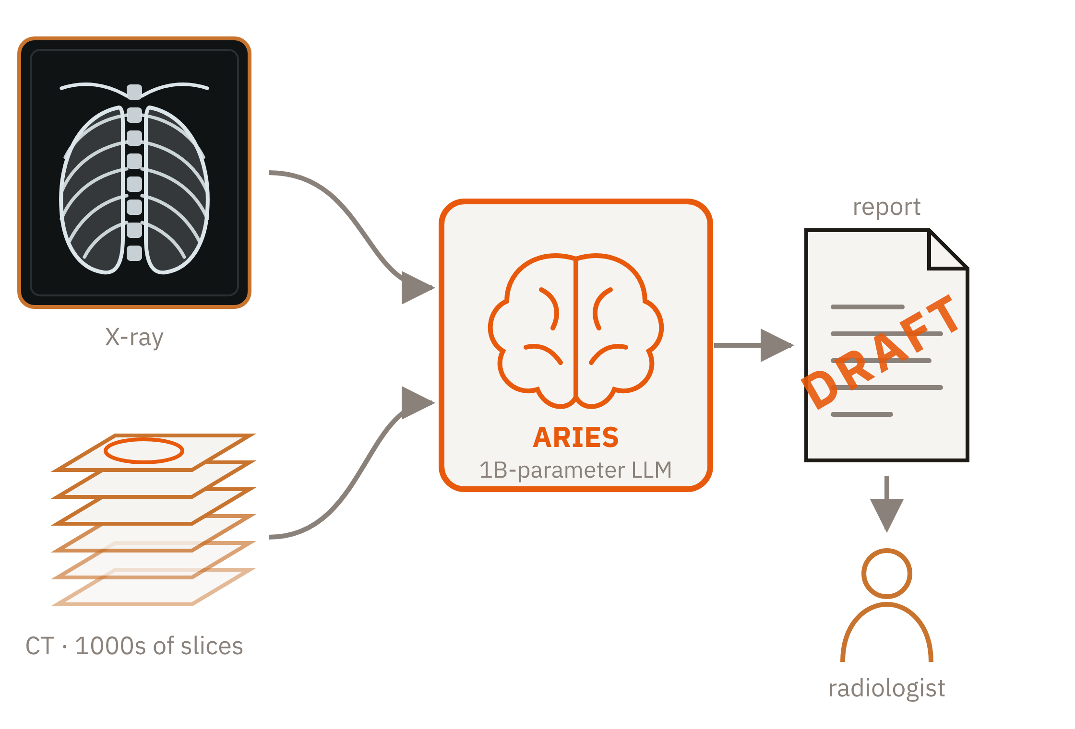
What is ARIES?
1B
Parameters
32 H100s
Used to train
Days to Weeks
Time to train

Slide 4
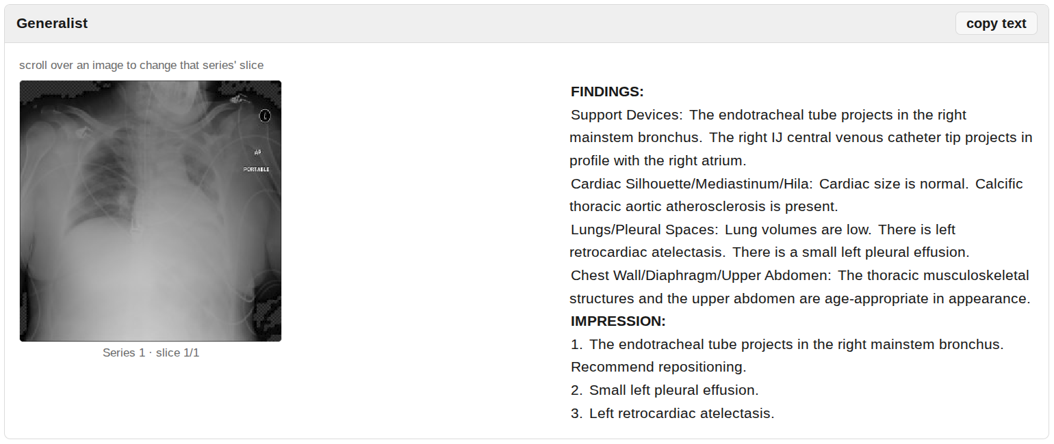
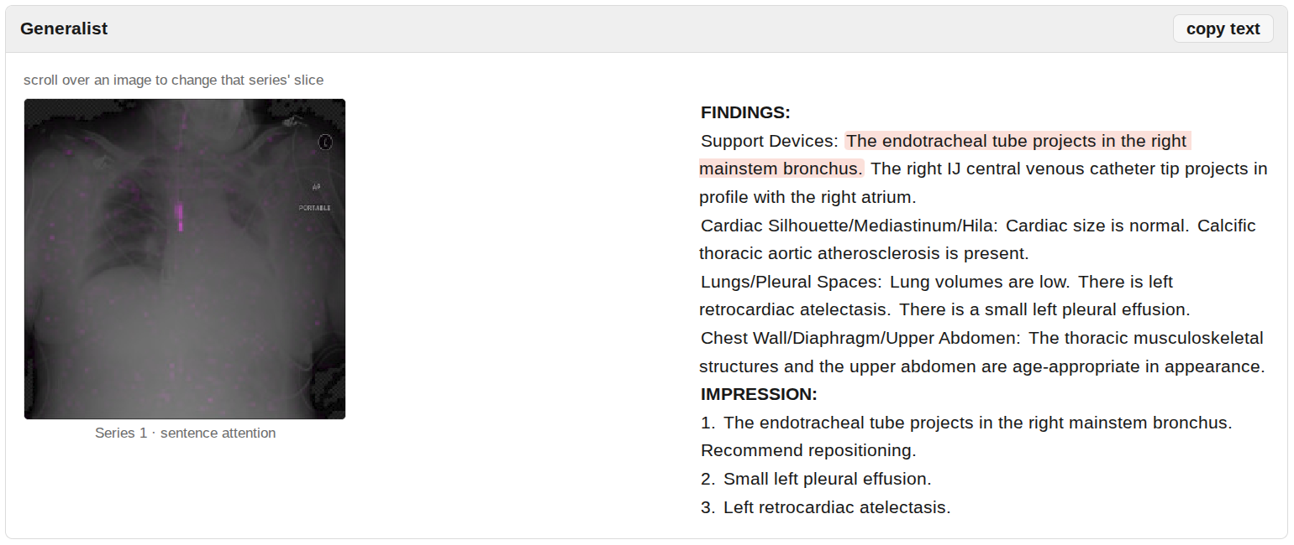
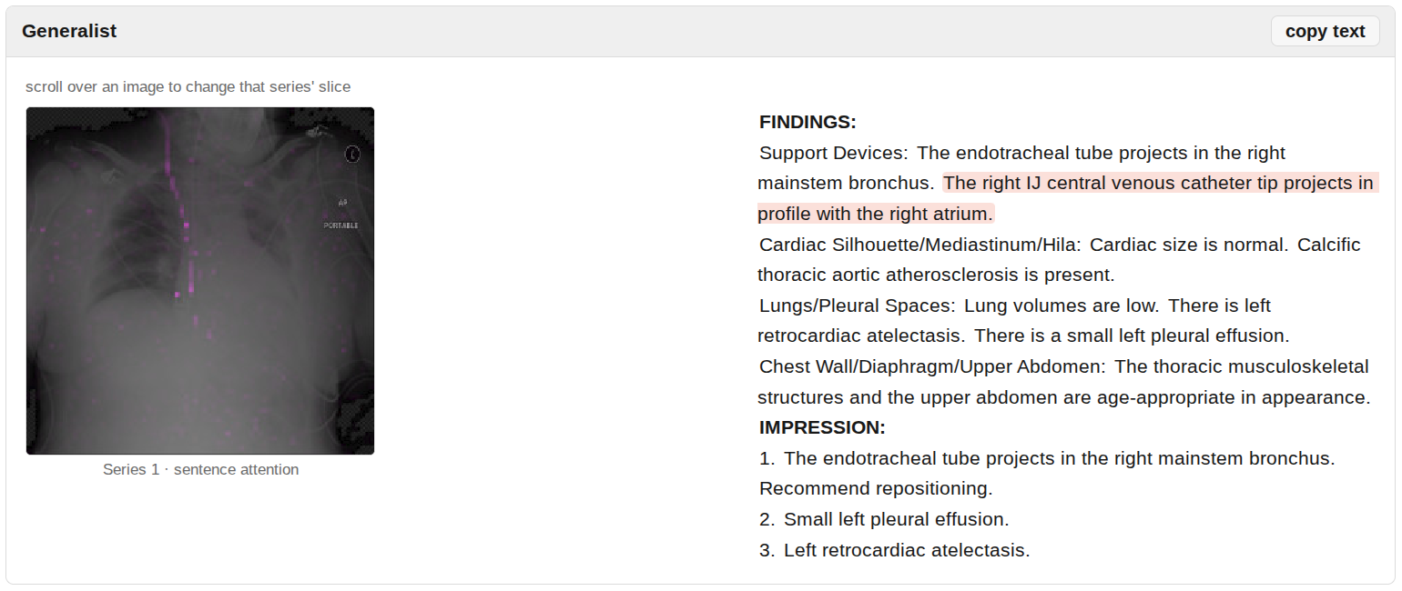
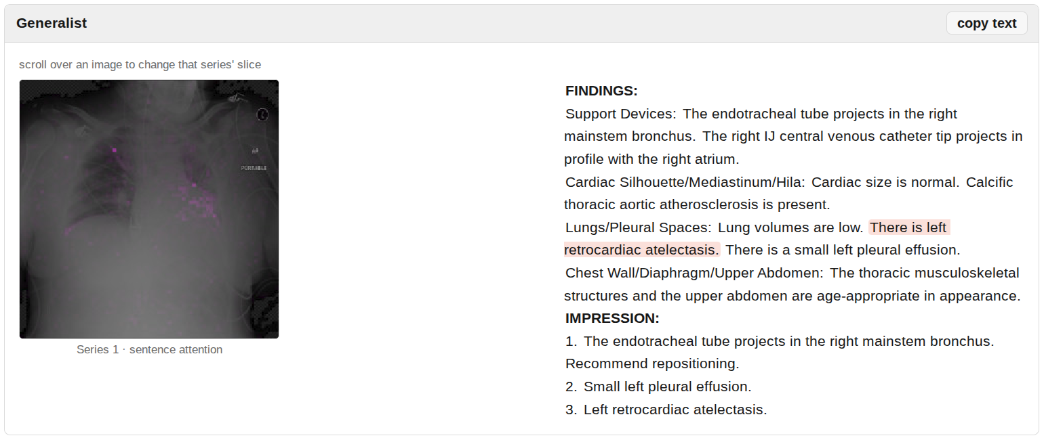
Demo

Slide 5
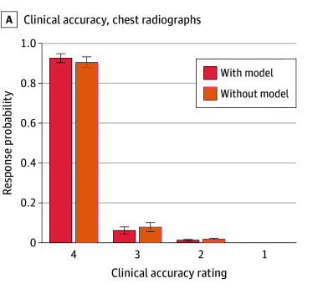
Does it Work?
80%
Efficiency Gains, up to, in a later test
=
Quality Equal
Figure: JAMA Network Open, June 2025, CC BY 4.0 — doi.org/10.1001/jamanetworkopen.2025.13921
Addl Stats: nmventures.org/aries

Slide 6
Leveraging PyTorch & TorchTitan

Slide 7
Dell + MedikaMind + PyTorch!
Special thanks to:
Dr. Mozziyar Etemadi (MedikaMind CEO)
Galal Galal (MedikaMind CAIO)
Hossein Kavianihamedani (Meta)
Bhavesh Patel (Dell Fellow)
Onur Celebioglu (Dell Fellow)
Savi Venkatachalapathy (Dell AI Architecture - Leadership)
Tao Zhang (Dell AI Architecture – Engineering)
Notes:
As a member of the PyTorch Foundation, Dell is committed to supporting the growth and adoption of PyTorch as a leading AI framework.
Khushboo and I were asked to investigate use cases related to supervised fine-tuning, and we partnered with Bhavesh to engage with Dr. Mozzi's team.
By combining our expertise and resources, we identified key areas for evaluation, developed a test plan, and assembled the infrastructure and tools needed to run experiments and optimize performance.
I'd also like to extend a special thank you to Galal, who led much of the engineering effort and created the content for this section of the presentation.

Slide 8
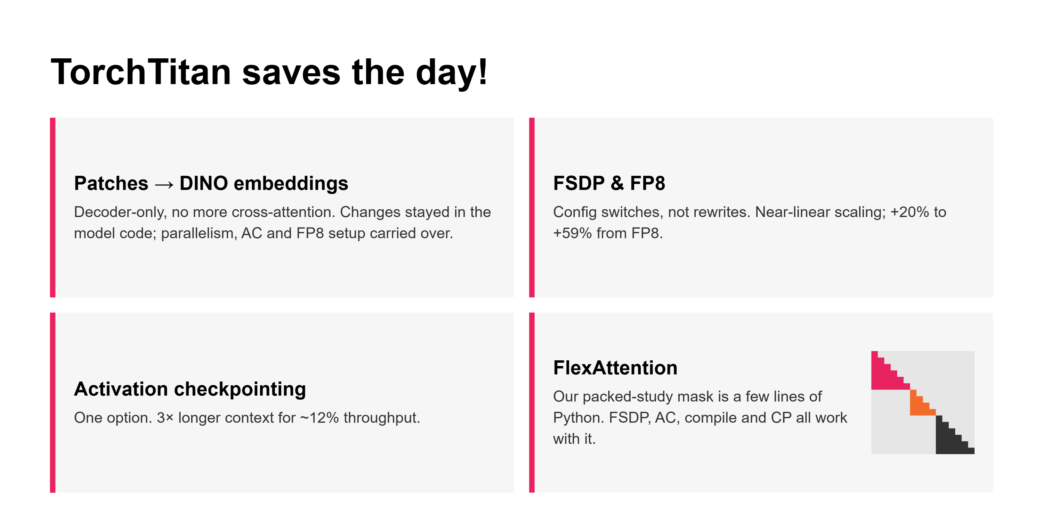
Notes:
Prior to MedikaMind’s adoption of TorchTitan, every change to their radiology model was a project in its own right. Once they switched, many major projects became small changes. I'll go around the grid.
MedikaMind wanted to swap ViT patch tokens for DINO embeddings and drop cross-attention, going decoder-only. On TorchTitan, that work stayed in their model code. The parallelism, activation checkpointing and FP8 setup carried over untouched, so their team could focus on the model and not the plumbing.
FSDP and FP8 are config switches, not rewrites. Scaling came out near-linear, and FP8 added between 14 and 59 percent more throughput depending on sequence length.
Activation checkpointing is another option that we were able to explore during our testing. We learned that for MedikaMind’s use case, it buys three times the context for about 12 percent of throughput.
Bottom right is the one that impressed me most. MedikaMind packs several studies into each sequence, so it’s vital that attention doesn’t leak between them. With TorchTitan, the FlexAttention code is abstracted, and FSDP, checkpointing, compile and context parallelism all kept working with it.

Slide 9
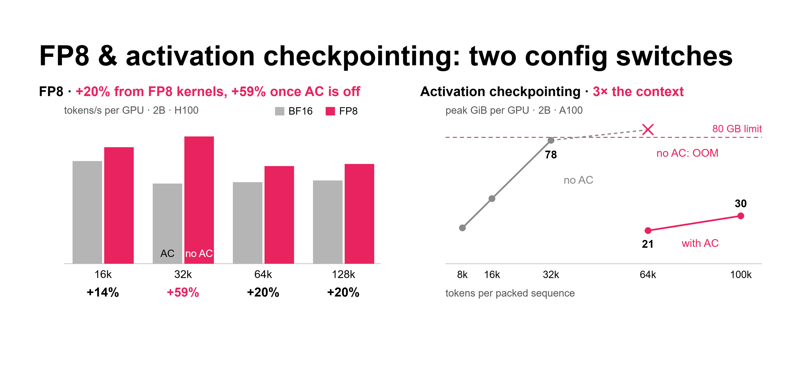
Notes:
When we began this experiment, two things caught our attention immediately, and they ended up being the two switches that mattered most.
On the left is FP8 against BF16 for their 2 billion parameter model. At 64k and 128k, the FP8 kernels alone give about 20 percent better training performance in tokens per second.
On the right is peak memory per GPU versus sequence length. Without checkpointing, the model bumps up against the 80 GB limit around 32k and runs out of memory at 64k. With it, 64k takes 21 GiB and 100k takes 30. The bottom line is that activation checkpointing allows for three times the context.
The two trade against each other for memory, and where you sit on that trade depends on sequence length. That shaped the setup on the next slide.

Slide 10
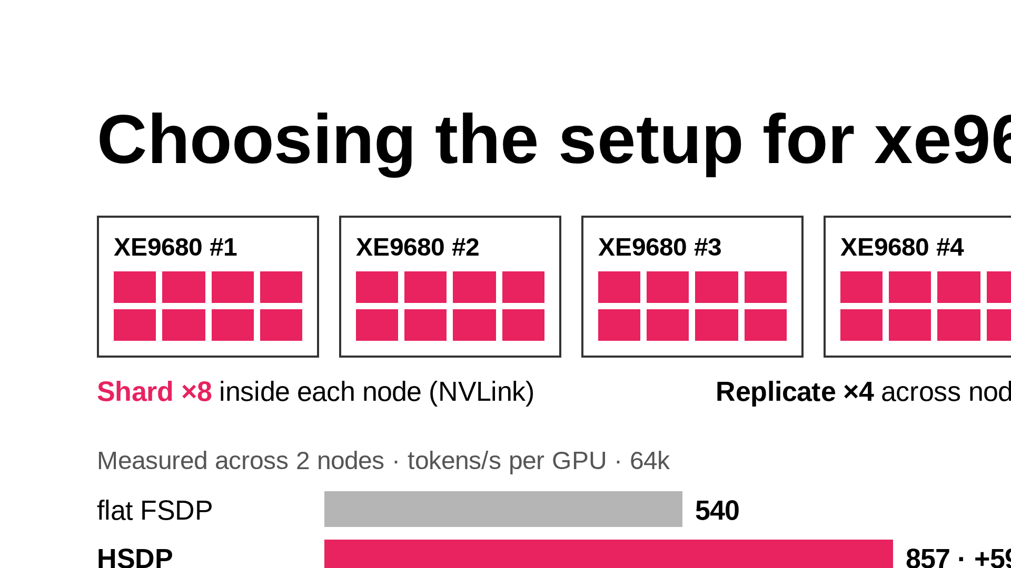
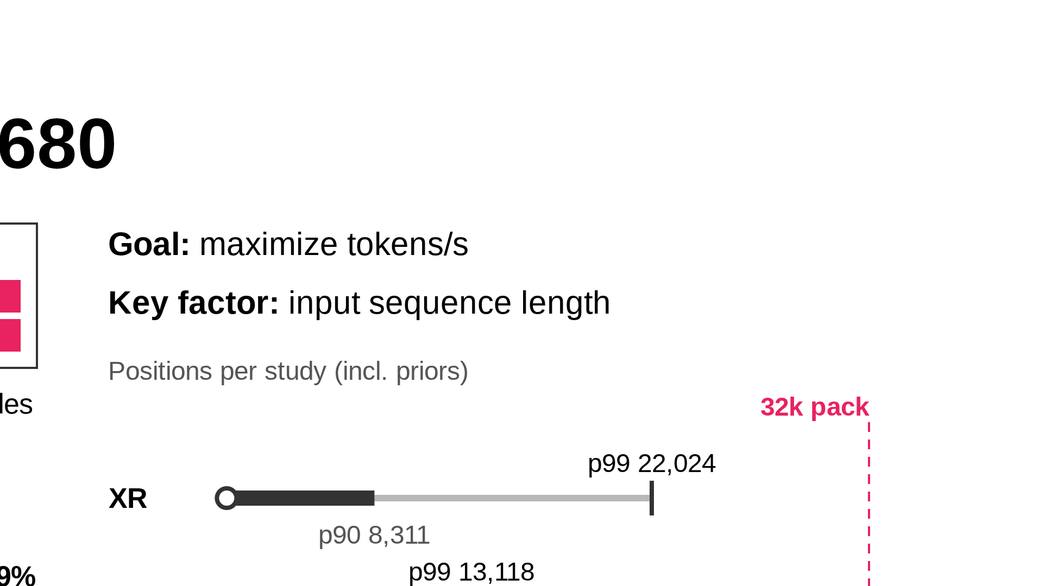
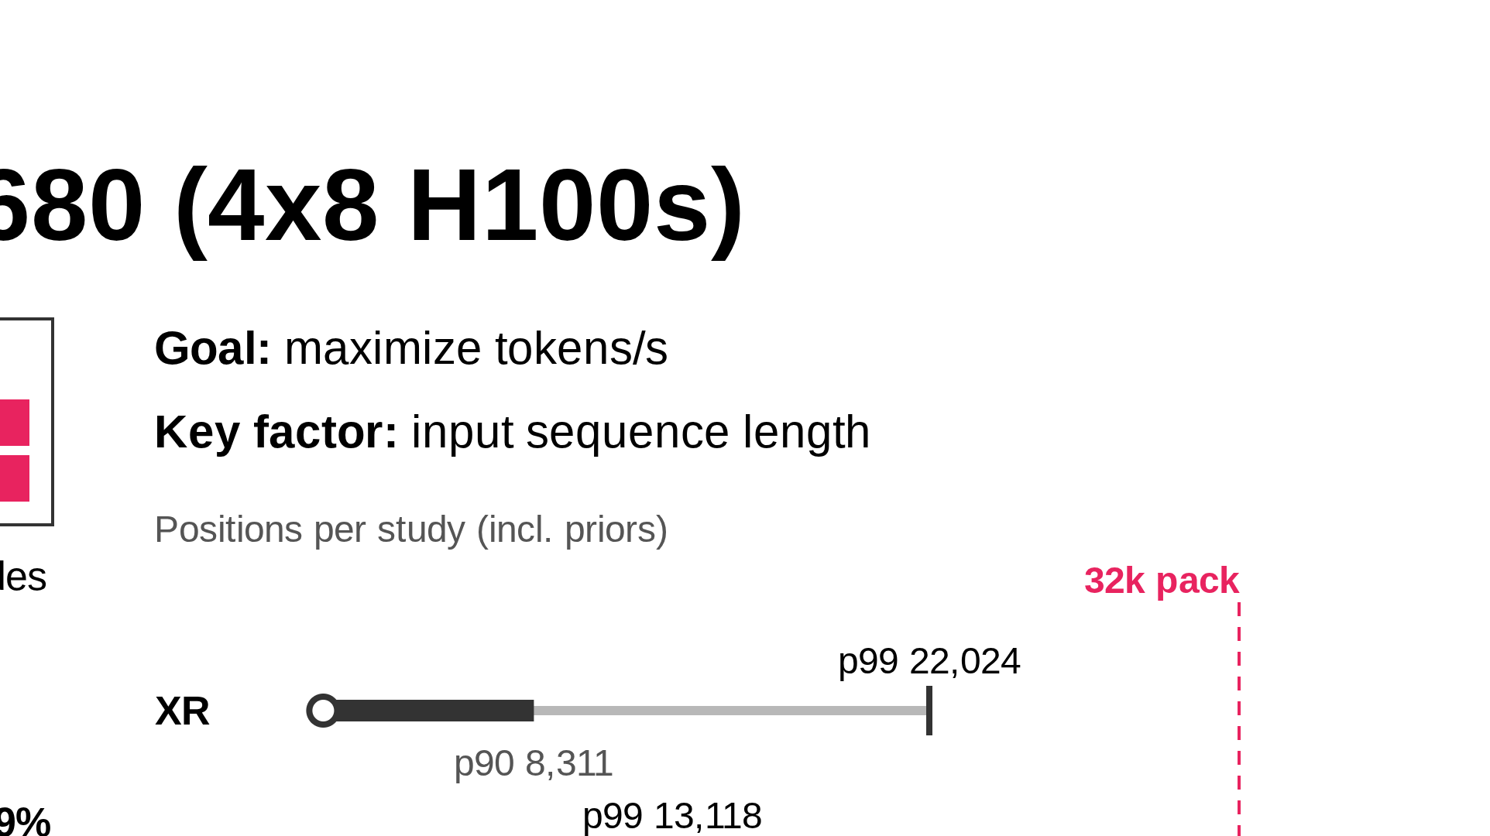
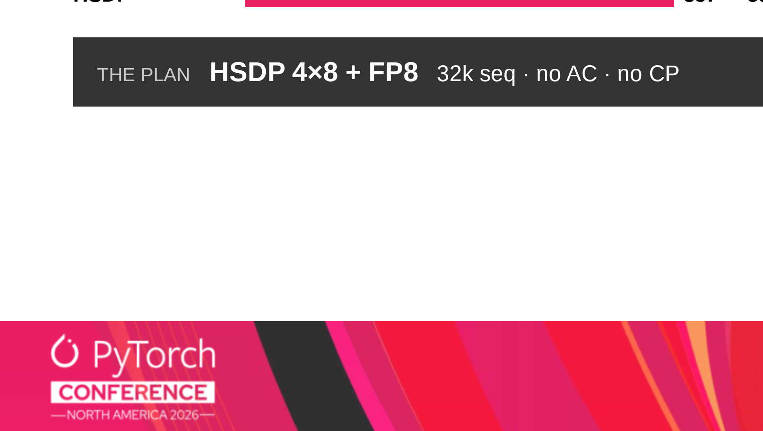
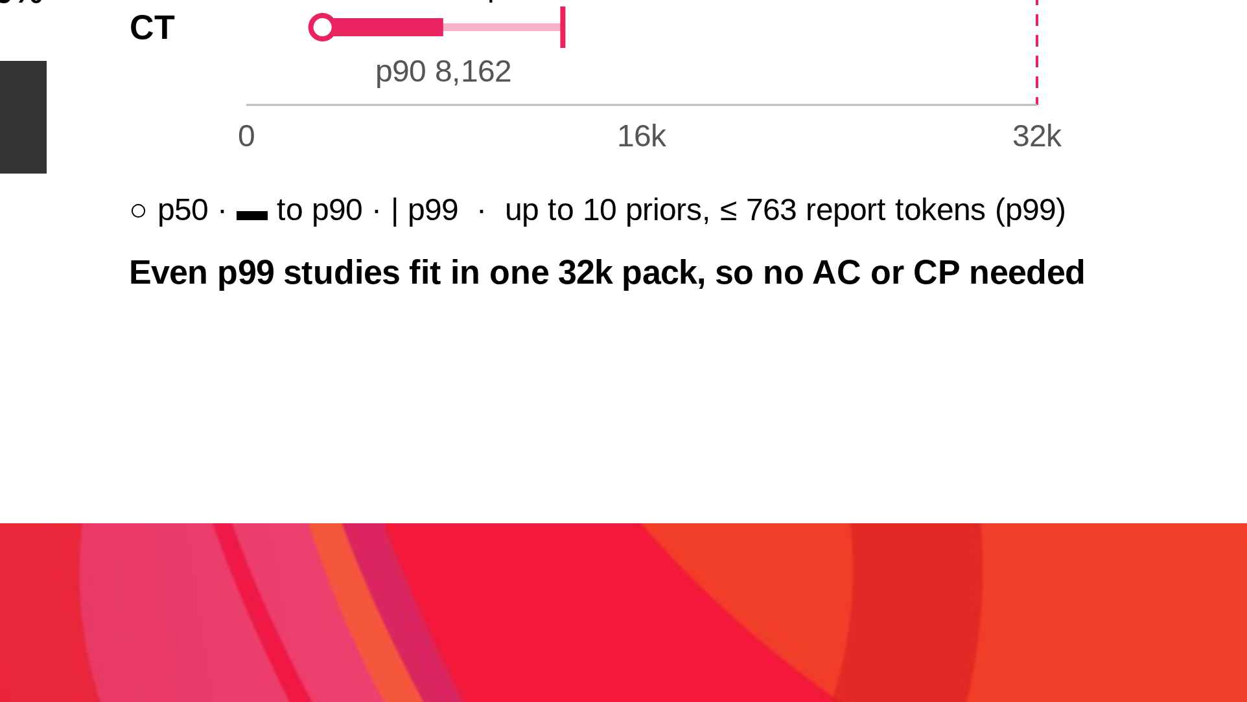
Notes:
~1.5 min.
MedikaMind is training on four Dell PowerEdge XE9680 servers, each with eight H100s.
The question we set out to answer was - how do we get the most tokens per second out of them. In every sweep, input sequence length decided the answer.
Start with the layout.
With HSDP we shard eight ways inside each XE9680, so the per-layer traffic stays on NVLink.
Then we replicate four ways across the servers, so only gradient sync crosses the network.
This configuration yielded 59 percent more tokens per second vs FSDP - from the same hardware.
Whether or not we need activation checkpointing or context parallelism are controlled by the input data. On close examination, the worst case token length of a single input worked out to be around 22,000 tokens.
That includes the current x-ray data, the corresponding radiology report, and up to 10 priors as well.
Since that value is well within the 32k window, we could leave activation checkpointing turned off, and skip doing context parallelism.

Slide 11
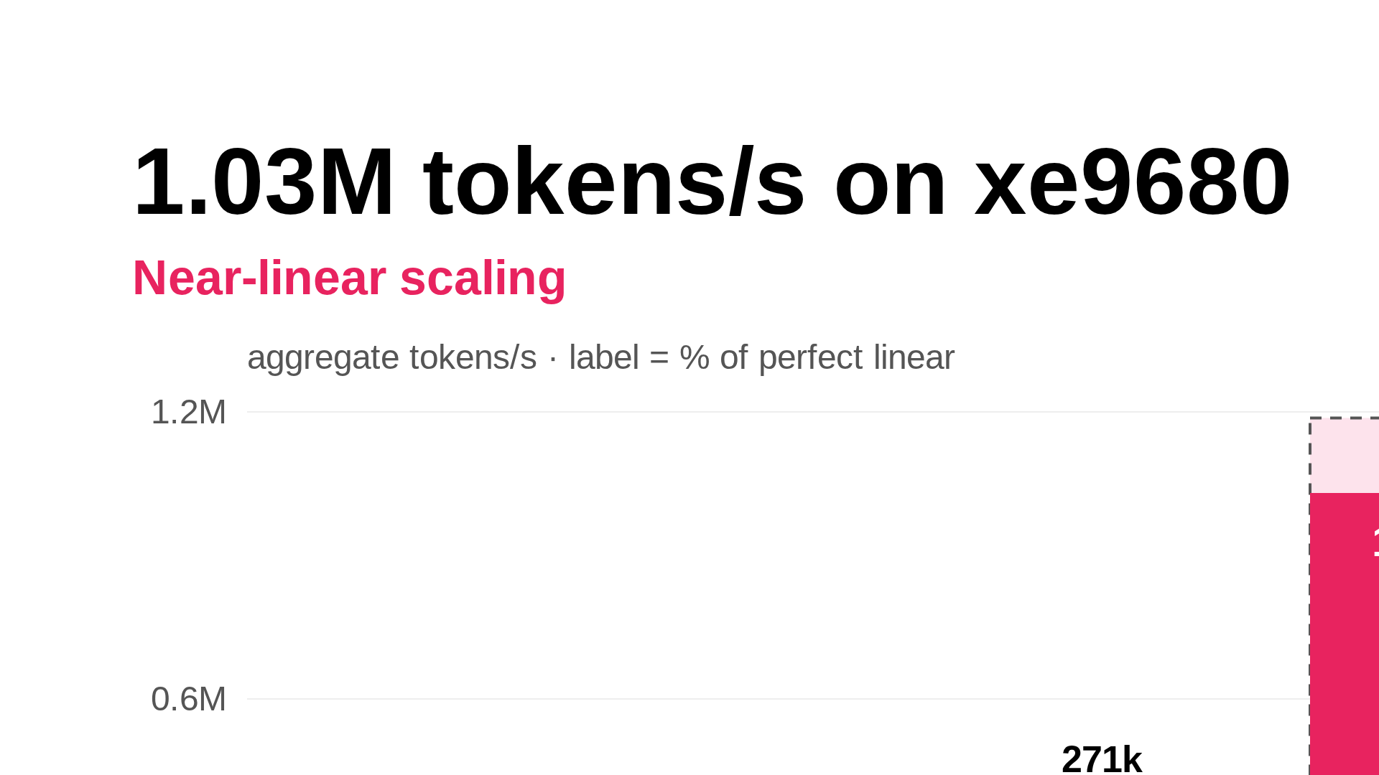
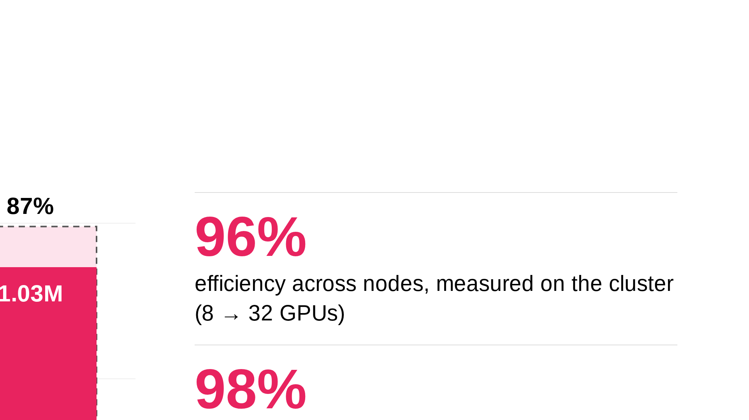
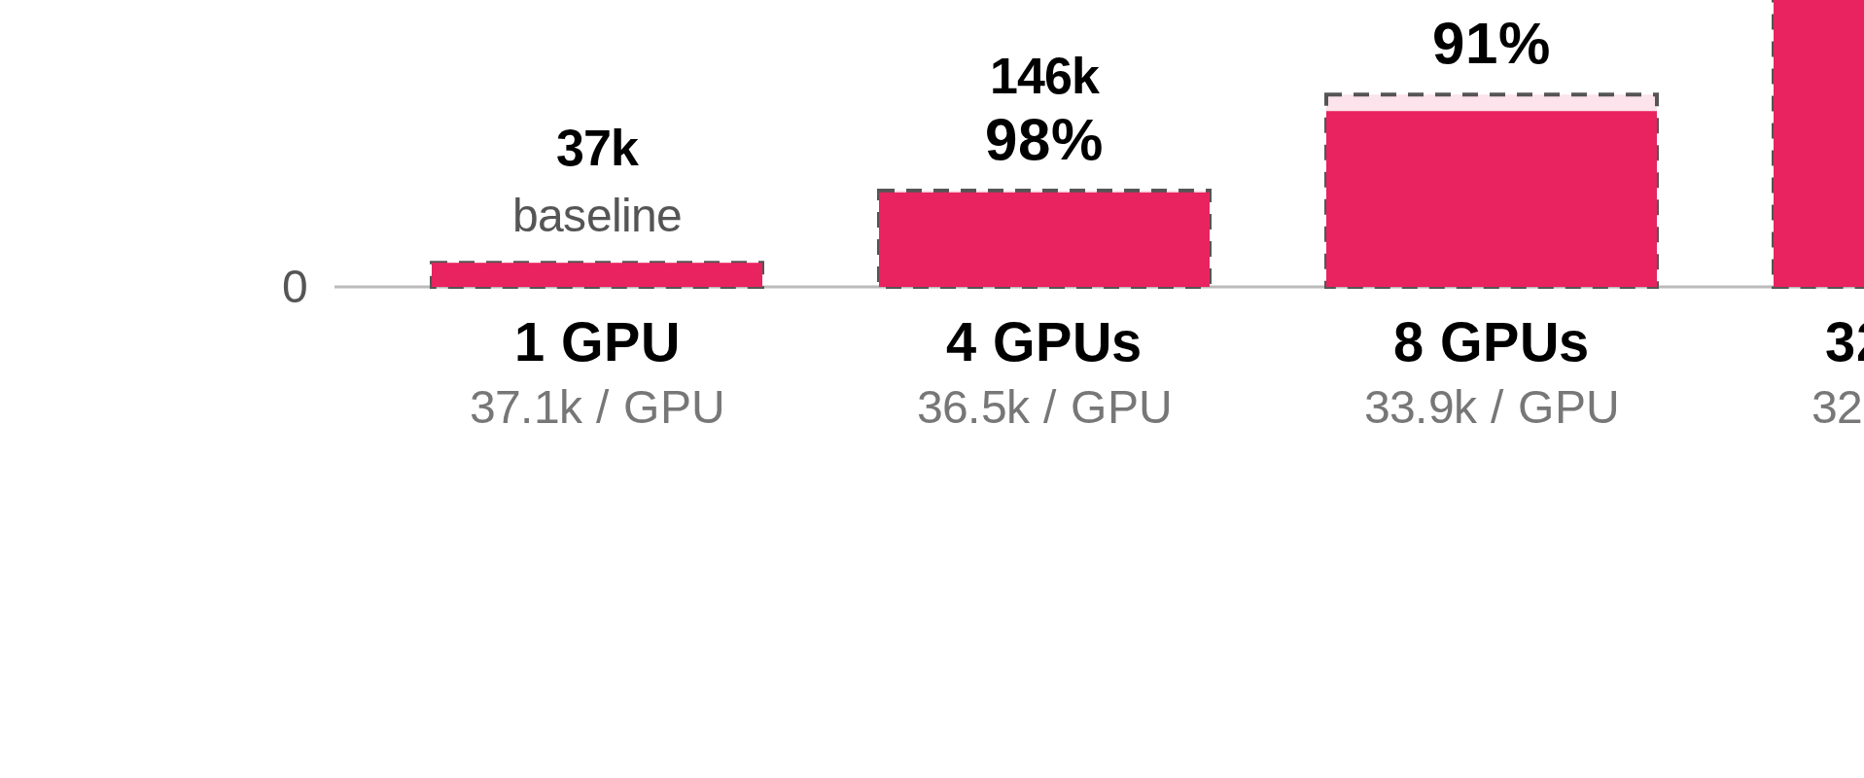
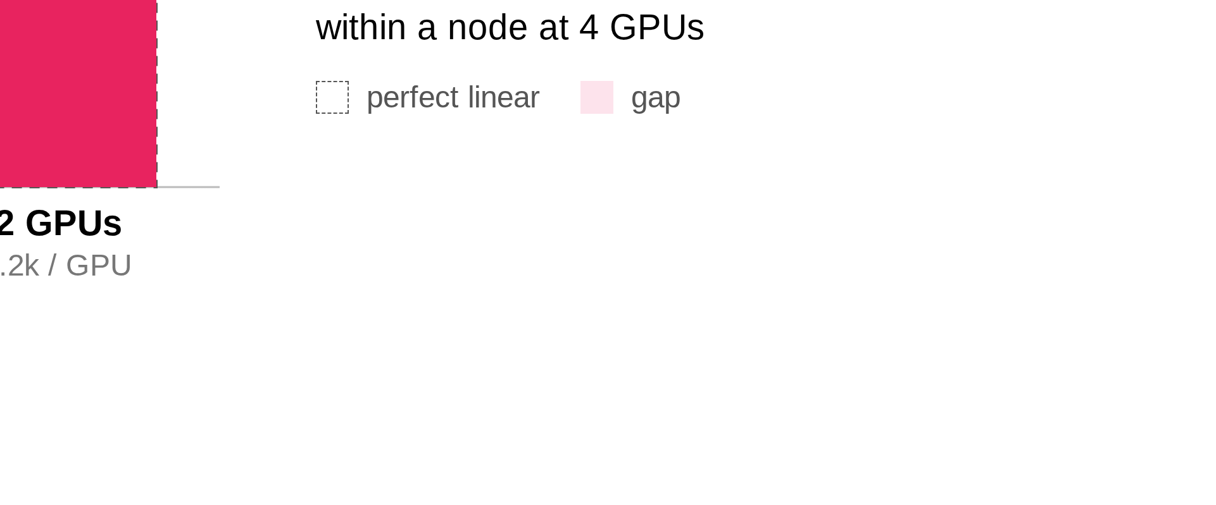
Notes:
~45 s.
Here's what that setup delivers: a little over a million tokens per second across all 32 H100s in the XE9680 cluster.
Each bar is aggregate throughput, and the dashed outline is perfect linear scaling from the value measured at one GPU, which is 37 thousand tokens per second.
The pink sliver is what’s lost from ideal as the cluster scales. A single XE9680 node gets 91% of ideal, and the four node cluster gets 87%.
Per GPU, that's 37 thousand on one GPU and still 32 thousand at full scale.
Adding servers costs MedikaMind almost nothing, which is what HSDP on NVLink buys them.

Slide 12
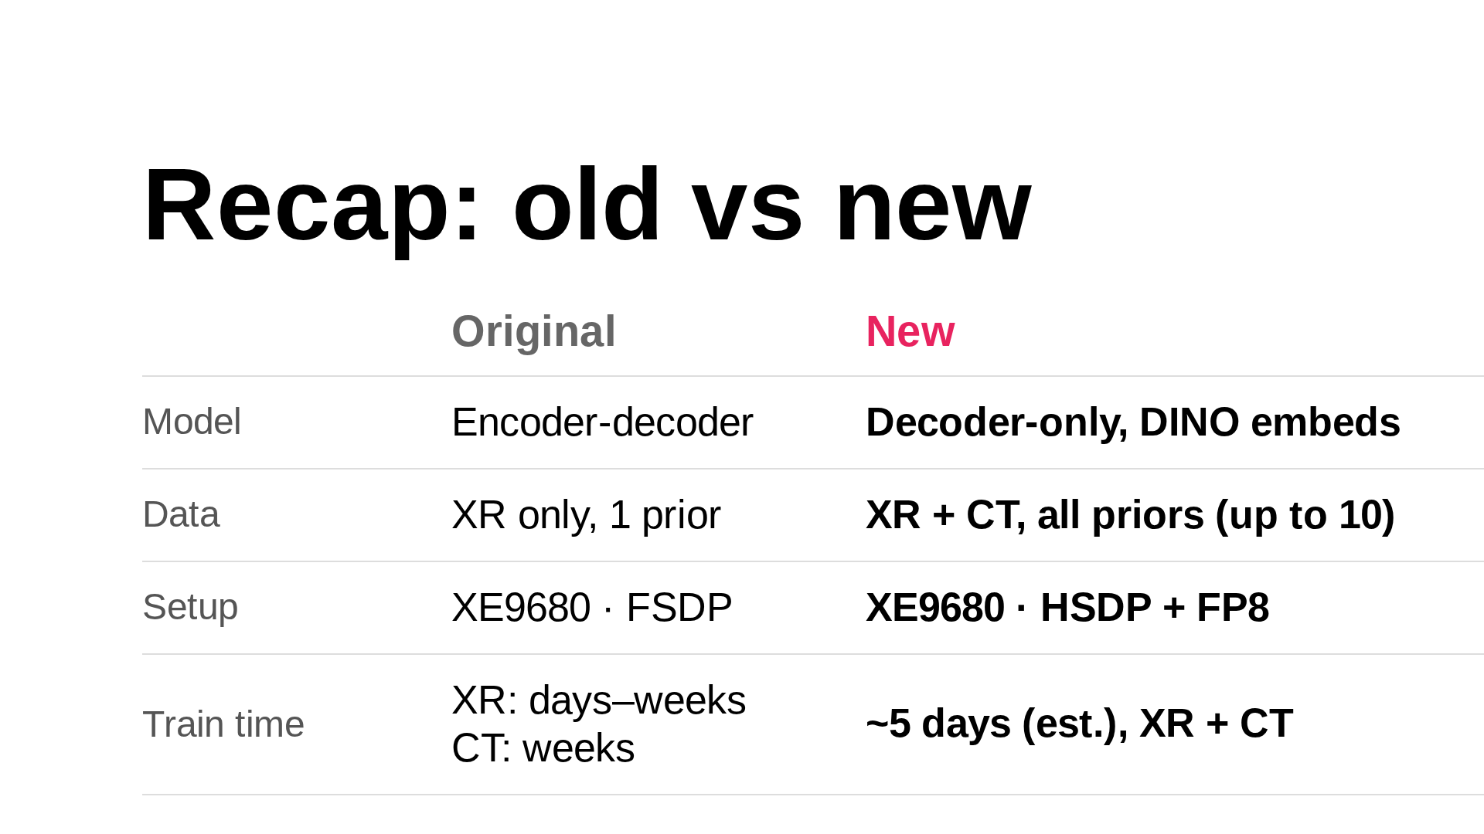
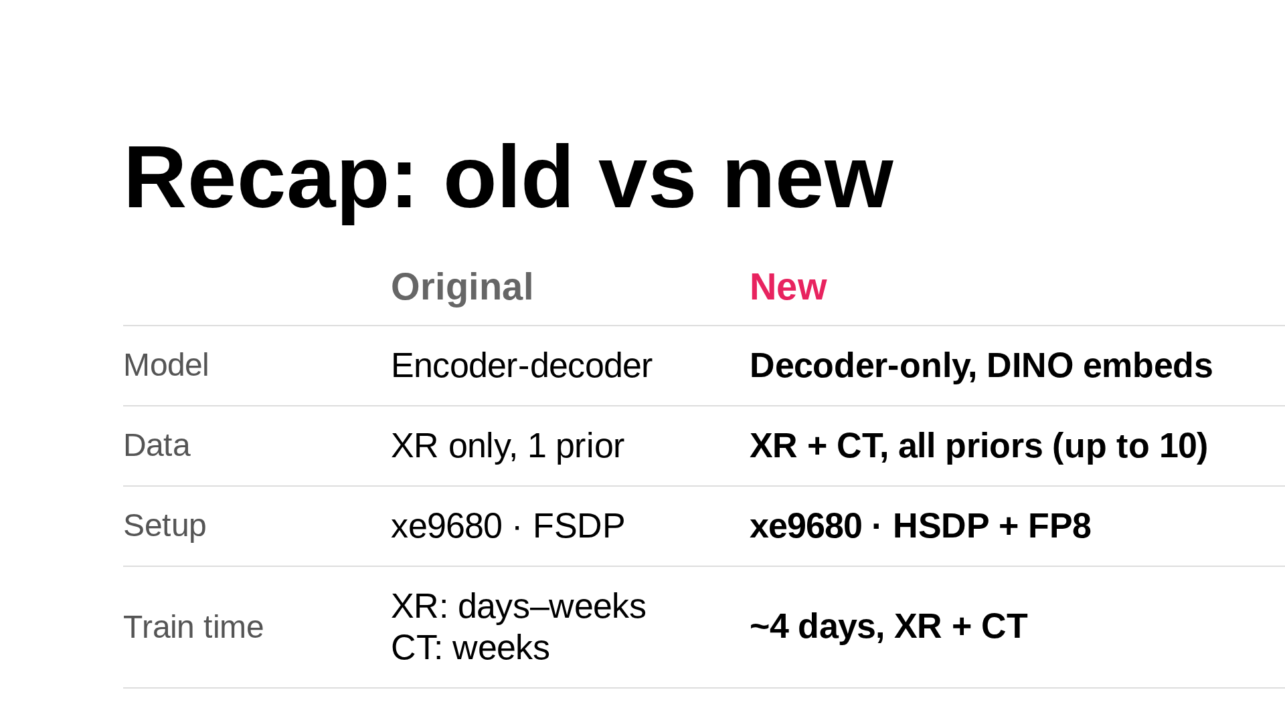
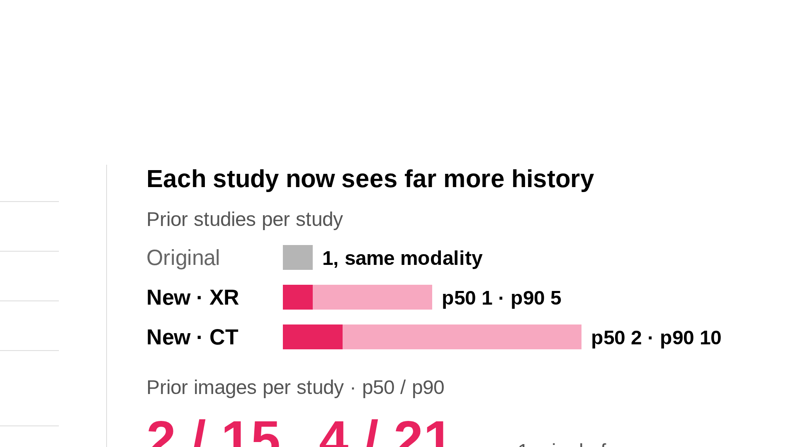

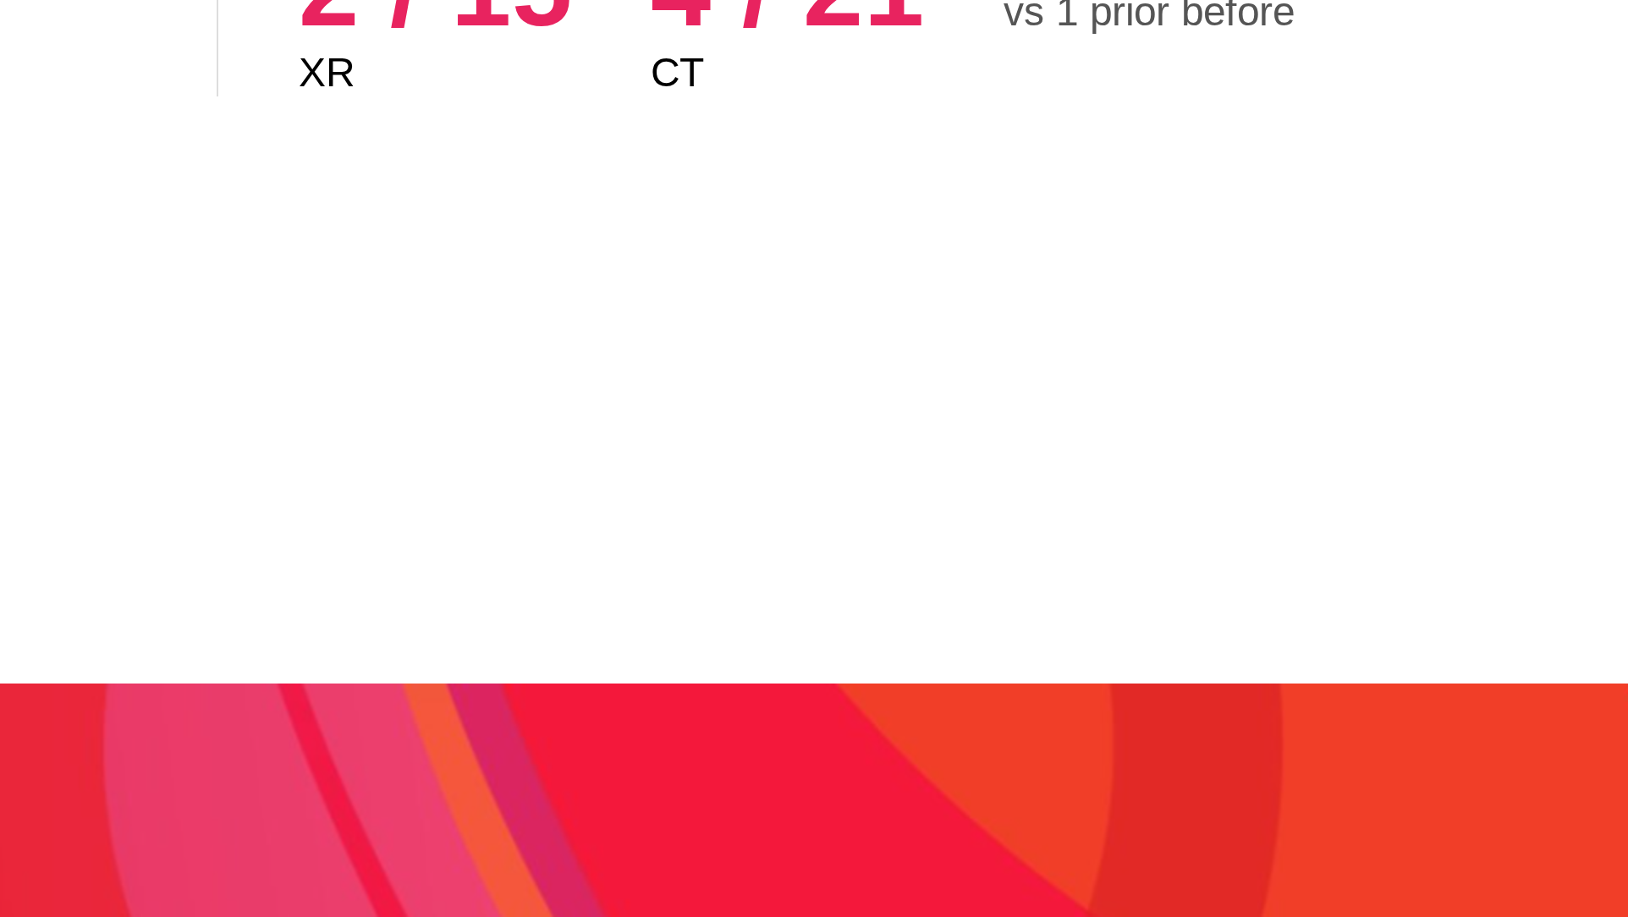
Notes:
~1.5 min.
To recap, here's where MedikaMind started and where they are now, on the same XE9680 hardware.
On the left:
The model went from encoder-decoder to decoder-only on DINO embeddings.
The data went from X-ray only, with a single prior, to X-ray plus CT with up to ten priors per study.
The setup went from plain FSDP to HSDP with FP8.
And training time went from days to weeks for just one dataset, to about four days for both datasets together
On the right is what that buys clinically.
Before, the model saw one prior study, always the same modality.
Now a typical X-ray study brings one prior and the 90th percentile brings five.
for CT it's two at the median and ten at p90.
The type of prior study can also now be a CT or an x-ray, depending on the patient’s history.
In terms of images, there’s a corresponding increase as well.
The takeaway is that - the same hardware now trains a model that captures far more of the patient's history, in a fraction of the time.

Slide 13
Experimenting With AutoParallel
Notes:
AutoParallel automatically shards and parallelizes PyTorch models across distributed device meshes.
It eliminates the need for manual distributed training code (FSDP, tensor parallelism, etc.)
Internally, it uses linear programming to analyze model structure and device configuration to find optimal parallelization strategies.
It optimizes for trade-offs between communication costs, compute efficiency, and memory utilization.
Theoretically, it offers most of the benefits of manual optimization without the overhead of writing and testing each potential strategy.

Slide 14
AutoParallel in Practice
94%
of hand-tuned
performance, average across 1/2/4/8 GPU runs
Relatively limited search space
Some limitations on what parallel methods are tested
Identified more parameters worth investigating/tuning
AutoParallel still a work in progress
Notes:
Would mean more if the model was bigger and say TP/EP were relevant
AP would benefit from a much larger cluster or some other complexity in the overall training process
Would have been more use if it was testing more parameters that we were interested in (ie, AC weighting and context length)
Also would be useful for running more diverse experiments (ie, parallelize for this cluster, without changing the parallel code, change a number of the model parameters (ie, size, type, etc)

Slide 15
Dell Hardware – Optimized for Training

Slide 16
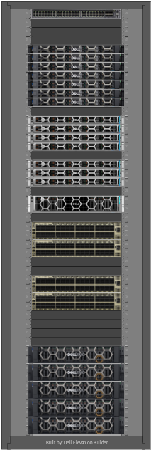
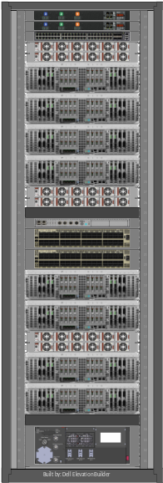
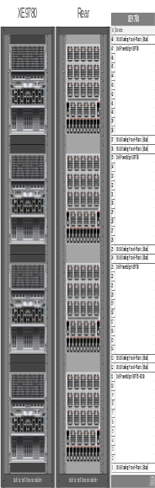
Enterprise Training Models with Dell AI Factory
Dell AI Factory
MGMT
Kubernetes MGMT
Telemetry
LoadBalancer
Application Stack
Compute Engine
Dell PowerEdge server
(Training Weights)
Applications
Training Libraries
Custom LLM
XE9780/5 & XE9780L/5L
…
AI Data Platform
Dell Orchestration Engine
…
Dell Search Engine
Dell Processing Engine
Dell Analytics Engine
…
Dell Storage
PowerFlex
ObjectScale
PowerScale
PowerStore
DLC
Air

Slide 17
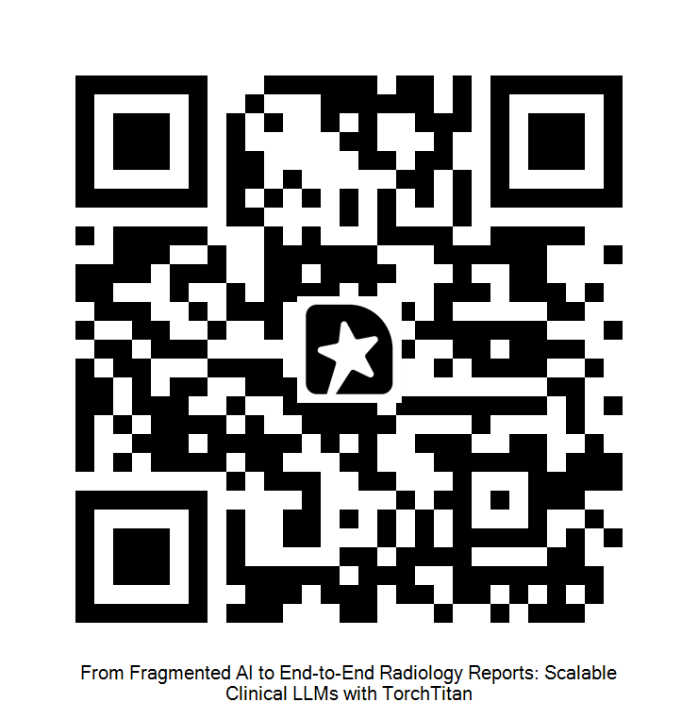
Questions & Feedback

