Slide 1


Precompile for Training
Compile once, run on every rank
Bob Ren · Aaron Orenstein
Meta · PyTorch Conference
Notes:
Quick show of hands: who's waited on torch.compile at startup? At Meta we have a lot of GPUs, and even more jobs waiting for them, so a GPU sitting idle while it compiles is expensive. We made one of Meta's largest training jobs compile once, on one GPU, and every rank just loads the result. Here's how.

Slide 2
One rank compiles, then recompiles
compile
recompile
rank 0
2
Notes:
A rank is one process driving one GPU. It compiles on the first step, and that's not the last time: a new shape can trigger a recompile mid-run. That recompile can spike memory into an OOM, and the compile workers kept around for recompiles quietly steal CPU and memory from training.

Slide 3
Every compile leaves the GPU idle
GPU idle
training
GPU idle
training
compile
recompile
rank 0
×N
compile
recompile
rank 1
compile
recompile
rank 2
⋮
compile
recompile
rank N-1
4
Notes:
First problem: every compile and recompile is time the GPU sits idle. While the compiler runs, nothing trains.

Slide 4
Every rank compiles, again and again
compile
recompile
rank 0
×N
compile
recompile
rank 1
compile
recompile
rank 2
⋮
compile
recompile
rank N-1
3
Notes:
Now scale it up. In data-parallel training every rank runs the same program, so every rank compiles essentially the same thing, recompiles included. The total cost is one compile multiplied by every shape multiplied by every GPU you're holding, and in a system like ours, where a higher-priority job can preempt you, you pay it again after every preemption.
What are the individual pieces?

Slide 5
Every rank does the same work
same work
same work
compile
recompile
rank 0
×N
compile
recompile
rank 1
compile
recompile
rank 2
⋮
compile
recompile
rank N-1
5
Notes:
Second: every rank is doing basically the same work. The same graph, compiled N times over.

Slide 6
…but even in SPMD every rank is slightly different
device baked in/nondeterministic
cuda:0
kernel A
rank 0
≠
cuda:1
kernel B
rank 1
cuda:2
kernel A
rank 2
⋮
cuda:N-1
kernel C
rank N-1
6
Notes:
Third: every rank is slightly different, which is what stops you from just sharing one result: Each rank bakes its own device index and process-group name into its graph.

Slide 7
Benchmarking picks a different winner on each rank
kernel A
kernel B
kernel C
rank 0
1.02 ms ✓
1.04 ms
1.05 ms
rank 1
1.05 ms
1.03 ms ✓
1.06 ms
rank 2
1.01 ms ✓
1.04 ms
1.03 ms
⋮
rank N-1
1.04 ms
1.05 ms
1.02 ms ✓
Different kernels → slightly different numerics on each rank
7
Notes:
And it's not just specialization: compilation is nondeterministic too. Take max-autotune: on every rank, it benchmarks kernels and keeps the fastest. When candidates are within noise of each other (which happens a lot), each rank can pick a different winner, so ranks end up running slightly different code, with slightly different numerics.

Slide 8
Can't we just do all this work
once, up front?
8
Notes:
Can't we just do all this work once, up front? I'm glad you asked. Yes: that's precompile. But it took some work to get there.

Slide 9
Rank-agnostic
compile_on_one_rank + portable guards
Notes:
The first step is making the output rank-agnostic: one rank's compiled output has to work on every rank.

Slide 10
Hard-coded GPU and process group → generic
Before default, compiled on GPU 3
After compile_on_one_rank
# guards
check_tensor(x, device=3)
pg.group_name == '0'
# generated code
cuda.set_device(3)
stream = get_raw_stream(3)
all_reduce_(buf, 'sum', '0')
# guards
check_tensor(x, device=current)
# no group_name guard
# generated code
idx = cuda.current_device()
cuda.set_device(idx)
stream = get_raw_stream(idx)
all_reduce_(buf, 'sum', pg)
→
✕
✓
runs on GPU 3 only
one artifact runs on every GPU
10
Notes:
Here's an example of the kinds of things that get specialized into a graph. Before: the guards check for GPU 3 and process group zero, and we hard-code device 3, stream 3 and group zero. That file only runs on GPU 3. After, with compile_on_one_rank turned on: the guard checks for the current GPU, the code asks for the current device when it runs, and the process group is passed as an input. Same file, every GPU. This assumes SPMD, every rank running the same program; with MPMD, like pipeline stages, you capture once per distinct program.

Slide 11
Process-local guards → portable guards only
Before built in the capture process
After saved in the artifact
tensor(x): float32, [*, 64]
type(batch) is Batch
self.training == True
id(self.fc) == 0x7f3a…
dict_version(G) == 4211
id(step_fn) == 0x55b1…
tensor(x): float32, [*, 64]
type(batch) is Batch
self.training == True
# dropped + reported:
# id ×2, dict_version ×1
→
✕
✓
addresses never match on another rank
every guard means the same everywhere
11
Notes:
Guards have the same problem. Dynamo builds them while tracing, and some of them only make sense in that process: an object's address, a dict's version counter, a function's identity. On another rank those never match. After: the artifact keeps only guards that mean the same thing in any process, like tensor dtype and shape, types by name and plain values. Everything we drop is reported, so nothing disappears silently.

Slide 12
Your Python can still leak the rank
@torch.compile
def step(x):
y = x * 2
if dist.get_rank() == 0: # rank guard
y = y + 1
return y
✓
✕
✕
✕
rank 0
rank 1
rank 2
rank 3
only rank 0 passes the guard
Fix: keep rank-dependent branches outside the compiled region
12
Notes:
Neither fix covers your own Python. For example dist.get_rank() returns a plain int, so Dynamo bakes rank 0's branch into the graph and guards on the rank. Every other rank fails that guard, so the compile only runs on rank 0. Keep rank-dependent branches outside the compiled region.

Slide 13
Compile once
precompile
Notes:
[I propose Bob takes over here]
The final step: compile once. Now that one rank's output works on every rank, we don't need every rank to redo the work.

Slide 14
Precompile: compile once, load on every rank
m.py
def call():
run(...)
capture job
1 GPU
14
Notes:
So we move to a model where we only trace once: Run the compiler ahead of time, in a small capture job of its own, on one GPU. Every shape and every eval step goes into one artifact: a Python file plus a cache. Every rank of the training job loads it instead of compiling. As long as training only makes calls you captured, it never waits for the compiler.

Slide 15
Caching skips compiling; precompile skips tracing too
Cache miss
everything runs
Dynamo
trace
AOTAutograd
fwd + bwd
Inductor
compile
training ▶
Cache hit
Dynamo re-traces
Dynamo
trace
AOTAutograd
cache lookups
training ▶
Precompile
Dynamo never runs
load
artifact
training ▶
time →
15
Notes:
And this is the key difference from caching. On a cache miss, every rank runs the whole pipeline: Dynamo traces, AOTAutograd builds forward and backward, and Inductor compiles. A cache hit skips Inductor's compile, but Dynamo still re-traces on every rank and AOTAutograd still hashes and fetches from the cache, because the cache key comes from the traced graph. Precompile's artifact already holds the results of tracing: the guards and Dynamo's rewritten bytecode next to the compiled code. Each rank just loads it and starts training.

Slide 16
The trade: a compiler-free training loop
You get
You give up
✓
–
No recompiles
Know input shapes up front
✓
–
No compile workers
A small job alongside yours
✓
–
1 GPU compiles, not N
You own invalidation
✓
Same kernels on every rank
16
Notes:
What you get: the compiler is out of the training loop. No recompiles, no compile workers, one GPU compiles instead of all of them, and every rank runs the same kernels. What you give up: you need your input shapes up front, a small one-GPU job runs alongside yours, and you own invalidation.

Slide 17
Precompile is a contract: run what you captured
Checked at load
Your job
✓
!
PyTorch build + Python version
Same model code
✓
!
Input guards
Same model config
✓
!
Param names, shapes, dtypes
Rank-independent Python
break your side and the artifact still loads, but can be silently wrong
17
Notes:
All of this makes precompile a contract, and you hold half of it. At load we check what we can see: the PyTorch build and Python version, that the artifact and its cache belong together, that the model you pass has the same structure, and the input guards. What we can't see is whether your model code or config changed since capture. If they did, the artifact can still load and be silently wrong. Keeping the code you run equal to the code you captured is your job, and so is keeping rank-dependent Python out of the compiled region, like we saw earlier.

Slide 18
Keeping it valid: key artifacts by commit + model
commit a1b2c3d
model ranker_v2
a1b2c3d/ranker_v2
+
=
config-driven models: the commit pins code + config, the name picks the model
capture job
1 GPU
training job
every rank
write key
artifact store
read key
new commit → new key → no artifact yet → capture again, or fall back to torch.compile
18
Notes:
Here's how we did it internally. Our models are config-driven and live in the repo, so a commit hash pins both the code and the config, and the model name picks which model. The capture job writes the artifact under commit plus model name; every training rank reads it back with the same key. Change anything, you get a new commit, a new key, no artifact, and you capture again or fall back to regular torch.compile.

Slide 19
Results
one of our largest models
Notes:
So, did it work?

Slide 20
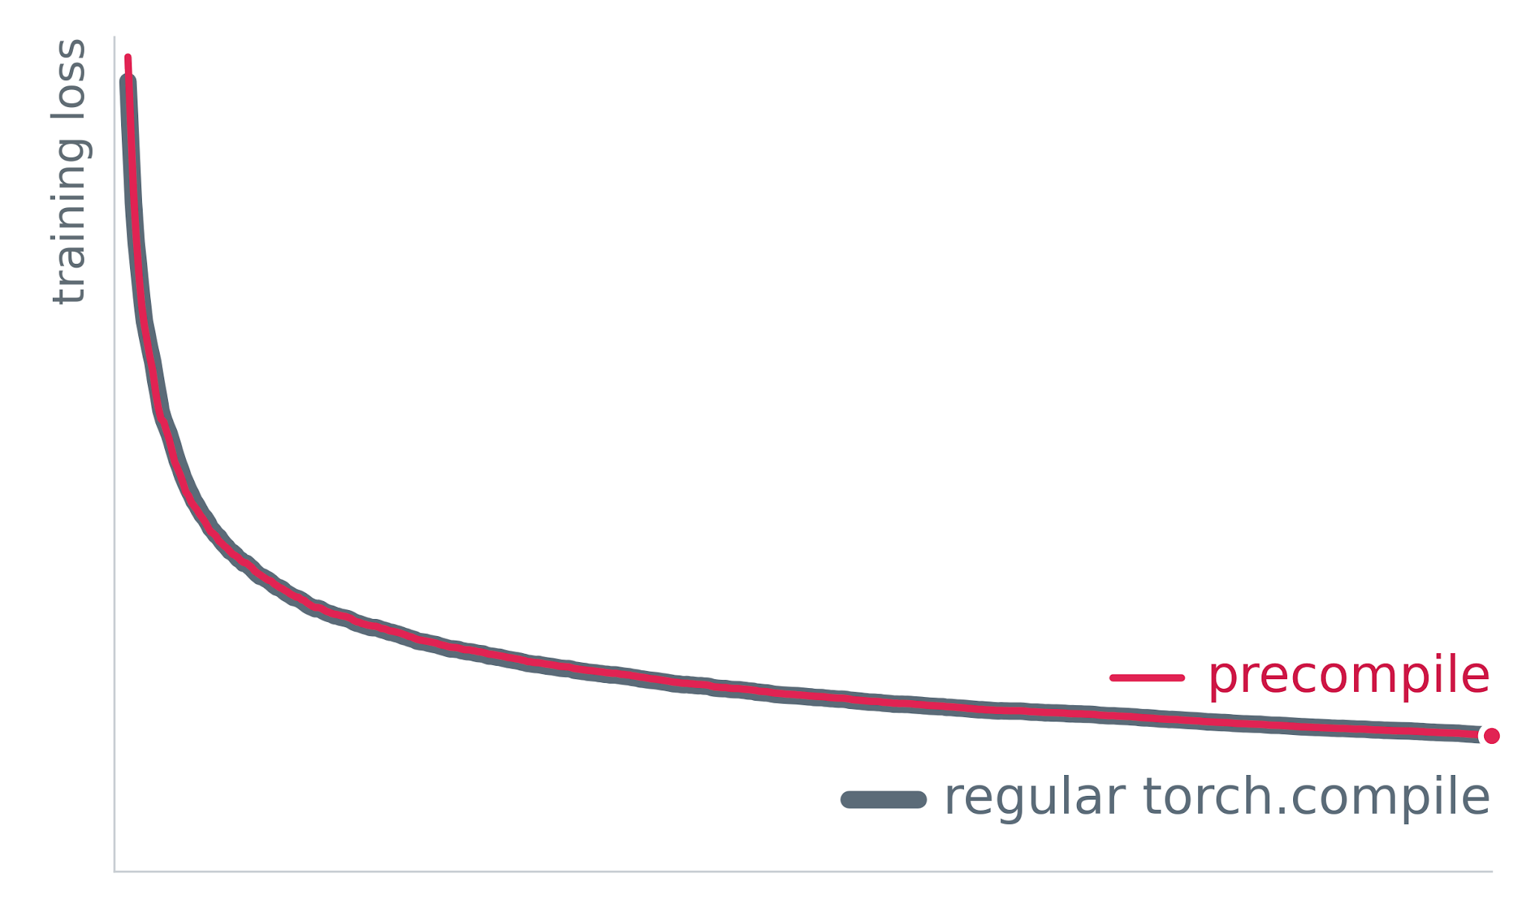
Same loss curve as regular torch.compile
On one of Meta's largest internal models
< 0.001%
final-loss gap (run-to-run noise)
20
Notes:
All of these results come from one of Meta's largest internal models. First, correctness: the loss curves overlap for the whole run, within run-to-run noise.

Slide 21
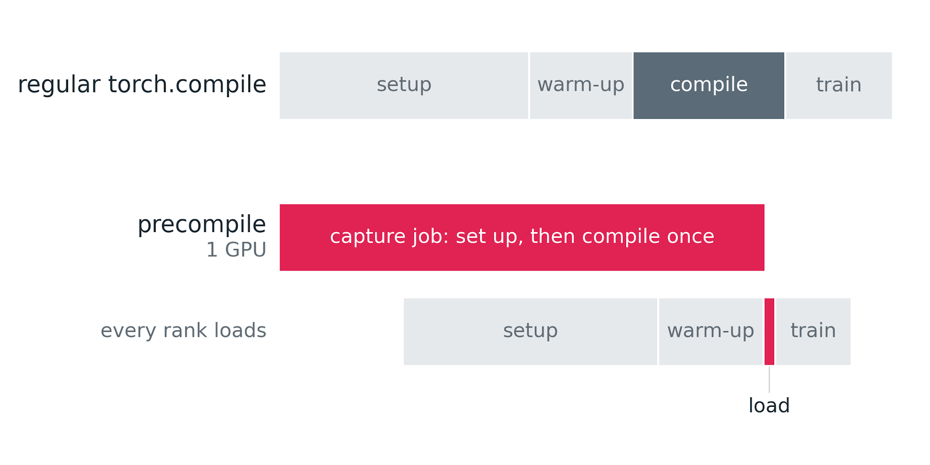
One GPU compiles; every rank just loads
69–92%
less compile time per rank
15–26%
fewer job GPU-hours
Short test runs; ranges span the job sizes we tried.
21
Notes:
Here's one job end to end. On top, every rank sets up, warms up, then compiles. Below, the 1-GPU capture job starts first and finishes just as the training ranks are ready, so each rank pays only a short load. Across the job sizes we tried, per-rank compile time dropped 69 to 92 percent, and total GPU-hours 15 to 26 percent.

Slide 22
Compile cost stays flat as you scale
1× ranks
2×
4×
4.1×
≈1×
compile cost at 4× ranks
regular
precompile
22
Notes:
Each square is a rank. With regular torch.compile every rank compiles, so total compile cost grows with the job: 4.1 times at four times the ranks. With precompile, one GPU compiles and the rest load, so it stays about flat. That's why the savings grow with job size.

Slide 23
At 2,048 GPUs: ~300 GPU-hours saved per launch
GPU-hours saved each time the job starts, cold start
300
150
75
37
1.7
18
16
GPUs · measured
128
GPUs
256
GPUs
512
GPUs
1,024
GPUs
2,048
GPUs
16 GPUs measured; larger sizes scale per-GPU time by N · capture: 0.64 GPU-h
23
Notes:
Here's what that means at scale. We measured at 16 GPUs: each rank's compile window drops from about eleven and a half minutes to under three, and the capture job costs the same 0.64 GPU-hours however big the job is. Projecting that out, at 128 GPUs that's about 18 GPU-hours saved every time the job starts; at 2,048 GPUs, about 300. And every restart or preemption saves it again, since you keep the compiled artifact.

Slide 24
Try it
API + takeaways
Notes:
And finally, how to try it.

Slide 25
Two calls: capture once, load everywhere
import torch
from torch.compiler.precompile import capture, load
from my_train import step # must live in an importable module
# precompile job, 1 GPU:
with torch.compiler.config.patch(compile_on_one_rank=True):
with capture(step, artifact_path="m.py", cache_path="m.cache") as cap:
cap(model, batch1)
cap(model, batch2) # a new shape adds a variant
# training job, every rank:
compiled_step = load("m.py", "m.cache")
compiled_step(model, batch) # pass the model in again; the artifact holds no weights
25
Notes:
Here's the whole API. Your step function lives in an importable module. In a one-GPU precompile job, turn on compile_on_one_rank and call step inside capture; each call runs for real, and a new shape adds another variant. When the block exits, the artifact is written. Every rank of the training job calls load and gets back a callable. You pass the model in again, because the artifact holds no weights.
Note that the artifact only loads on the same PyTorch build and Python version that produced it. And no cross-compiling: capture on the GPU type you train on. On a different GPU the cached kernel binaries don't apply, so every rank compiles the kernels again.

Slide 26

Compile once, run on every rank
compile_on_one_rank makes graphs rank-agnostic
one compile, every rank
Compile once, load everywhere
no compiler in the training loop
The artifact is a contract
key it by what built it: commit + model
Experimental, on trunk today
torch.compiler.precompile · compile_on_one_rank
Questions?
26
Notes:
Three things to take home: make graphs rank-agnostic with compile_on_one_rank, build it once, and treat the artifact as a contract. The API is available on trunk today as an experimental feature - we're still submitting patches. Thanks, and we're happy to take questions.

