Slide 1
From Backed to Unbacked: Sound, Predictable, and Controllable Dynamic Shapes in PyTorch
Laith Sakka - Meta
Notes:
Hello everyone my name is Laith Sakke I am a software engineer at Meta, and I am going to talk about unbacked dynamic shape in pytorch and the work we did to enhance them !

Slide 2
Dynamic shapes
Dynamic shapes allow PyTorch to represent tensor dimensions (and scalar inputs) symbolically during graph capture.
Use cases:
Torch.compile →
Reduce recompilations.
torch.export
→ Capture one graph for a range of input sizes
@torch.compile()
def f(x):
return torch.ones(x)
1
torch.ones(1)
1
compile
compile
2
torch.ones(2)
2
torch.ones(s0)
3
torch.ones(3)
3
Notes:
Dynamic shapes are a PyTorch feature that allows tracers to represent tensor dimensions and scalar inputs symbolically.
Instead of capturing a separate graph for every input, we can capture a single graph that works across many different sizes.
For example, instead of capturing torch.ones(10) and torch.ones(20) separately, we capture torch.ones(s0), where s0 is a symbolic dimension.”
This is particularly useful for torch.compile, where it helps reduce recompilations when input sizes change, and for torch.export, where we want to capture a graph that works across a range of input shapes.”

Slide 3
Presentation Roadmap
1. Backed Dynamic Shapes and why they are NOT enough.
2. Unbacked Dynamic Shapes and what problems they fix.
3 Unbacked Revamp
Data dependent errors.
Performance.
User Control.
Notes:
“In this talk, I'll first explain how backed dynamic shapes work and why they're not enough.
Then I'll introduce unbacked shapes and the problems they solve.
Finally, I'll walk through three important improvements we've made to the unbacked experience: data-dependent errors, performance, and control.”

Slide 4
Backed shapes– the branching issue.
func(x):
if x % 16 == 0:
fast_path()
else:
general_path()
During compilation, Python branches need to be resolved.
Branching on symbol:
s0 → hint = 16
s0 % 16 == 0 → True
guard: s0 % 16 == 0
s0 is backed with a hint “backed shapes” that allow it to resolve branches.
16
func(x| x%16==0)
fast_path()
compile
100
123
func(x| x%16!=0)
general_path()
32
Notes:
“When we trace Python code, we typically resolve Python control flow and capture the PyTorch operations from the branch we take.
But what happens when a branch depends on a symbolic dimension?
This is where backed shapes come in.
We associate the symbolic dimension with a hint from the example input.
For example, if s0 has a hint of 16, we evaluate s0 % 16 == 0 as true and trace that branch.
But we also record a guard, s0 % 16 == 0, to ensure we only reuse this graph when that branch remains valid.
That's why we call it a backed shape: a symbolic dimension backed by a concrete hint.”

Slide 5
An inherent limitation with backed shapes.
Constraints are discovered during compilation and they are NOT inputs.
Example inputs
compiler code
→
compile
(..,branches...)
→
Graph
Guards
Changes in example inputs or compiler code may change the guards and the traced graph (different branch taken).
Users have no control what shapes does my graph works for.

Slide 6
Why Backed Shapes Aren't Enough
we can't:
Guarantee a single graph that works for all valid input shapes.
Critical for export and precompilation.
Major pain point for vLLM integrations.
Hack: Pick inputs that trigger general paths, then drop guards — unsound.
2. Torch.compile: No unexpected recompilations during training or inference.
We'll come back to this later.
Notes:
Because of that limitation there are important situations where backed shapes CANT NOT HANDLE.

Slide 7
The birth of unbacked shapes.
Original use case:
Capture data-dependent ops in the graph? No hint, and can’t guard.
Solution
Use dynamic shapes to represent this value, but without a hint → unbacked symbol (u0).
But what if we branch on u0?
→ Data-dependent error (DDE).
def f(x):
u0 = x.item()
return u*x
def f(x):
u0 = x.item()
if u0 >10 :
return u*x

Slide 8
Framework DDEs — The Problem
Major blocker for export:
35+ GitHub issues
40+ internal user reports
#1 blocker in a 50-model export benchmark
Most DDEs came from framework code:
Decompositions
Meta kernels
Inductor optimizations
Unresolved branches on unbacked symbols → DDEs

Slide 9
Framework DDEs — Explicit Unbacked Semantics
Solution: Teach the code what to do when it does not know the answer.
Observation: A general path often exists that works for all shapes.
Optimizations / short-circuits →
Skip and use the general path.
Eager semantics → Ok to deviate harmlessly
(e.g: different strides, add copy)
Other tricks!
If tracer does not know the answer assumes its false.
if guard_or_false(x % 16==0):
use_aligned_fast_path()
else:
use_general_path()

Slide 10
Framework DDEs — Reshape
Eager: Return a view if possible; otherwise copy.
Unbacked:
Can prove a view is safe symbolically? → view.
Cannot prove it? → copy -> view.
Consequence: Even if a runtime input is view-safe, we may still copy → different strides.

Slide 11
Framework DDEs — select
with an unbacked index
y = x[u0]
Problem: a branch asks weather u0 >0 or u0<0 during tracing to compute storage offset.
Trick:
Introduce a fresh unbacked symbol u1 for the storage offset.
During codgen in Inductor, computes u1 at runtime using the actual index.

Slide 12
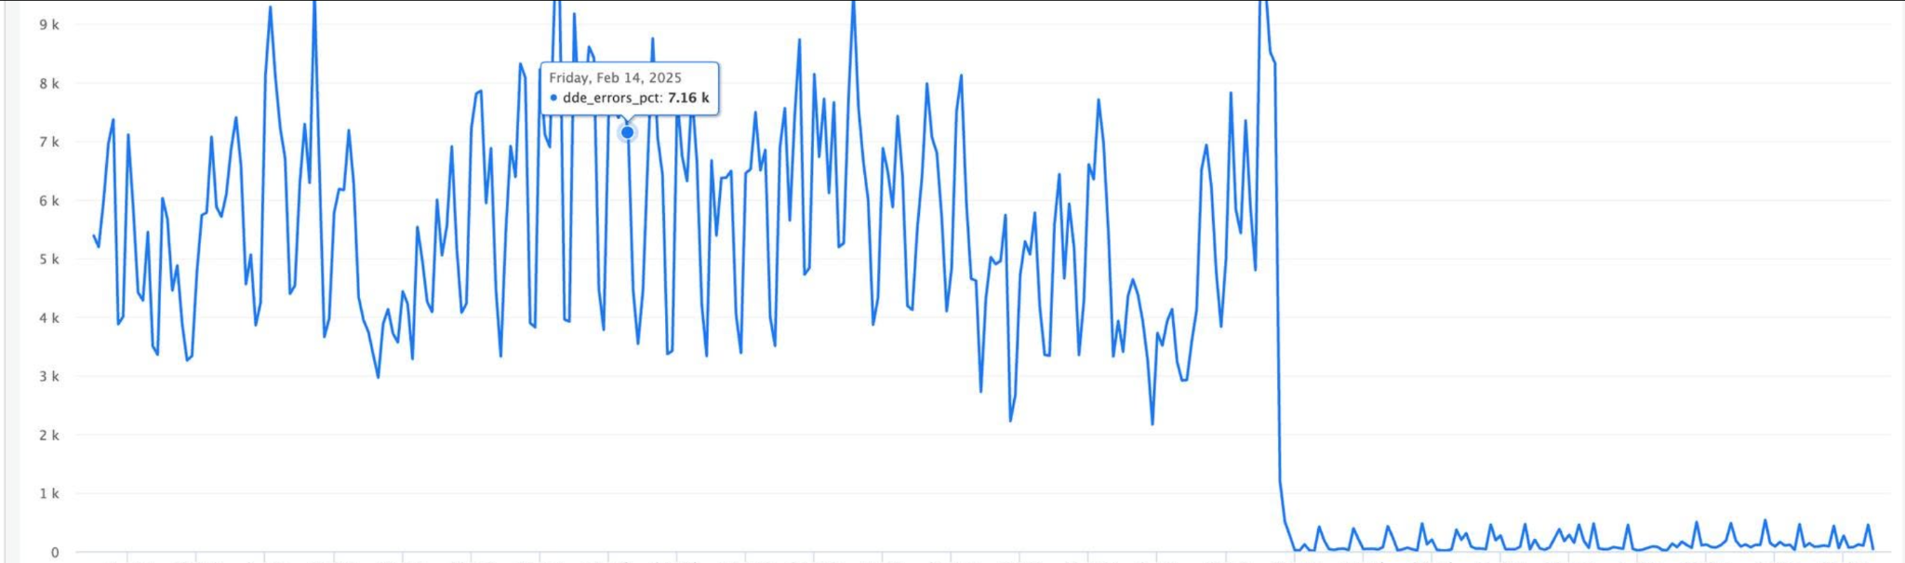
Framework DDEs — Results
Addressed more than 300 code branches
User reported issues down to almost zero
Closed 35+ github issues.
Export benchmark: all models exported without framework DDEs!

Slide 13
Unbacked Shapes for Graph Inputs
Unbacked semantics → Picks general paths without specialization.
Backed limitations addressed!
1. output graph works for any x.
2. No recompilation when x changes.
Make x unbacked (no hint)
def f(x):
…

Slide 14
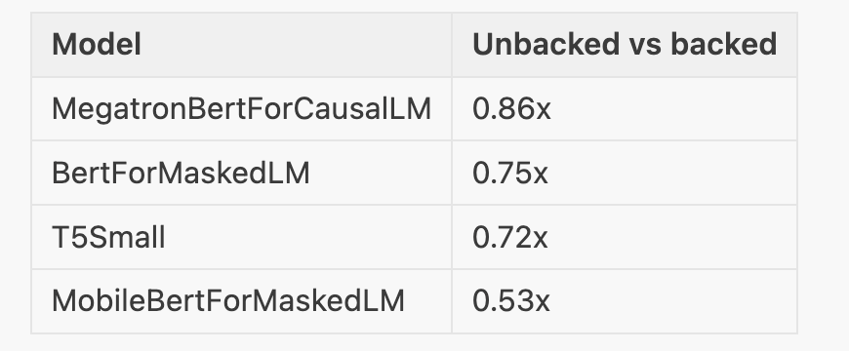
Performance — The Gap
Second blocker: Unbacked shapes were slower, wven wheUp to 2× slower on TorchBench benchmarks.
Approximately 30% slower on vLLM models.

Slide 15
Performance — Root Cause 1: Optimization hints
Problem: One hint served two purposes:
Resolving branches and adding guards.
Guard-free optimizations (e.g., generating autotuning inputs).
Fix: Split hints into two APIs.
optimization_hint(expr) — For optimizations without specialization. Backed + Unbacked.
guarding_hint_or_throw(expr) — For resolving branches and adding guards. Backed only.
~200 call sites migrated to the new APIs.
Users have to set optimizations hints.

Slide 16
Performance — Root Cause 2: Symbolic Reasoning
Unbacked shapes rely more on symbolic reasoning — no guarding hint fallback.
guard_or_false(12 * s0 > s0) → Hint + guard → True (if hint > 0)
guard_or_false(12 * u0 > u0) → Unknown → False (slow path)
Fix:
Improve symbolic reasoning for edge cases.
Track known shape equalities.
→ Avoid unnecessary slow paths.

Slide 17
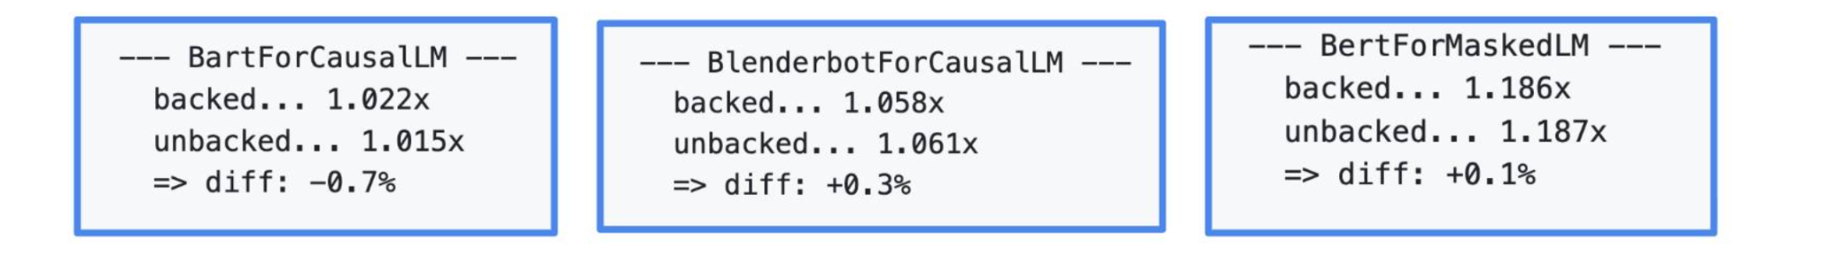
Performance — Parity Achieved
Unbacked shapes no longer have an inherent performance penalty.
Torch Bench: performance parity across all tested Hugging Face models.
vLLM: No performance regressions across a wide range of models and configurations.
For optimal performance, the compiler may need:
Optimization hints — e.g., from example inputs.
Known shape relationships — e.g., x.size(0) == y.size(0).

Slide 18
Problem 3: Giving user finer grained control
What if user want to compile/export three graphs
S < 32
S % 16 == 0
otherwise
Small batch
aligned fast path
general fallback
Why aren't existing approaches enough?
❌ Backed: May introduce additional guards and specializations I didn't ask for.
❌ Unbacked as is: Avoids all specializations .
❌ torch._check: persistent in code, have update model code.

Slide 19
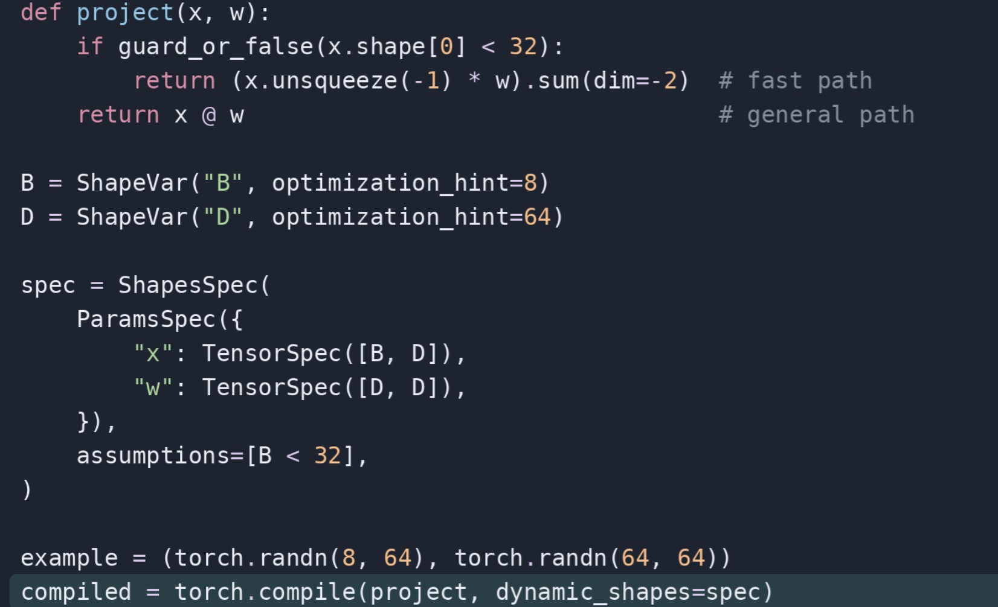
ShapesSpec: Declare the assumptions
Define your spec ahead of time.
All represent D number of features: u0==u1==u2
Compile for small batch

Slide 20
One function → three controlled compilations
small = torch.compile(f, dynamic_shapes=spec_small, isolate_recompiles=True)
aligned = torch.compile(f, dynamic_shapes=spec_aligned, isolate_recompiles=True)
general = torch.compile(f, dynamic_shapes=spec_general, isolate_recompiles=True)
dispatch(runtime S)
S < 32
S % 16 == 0
otherwise
spec_small
spec_aligned
spec_general
17 / 20

Slide 21
Backed vs Unbacked
Graph
specs
Inputs
Compile with backed
Compile with unbacked
Graph
Constraints
inputs
Backed
Aligns with JIT schemes.
Minimal effort.
OK with recompiations.
Ubacked
Aligns with export/precompile schemes,
No silent specializations.
No recompilations.
Control over supported shapes.

Slide 22
Conclusion
Unbacked shapes enable sound, predictable, and controllable graph capture — especially for export and precompilation.
We made unbacked shapes more practical:
Reliability: Dramatically reduced framework DDEs.
Performance: Achieved parity with backed shapes on tested workloads.
Control: Explicit shape assumptions and specialization.
→ Predictable graph capture without sacrificing performance.

