Slide 1
Writing Evaluations For Your MCP Server
Calum Murray, Red Hat
Nader Ziada, Red Hat

Slide 2
Agenda
Why do we need MCP specific evals?
mcpchecker: what it is and how it works
Installing mcpchecker
How to find good evaluation scenarios
Making your own evaluation scenarios
How to write evaluations in mcpchecker
Write your evaluation scenarios in mcpchecker
What we’ll discuss today

Slide 3
Why do we need
MCP specific evals?

Slide 4
The Illusion of Perfection
With time and caring (and the help of your favourite coding agent!) it is possible to create MCP Servers that meet the traditional definition of “perfect” or really good software
High Test Coverage
Clean Code
Typed Schemas

Slide 5
The Illusion of Perfection
However despite the seemingly high quality of software, when an agent uses your MCP server it can easily run into problems:
Agent doesn’t understand when to use tools
Tool definitions explode the context of the agent
Agent can’t understand tool inputs or outputs

Slide 6
The Probabilistic Gap
The problem is what we call the probabilistic gap: the server is deterministic, but the agent using it is stochastic
Traditional software testing can not give a full picture of quality/effectiveness of MCP servers
Need to test these MCP servers with agents to understand how well they can understand and use them

Slide 7
The Probabilistic Gap
The problem is what we call the probabilistic gap: the server is deterministic, but the agent using it is stochastic
Traditional software testing can not give a full picture of quality/effectiveness of MCP servers
Need to test these MCP servers with agents to understand how well they can understand and use them

Slide 8
Agent Evals to the Rescue?
As Agents have exploded over the last few years, there have been agent evaluation tools created to help evaluate and compare agents across many metrics
Quality/tone/accuracy of response
Correctness of action taken
Focus primarily on the outcome and what the agent did, not on MCP server(s) connected to the agent

Slide 9
Agent Evals to the Rescue?
Using an agent to test your agent may make sense if
MCP Server is only meant to be used by a specific agent
  Sort of defeats the purpose of having an MCP server instead of agent specific tools
You care more about agent level metrics than about the MCP server specifically

Slide 10




Types of Traditional Software Testing
Unit Tests
Integration Tests
System Tests
Acceptance Tests
Examine individual components or functions of the system in isolation.
Verify different modules or services interact with each other correctly.
Check that the entire system works correctly end-to-end
Tests to confirm that the system meets business and customer needs

Slide 11
Evaluations/benchmarks are the new tests
As we build newer agentic software systems and tooling we are going to need new types of benchmarks/evaluations to properly test the probabilistic gap posed by agents
LLM benchmarks published by researchers/model providers are the new unit tests
Agent evaluations are the new system/e2e tests
MCP specific evaluations are the new integration tests, for systems that use MCP

Slide 12
What is mcpchecker?

Slide 13
mcpchecker
An open source MCP evaluation framework created originally for the Kubernetes MCP Server
Focuses on testing the agent/MCP server semantic interface
Compatible with (almost) any agent
Compatible with any MCP server or combo of MCP servers

Slide 14
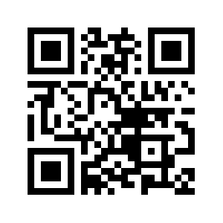
mcpchecker

Slide 15
Key features
Several key features in mcpchecker that help us
Captures all mcp interactions
Works with almost all agents without requiring code changes/instrumentation within the agent
Eval scenarios should be easy to understand

Slide 16
Capture all MCP interactions
In order to capture all MCP interactions, mcpchecker creates an MCP proxy server that sits between the real MCP server and the agent
Captures and records all communication between the agent and the MCP server
Allows for seeing what the agent does on the MCP server without instrumenting the MCP server or the agent

Slide 17
Work with any agent
mcpchecker supports multiple ways to “work with any agent”
Agent Client Protocol (ACP), with emerging support and popularity, allows for agents like Claude Code, OpenCode, etc.
A built in LLM agent allows testing directly against providers like OpenAI/Anthropic/Google/local OpenAI compatible models
Using a shell wrapper to any arbitrary agent you provide

Slide 18
Easy to understand evals
To make eval scenarios easily understandable and portable across different developer ecosystems, each eval scenario should be understandable on its own and not tied to a single dev language
Agent Client Protocol (ACP), with emerging support and popularity, allows for agents like Claude Code, OpenCode, etc.
A built in LLM agent allows testing directly against providers like OpenAI/Anthropic/Google/local OpenAI compatible models
Using a shell wrapper to any arbitrary agent you provide

Slide 19
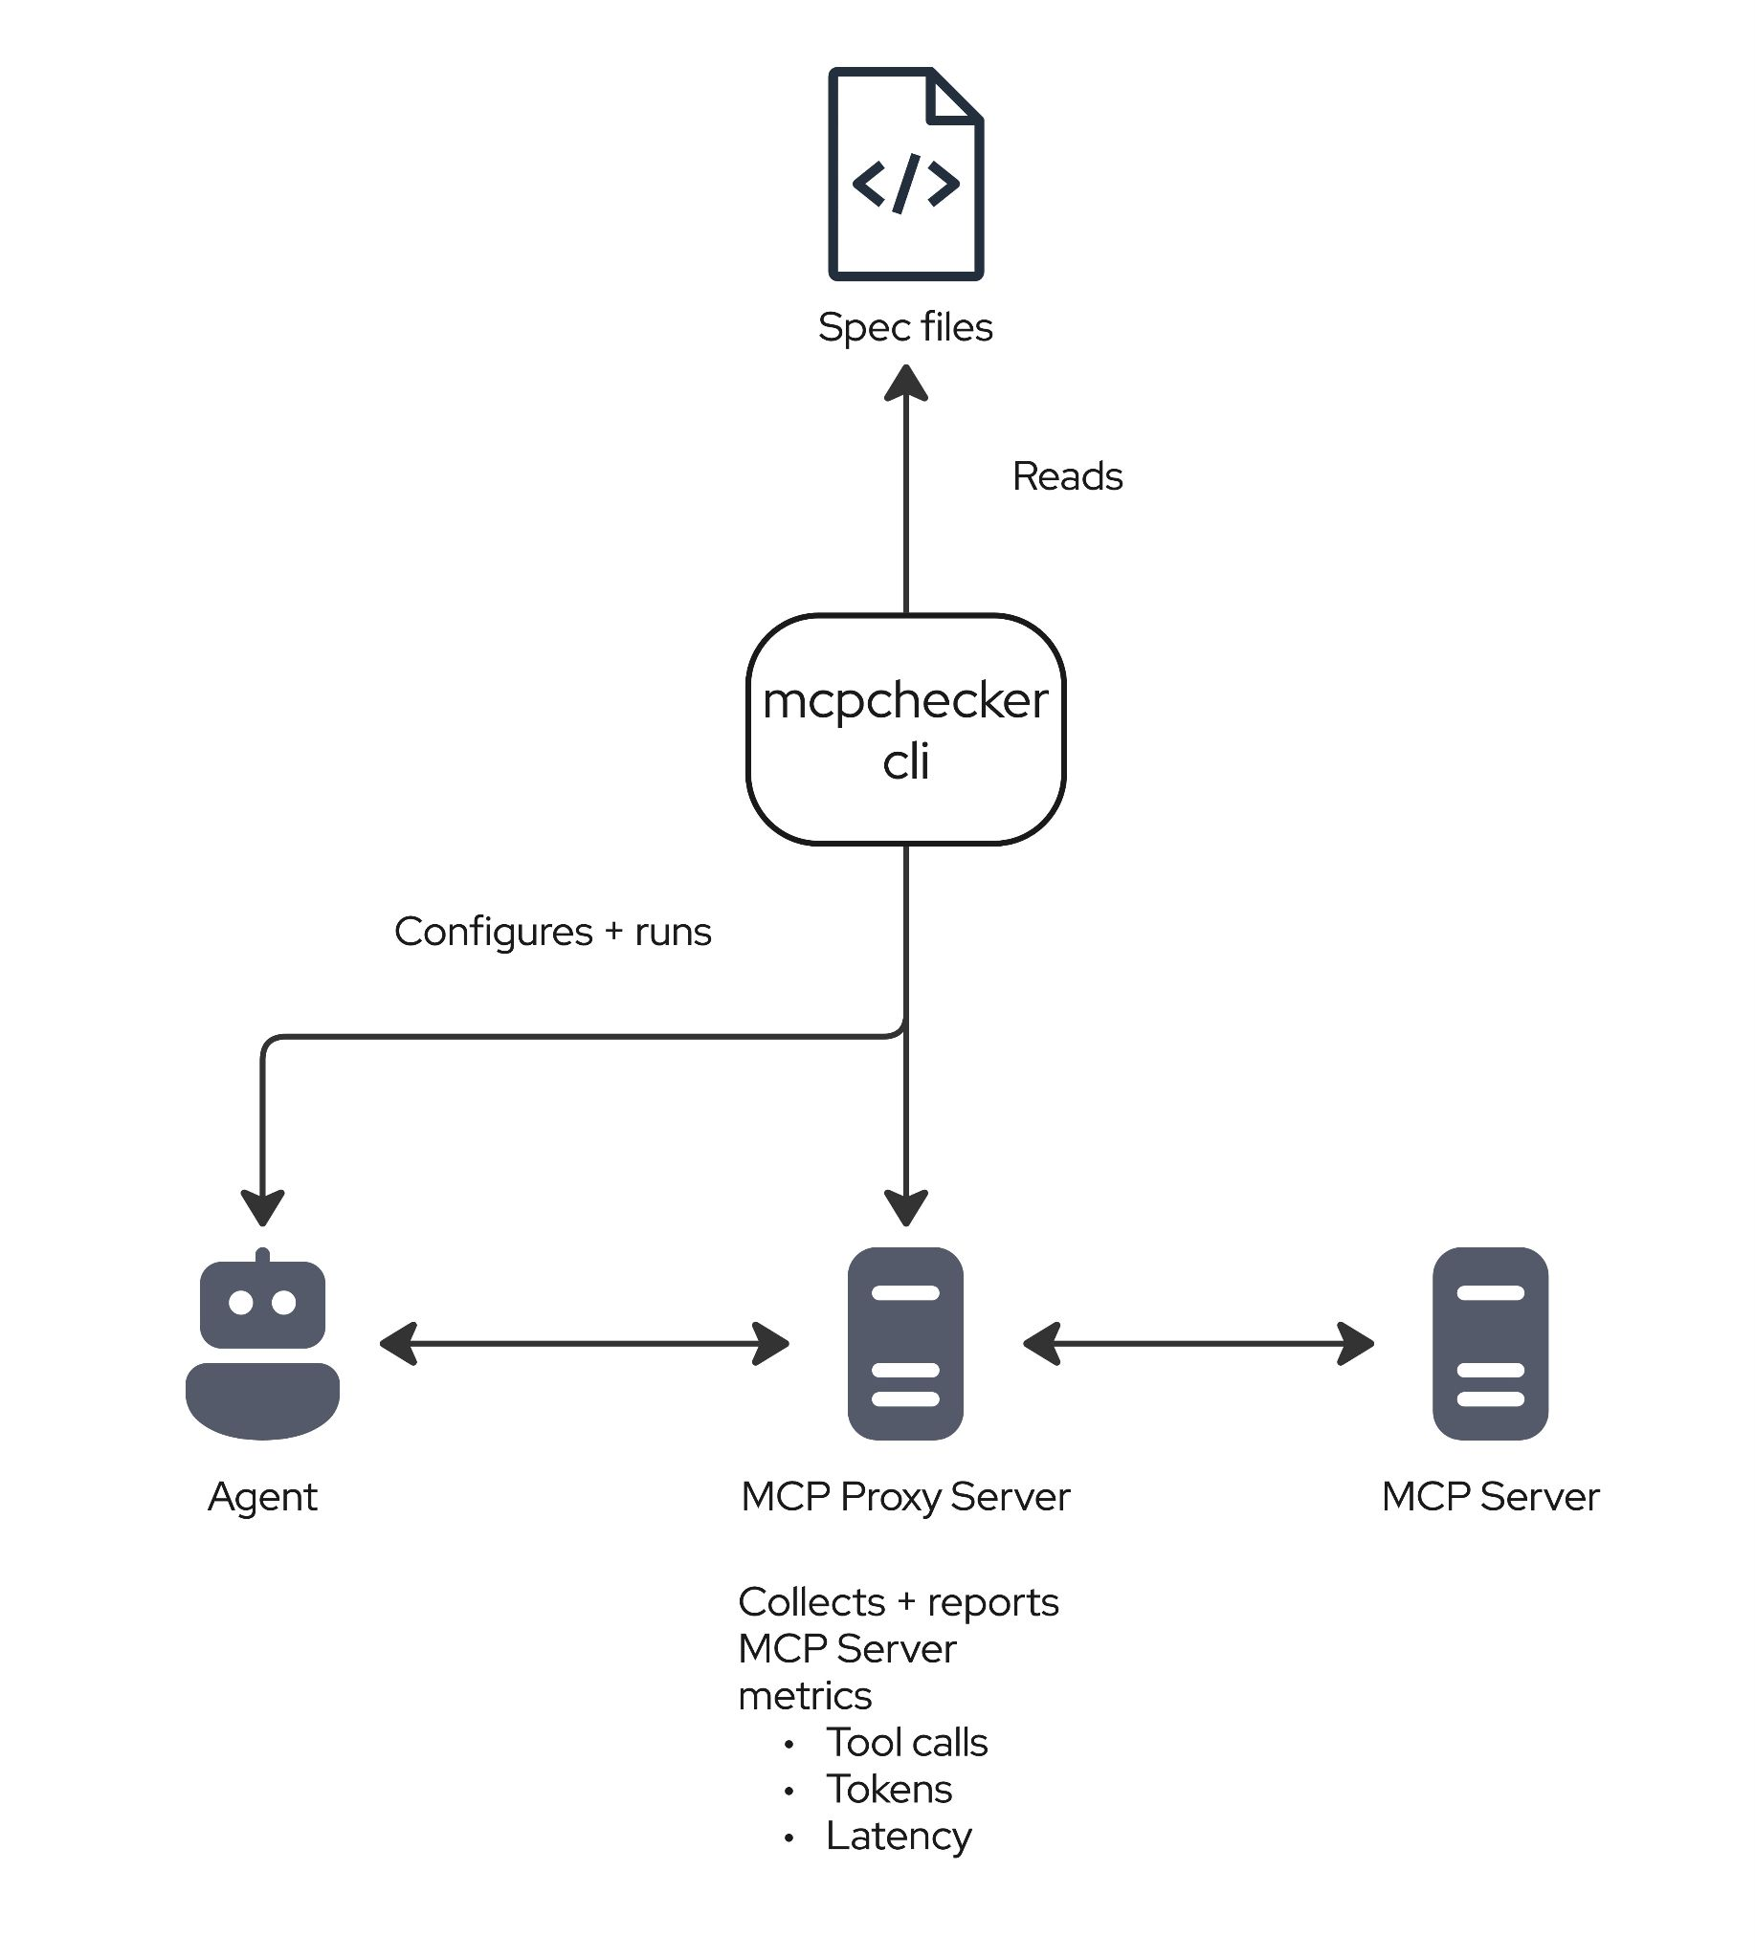
mcpchecker

Slide 20
Installing mcpchecker

Slide 21
Install mcpchecker
MacOS
brew tap mcpchecker/mcpchecker
brew install mcpchecker
Other platforms:
https://github.com/mcpchecker/mcpchecker/blob/main/docs/getting-started.md

Slide 22
How to find good
Evaluation scenarios

Slide 23
What is the MCP server for?
Evals ultimately test how well agents can use your MCP server, so a good place to start is what your MCP server is meant to be used for
Who are the main users?
What do they want from this server?

Slide 24
Types of evaluation scenarios
Eval scenarios range from simple to complex and help you test different aspects of the agent/server semantic interface
Simpler tasks test if the agent can select and use a correct tool
  Help test an individual tool, but not super useful beyond that
More complex tasks test if the agent is able to use a combination of tools across multiple steps
  More broadly useful, help test if you actually have the right set of tools
  Closer to real user workloads

Slide 25
What each scenario needs
To be able to actually create these scenarios and run then, we will need to write down
Prompt
Desired outcome
Environment

Slide 26
Good evaluation prompts
The key to a good evaluation prompt is to give the agent the correct/intentional amount of guidance and ambiguity
It should only be ambiguous in ways where you want to see if the agent can navigate that ambiguity or where you expect users to be ambiguous
It should not tell the agent all the steps of how to resolve the prompt
  Unless you expect your users to define a specific workflow when prompting the agent

Slide 27
Good evaluation outcome
Being able to determine whether or not the agent succeeded on a task is very important
Ideally largely testable by checking things in the agents environment
  E.g. is the previously broken deployment working now?
Use an LLM Judge to see if agent gave a reasonable response

Slide 28
Good evaluation environment
The environment that the agent runs in often makes or breaks your evals
What needs to be present for this to be a realistic test of your agent?
  E.g. do we need a “broken deployment” to fix?
Should be as realistic as possible

Slide 29
Making your own
Evaluation scenarios

Slide 30
Let’s make some evaluation scenarios
We want 3-5 evaluation scenarios that will be relevant to your MCP server
One “simple” scenario that makes sure the model can understand a tool
One more “complex” scenario that models real use cases
If you don’t have an MCP server, we have a dummy server here:
  https://github.com/Cali0707/mcp-eval-workshop-server/tree/main
  4 tools, all help with text analysis
    Convert to upper case
    Convert to lower case
    Capitalize every word
    Capitalize first word

Slide 31
How to write evaluations
in mcpchecker

Slide 32
It all starts with an eval.yaml file
kind: Eval
metadata:
name: "demo-server-test"
config:
agent:
type: file
path: agent.yaml
mcpConfigFile: mcp-config.yaml
# LLM judge configuration (reuses the same agent)
llmJudge:
ref:
type: file
path: agent.yaml
taskSets:
- path: tasks/add.yaml
assertions:
minToolCalls: 1
maxToolCalls: 5

Slide 33
Each task (scenario) is in its own file as well
kind: Task
apiVersion: mcpchecker/v1alpha2
metadata:
name: "add-test"
difficulty: easy
spec:
verify:
- llmJudge:
contains: "8"
prompt:
inline: |
I need to know what 5 + 3 equals. Can you help me figure this out?
assertions:
toolsUsed:
- server: demo-server
tool: add
https://github.com/mcpchecker/mcpchecker/blob/main/docs/how-to/write-tasks.md

Slide 34
About the agent.yaml file
kind: Agent
metadata:
name: "anthropic-agent"
builtin:
type: "llm-agent"
model: "anthropic:claude-sonnet-4-6"
kind: Agent
metadata:
name: "claude-acp"
acp:
cmd: "claude-agent-acp"
https://github.com/mcpchecker/mcpchecker/blob/main/docs/how-to/configure-agents.md

Slide 35
Configuring your mcp server with mcp-config.yaml
mcpServers:
kubernetes:
type: http
url: http://localhost:8080/mcp
enableAllTools: true

Slide 36
Running the evals
To actually run these evals, we can use the mcpchecker CLI from before
mcpchecker check eval.yaml
mcpchecker result <summary|diff|verify|view>

Slide 37
Write your evaluation
scenarios in mcpchecker

Slide 38
Let’s turn all your evaluation scenarios into tasks
Let’s take those 3-5 eval scenarios from before and make them into tasks, and then wire up agent/eval/other required files.
https://github.com/mcpchecker/mcpchecker/tree/main/docs
  Please star if you find this tool useful!
https://github.com/Cali0707/mcp-eval-workshop-server
  If you don’t have your own MCP server to test
  Also has agent/eval/mcp config files, so can be a useful starting point

