Slide 1
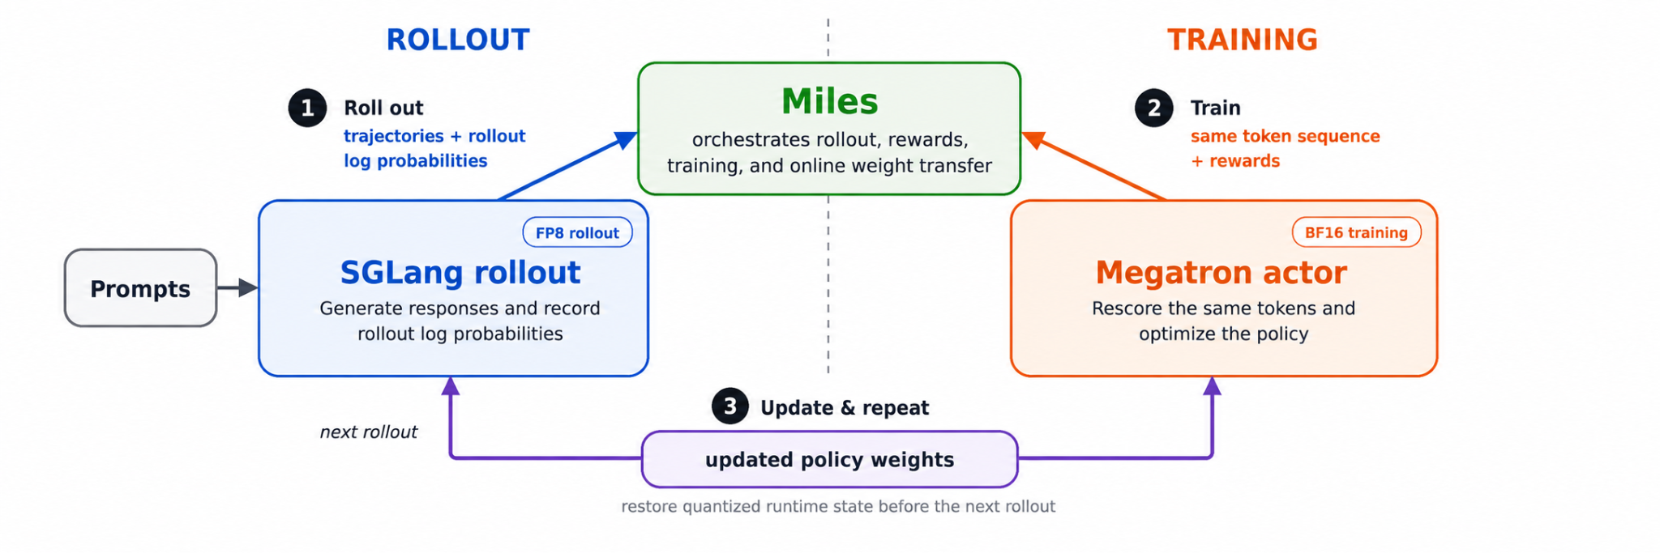
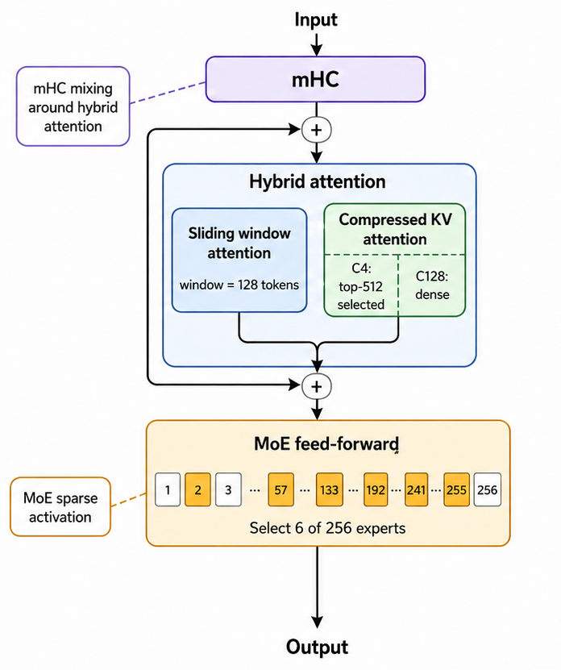
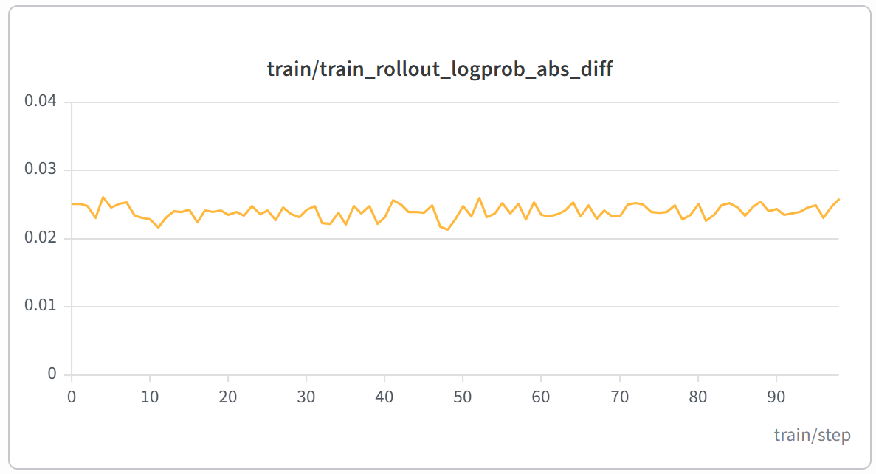
One Policy, Two Engines
Closing Training–Rollout Drift
in DeepSeek-V4 Flash RL
Xinyu Kang, Yuankai Chen, Liz Li / AMD
DeepSeek-V4 Flash combines compressed attention, sparse experts and mHC residual mixing. Our Miles integration on AMD Instinct MI355X aligns SGLang rollout with Megatron training and preserves FP8 inference state as policy weights change. Over 100 RL steps, the train–rollout logprob gap stays at 0.024.
01
The Miles RL stack
04
Aligning train–rollout logprobs
Locate the mismatch
FP8 training
Match next-token shifts, masks and temperature handling. Inspect token outliers and compare layer outputs to locate the mismatch. An independent HF reference breaks ties.
Match grouped top-K scoring
Expert-choice replay (R3) reuses SGLang’s expert IDs in Megatron. One SGLang grouped top-K path used sigmoid, while Megatron computed expert weights with the configured √softplus score. Honoring the configured score reduced the logprob gap.
SGLang generates responses and records their logprobs. Megatron scores the same responses and updates the actor. Miles coordinates rewards, training and weight transfer to prepare the next rollout.
Replay sparse-attention choices
Megatron also reuses SGLang’s top-512 compressed-KV selections. Without this replay the gap grew after position 2,048 (step-0 gap 0.058 vs 0.020).
02
DeepSeek-V4 Flash
Apply expert math exactly as configured
Apply the ×1.5 routed scale exactly once, including in the 3 hash-routed layers, and clamp SwiGLU at 10 in shared and routed experts. Scale and clamp corrections reduced the gap from 0.18 to 0.02.
284B
Recheck after weight updates
total
parameters
Recheck both engines after each weight update. Our ROCm interface lets Miles run SGLang’s required FP8 post-processing before rollout resumes. Power-of-two scales reproduce the checkpoint’s FP8 weights exactly, eliminating a 2.7% initial requantization error.
Train with the FP8 weights you roll out
13B
The actor trains in FP8 with the same blockwise, power-of-two quantization that weight sync applies, so the trainer computes with FP8 weights quantized the same way as the copy SGLang receives. The gap stays flat over 100 steps.
active per
token
05
Validation on MI355X
Inside a
DeepSeek-V4 layer
sgl-project/DeepSeek-V4-Flash-FP8
32 MI355X GPUs, FP8 rollout / FP8 actor, R3 + top-512 replay.
GRPO on DAPO-Math-17K, 32 prompts × 8 samples per step.
03
Why logprob differences matter
Mean absolute logprob gap
SGLang rollout
log p_rollout
vs
Megatron training
log p_train
Gap per token
|log p_train − log p_rollout|
0 means the two engines agree exactly.
Why it matters RL treats the sampled tokens as coming from the policy being trained. A gap can distort the probability ratios used for policy updates.
Mean gap: 0.024 nats Completed steps: 100
How we measure Megatron rescores SGLang’s sampled tokens at the same policy version and averages the gap.
Logprob gap (nats) | Steps 0–49 | Steps 50–99
Mean | 0.024 | 0.024
Per-step range | 0.021–0.026 | 0.023–0.026
How to read it Smaller values mean closer agreement on the sampled tokens.
This run measures the integrated setup. It does not isolate individual fixes.

