Slide 1

Notes:
title — The plate is the whole talk: A and B panels sweep over k into one accumulator tile (amber). Everything in ink is the GEMM we already have; the green chain is the part you write. The dotted C is never written; D is the only thing that leaves the kernel.

Slide 2
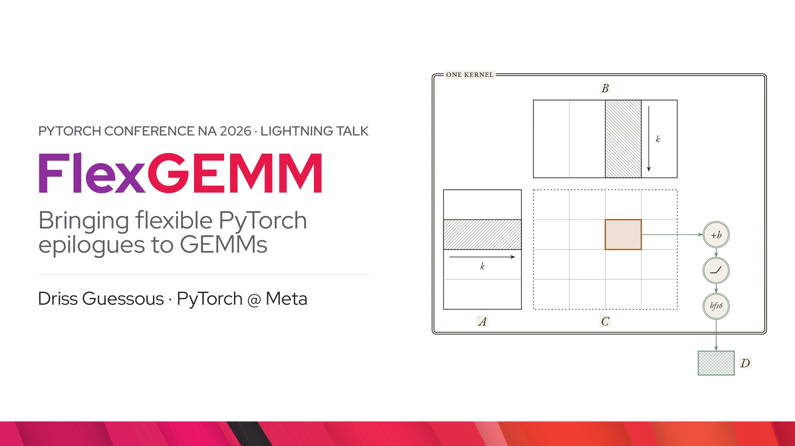
Notes:
title.flex — That green region is the Flex in FlexGEMM: a hook in the store path of a fixed, fast GEMM where your PyTorch runs on the accumulator tile. Same idea as score_mod in FlexAttention.

Slide 3
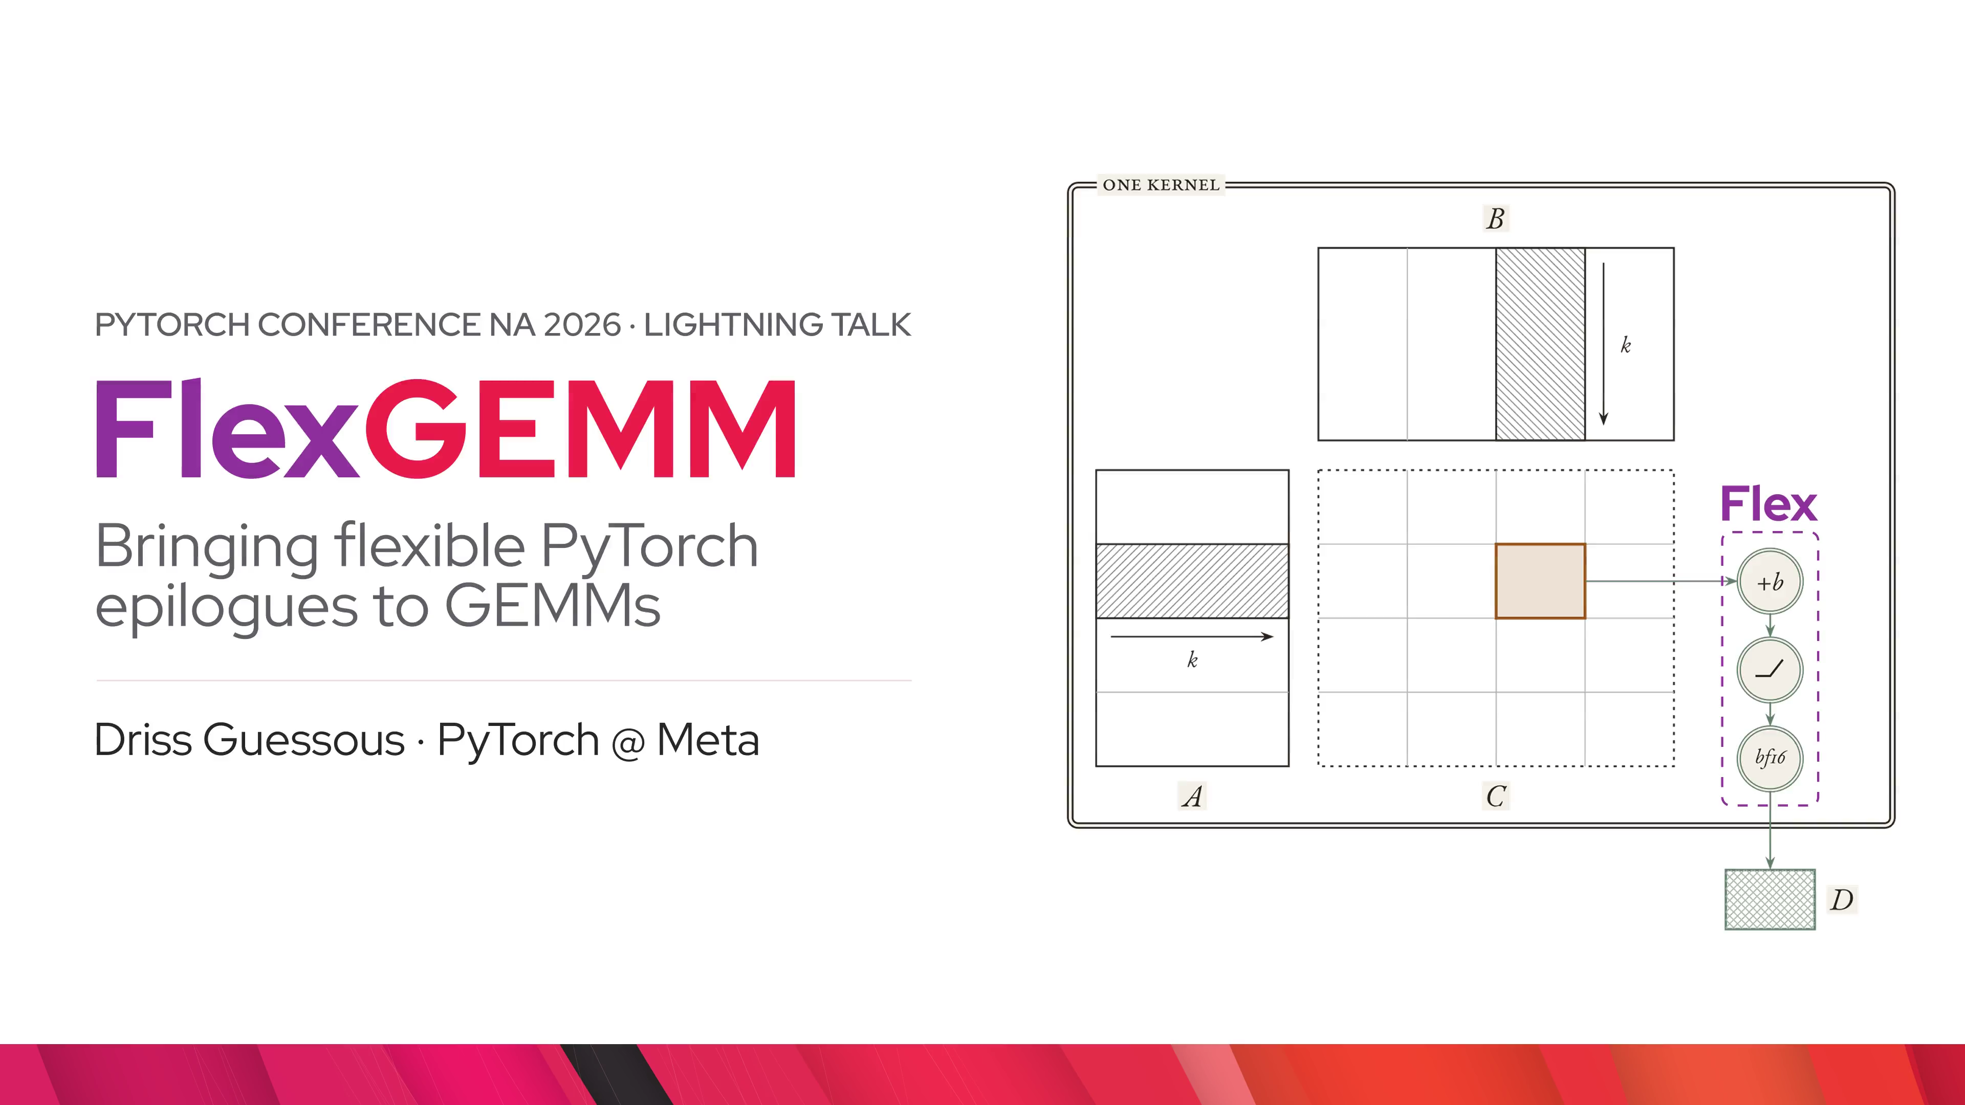
Notes:
problem.unfused — Users write the epilogue as normal tensor code after mm. The GEMM output C leaves registers and shared memory: it is written out to HBM (global memory), then read all the way back up by a second kernel, and D is written again. Red dashed is traffic that exists only because we did not fuse.

Slide 4
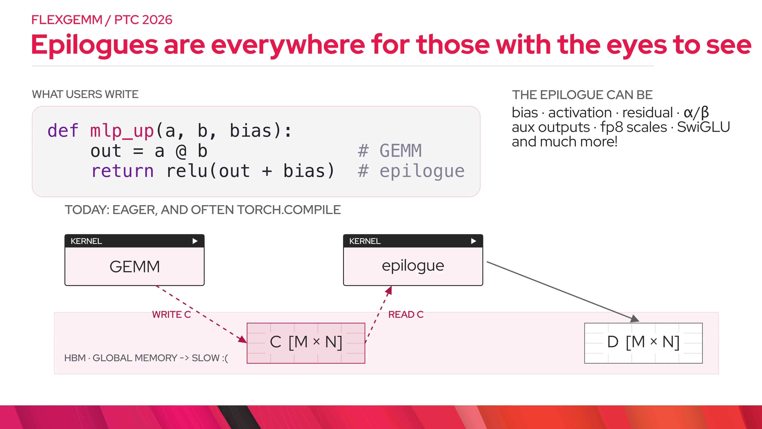
Notes:
problem.fused — Fusing the epilogue into the store path: the round trip disappears, C never goes down to HBM, and two kernels become one. That is the entire source of the win; no magic mainloop speedup.

Slide 5
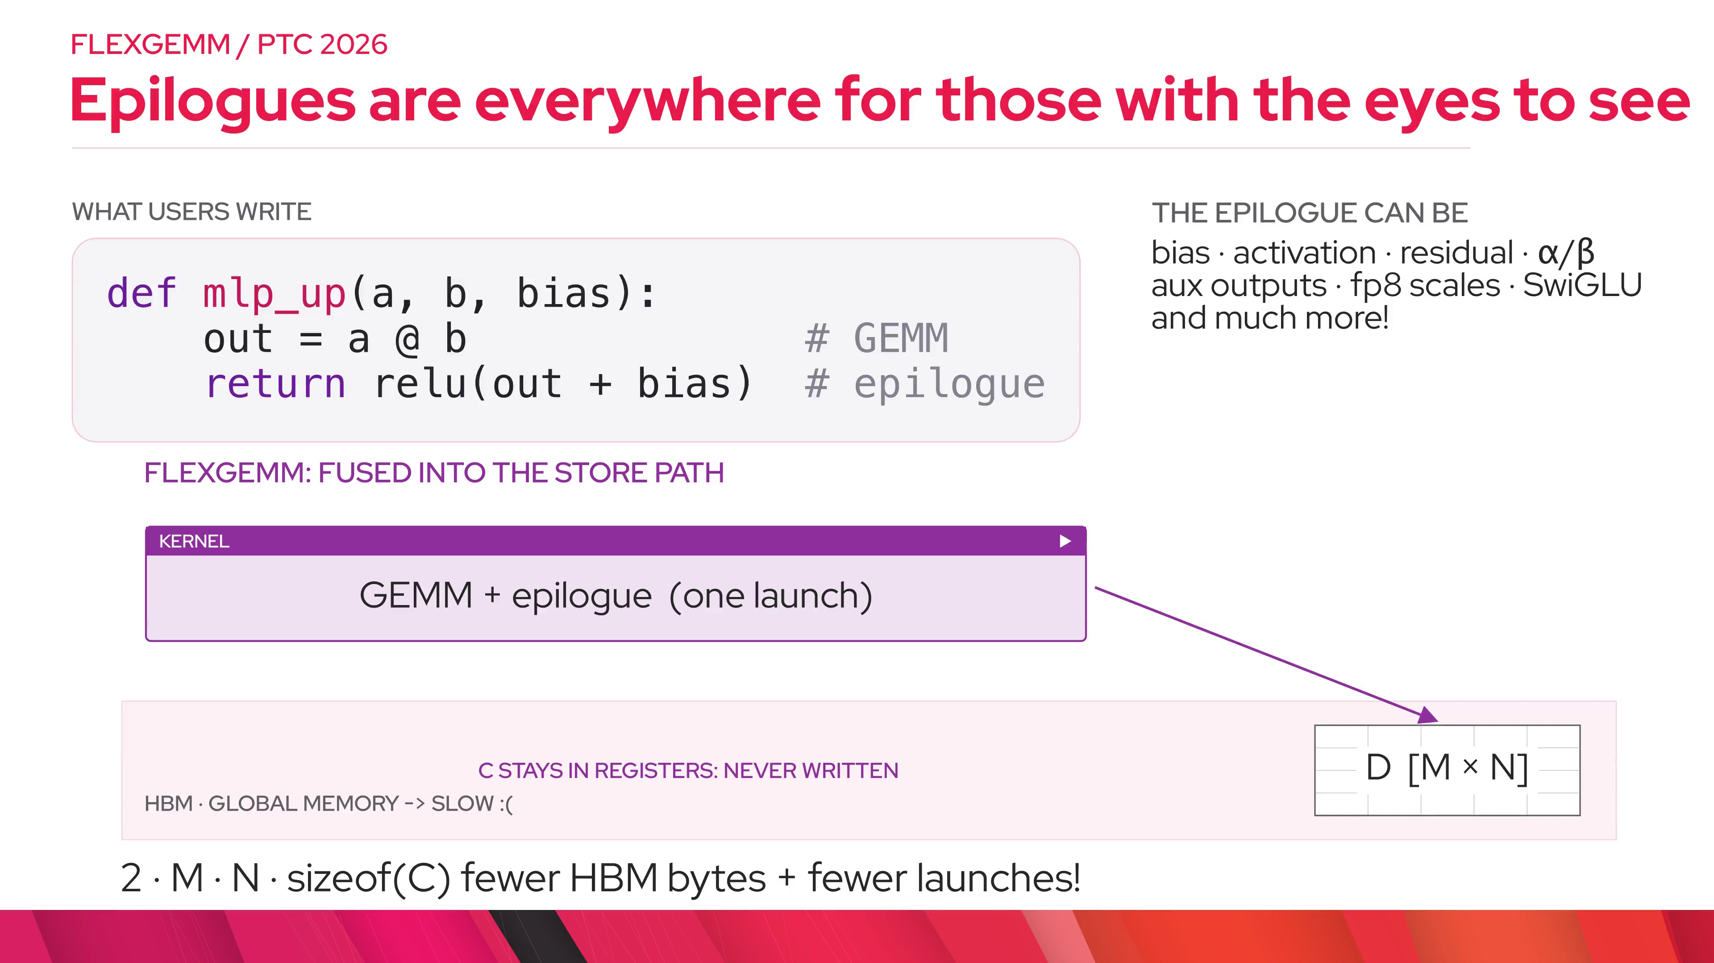
Notes:
api.code — Same idea as FlexAttention's score_mod: you get a hook over the accumulator, write eager PyTorch, and the compiler inlines it into the GEMM kernel.

Slide 6
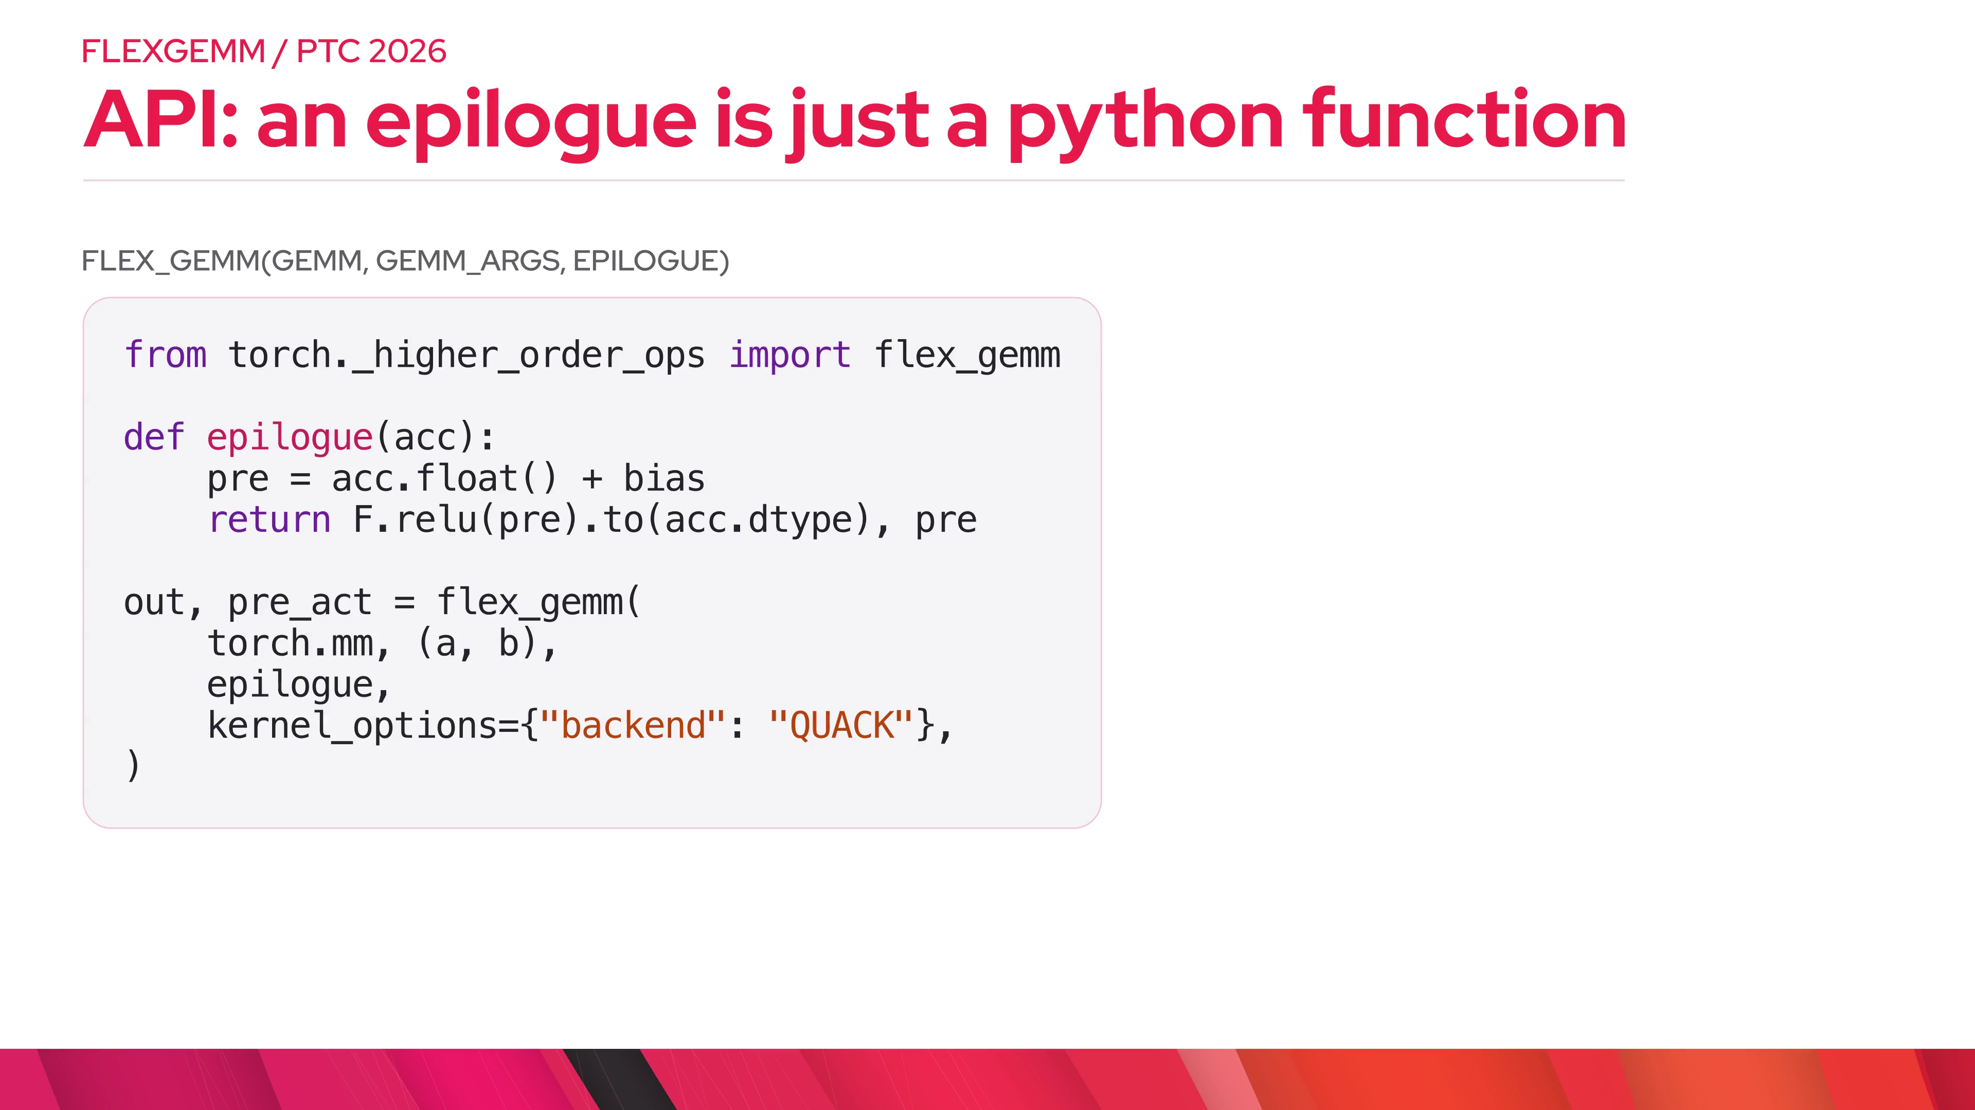
Notes:
api.features — acc is the accumulator tile in registers. Closures like bias become global-memory loads. Tuple returns become aux stores from the same tile. The GEMM itself is the ordinary PyTorch op you already call. Reference semantics are just eager: epilogue(torch.mm(a, b)).

Slide 7
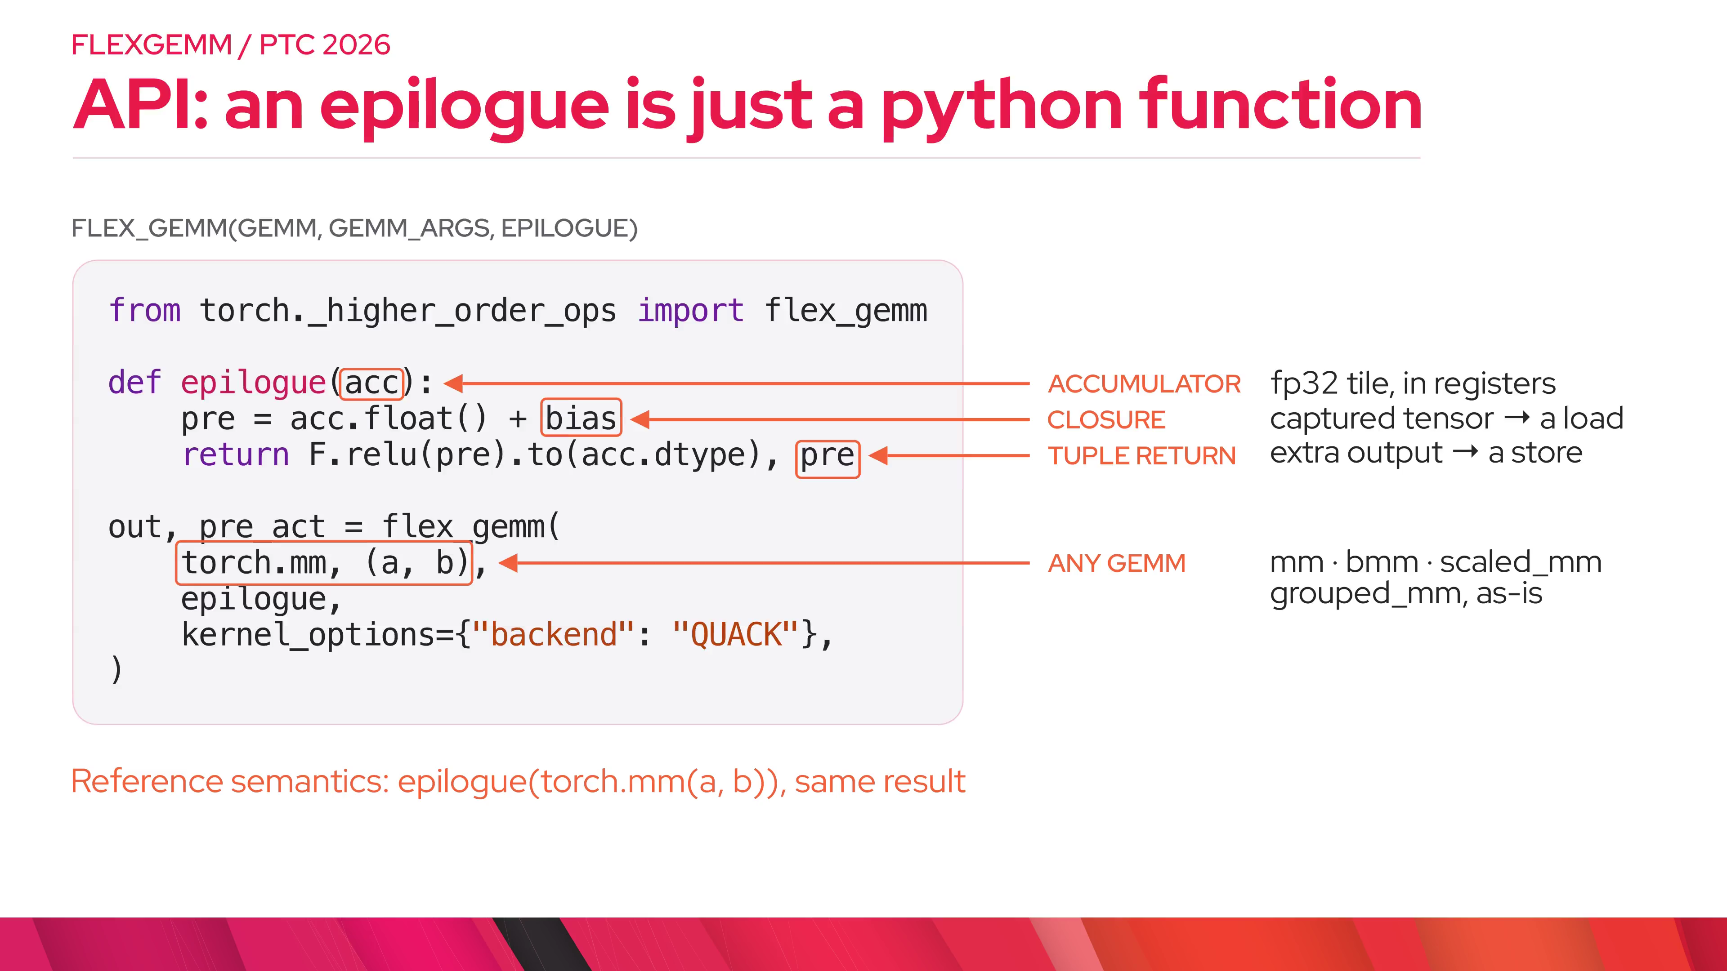
Notes:
coverage.supported — You do not rewrite your model around a new GEMM. flex_gemm takes the op you already call: mm, addmm, bmm, baddbmm, F.scaled_mm for MXFP8 and NVFP4, and F.grouped_mm for MoE experts. All of these are in PyTorch main.

Slide 8
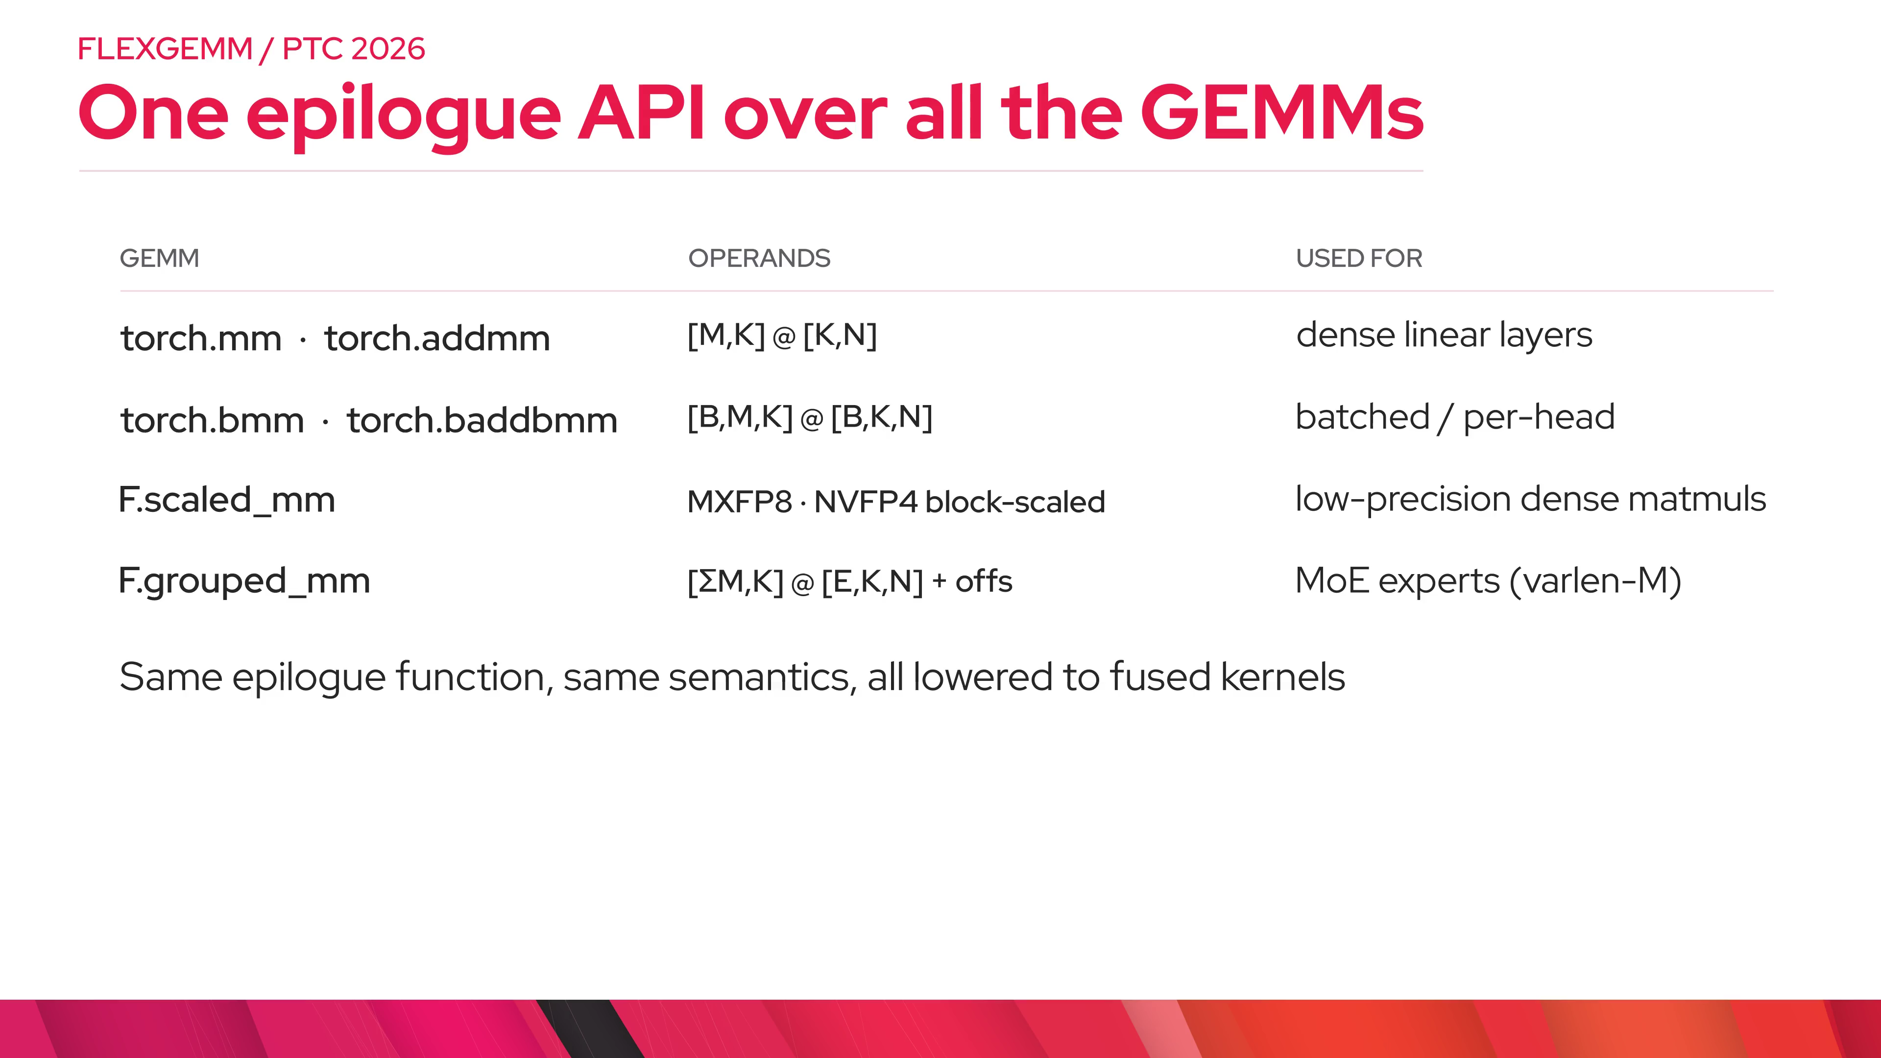
Notes:
coverage.gaps — Coming soon: scaled grouped GEMM, prototyped and bit-exact but not landed yet.

Slide 9
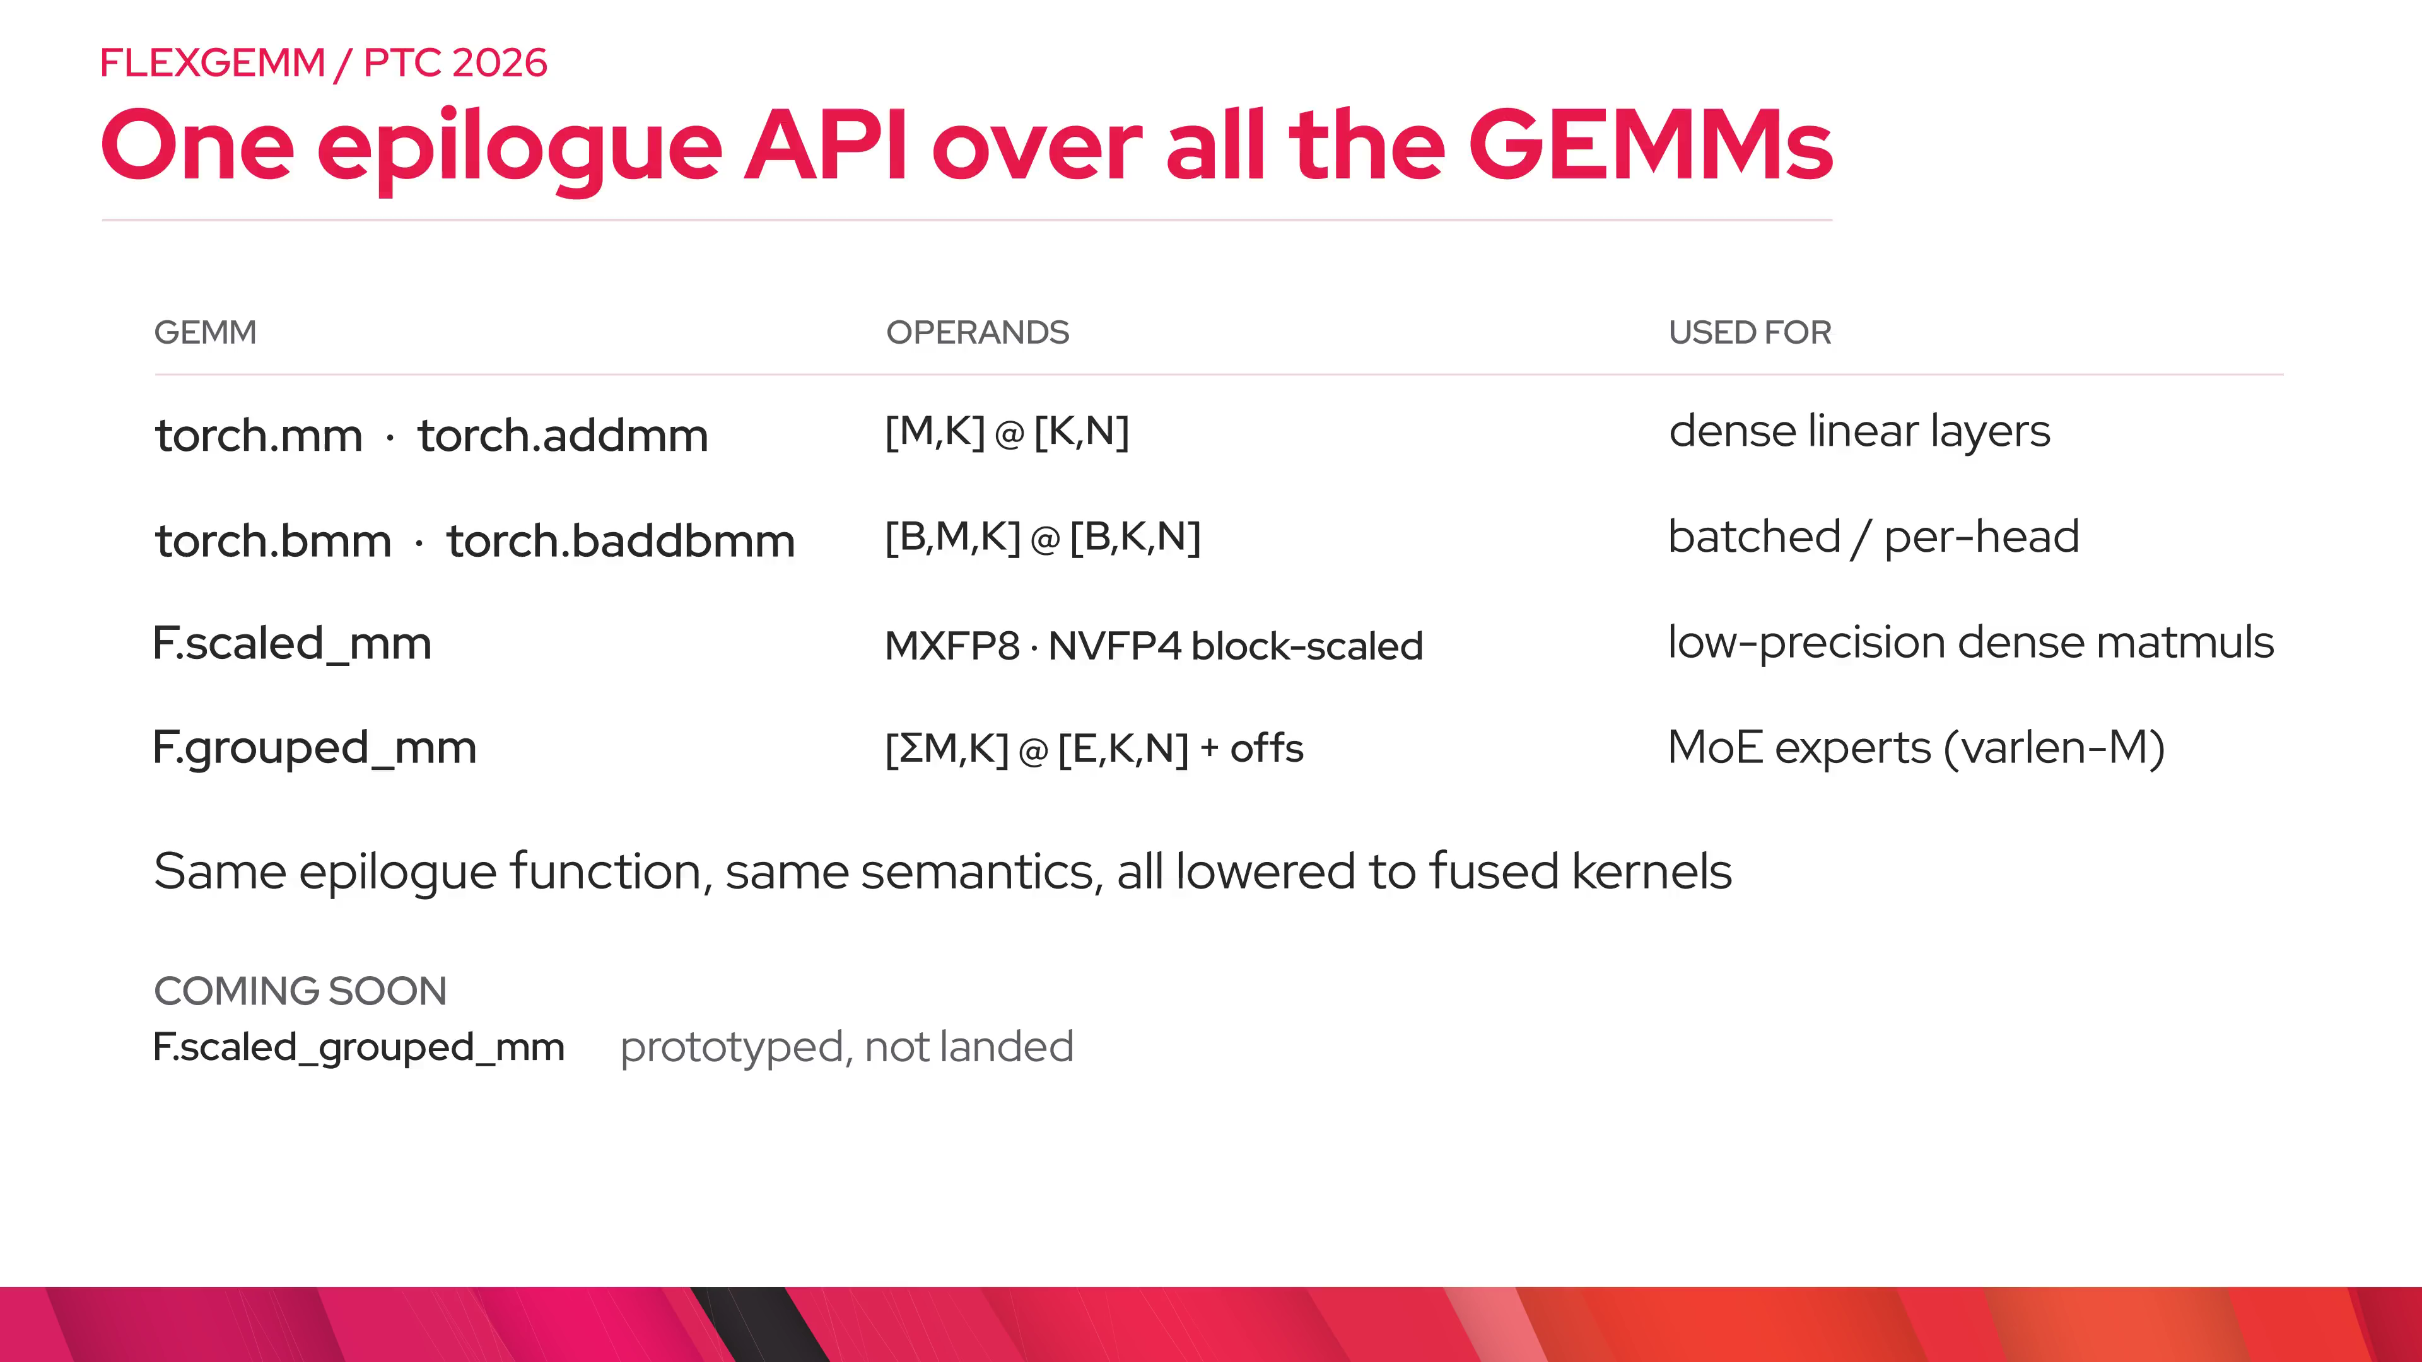
Notes:
contract.gemm — Start from the whole problem: C is M by N, built from A and B.

Slide 10

Notes:
contract.tiles — The kernel never sees all of C at once. It is cut into output tiles, and each tile is an independent unit of work handed to an SM.

Slide 11
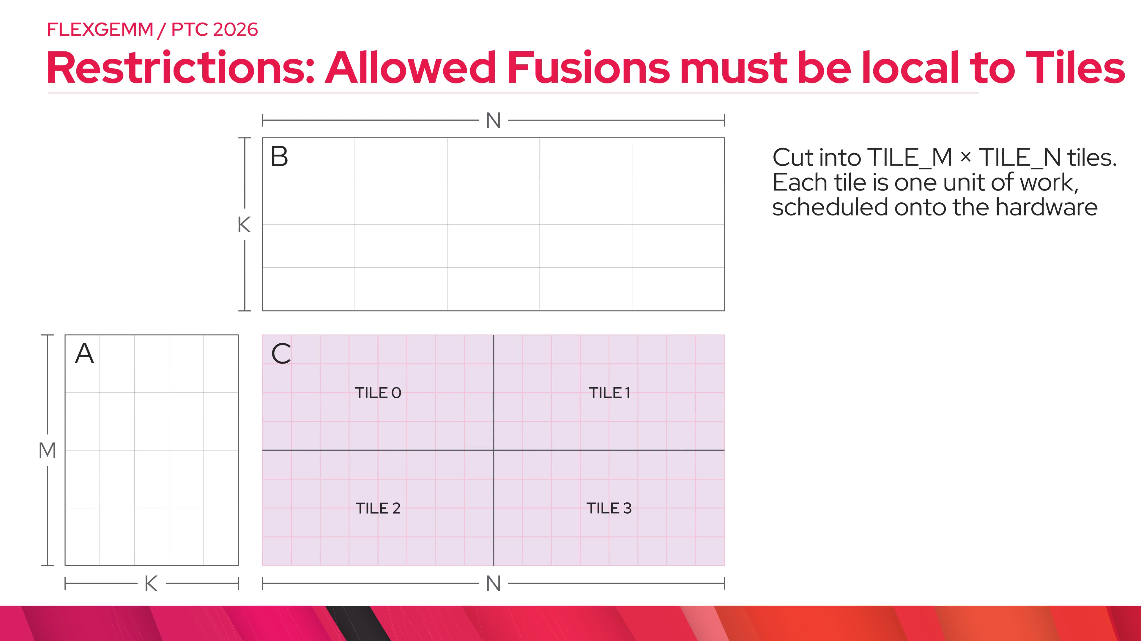
Notes:
contract.map — One tile needs one block of rows of A and one block of columns of B. The mainloop walks K, accumulating into registers. When it finishes, that tile's accumulator is exactly what the epilogue sees, before the single store.

Slide 12
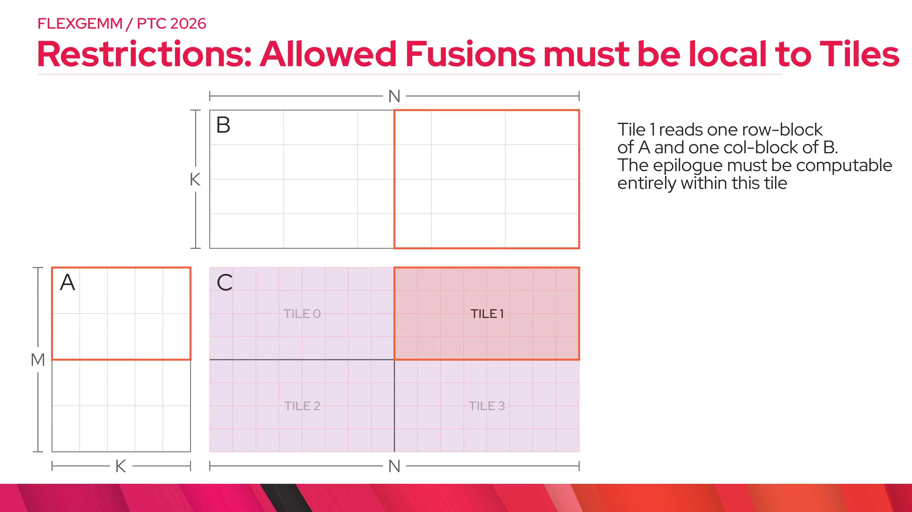
Notes:
contract.fuses — Everything that needs only this tile, plus captured inputs, fuses: pointwise, loads, aux stores, SwiGLU gate/up lane pairs, and reductions over a bounded group of N columns like MX/NV scale blocks.

Slide 13
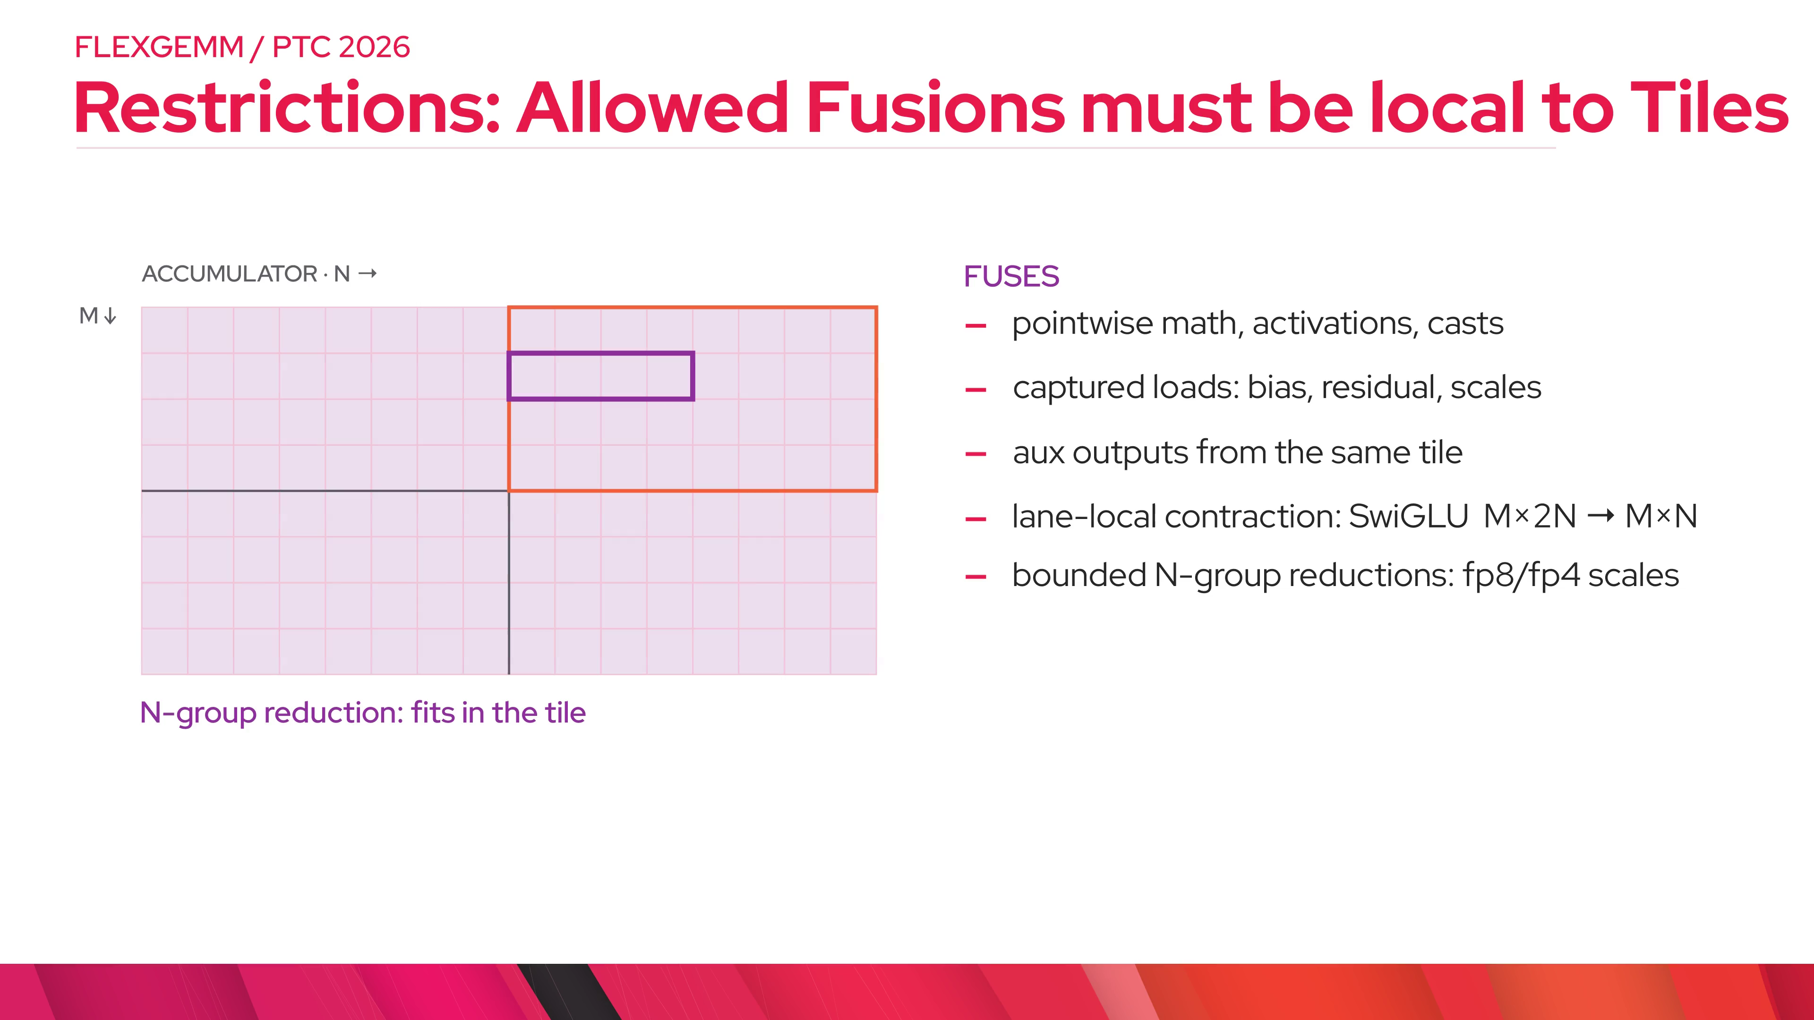
Notes:
contract.rejects — Fail closed: if the epilogue needs data from other tiles or would change numerics under split-K, you get an error, not a silently slower or different kernel. That guarantee is what makes quantized producers safe.

Slide 14
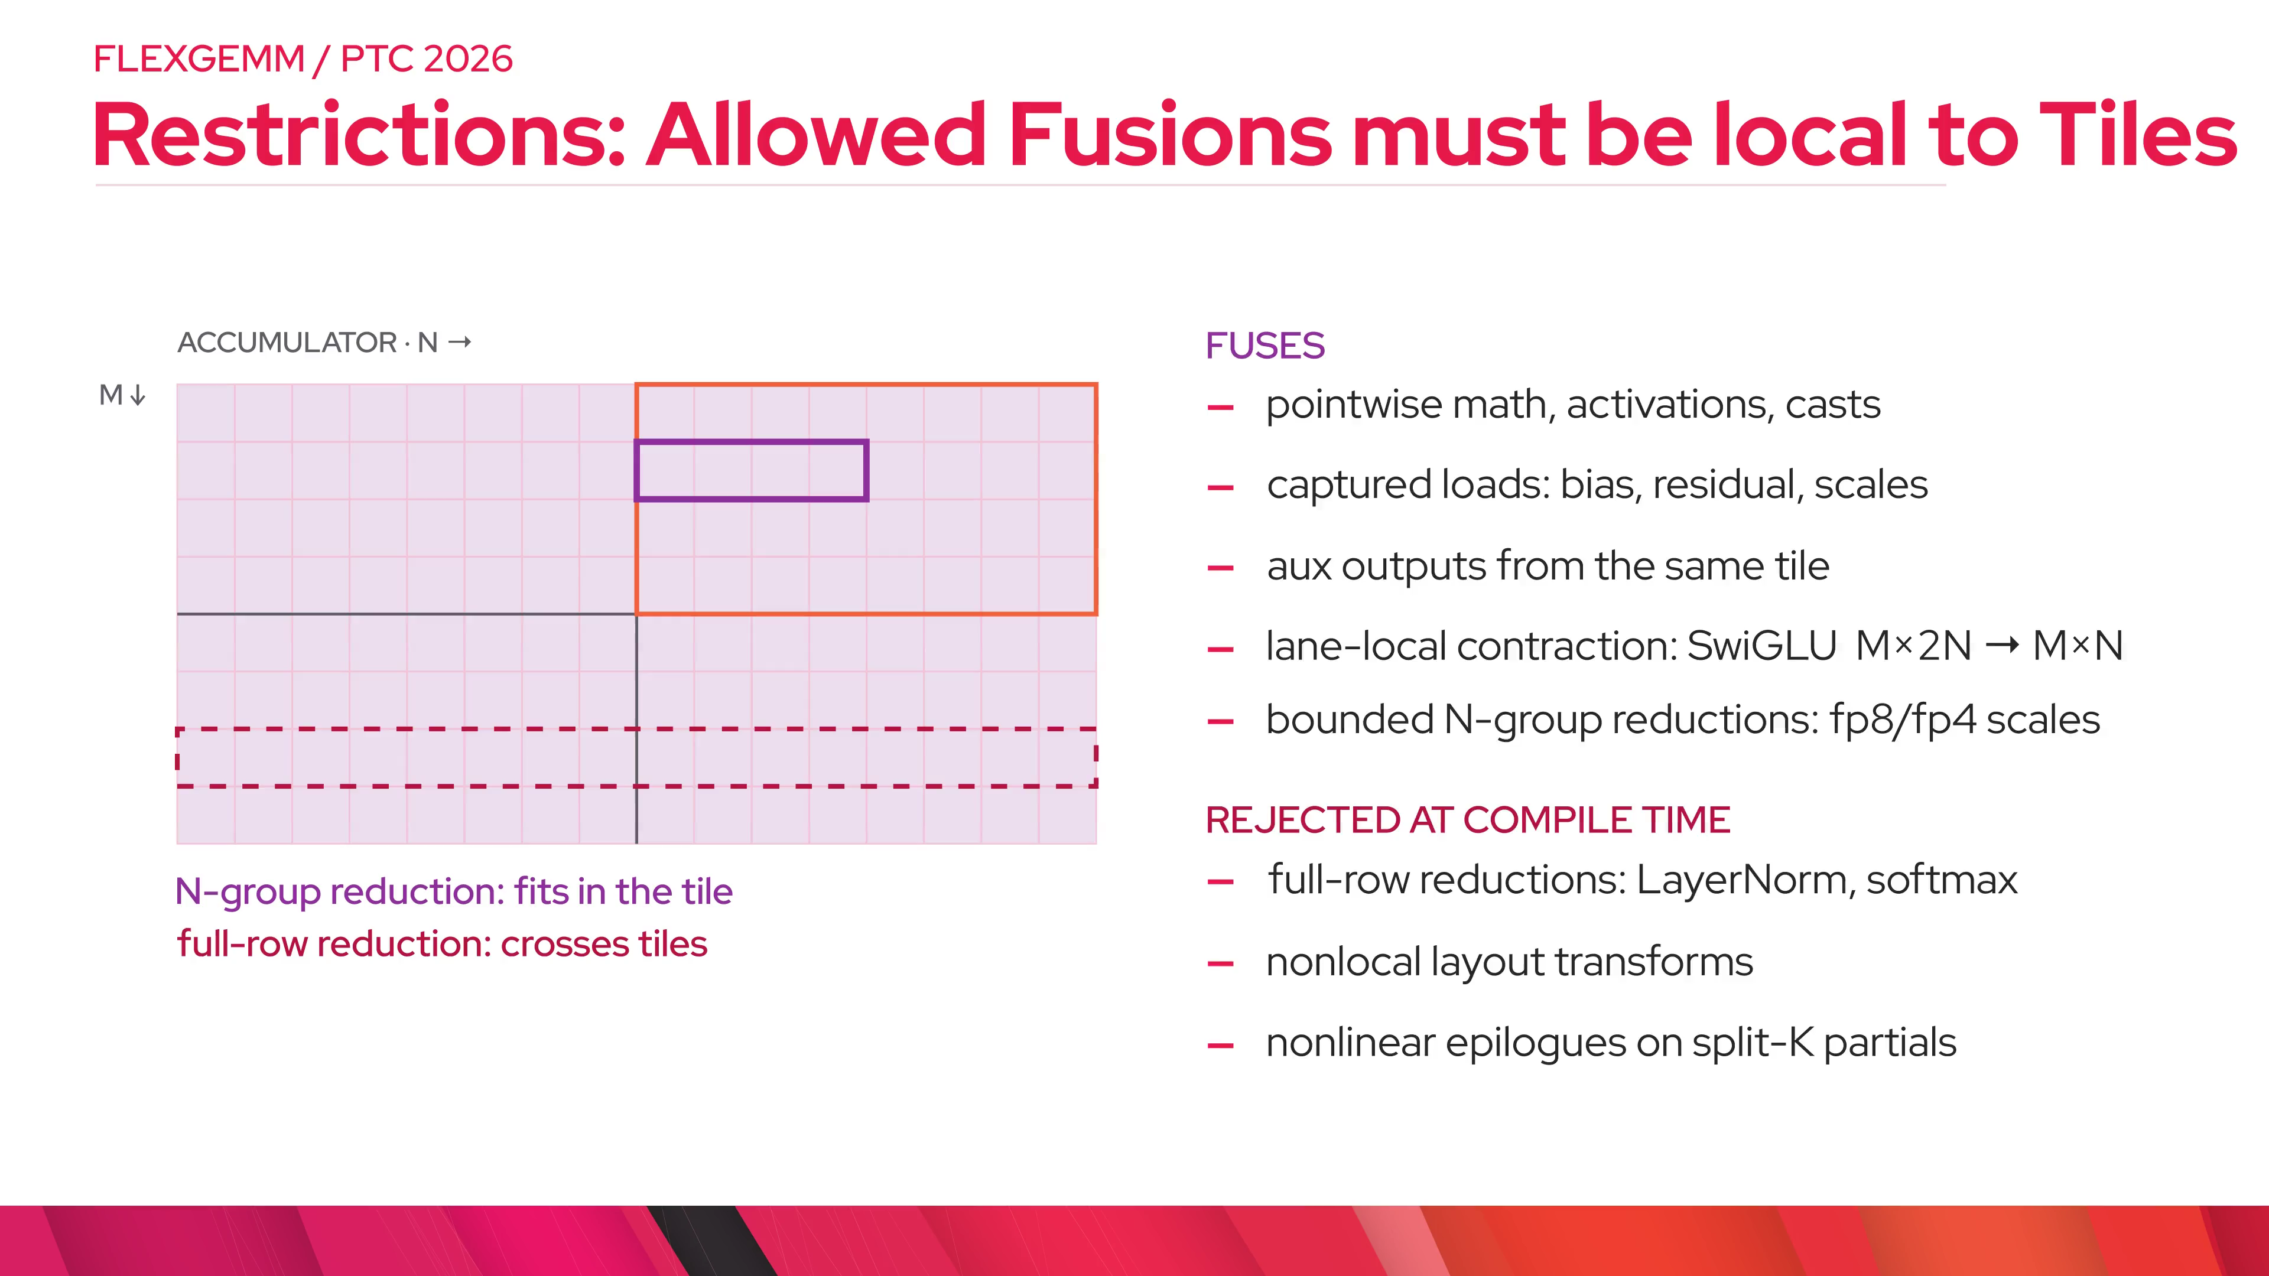
Notes:
contract.locality — Local has layers: within a warp, then within a CTA's output tile. On Blackwell the widest tile we support is 256 along N, so that bounds the N-group reductions. Going wider means a different mainloop or distributed shared memory across a cluster; that is later work, not today.

Slide 15
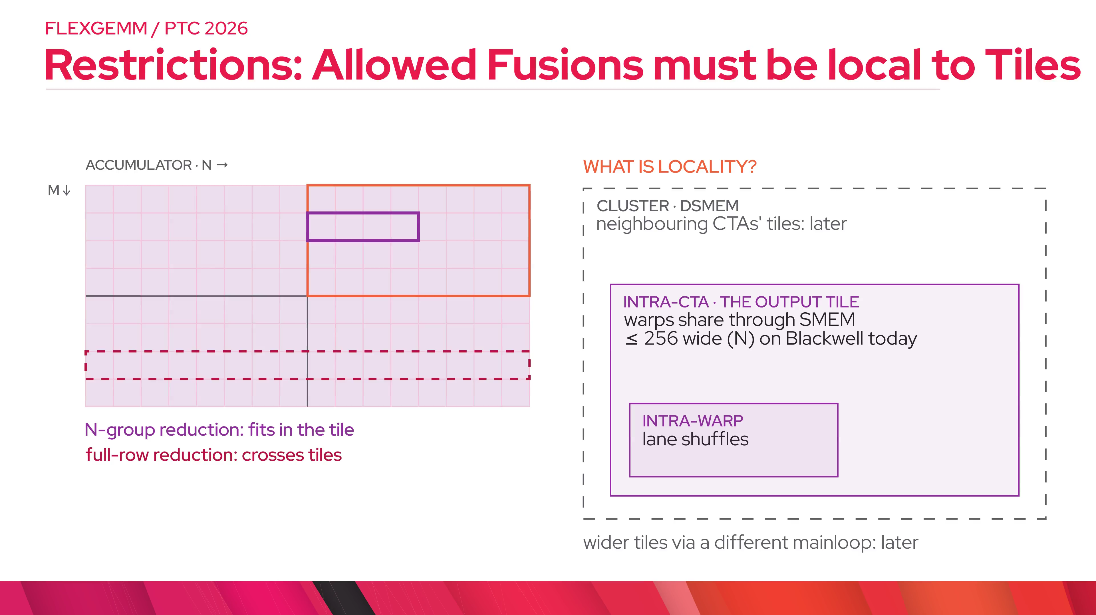
Notes:
wins.model — Fused time is GEMM time times one plus a small epilogue penalty; unfused adds the C round trip. Biggest wins when the separate epilogue is bandwidth-bound and the GEMM is not saturating compute, or when the output is much smaller than the accumulator (fp8/fp4).

Slide 16
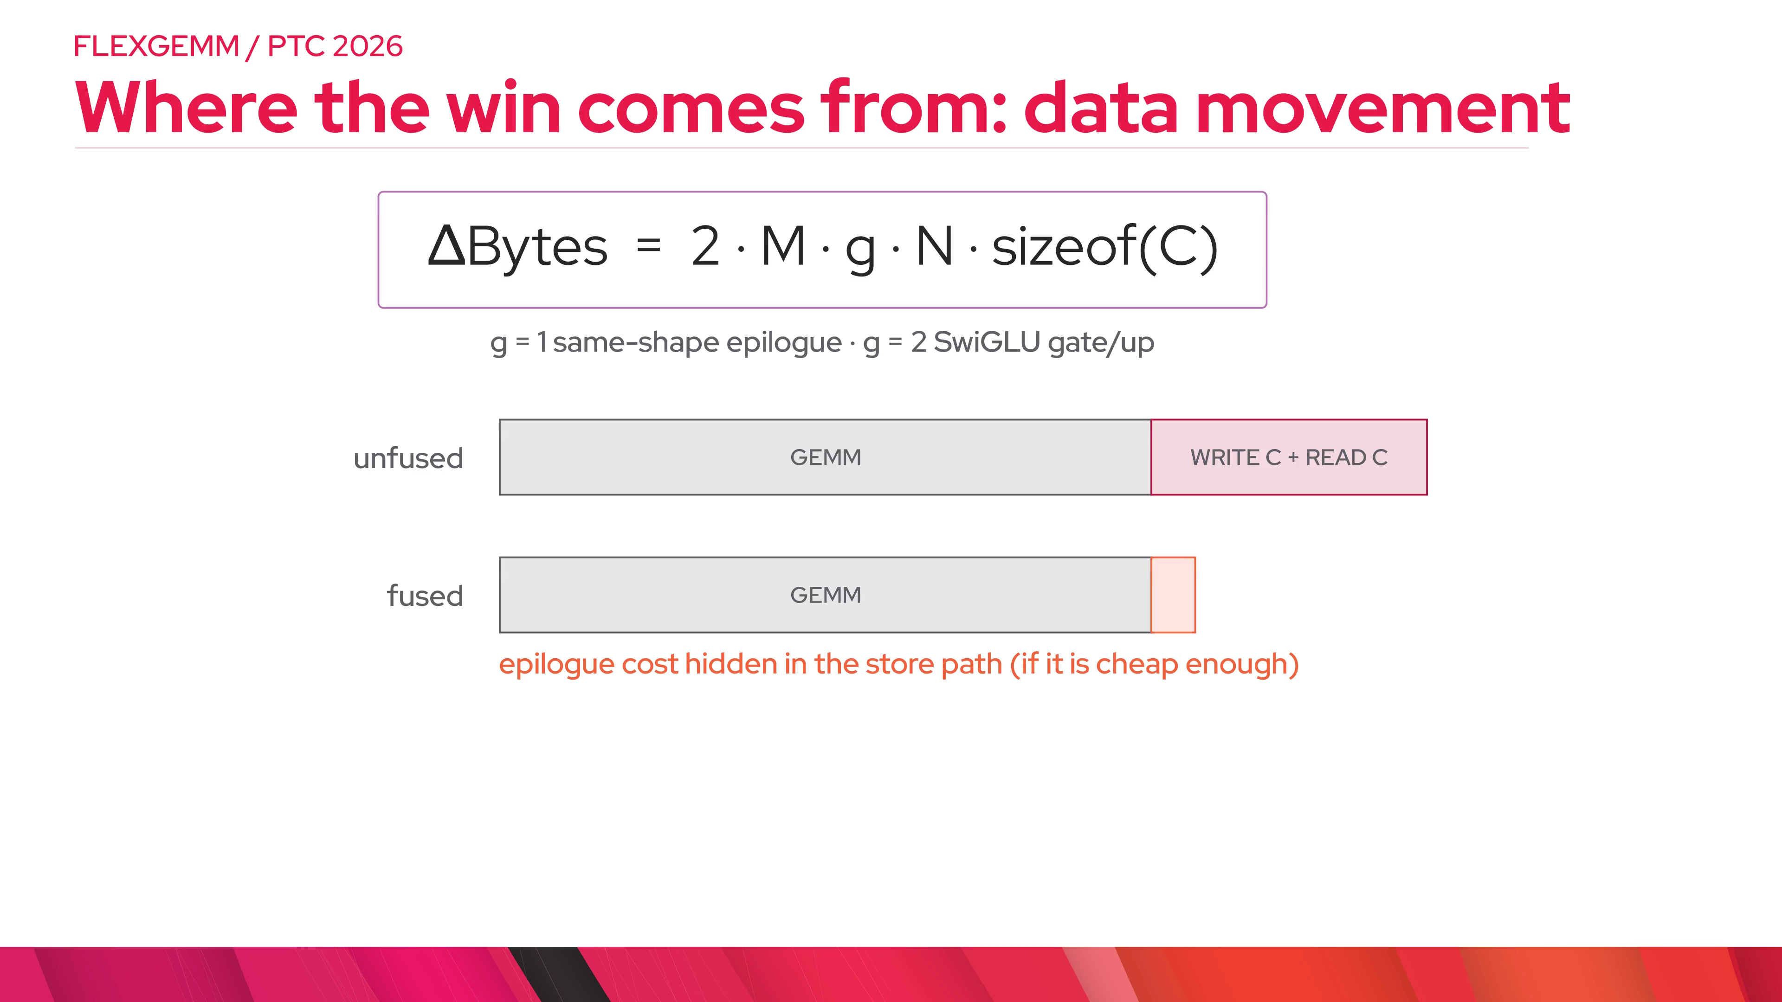
Notes:
wins.caveats — Fusion is not free. It loses when the epilogue costs the mainloop: register pressure lowers occupancy, epilogue math that does not overlap the next tile adds directly to runtime, and the tile shape that makes the mainloop fastest may not fit the epilogue, for example a reduction wanting a wider tile_n. This is why older Triton epilogue fusion rarely beat cuBLAS plus a standalone kernel, and why dispatch should be able to say no.

Slide 17
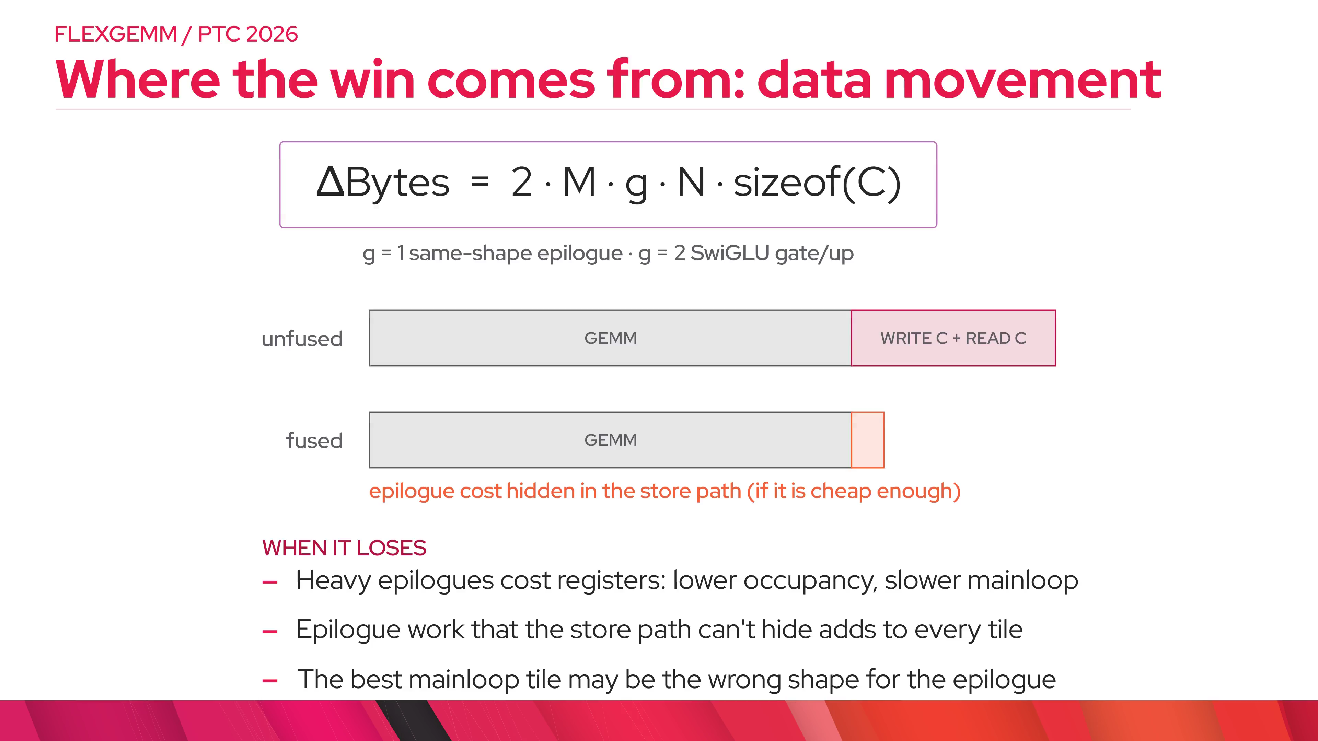
Notes:
epilogue_bound.timeline — Real in-kernel Perfetto traces of flex_gemm on GB300, one CTA. The two runs differ by one kernel option. With fast_math, silu becomes half x times tanh of half x plus half x; the epilogue is 0.79 of the mainloop, the red mainloops run back to back and the magenta epilogues fit underneath: 68 microseconds in this instrumented trace, 78 in the timed run. Default precise silu is 3.2 times the mainloop; the MMA warp spends most of its time in teal acc-wait, waiting for a free accumulator, 68 percent exposed: 186 microseconds traced, 177 timed. Rule: the epilogue is free while its time per tile is at most the mainloop's. Links: fburl.com/perfetto/h91qvdev and fburl.com/perfetto/ba3gyzxu.

Slide 18
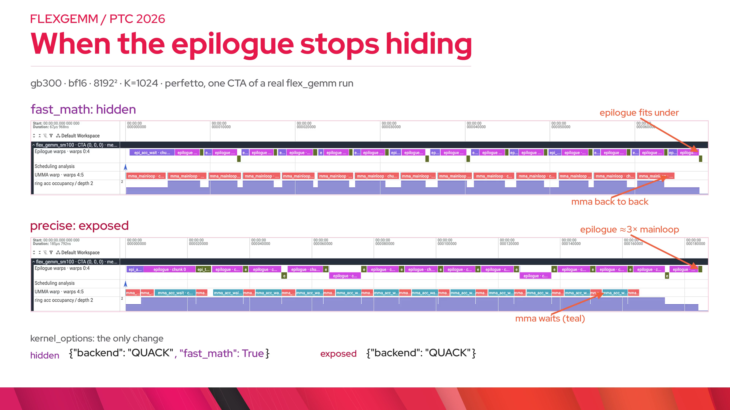
Notes:
epilogue_bound.cost — Same runs as matmul throughput, 2·M·N·K over time. Fast-math silu fused delivers about 1770 TFLOP/s, essentially cuBLAS at 1800 for the GEMM alone. Precise silu fused drops to about 780, below running the GEMM and then a separate silu kernel at about 1070: the fused epilogue has only four warps per SM for that math, a standalone kernel uses every warp. Raw times on GB300, main 79ef85d: 76.4, 77.7, 176.5 and 128.6 microseconds.

Slide 19
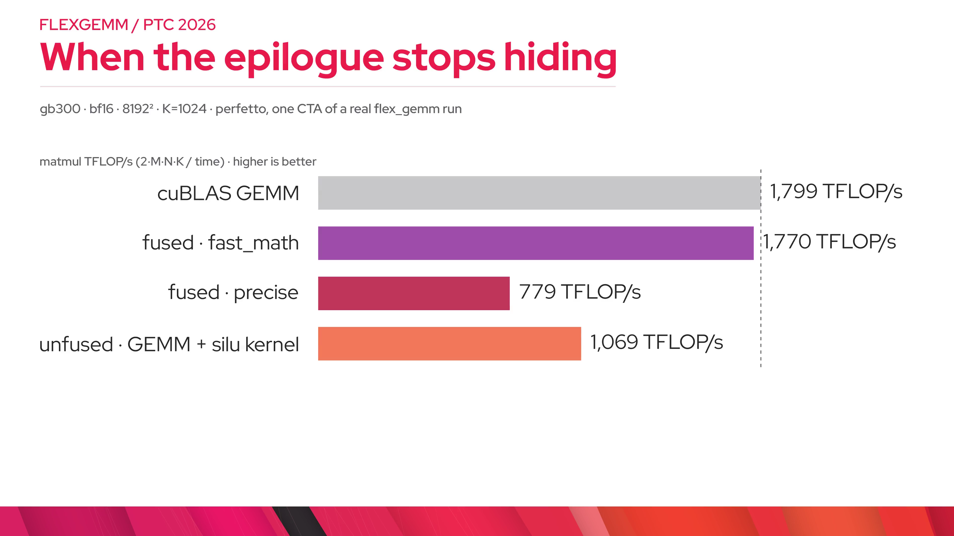
Notes:
results.speedups — GB300, pytorch main from this week, every bar against torch.compile of the same eager code. Bias plus ReLU at K equals 1024 is 1.75x: the GEMM is short, so skipping the bf16 C write and re-read is almost half the time; against max-autotune it is still 1.31x, and at 2048 cubed it is 1.13x. Wins grow with M times N over K; across an M by N by K sweep the only loss is 256 by 1024 by 4096 at 0.93x, which the exhaustive tile search turns into 1.11x. MoE grouped_mm with a SwiGLU epilogue is new on main: 1.34x with fast_math, 1.13x precise. The NVFP4 producer writes 4-bit data plus scales instead of a bf16 accumulator: 1.39x. The full MXFP8 MLP is 1.05x end to end. Residual add is about 1.3x against default compile, but only about 1.13x against a good unfused add, so it is not on the slide.

Slide 20
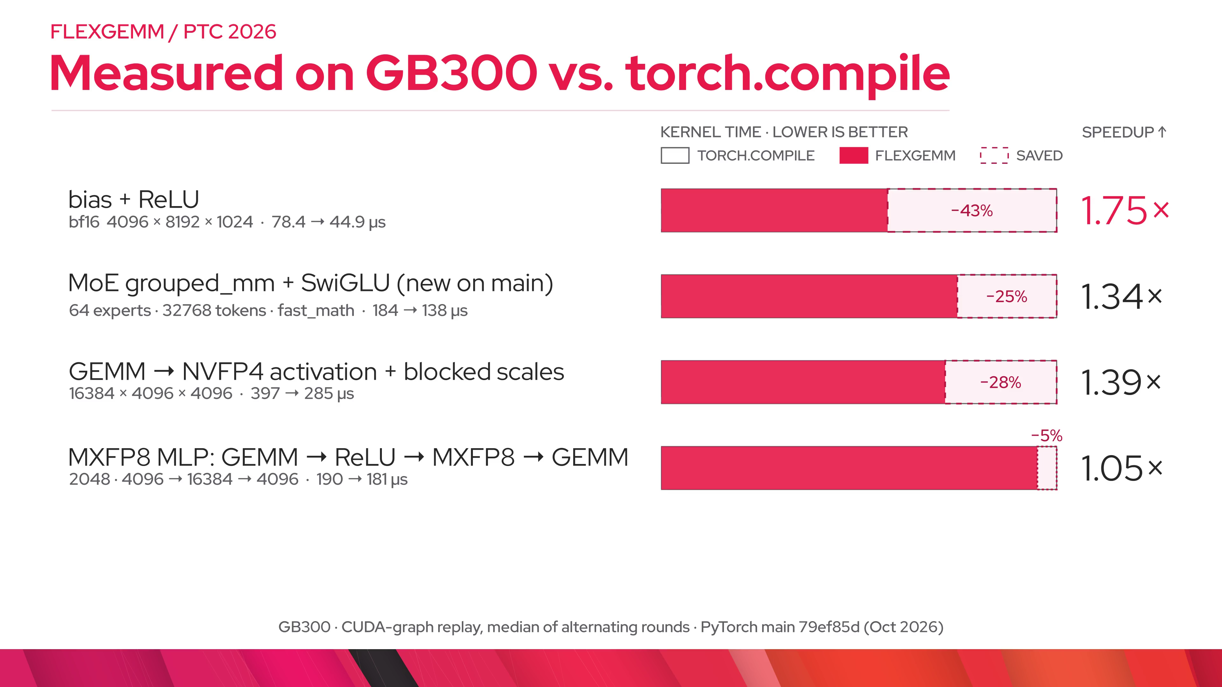
Notes:
results.numerics — The more interesting MXFP8 result is numerics: the scales are computed from the fp32 accumulator in registers, not from a rounded bf16 intermediate. That is only safe to promise because fusion is guaranteed or the compile fails.

Slide 21
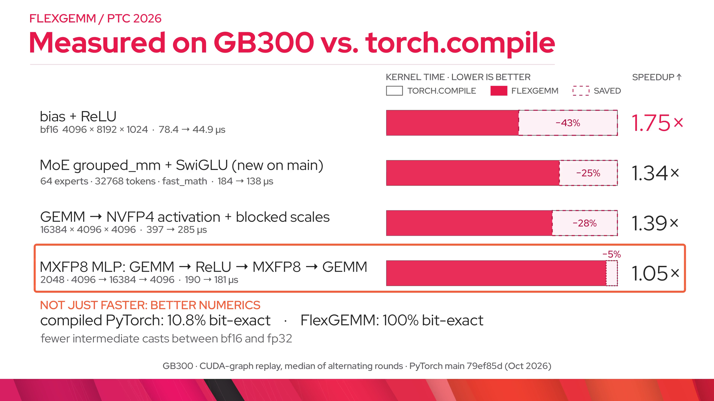
Notes:
results.mxfp8 — This is the code for that row. The epilogue is the MXFP8 quantizer in plain PyTorch: ReLU, a 32-wide amax, an E8M0 scale via one inline PTX instruction, the E4M3 cast, and the blocked scale layout. GEMM 1 writes exactly what GEMM 2 consumes. Because fusion is guaranteed, the scales come from the fp32 accumulator, which is why it is bit-exact.

Slide 22
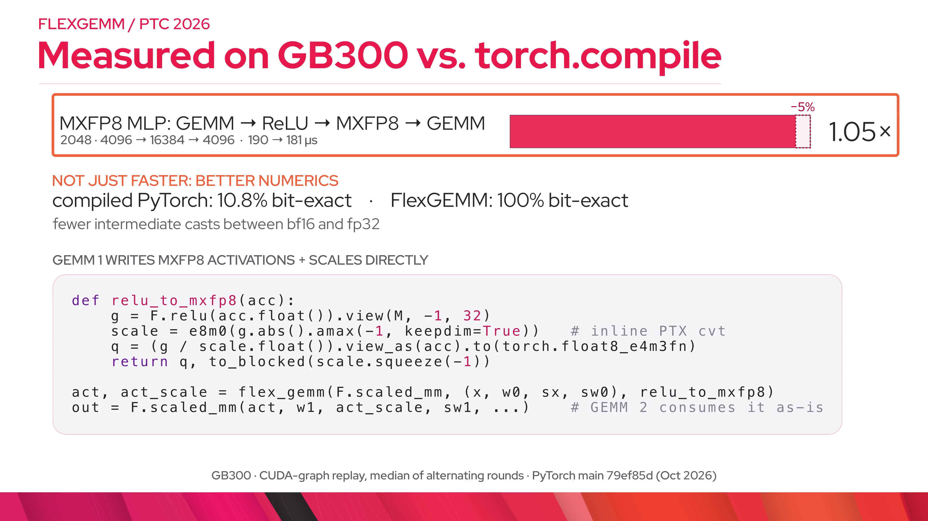
Notes:
stack.pipeline — flex_gemm is a higher-order op like flex_attention. Dynamo traces the epilogue to FX; Inductor builds a representation of the tile program, mostly figuring out which reductions are local; then it emits code into an existing high-performance GEMM template.

Slide 23
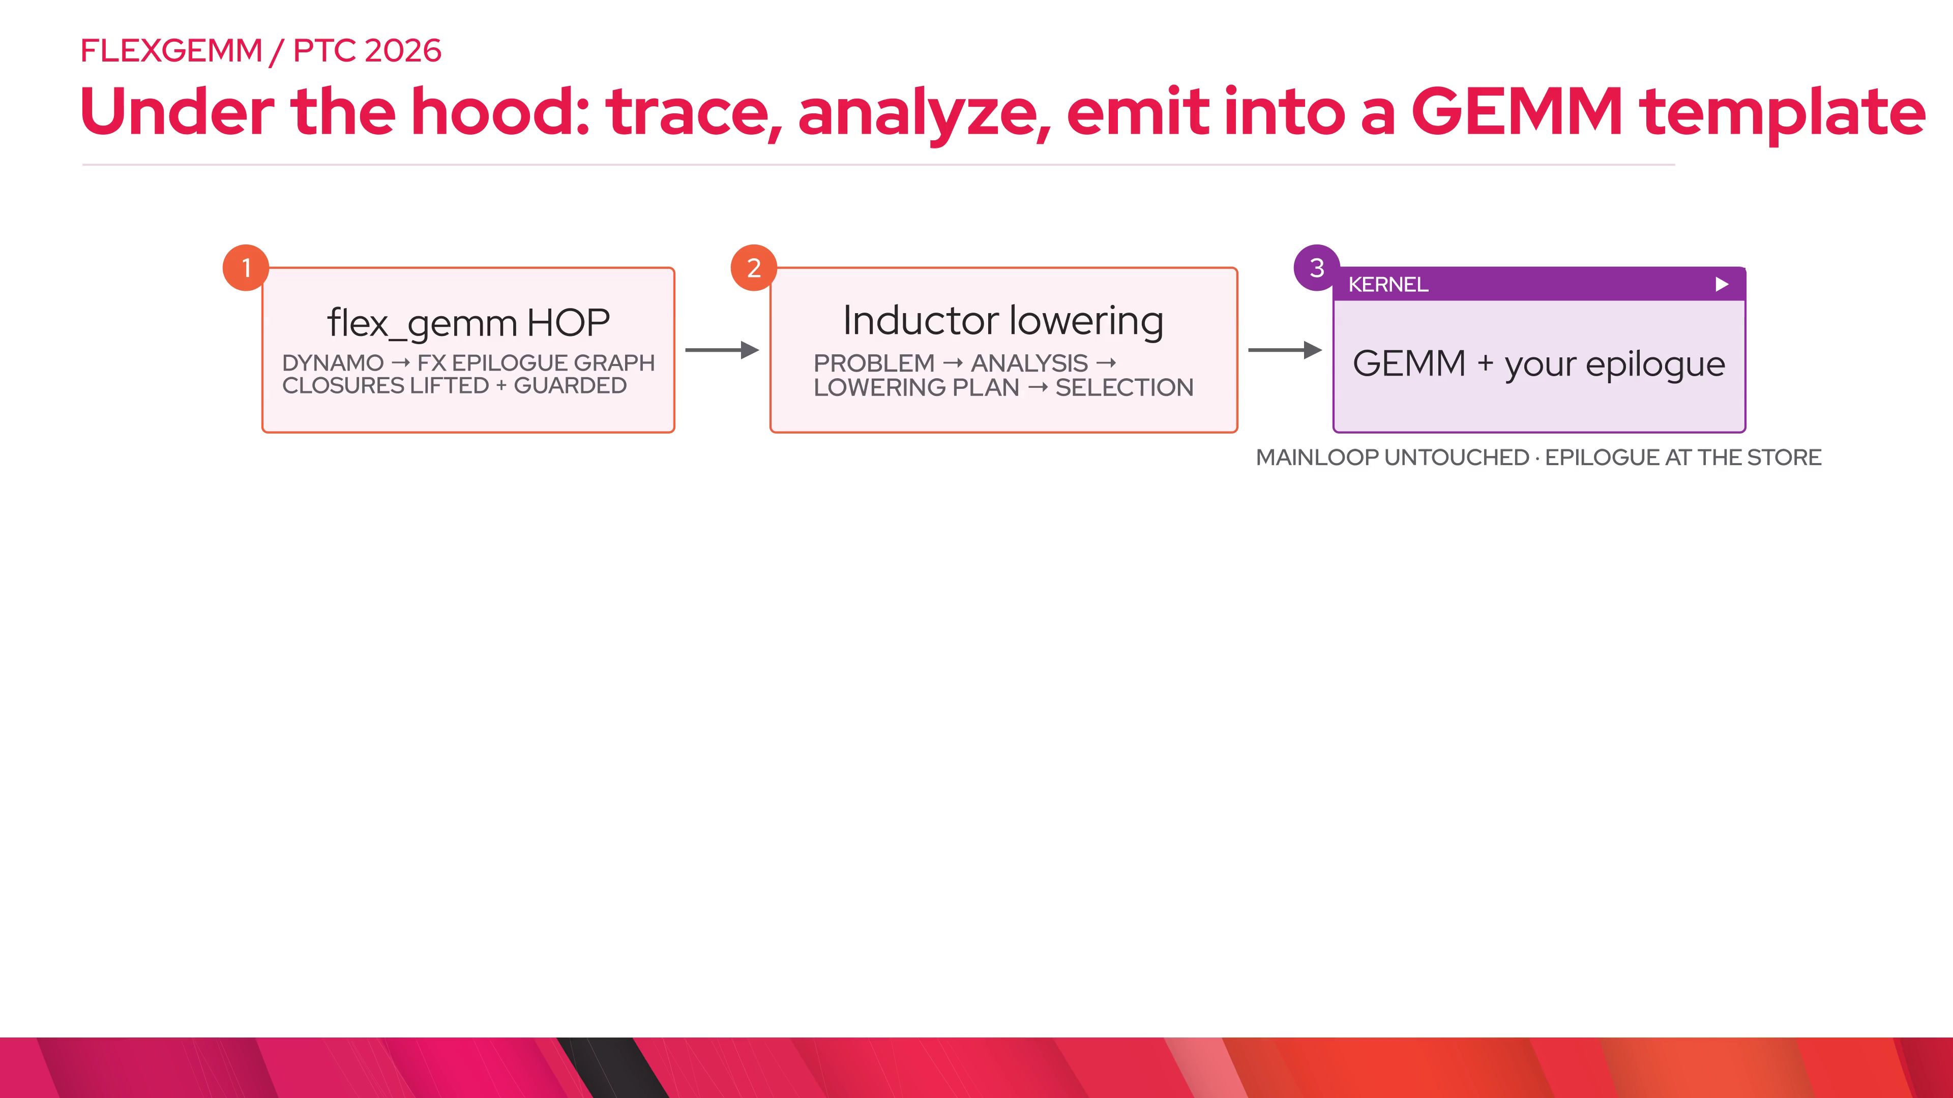
Notes:
stack.backends — The lowering is template-agnostic: the same traced epilogue can be emitted into different GEMM templates. Today that is QuACK, Tri Dao's CuTeDSL GEMMs vendored into PyTorch, sharing code with the FlexAttention/FlashAttention-4 integration. Next is NVGEMM, so NVIDIA can supply day-0 mainloops for new hardware. Triton is the portable path, including AMD; it works but needs a faster mainloop and more robust fusion, on the roadmap next to NVGEMM.

Slide 24
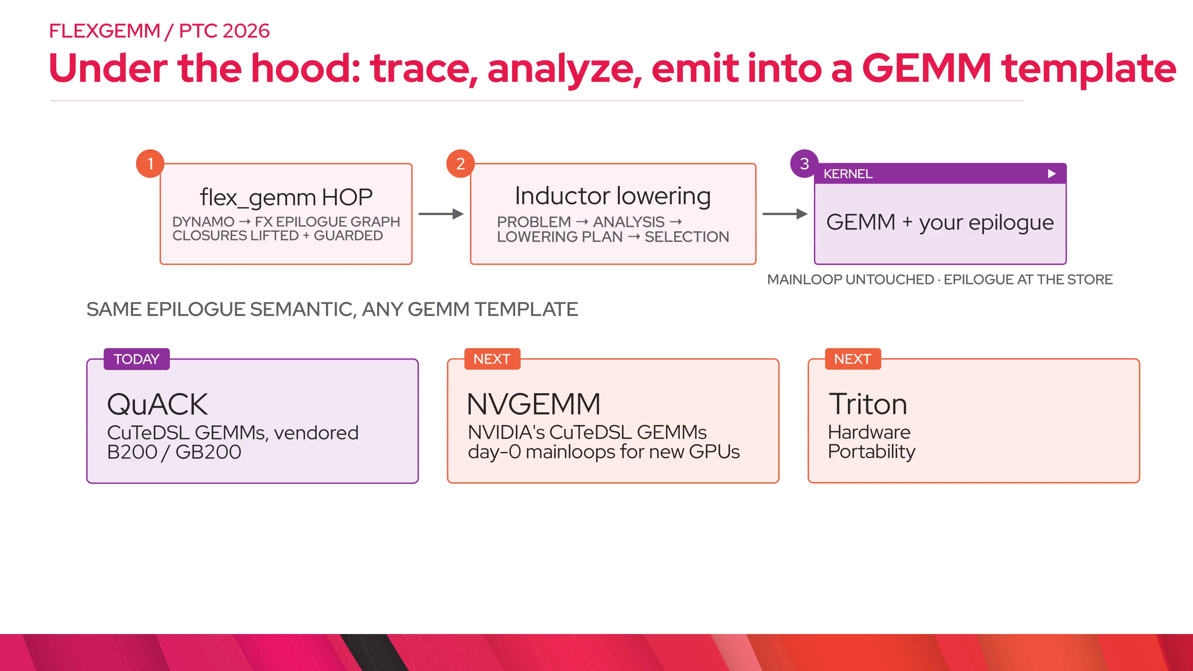
Notes:
philox.asm — PyTorch has a huge op surface, but sometimes what you want is one specific hardware instruction. inline_asm_elementwise turns a PTX snippet into an elementwise tensor op, so FlexGEMM fuses it like anything else. Here: Blackwell's stochastic-rounding convert, cvt.rs, applied to the fp32 accumulator. One kernel. The cost is that you own the portability: this instruction is sm100a/sm103a only.

Slide 25
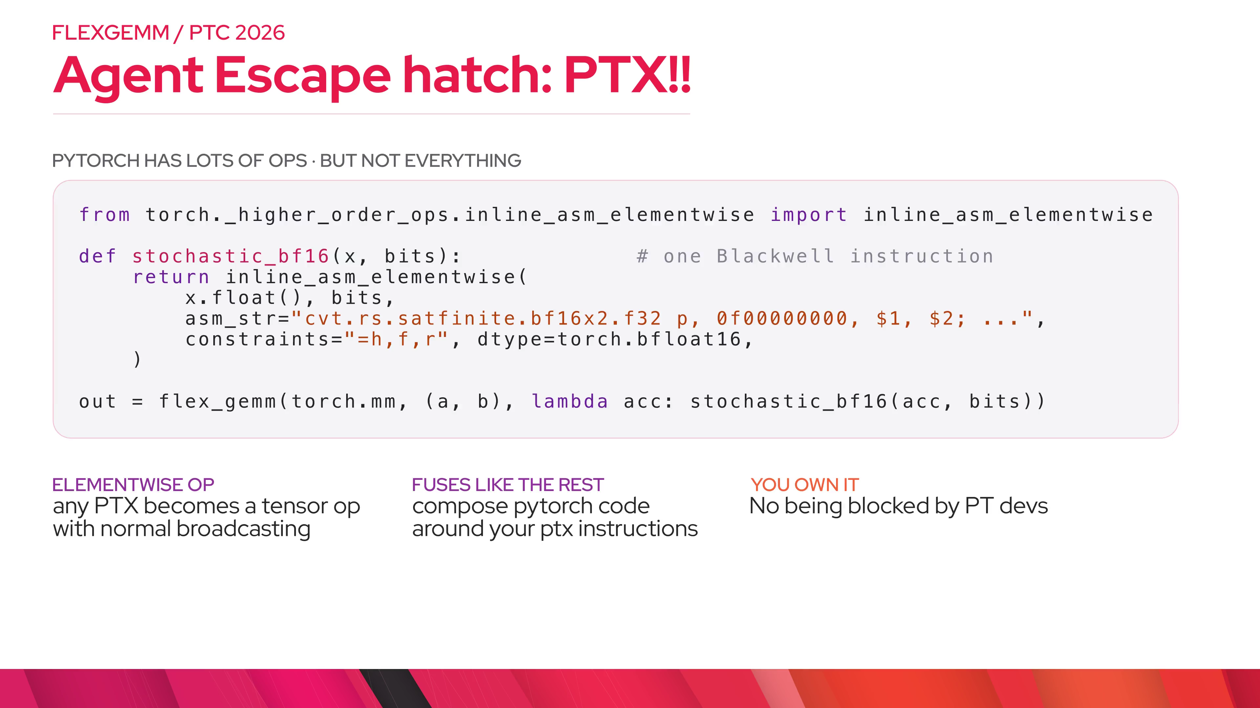
Notes:
philox.epilogue — Our Philox epilogue is two lines: philox_bits is a Philox4x32-10 written as inline PTX, ten rounds of two wide multiplies and a cross-wired xor with the key, and stochastic_bf16 is the cvt.rs helper from the previous click. For one output element the counter is its row and column plus an invocation number you bump each call, the key is a seed; the low 16 bits of word 0 feed cvt.rs, and the bf16 result is the only store. Measured on GB300 at 4096 cubed: 120 microseconds when the bits come from a separate kernel, 88 fused, 1.36x; against an all torch.compile split it is 1.31x. Still one QuACK kernel. No M by N random tensor, the bits do not depend on tile shape, and it is its own counter stream, not torch.Generator.

Slide 26
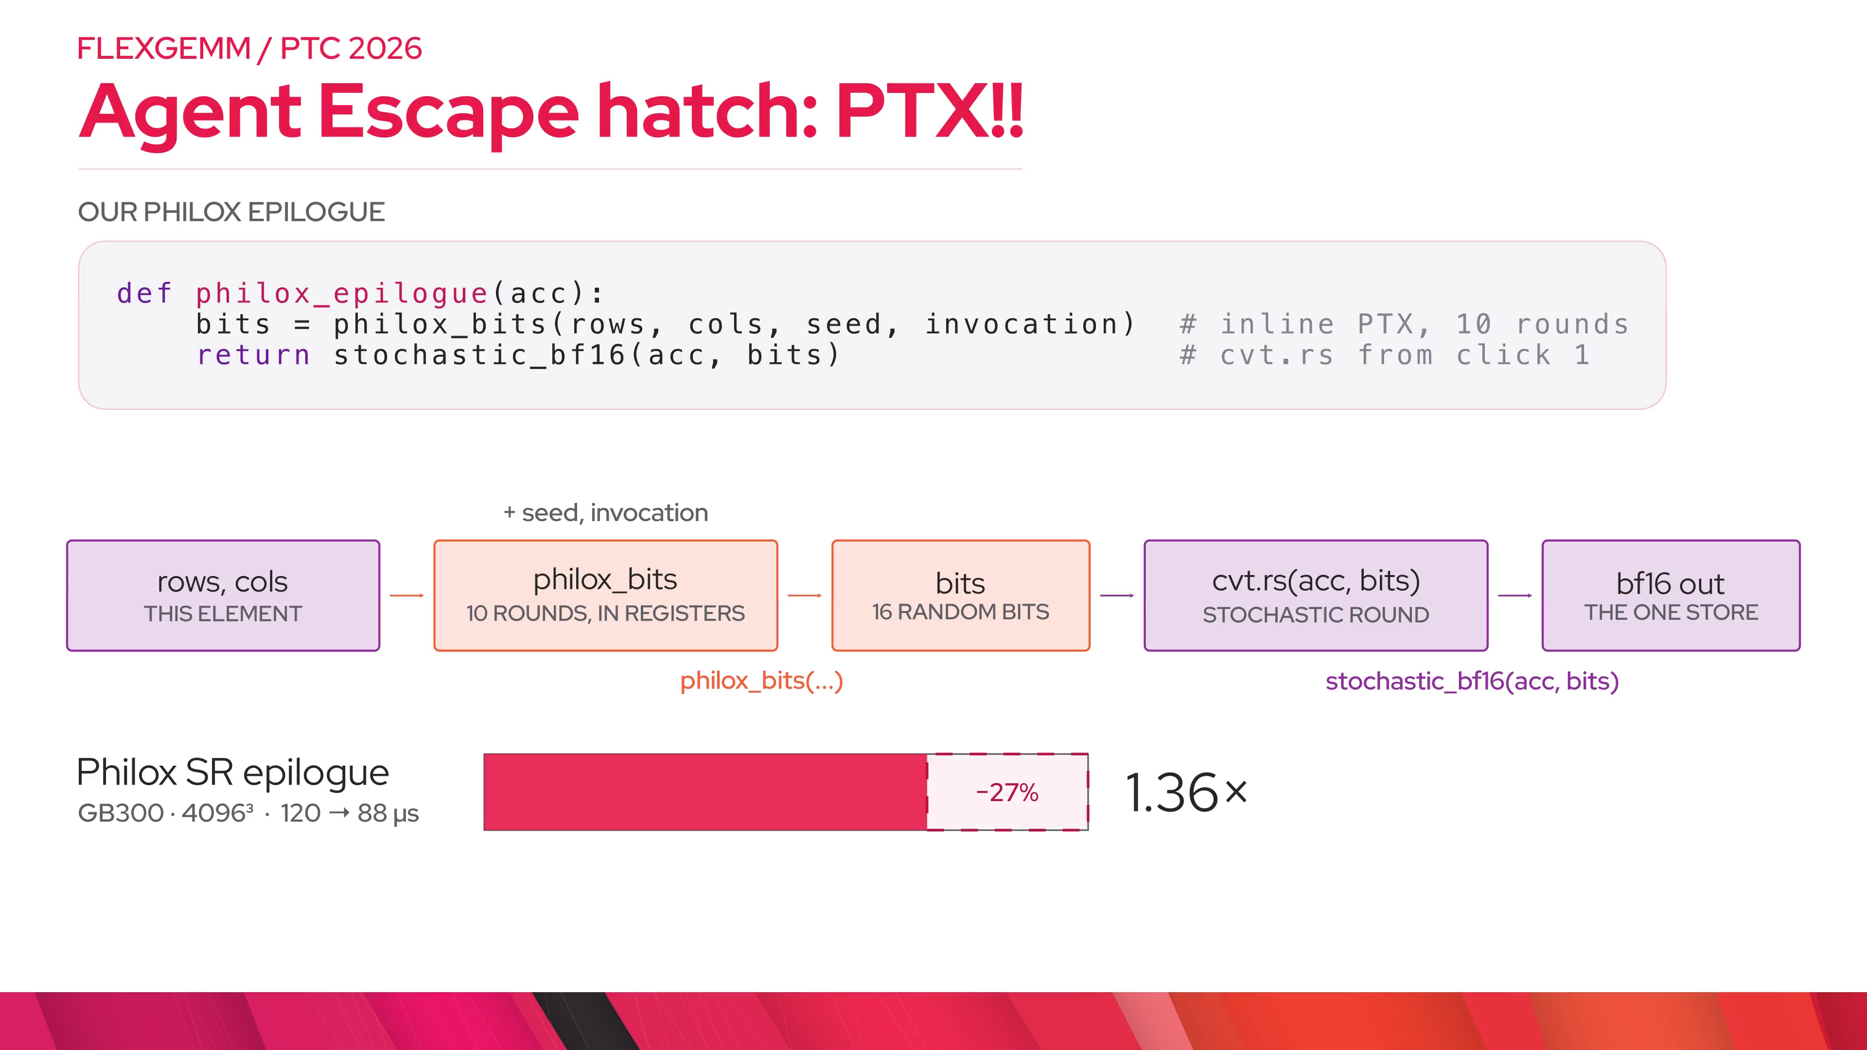
Notes:
autograd.forward — Forward is one flex_gemm: relu fused, and the pre-activation comes out of the same kernel as an aux output.

Slide 27
Notes:
autograd.backward — Backward is another flex_gemm. relu-prime is not a prologue of the gradient GEMMs; it becomes the epilogue of the GEMM that produces d-hidden.

Slide 28
Notes:
autograd.fused — The only fused work is these two calls. Every fused op stays an epilogue; the mainloops stay untouched.

Slide 29
Notes:
autograd.use — Then it is a drop-in module. The other route, prototyped in TorchTitan, is a post-autograd FX rewrite that keeps the traced ATen backward. Compiled backward through flex_gemm raises instead of silently returning None grads.

Slide 30
Notes:
status — Three takeaways. It is in main and the nightlies now, still a private-namespace API. The user-facing API is not final: typed entry points like flex_mm and flex_scaled_mm, grouped in their own module, are coming. Ask the audience for real epilogues from their models.

