Slide 1
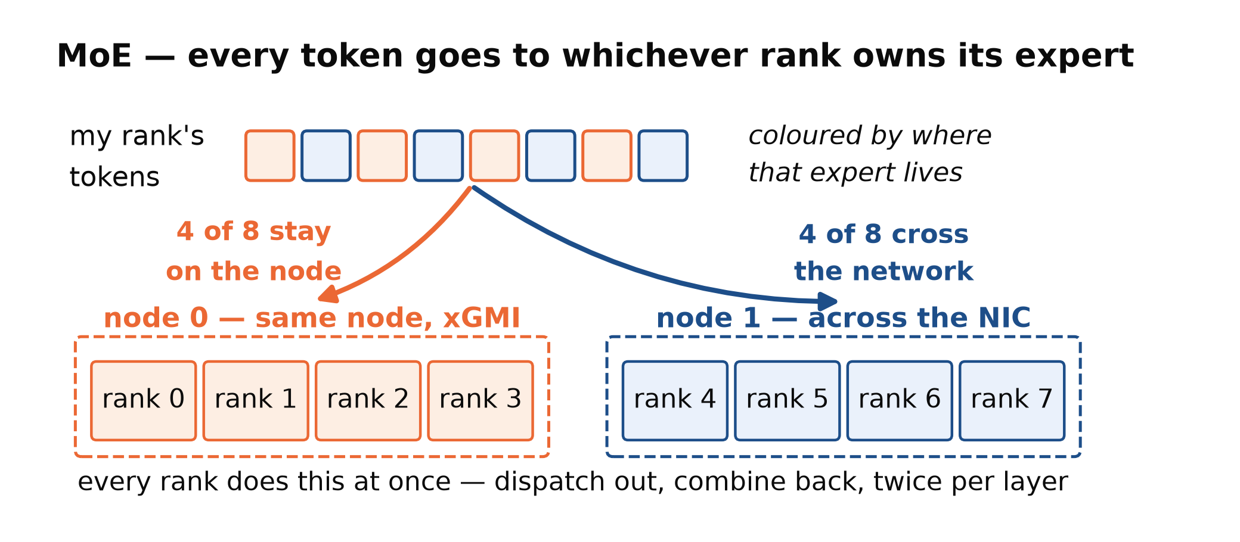
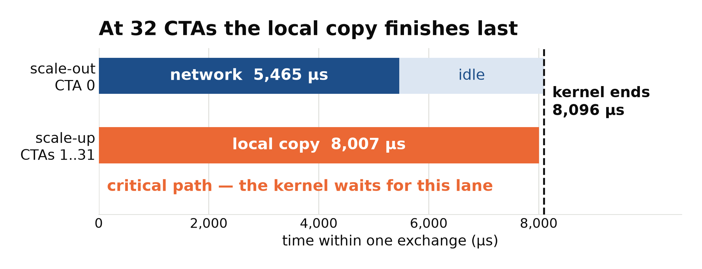
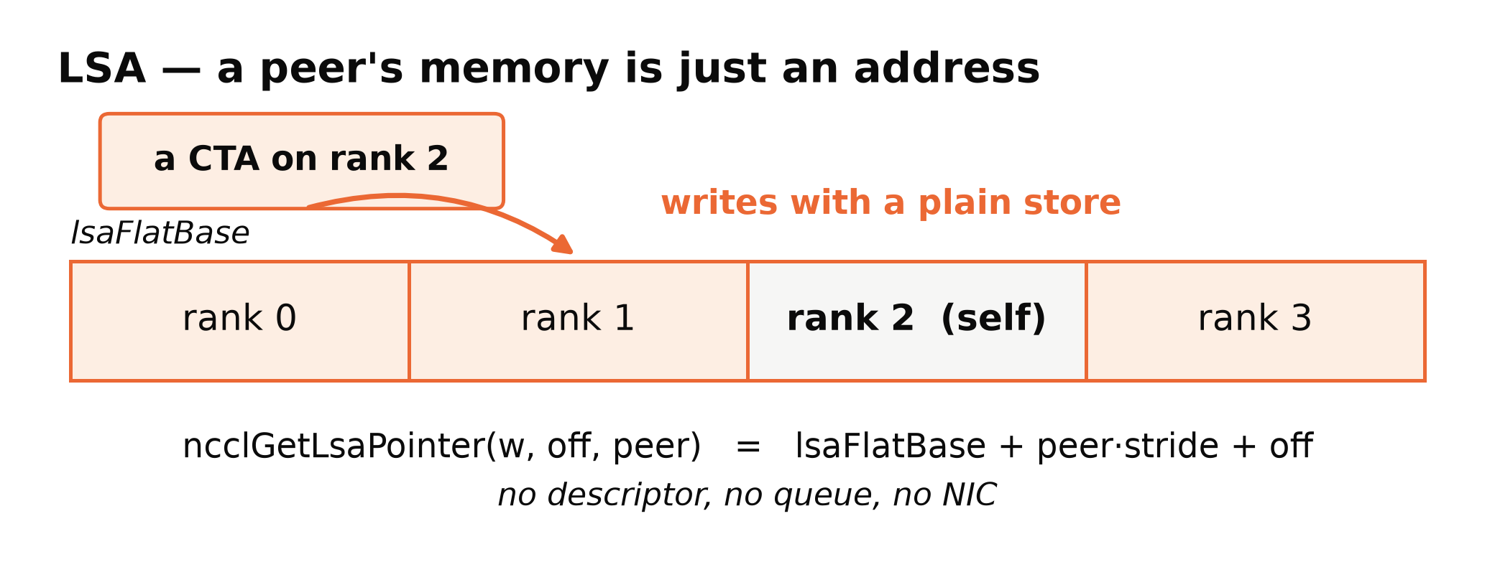
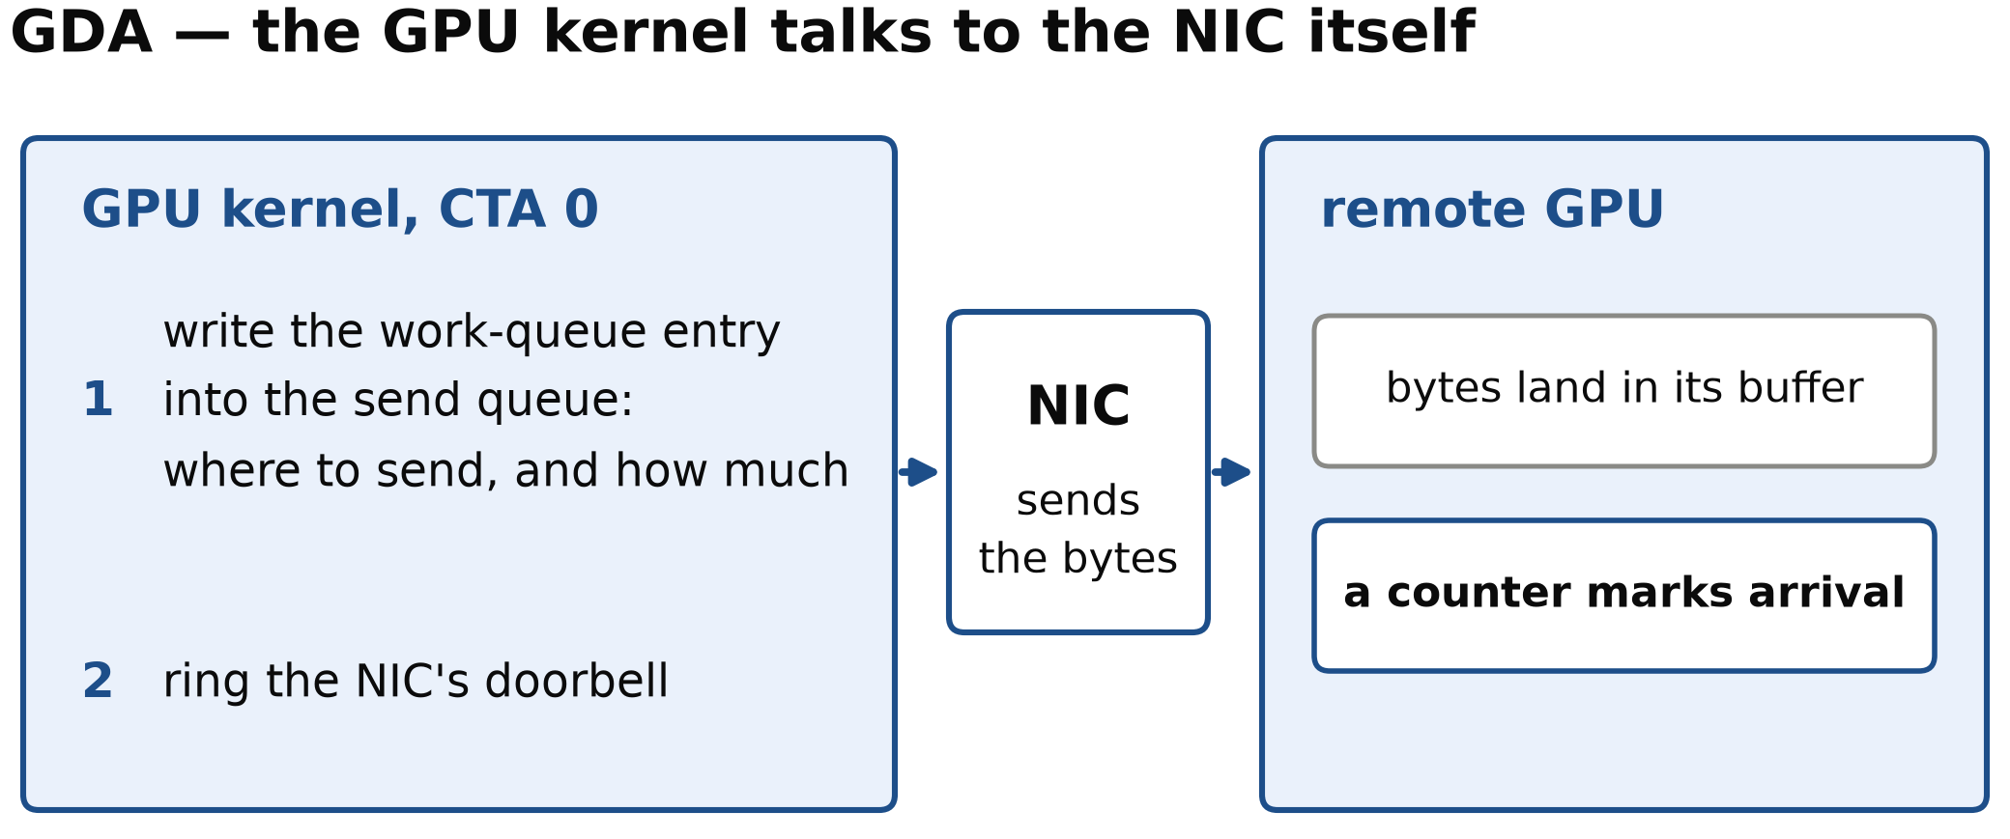
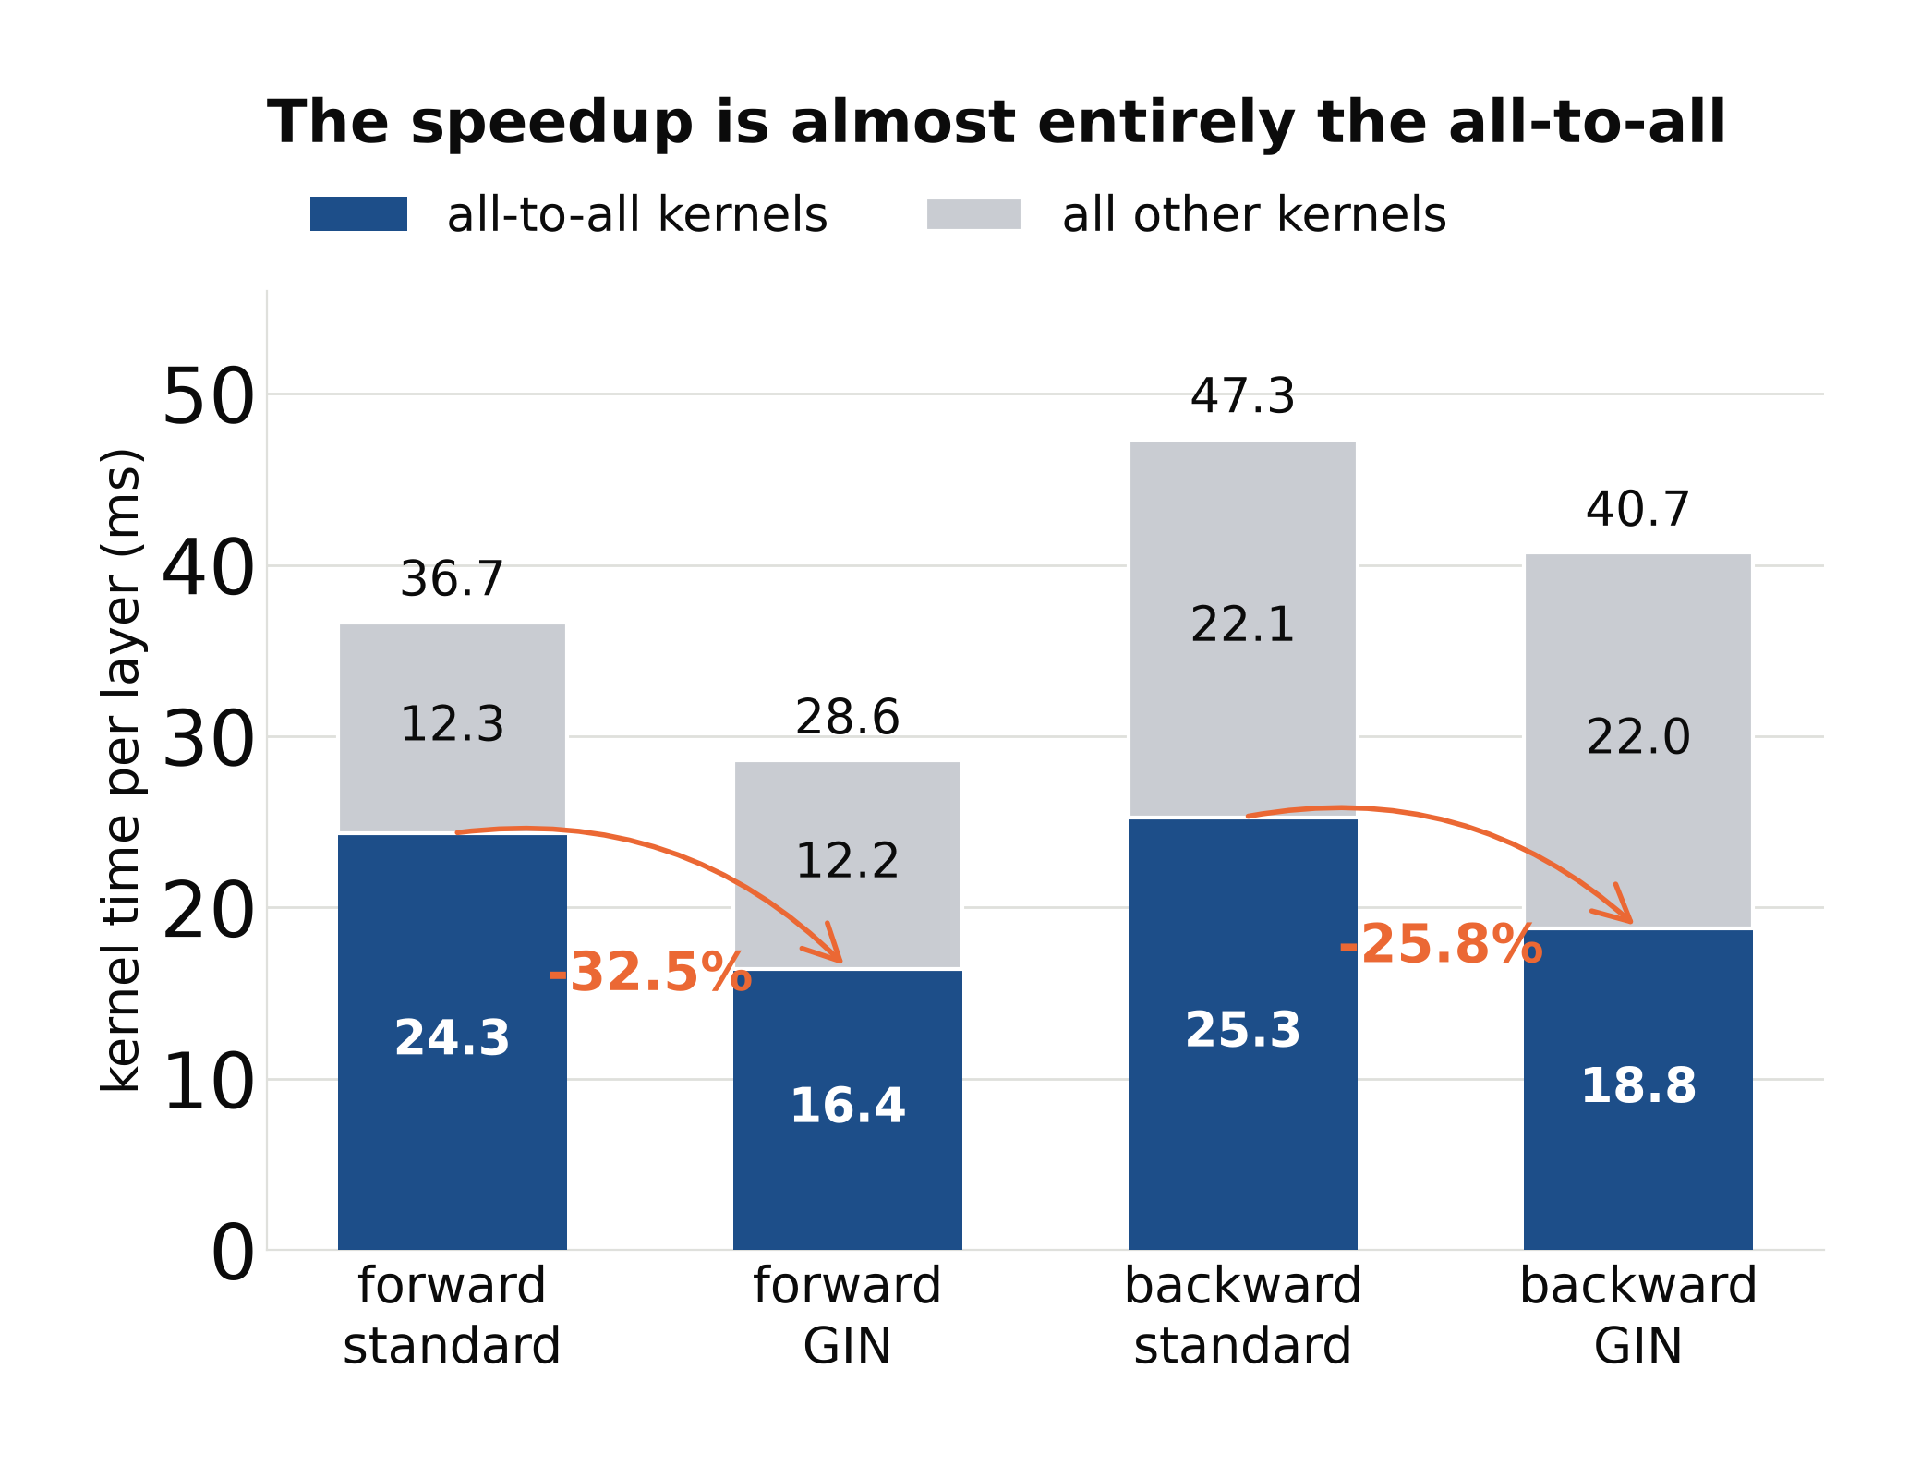
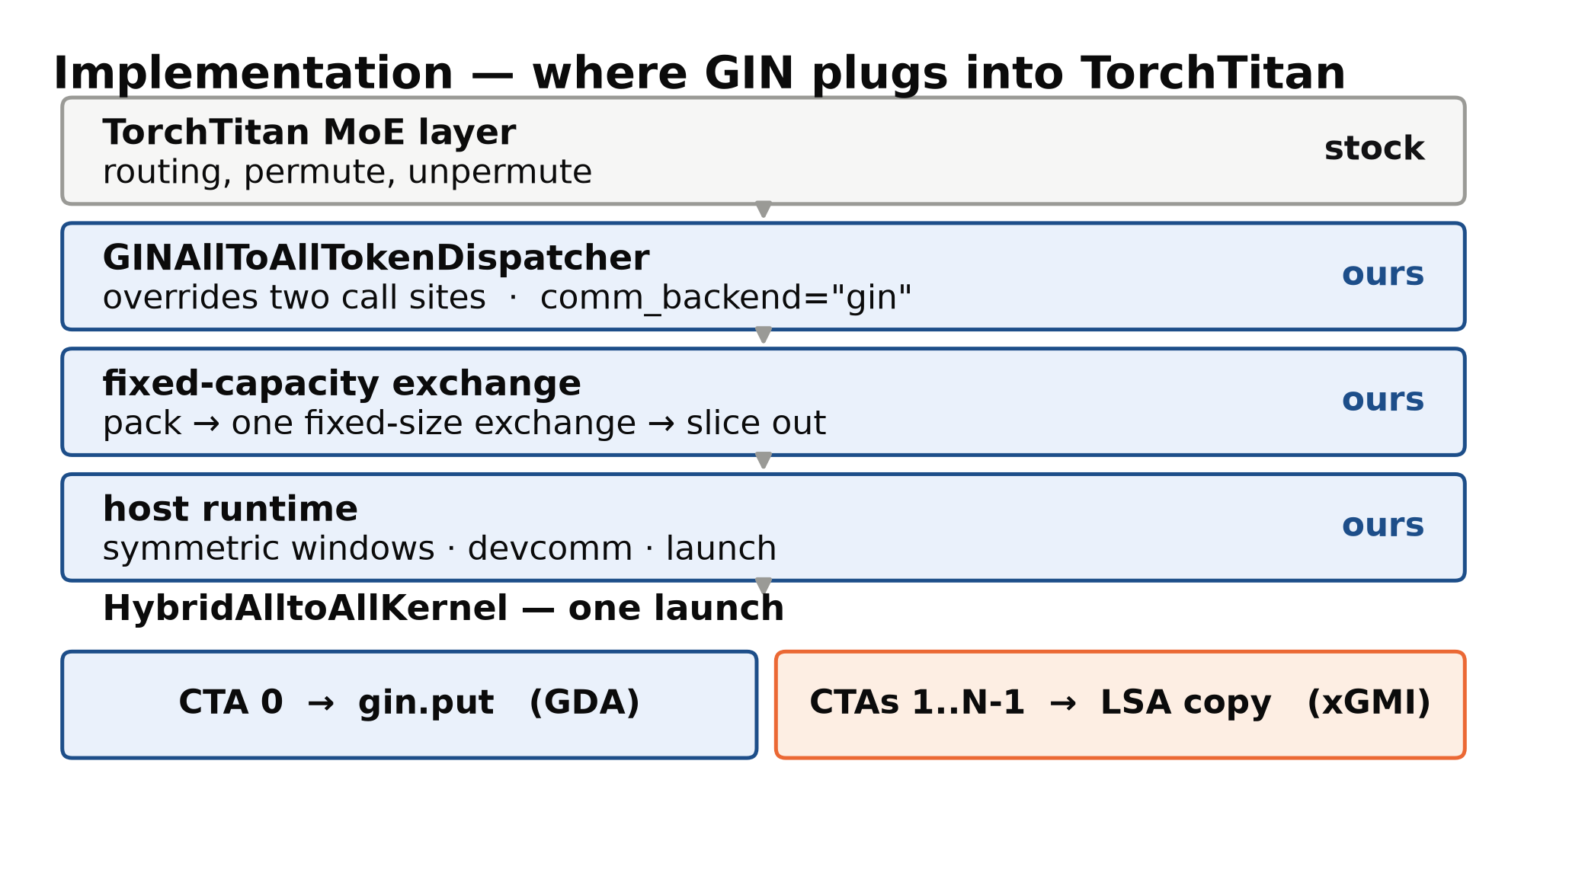
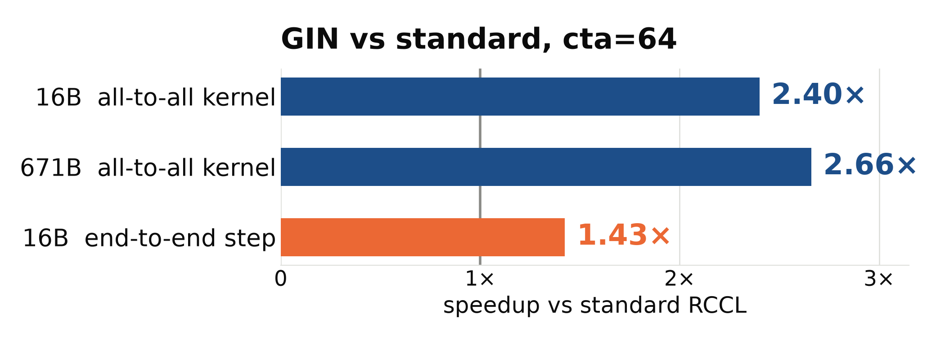
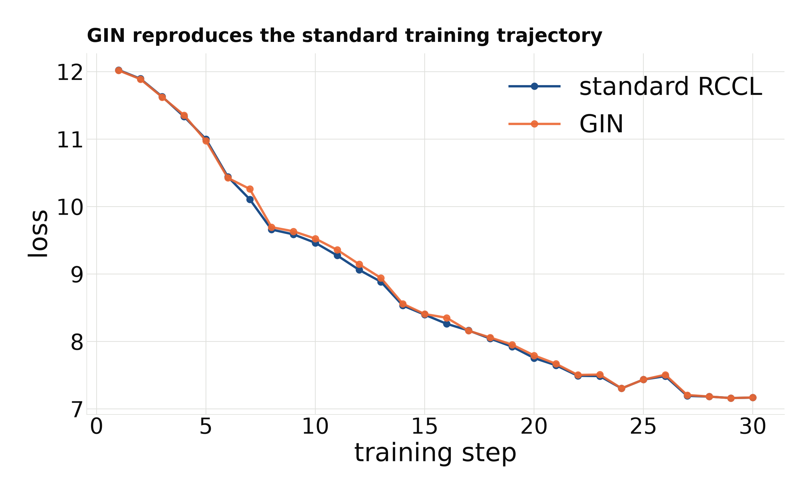
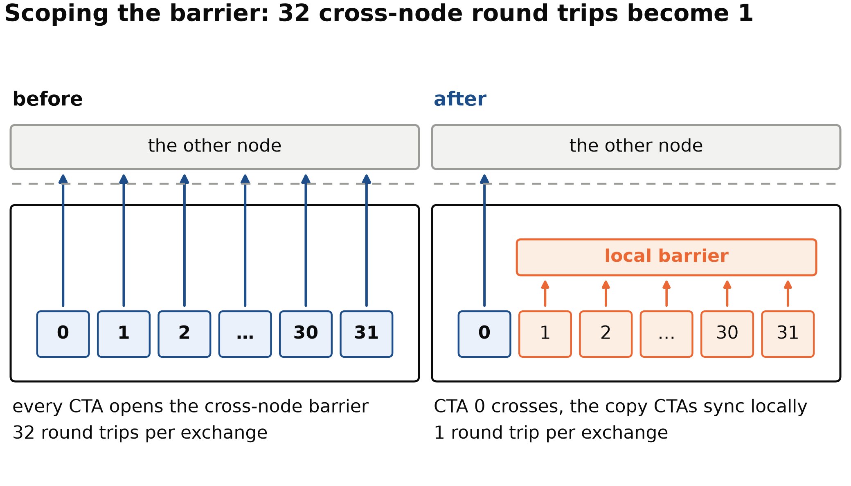
Integrating GPU-initiated -networking for expert parallelism in Distributed Training
Rishi Sinha · Liz Li · Maria Garzaran · Aurelien Bouteiller · Nusrat Islam · Sri Raj Paul · Kapil Pawar · Yuankai Chen
1 The all-to-all is the bottleneck
4 Where the time goes
copy ≈ 53 GB/s network ≈ 44 GB/s
Both rates hold across a 4.67× payload increase in message sizes
2 GDA and LSA: one API, two transports
5 Results
Kernel up to 30% faster
End-to-end 12 – 15% faster
DeepSeek-V3 16B · EP=8 · 2×4 MI300X · cta=32 · forced balanced routing
3 Our implementation
Increasing Compute Units improved E2E performance
(Work in progress)
Next steps
• Scale to MI355 across more nodes.
• Heuristic to estimate ideal number of CTAs per workload
• Backend with GDA and SDMA

