Slide 1

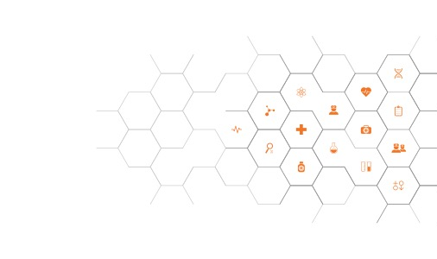



JUPYTERHEALTH
Transforming Digital Health Ecosystems
Ida Sim, MD PhD
Fernando Pérez, PhD
JP Pollak, PhD
A Platform for Interoperability, Insight, and Innovation
JupyterHealth.org
JupyterHealth@Berkeley.edu
https://github.com/JupyterHealth
October 19, 2026

Slide 2


The Problem
Fragmented, Reactive Healthcare Systems
The Opportunity
A New Era of Connected, Data-Driven Healthcare
Healthcare systems operate in silos, limiting real-time data access for clinicians and patients.
Inefficient workflows shift focus away from care, wasting time and resources.
Despite advancements like wearables, care delivery remains episodic, not proactive.
Integration challenges restrict the potential of life-saving algorithms and remote monitoring.
The rise of wearables, IoT, and AI creates a pivotal moment for healthcare transformation.
Real-time data integration can enable personalized care and earlier interventions.
A unified platform is essential to securely connect diverse data, bridging clinical care and research.

Slide 3
What If…
each of us could get the best proactive care and self-care we need based on complete data and knowledge for our specific mix of conditions, within the context of our clinical and life situation?
Notes:
Here’s my operational definition. Though my research is in informatics and AI, I still see patients as a primary care doc, so I always start with the patient. What if each patient, each of us…Notice this definition doesn’t include the words AI or computation or even omics.

Slide 4
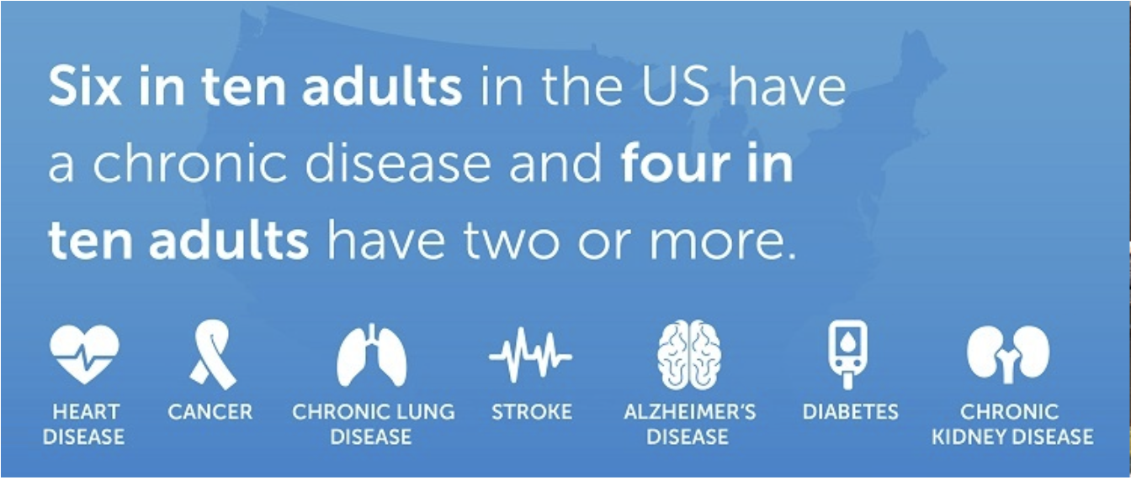
Burden of Chronic Disease
Three out of four Americans have
at least one chronic disease and over
half of adults have two or more.
Notes:
Continuing with the patient as the starting point, three out of 4 adults in the US have at least one of these chronic diseases, and over half have two or more of these 7 diseases. Remember this statistic for later in our talk.
https://www.cdc.gov/chronic-disease/about/?CDC_AAref_Val=https://www.cdc.gov/chronicdisease/about/index.htm

Slide 5
Burden of Chronic Disease
Three out of four Americans have
at least one chronic disease and over
half of adults have two or more.
90% of $5 trillion annual US healthcare costs
Notes:
These chronic diseases account for 90% of the $5 trillion in annual healthcare costs in the US. Most of these costs are incurred in community and hospital clinics, emergency rooms, and hospitals. In other words, in the healthcare system.
https://www.cdc.gov/chronic-disease/data-research/facts-stats/index.html

Slide 6
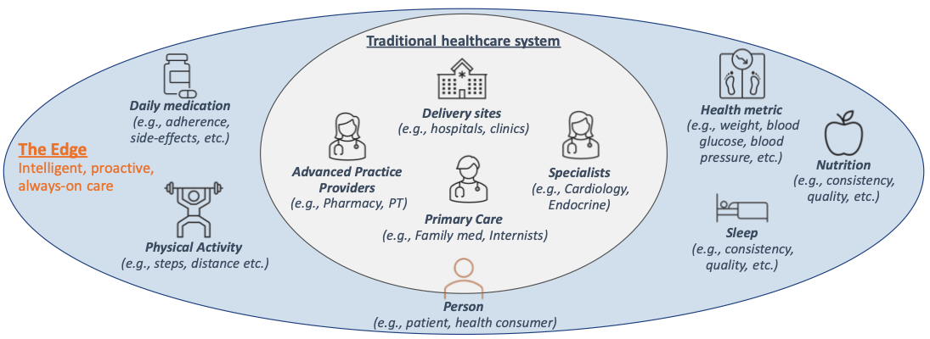

Edge Medicine: Frontline of Health Care is You
edgemedicine.org
Notes:
These chronic diseases account for 90% of the $5 trillion in annual healthcare costs in the US. Most of these costs are incurred in community and hospital clinics, emergency rooms, and hospitals. In other words, in the healthcare system.
https://www.cdc.gov/chronic-disease/data-research/facts-stats/index.html

Slide 7
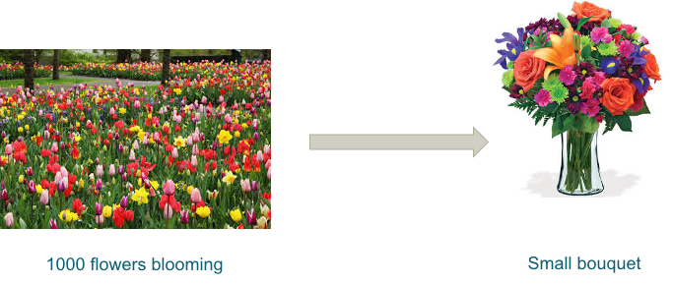
Digital Monitoring for Chronic Care
Patient-generated data (PGD) are a remote window into a patient’s 24/7 health state
  patient-reported outcomes (PROs)
  home medical devices (e.g., BP cuffs, glucometers), wearables (e.g., Oura, AppleWatch), other sensors
Where we are today:
1000 flowers blooming
Notes:
As you’re well aware, billions of dollars have been invested into digital health. We have many apps, sensors, and startups -- a 1000 flowers blooming. But as a practicing doc, I’ll tell you that remote monitoring is NOT a meaningful part of my practice. These 1000 flowers are only giving a bad case of allergies.

Slide 8
Digital Monitoring for Precision Care
Patient-generated data (PGD) are a remote window into a patient’s 24/7 health state
  patient-reported outcomes (PROs)
  home medical devices (e.g., BP cuffs, glucometers), wearables (e.g., FitBit, AppleWatch), other sensors
Where we want to go:
1000 flowers blooming
A bouquet
Notes:
Instead, what we want to get to is a bouquet of flowers, pleasingly arranged, where all the solutions/flowers work well together.
but not just one single bouquet. Remember that 40% of Americans have 2 or more chronic conditions. Each of us needs different flowers in our bouquet, maybe a glucometer and stress PROs for one person, and pain, mobility, and sleep monitoring in another.
And our needs will change over time, as we get sick, recover, get sick again and collect another one of those 7 chronic conditions.

Slide 9



Digital Monitoring for Precision Care
Patient-generated data (PGD) are a remote window into patient health states
  patient-reported outcomes (PROs)
  home medical devices (e.g., BP cuffs, glucometers), wearables (e.g., FitBit, AppleWatch), other sensors
What we really need:
1000 flowers blooming
Many individualized bouquets that mix and match over time
A bouquet
Notes:
So what we really want is individualized bouquets for each person, that can mix and match over time.

Slide 10



Towards Precision Bouquets
Need an ecosystem of modular standards-based composable solutions
1000 flowers blooming
Many individualized bouquets that mix and match over time
Notes:
We want precision bouquets! To get to precision bouquets, we need an ecosystem of modular, standards-based solutions that can be mixed and matched.
This isn’t a pipe dream. I come from the world of open-source platforms, and I know that this has been done before, in areas outside of healthcare. I’m building JupyterHealth to enable precision bouquets, and from there to precision medicine.

Slide 11
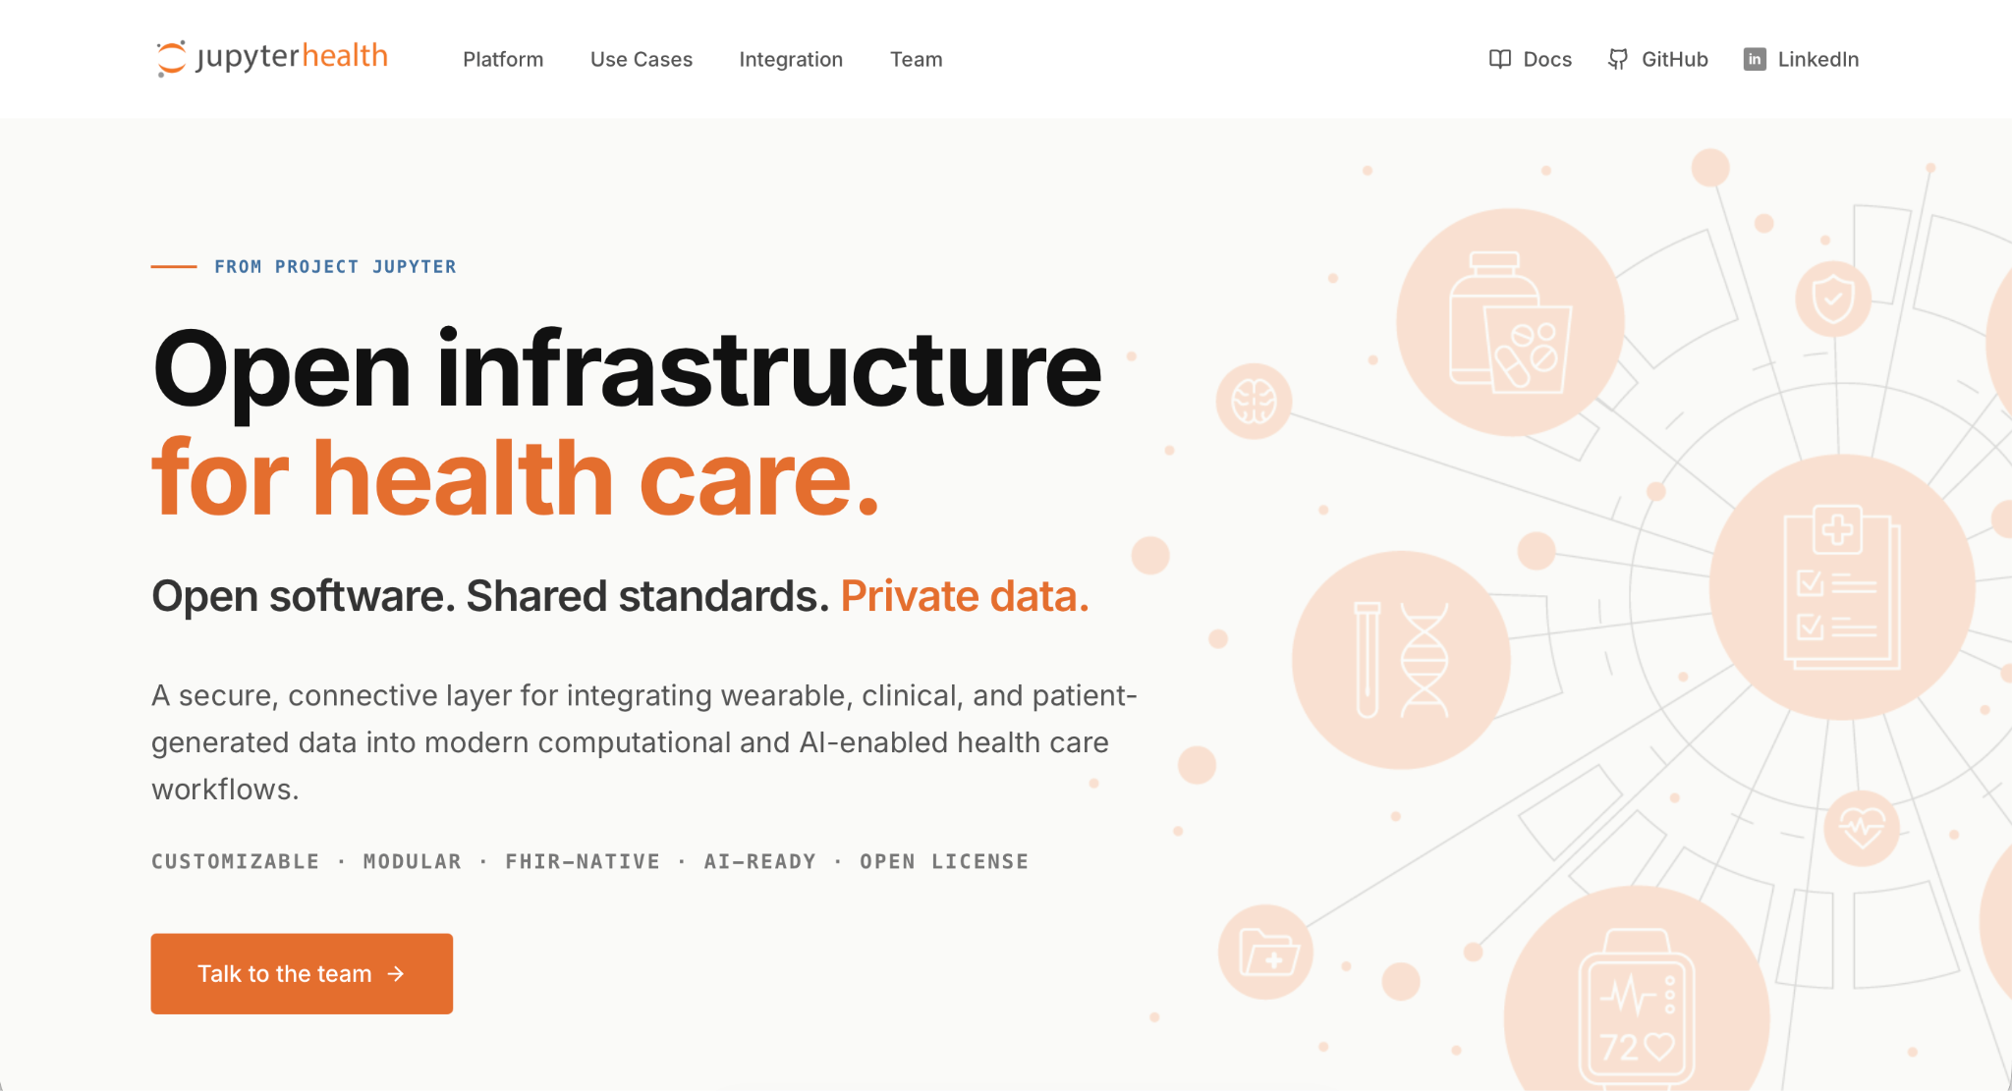

Slide 12
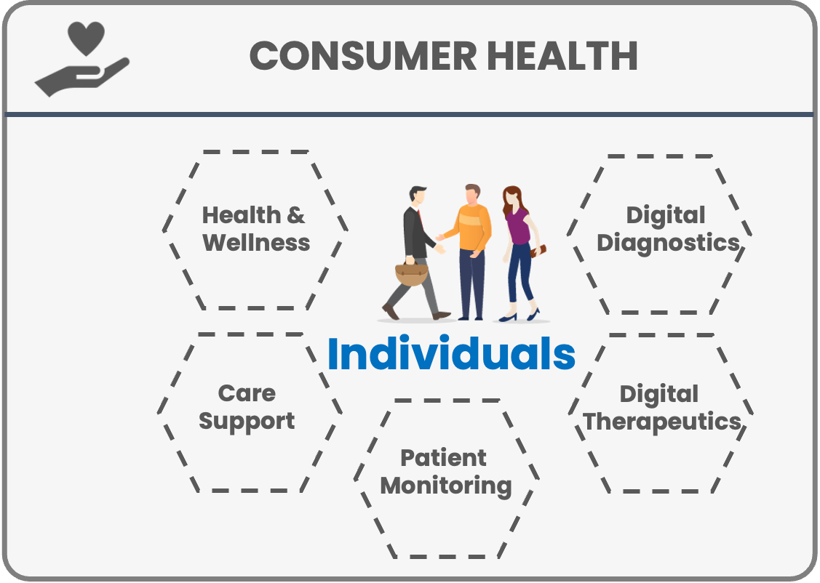

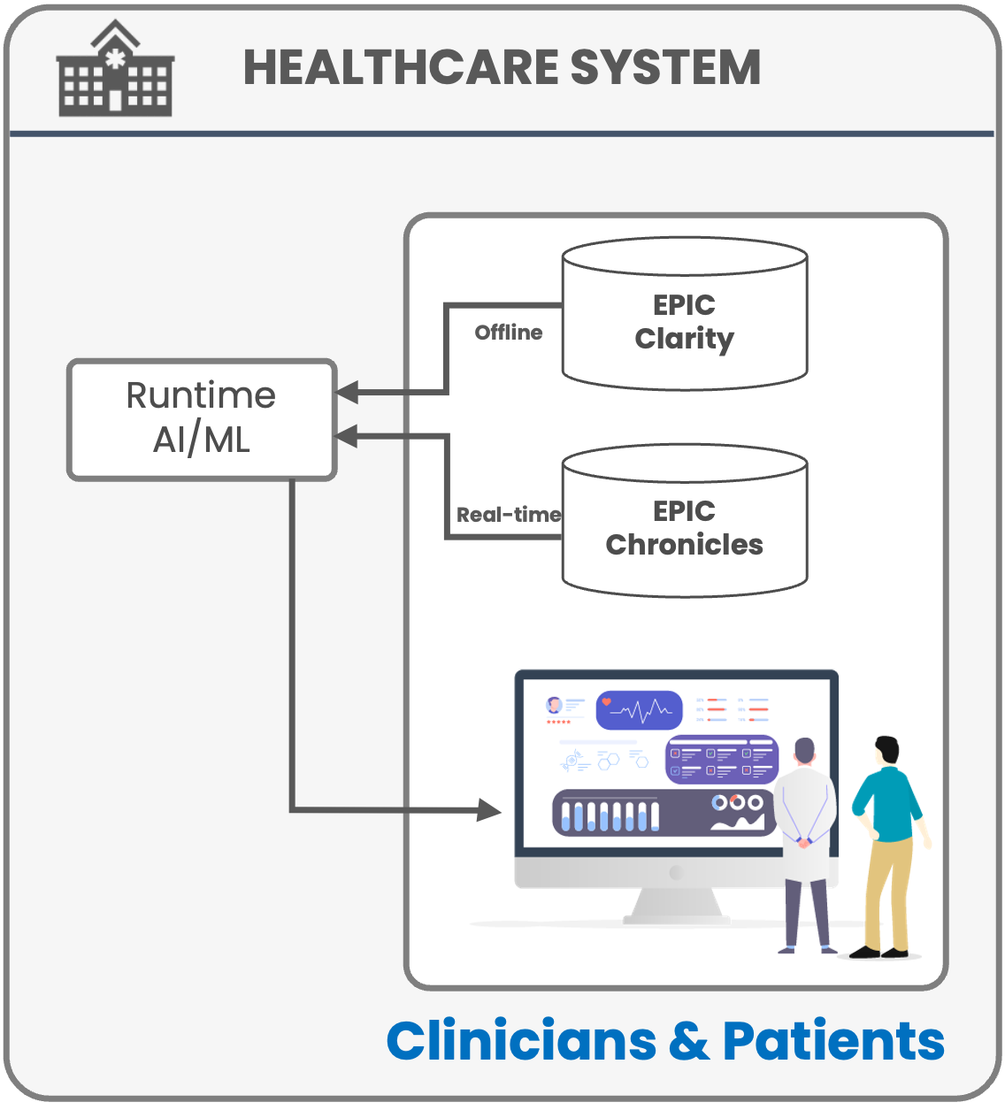
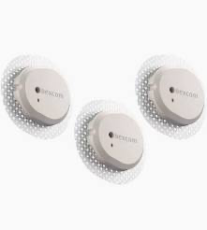
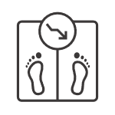
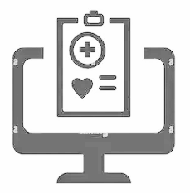

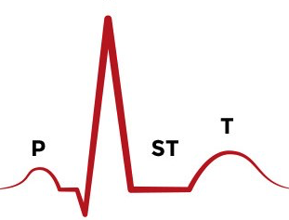


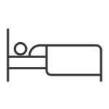
JupyterHealth
JupyterHealth Open Source Community
JupyterHealth Hub
3rd-Party
Repositories
JupyterHealth Exchange
People
Medical Records
Remote sensing
Notes:
Summary JupyterHealth lowers the friction for privacy-preserving real-time data integration and interactions with patients. It leverages a proven science computing platform for researchers and analysts across the biomedical spectrum to work together. And JupyterHealth is built to facilitate companies deploying for impact for clinicians and patients.

Slide 13
JupyterHealth
JupyterHealth Exchange
Data acquisition and standardization:
  Brings data into the JupyterHealth ecosystem.
  Direct or facilitated.
  For now, focused on mobile health (mHealth) data and medical records.
Privacy-preserving data management:
Securely stores health data.
Provides scoped, authenticated access via standards-based FHIR API.
JupyterHealth Open Source Community
JupyterHealth Hub
3rd-Party
Repositories
JupyterHealth Exchange
People
Medical Records
Remote sensing
Notes:
Summary JupyterHealth lowers the friction for privacy-preserving real-time data integration and interactions with patients. It leverages a proven science computing platform for researchers and analysts across the biomedical spectrum to work together. And JupyterHealth is built to facilitate companies deploying for impact for clinicians and patients.

Slide 14
JupyterHealth
JupyterHealth Hub
Data analysis:
Accesses data from JupyterHealth Exchange and other sources.
Supports Jupyter, JupyterAI, and JupyterHealth analytical and visualization packages of your choice.
Use AI models via MCP.
Clinical workflow integration:
Deliver decision support directly into electronic health records workflows, via by SMART-on-FHIR.
JupyterHealth Open Source Community
JupyterHealth Hub
3rd-Party
Repositories
JupyterHealth Exchange
People
Medical Records
Remote sensing
Notes:
Summary JupyterHealth lowers the friction for privacy-preserving real-time data integration and interactions with patients. It leverages a proven science computing platform for researchers and analysts across the biomedical spectrum to work together. And JupyterHealth is built to facilitate companies deploying for impact for clinicians and patients.

Slide 15
JupyterHealth
3rd Party Repositories
Additional functionality
Digital biomarkers
Clinical guidelines
Reinforcement learning
Study management
etc.
JupyterHealth Open Source Community
JupyterHealth Hub
3rd-Party
Repositories
JupyterHealth Exchange
People
Medical Records
Remote sensing
Notes:
Summary JupyterHealth lowers the friction for privacy-preserving real-time data integration and interactions with patients. It leverages a proven science computing platform for researchers and analysts across the biomedical spectrum to work together. And JupyterHealth is built to facilitate companies deploying for impact for clinicians and patients.

Slide 16
Standardizing mHealth data will
Clarify and ensure meaning of data is kept as it flows through digital biomarker pipeline to end user
Make data aggregation across multiple sources easier and more accurate
Facilitate development and validation of digital biomarkers
Reduce costs of using mHealth data to make biomedical discoveries, improve health, manage disease
Notes:
schema creation is done with the community
specifications are all well and good, but people need tools
pull requests

Slide 17
Example Blood Glucose Data Instance
{
"blood_glucose": {
"value": 128
}
}
Notes:
What is this observation?

Slide 18
Example Blood Glucose Data Instance
average fasting blood glucose in mg/dL over a 3-month period, Jan 5 to Mar 5 2026
{
"blood_glucose": {
"unit": "mg/dL",
"value": 128
},
"effective_time_frame": {
"time_interval": {
"start_date_time": "2026-01-05T07:25:00Z",
"end_date_time": "2026-03-05T07:25:00Z"
}
},
"temporal_relationship_to_meal": "fasting",
"temporal_relationship_to_sleep": "on waking",
"descriptive_statistic": "average"
}
required
optional
Notes:
JSON schemas allow us to be clear and standardized in saying things that need to be said for an observation or “biomarker” to be appropriately interpreted and used.

Slide 19
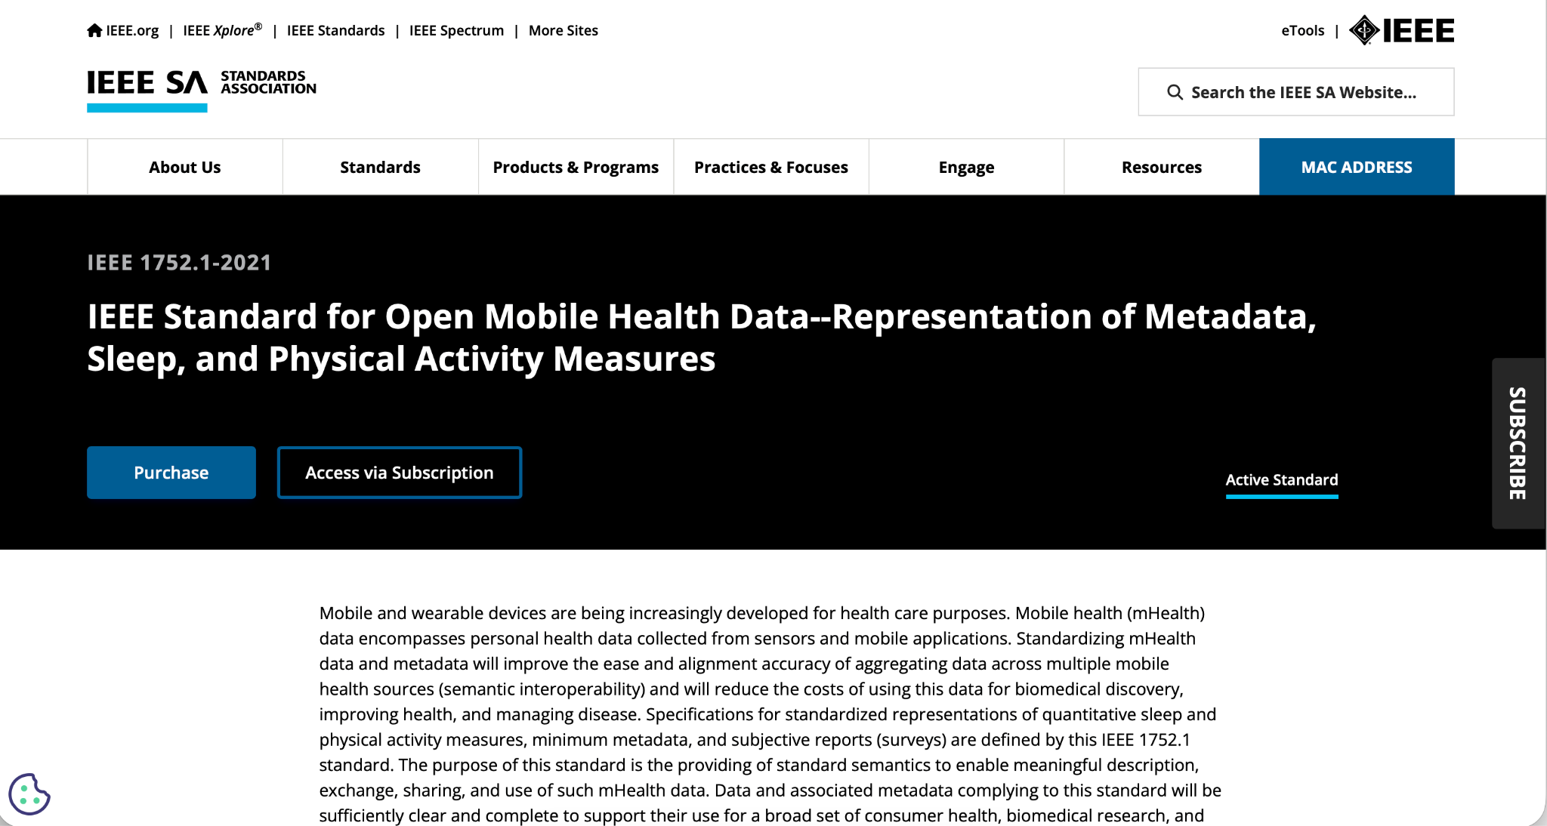
Notes:
This was when IEEE came to us, with a story. Companies want and need an open standard for mobile health, but it has to be a vetted standard that has some institutional weight behind it. And an open standard is a non-excludable, non-rivalrous public good – that greases the wheels for the private sector. IEEE saw that and invited Open mHealth to become an official Working Group to eventually make OmH an IEEE standard.

Slide 20
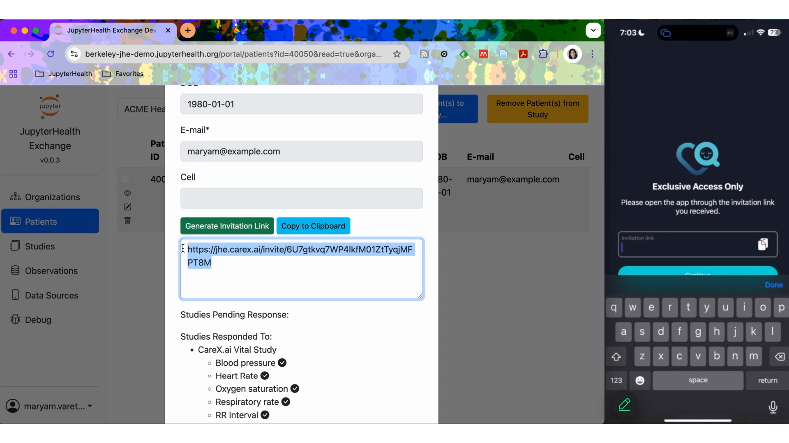

Slide 21






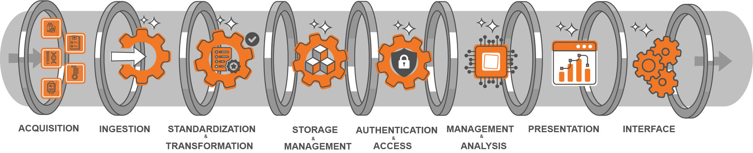
Ecosystem Overview:
Horizontal Foundation and Vertical Solutions
EARLY ADOPTERS
Vertical applications provide targeted solutions for specific use cases…
Cardio-Kidney-
Metabolic
Perioperative Monitoring
Clinical Language Bridge
Hypertension
Diabetes
Climate & Sleep
Patient Engagement
Heart Failure
JupyterHeatlh components provide foundational architecture for
Notes:
Here’s why JupyterHealth will be a gamechanger. JupyterHealth piggybacks on the proven scale and success of Jupyter to seed a new digital health ecosystem. This new ecosystem has JupyterHealth as the horizontal foundation that provides a scalable backbone serving verticals that provide customized, high-impact solutions such as
For Clinicians and researchers: testing at UCSF Health and Weill Cornell. Can be mix and match because of the common foundation
For Patients: Columbia
For Health Systems: Knit.Health company

Slide 22
What Sets JupyterHealth Apart
Interoperability Across the Edge & Health Systems
Open-Source and Customizable
Privacy-Preserving
A Backbone for Composable Vertical Solutions for Precision Bouquets
Reusable Real-Time Analytics for Research and Care
Extends proven success of Project Jupyter to healthcare
EFFICIENCY
SCALABILITY
FLEXIBILITY
IMPACT
Notes:
There are proprietary platforms, maybe even some in the exhibition hall, that do some of what we do. What sets JupyterHealth apart is our open source approach offering efficiency, scalability, flexibility and impact across the whole ecosystem, for academia and industry alike.
We will be launching JupyterHealth officially next week at JupyterCon in San Diego, and again, I could not be more excited.

Slide 23
JupyterHealth
JupyterHealth.org
JupyterHealth@Berkeley.edu
https://github.com/JupyterHealth

