Slide 1
Governing
Agentic AI in
Financial Services
Practical Methods for Navigating Responsible Innovation
Dr. Swapnil Govind Dambe
Trust by design for ethical, agent-led transformation
Notes:
Welcome. Today's story: agentic AI will transform financial services. Whether that transformation is ethical and trusted is something we design, not something we hope for. We will walk in the client's shoes, then build the governance that earns the right to scale.

Slide 2

Points to Know
The storyline, slide by slide
Start with trust (slide 3)
Technology evolves, human needs endure
See the shift (slides 4–5)
From branch to agent, and who must now be governed
Understand the risk (slides 6–7)
Four dimensions of risk; autonomy that is earned
Govern by design (slides 8–9)
Five lifecycle phases, scaled with FINOS AIGF
Lead with ethics (slide 10)
Five principles for better client outcomes
The storyline: build trust, see the shift, understand the risk, govern by design, then lead with ethics.

Slide 3
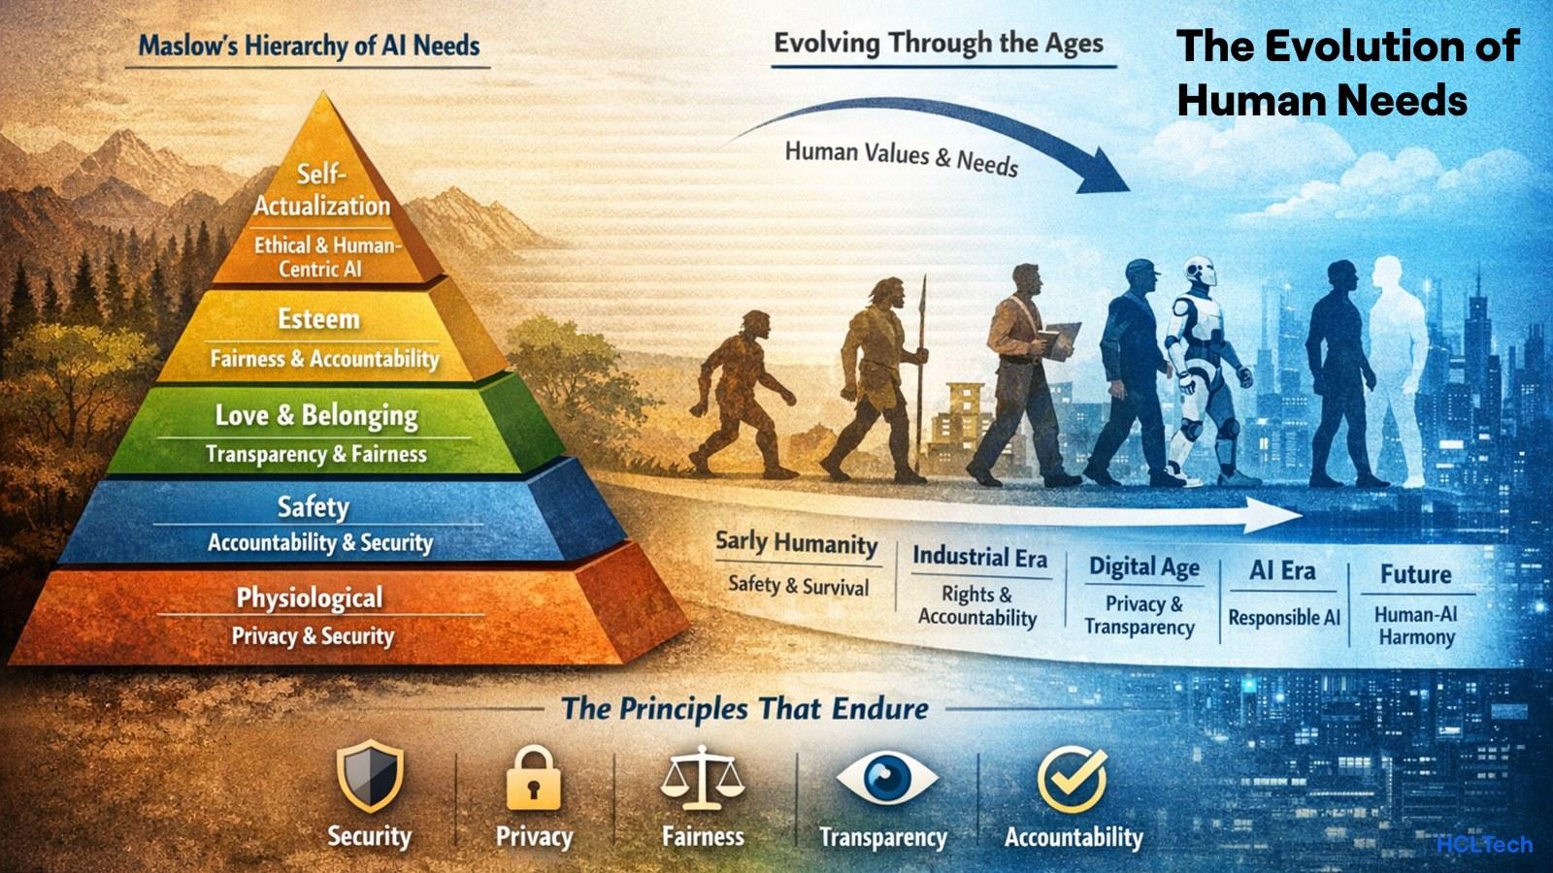
Technology evolves. Human needs endure.
Would you trust an agent with your family’s savings?
From survival to safety, from fairness to trust, people have always asked the same thing of every new era of AI Agents.
Now the answer depends on how we govern agents.
Security. Privacy. Fairness. Transparency. Accountability. The principles that endure.
Kick-start: every era asked one question, can I trust it? In the agentic era, governance is the answer.

Slide 4





From branch to agent: how financial services evolved
Face-to-face relationships
People serve people
Phone-based networks
Staff, aided by machines
Digital transformation
Customers self-serve online
Data-driven and mobile
Analytics guide every choice
Agentic and human-led
Agents act under human authority
1800s–1900s
Mid-20th century
1990s–2000s
2010s–today
Now and next
Each stage added reach and speed. Agentic adds action, so governance must evolve with it.

Slide 5
From branches to apps to agents,
would you let one move a client’s money?
Every era gave customers more reach. Agentic gives them action.
Agentic governance is not about taming technology. It’s about empowering people around agents.
Not governing a model, but governing how people:
01
Build and deploy agents
02
Use and interpret outputs
03
Decide with agents in the loop
04
Stay accountable when outcomes matter

Slide 6




Why agent governance is essential
Dimension | Why it is essential | If left ungoverned
Agent behaviour | Agents act, not just answer. Intent, authority and tool use must stay within set limits. | Unauthorised or harmful actions, unfair outcomes, client harm and no clear accountability.
Orchestration | Many agents hand off work. Roles, permissions and handoffs need one accountable owner. | Access creep, duplicate payments and cascading errors that nobody can trace or stop.
Cost to value | Every step consumes tokens, tool calls and credits, whether or not it helps the client. | Runaway spend, paying for activity instead of outcomes, and a business case that quietly erodes.
Performance KPIs | Trust has to be measured: safety, accuracy, takeover speed and cost per outcome. | Silent drift, false confidence, a board blind to risk, and findings found by regulators first.
Ungoverned agents fail quietly, at machine speed.
Why now: agents now act as digital workers, and the EU AI Act, ISO/IEC 42001 and NIST AI RMF demand demonstrable control.

Slide 7
Earned autonomy: authority grows with trust
Autonomy level | What the agent does | Ethical guardrail
Assist | Drafts or summarises a case | A person reviews every answer. No write access.
Act within limits | Updates an internal ticket | Approved tools only, least privilege, capped retries.
Act on money | Moves funds or affects a client | A person approves the exact action. Banking controls still apply.
Autonomy is earned by outcomes, and re-earned when tools or data change.
Human authority by design: a control spectrum from in-protocol checks to external oversight.

Slide 8
From empathy to execution: ethical by design
1 Assess
2 Design
3 Validate
4 Operate
5 Evolve
The question we ask
Who is affected, and is an agent the right answer?
The question we ask
What may the agent see, say and do? When does a human step in?
The question we ask
Is it fair, safe and resilient to misuse and runaway loops?
The question we ask
Can we trace every action and weigh its cost against value?
The question we ask
Has autonomy grown? Re-earn trust, or retire access.
Key Agent Governance activities
Risk-tier the use case; set autonomy level
Agent metrics: Baseline KPIs and success targets for the agent
Key Agent Governance activities
Define roles, least-privilege access and approval gates
Agent metrics: Thresholds for accuracy, escalation, cost
Key Agent Governance activities
Test fairness, misuse and loop limits before go-live
Agent metrics: Pre-launch task success and error rates vs. targets
Key Agent Governance activities
Log every action; enforce spend, retry and takeover caps
Agent metrics: Live success rate, latency, cost per task
Key Agent Governance activities
Review KPIs; re-earn trust or retire access
Agent metrics: Trend scorecard raises or cuts autonomy
Who answers
Business owner
Who answers
Engineering lead
Who answers
Independent risk
Who answers
Service owner
Who answers
Governance lead
Full lifecycle coverage: strategy to enterprise scale. Governance you can prove, not just promise.
Notes:
Governance is a journey, not a gate at the end. Each stage has one plain question and one accountable owner, so nobody has to guess who decides. Empathy at the start, evidence at every step.

Slide 9
Scaling with confidence: FINOS AIGF in practice
Practice | What it means in action
01 Industrialise | Reuse and operationalize proven FINOS AIGF risk and control patterns instead of starting blank.
02 Verticalise | Turn local policy into runtime controls: permissions, approval gates and action logs.
03 Optimise | Optimise for outcomes, not activity: judge cost per successful outcome, not tokens consumed.
04 Democratise | Democratise with responsibility: share approved tools, usage limits and non-confidential lessons.
AIGF supports governance decisions. It does not certify compliance.
Reference architecture: 5 pillars, 4 enterprise layers, 33 governance categories; industry-ready across BFSI and beyond.
Notes:
Nobody should build this alone. The FINOS AIGF gives the industry a shared starting point. We make it local, make it measurable, and share what we learn so every institution moves faster and safer.

Slide 10
Five principles for better outcomes
Beyond governing agents: using them ethically to improve outcomes and client experiences.
Accountability
Transparency
Fairness
Privacy
Security
Governing agents
A named owner for every agent action and decision.
Better experience
Clients know who stands behind every outcome.
Governing agents
Every action is logged, traceable and explainable.
Better experience
Plain-language reasons build client confidence.
Governing agents
Bias tested before go-live and monitored after.
Better experience
Consistent, equal treatment for every client.
Governing agents
Data used only for its purpose and consent.
Better experience
Clients share more because their data is safe.
Governing agents
Least-privilege access and hard spend limits.
Better experience
Money and data stay protected at machine speed.
Govern with control. Use with ethics. Deliver trusted financial services.
Why it matters: the principles that govern agents also shape how clients experience them.
Notes:
Close on evidence. These measures connect trust, safety and economics, so no single number can be gamed. Looking ahead, agents will help monitor other agents, but humans keep setting the boundaries. Build intelligence with ambition, and sustain it through trust.

Slide 11
Thank you
Questions and conversation welcome
Governing agents so people can trust them
Dr. Swapnil Govind Dambe
Trust by design for ethical, agent-led transformation

