Slide 1
Building Portable, Composable Local Agents with ExecuTorch
Mergen Nachin · Digant Desai
Software Engineers, PyTorch team at Meta

Slide 2
We’re already in the agentic era
e.g., Codex, OpenClaw, Muse

Slide 3

Local AI is also going from chatbots to agents
e.g., LM Studio Bionic, Underdog
DRIVEN BY
USERS ALREADY EXPECT
WHERE AGENTS RUN
Privacy
Large Contexts
Today
Your data stays on your device
Documents, codebases, tool calls
Personal laptops and desktops
Low Latency
Long-horizon Tasks
Soon
No round trip to the cloud
Autoresearch
Phones, wearables and IoT
Cost
Multimodal
Hybrid / Cascade
No per-token bill
Full-duplex voice
Transcribe on device first

Slide 4
Challenges for local agents
1 · HARDWARE
2 · SOFTWARE
Limited compute and memory
Lack of flexibility and programmability
Efficient large-context management
Conforming to existing LLM server APIs
→ smart compaction · subagents for exploration
localhost:8080/v1/chat/completions
Embedding directly into apps
Voice transcription
Decode is memory-bandwidth bound
Better APIs for agents
Jev and Jev-like APIs
→ speculative decoding · batching
Portability
Across platforms and form factors

Slide 5

ExecuTorch

Slide 6
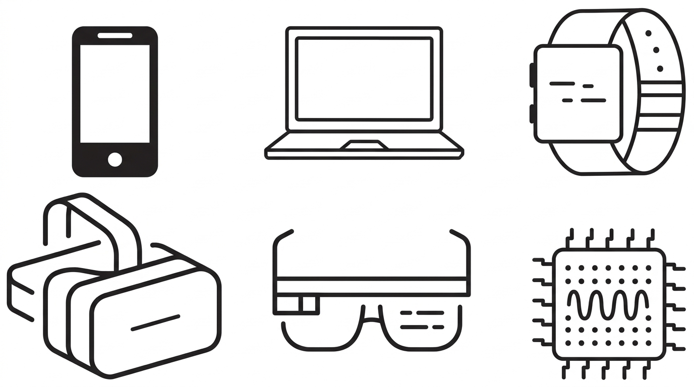
Quick primer on ExecuTorch
Without
ExecuTorch
PyTorch
model
?
With
ExecuTorch
PyTorch
model
Exported
graph
.pte
ExecuTorch
runtime
torch.export()
compile + lower
load
AHEAD OF TIME
ON DEVICE
15+ backends
CPU (x86, Arm), Qualcomm NPU, Arm Ethos-U, Apple Core ML, MLX, Vulkan, Intel OpenVINO, Cadence DSP, NXP Neutron, Samsung Exynos, WebGPU, CUDA, TensorRT
Consistent PyTorch semantics
The same operator semantics for research and deployment
Natively embeddable
In microcontrollers, phones, wearables, and desktop/laptop apps
Export from PyTorch source
Including model definitions in Hugging Face transformers

Slide 7
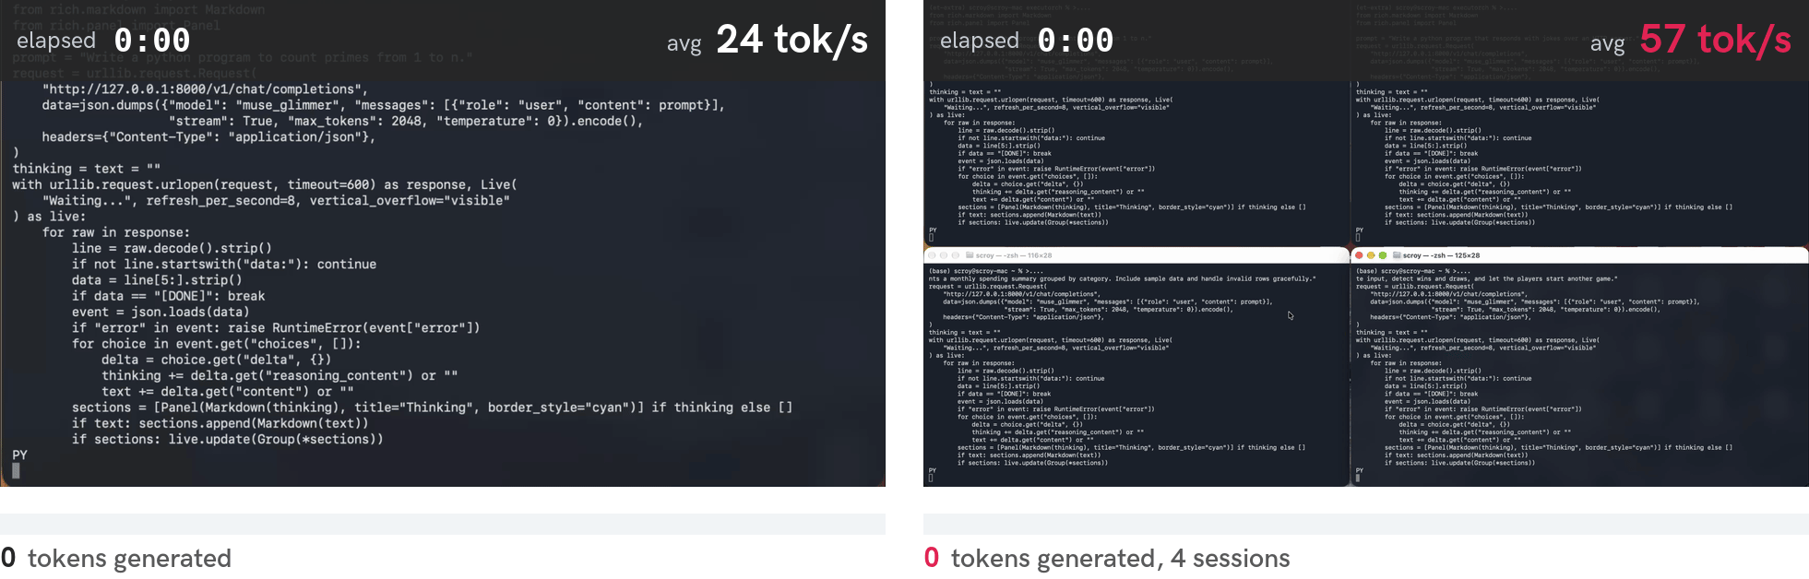
LLM-serving stack for Agents: Muse Glimmer 30B
Shown on Apple M4 Max · On NVIDIA RTX 5090: 83 → 308 tok/s
Baseline
With Continuous Batching + Speculative Decoding
Continuous Batching
Speculative Decoding
Prefix Caching
Dynamic KV Cache Management
DSL support
Just like PyTorch
K-quant for GGUF
Notes:
We have made some improvements to make ExecuTorch agent friendly. Starting with a first class, local LLM serving stack.
We have introduce features like Continuous batching, Speculative decoding, k-quant and other standard features. Being PyTorch native, we also embrace DSLs like Triton, Helion, etc. - allowing us to push performance of model performance for a given device.
Here is an example. Here we have MG running on an M4.It can squeeze more out of the device through Cont Batching and Spec Dec.

Slide 8
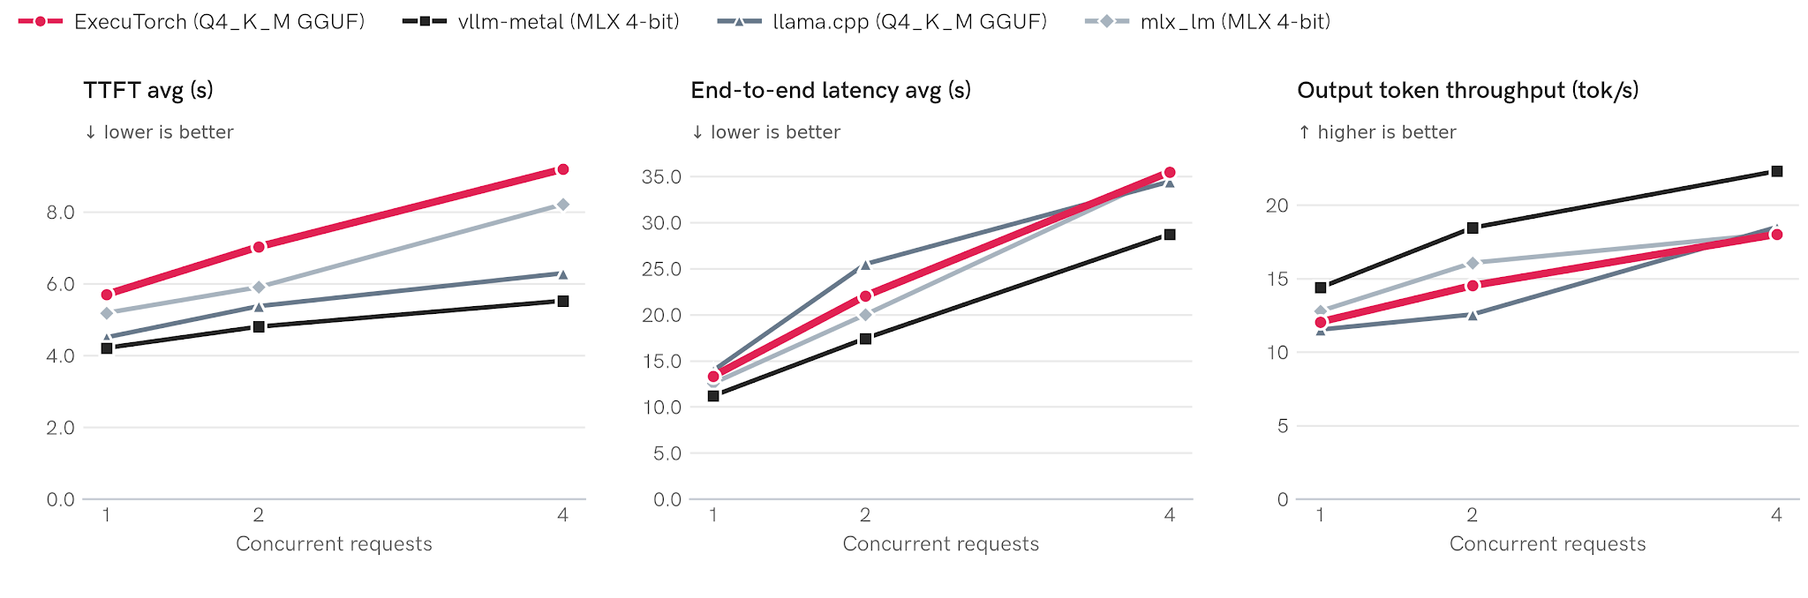
Are we fast yet?
SiliconBench chat split · Muse Glimmer 30B · 100 requests · Apple M4 Max, 64 GB
ExecuTorch and llama.cpp run the same Q4_K_M GGUF weights; vllm-metal and mlx_lm run MLX 4-bit. Each point is the average at that concurrency level.
Output throughput = total output tokens ÷ wall time to complete the 100 requests at that concurrency level.
Notes:
Not yet, but close: with the same GGUF weights, ExecuTorch is on par with llama.cpp on throughput and end-to-end latency; TTFT is the gap.This is using Silicon Bench in XXXX split mode on a mXXXX macbook.

Slide 9
New: ExecuTorch Native
PyTorch model
Hugging Face transformers and more
One portable file: .ptn
Export once and run it on every supported device.
torch.export
to_native
Native runtime
Model-agnostic runtime supported by graph engines.
Configurable features: speculative decoding, batching
AHEAD OF TIME
ON DEVICE
.ptn
Native runtime
Built on ExecuTorch
A new mode in ExecuTorch: same torch.export, quantization and backends.
Vulkan
ggml
XNNPACK
MLX
WebGPU
phones · laptops · browsers
Notes:
What?
PTE allows AoT specialization and prefers perf over portability. Native fills the gap in ET offering, and offers users a choice to trade performance for portability
PTN
Backend agnostic artifact
Native Runtime
Model agnostic runtime with graph manipulation utils, supported by capable Graph engines
ExecuTorch
This is a new mode for ExecuTorch, if you are a user, you should feel right at home
We also leveraged some of the leading on-device AI ecosystem libraries, namely ggml and mlx, and ofc XNNPACK. Thank you to them for pushing the local AI boundaries forward
Status
Standard decode only LLM running with competitive performance on Vulkan, ggml
Next
First class LLM serving stacl
Multimodality

Slide 10
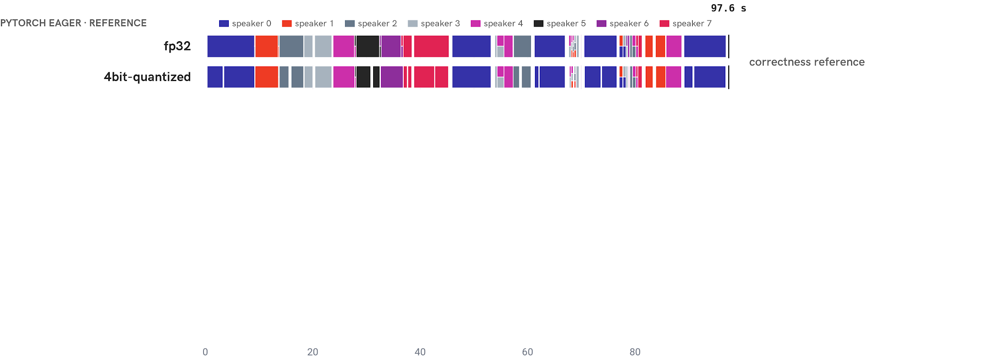
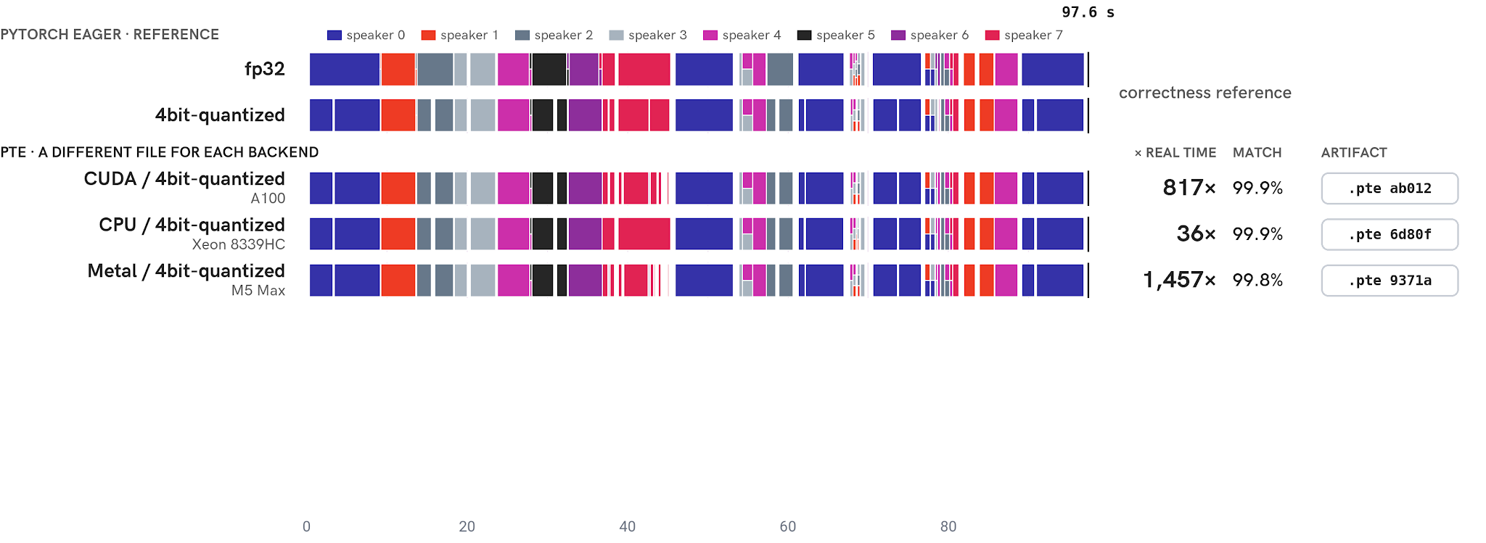
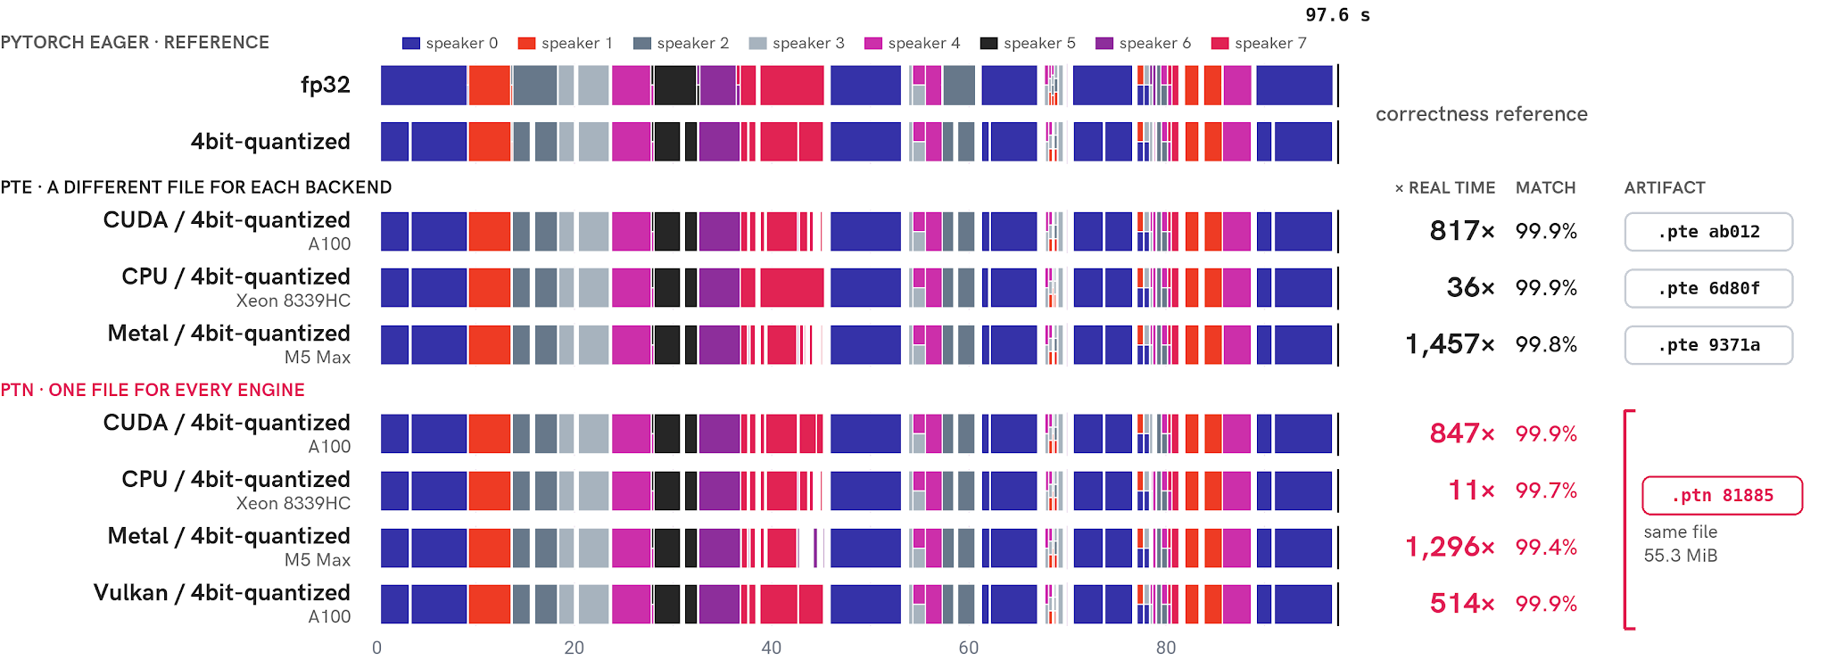
Demo: ExecuTorch Native
Nemotron 3 Diarization: who speaks when · 97.6 s of audio, 8 TTS voices
match = frame-level speaker decisions identical to PyTorch eager at the same quantization (9,761 frames) · × real time = audio length ÷ warm encoder time (pre_encode + encode) · This is a work in progress
Notes:
Nemtron 3 diarization is a new model from Nvidia and it detects who speaks when in an audio.
[1] Here is a pytorch model running for reference with and without 4b quantization - it detects each one of 8 speakers even when they are talking together.
[2] Now ExecuTorch runs it well on multiple platforms. As you can see it can runs many times faster than the real time on CUDA, CPU, and Metal on respective machines. Also notice, how we have a different .PTE artifacts, one per platform since it specializes AoT.
[3] Now here is the same PTN file running on same platform through ExecuTorch Native. As shown, it works correctly and has decent performance. This is a WIP, we hope to get to a decent state by the end of the year.

Slide 11
Co-design for local agents
Future research direction · model, harness and inference engine, designed together
Planning, reasoning, tool calling
Expose parallelism opportunities
Model
Resource-aware scheduling & coordination
Branching
Context management and compaction
Efficient HW utilization
Continuous batching
KV-cache primitives (e.g., prefix caching, cloning)
Expose available compute and memory budget
Harness
Inference engine
Optimize for task success rate and end-to-end latency
subject to available local compute and memory

Slide 12

Thank you!
github.com/pytorch/executorch
examples/models/muse-glimmer
examples/llm_server
backends/native

