Slide 1
Post-Training
is Back!
Ariel Shulman 23.10.2026 AgntCon&McpCon
Notes:
Welcome. For two years, “my agent gets this wrong” has had three answers: a better prompt, a bigger model, or an LLM judge in the loop. Fine-tuning felt like something only labs did. Today I want to argue that’s changing — and the reason is ground truth.

Slide 2
Ariel Shulman
Tech Lead
Public speaker
Academic lecturer
Data nerd
Dog Mom
X @ariel_shulman_
in linkedin.com/in/ariel-shulman
The views represented are my own and do not represent those of my current or former employers.
Notes:
Quick intro. I build, I speak, I teach. Everything today is from public material and my own perspective — not my employer’s.

Slide 3
How do you get an agent to answer reliably on enterprise data?
Notes:
That’s the challenge this whole talk is about: getting agents to answer reliably on enterprise data. Enterprise data isn’t in one place. It’s in the CRM, the support desk, call recordings, Jira, Slack, a bucket of PDFs. An agent has to find it, page through it, join it, do the math — and sometimes realize the fact simply isn’t there. That last part is where things break.

Slide 4
What is a reliable answer?
It’s in the company’s records
The system is reachable for an agent
The field has a value
Q: Why did Northwind churn?
Q: Who got paged last night?
Q: Northwind’s credit rating?
→ search("Northwind churn")
→ list_systems()
→ hubspot.company("Northwind")
← 0 results in 7 systems
← salesforce, zendesk, slack
← { credit_rating: null }
A: “Pricing. Too expensive.”
A: “No one. Quiet night.”
A: “Unrated. Low risk.”
// guessed the usual reason
// pager system not available
// read null as an answer
Fail any of these, and the only reliable answer is “I don’t know.”
Notes:
Flip the question: what makes an answer reliable? You can point to the record it came from. That takes three things, and an agent can break each one. [click] One: the company recorded it at all. Ask why Northwind churned. Nobody ever wrote the reason down; it searches seven systems, finds nothing, and still answers “pricing, too expensive.” That’s the most common churn reason in its training data, not in our records. [click] Two: the agent can reach the system. Ask who got paged last night: the paging tool isn’t connected, so it never sees a single page, and it says “no one, quiet night.” [click] Three: the field actually has a value. Northwind’s credit rating is null, and the agent reads that as “unrated, low risk.” Our agent on the previous slide failed exactly this one: the MRR field was null, and it answered “0” anyway. [click] Fail any of these, and the only reliable answer is “I don’t know.” Keep the third one in mind. An empty field looks exactly like a real answer, and it comes back at the end.

Slide 5
How do we make agents reliable today?
Notes:
So how do teams deal with this today? There are three common moves. Pay for a smarter model, write a better prompt, or package that prompt as a skill. Let’s look at each one.

Slide 6
Paying for a smarter model
“What’s Northwind’s current monthly recurring revenue?”
8B parameters
70B parameters
→ hubspot.get_company("Northwind")
→ hubspot.get_company("Northwind")
← mrr: null
← mrr: null
A: “0”
→ s3.search("Northwind invoice")
← invoice_2025-11.pdf
A: “About $11,500, per last invoice.”
$0.20 per 1M tokens
$0.90 per 1M tokens · 4.5× the price
Notes:
The first instinct: pay for a smarter model. Same question. An 8-billion-parameter model gets a null and answers “0”. [click] Move up to a 70-billion-parameter model and it does better work: it notices the null, goes looking, finds last November’s invoice, and answers “about eleven and a half thousand, per the last invoice.” Sounds great. But an old invoice isn’t current MRR. It’s still guessing, just more convincingly. And on a public serverless price list, that upgrade costs 4.5 times as much per token: twenty cents versus ninety cents per million. It also made twice as many calls, so the bill per answer grows even faster. [click] A smarter model makes a more convincing guess. That’s arguably worse, because now nobody questions it.

Slide 7

Improving the Prompt
<system>
<system>
You are a data analyst agent.
You are a data analyst agent.
Answer the user’s question using the connected tools.
Answer the user’s question using the connected tools.
If the data is missing or incomplete, don’t guess.
If the data is missing or incomplete, don’t guess.
</system>
An answer built on missing data costs more than saying the data isn’t there.
</system>
Notes:
This is the honest fix most of us ship first. It helps. But it lives in one prompt, it drifts as teams fork it, and nobody can tell you which version is the good one. Skills are the answer to that scaling problem. Which brings me to the word itself.

Slide 8
Pack it as a Skill
system prompt
research/SKILL.md
<system>
---
You are a data analyst agent.
name: research
Answer the user’s question using the connected tools.
description: answering from company data
Available skills:
---
- research: answering from company data
1. Search every connected system.
2. Read every page of results.
</system>
3. Null is not zero.
4. Not found? Abstain and say where you looked.
Notes:
Same rule, now packaged. The system prompt stays short and just advertises the skill; the agent loads the SKILL.md file when a company-data question comes in. It’s versioned, reusable, shareable and testable across teams. But look at what it is: instructions the agent reads at runtime. A note. Which brings me to the word itself.

Slide 9
skill
noun
The ability to do something well, acquired through training and practice.
Notes:
Let’s check the dictionary. A skill is something you do well because you trained and practiced. Nothing in that definition is about reading instructions first. So when we call a file of instructions a “skill”… hold that thought.

Slide 10
note
noun
A brief record of something written down to assist the memory or for future reference.
Dictionary.com
Notes:
Now the other word. A note: a brief record of something written down to assist the memory, or for future reference. That’s exactly what a SKILL.md file is. The agent doesn’t know how to do this any better; it reads a reminder at the moment it needs one. With today’s implementation, a better name for a “skill” would have been a “note.” A skill is what you get from training. A note is what you read because you didn’t.

Slide 11
Notes:
Pause here. Would you call that surgeon skilled? Expect someone to bring up surgical checklists — the WHO checklist genuinely saves lives. That’s actually my point: a checklist helps a surgeon who already has the skill. It doesn’t turn a non-surgeon into one. Skill comes from training.

Slide 12
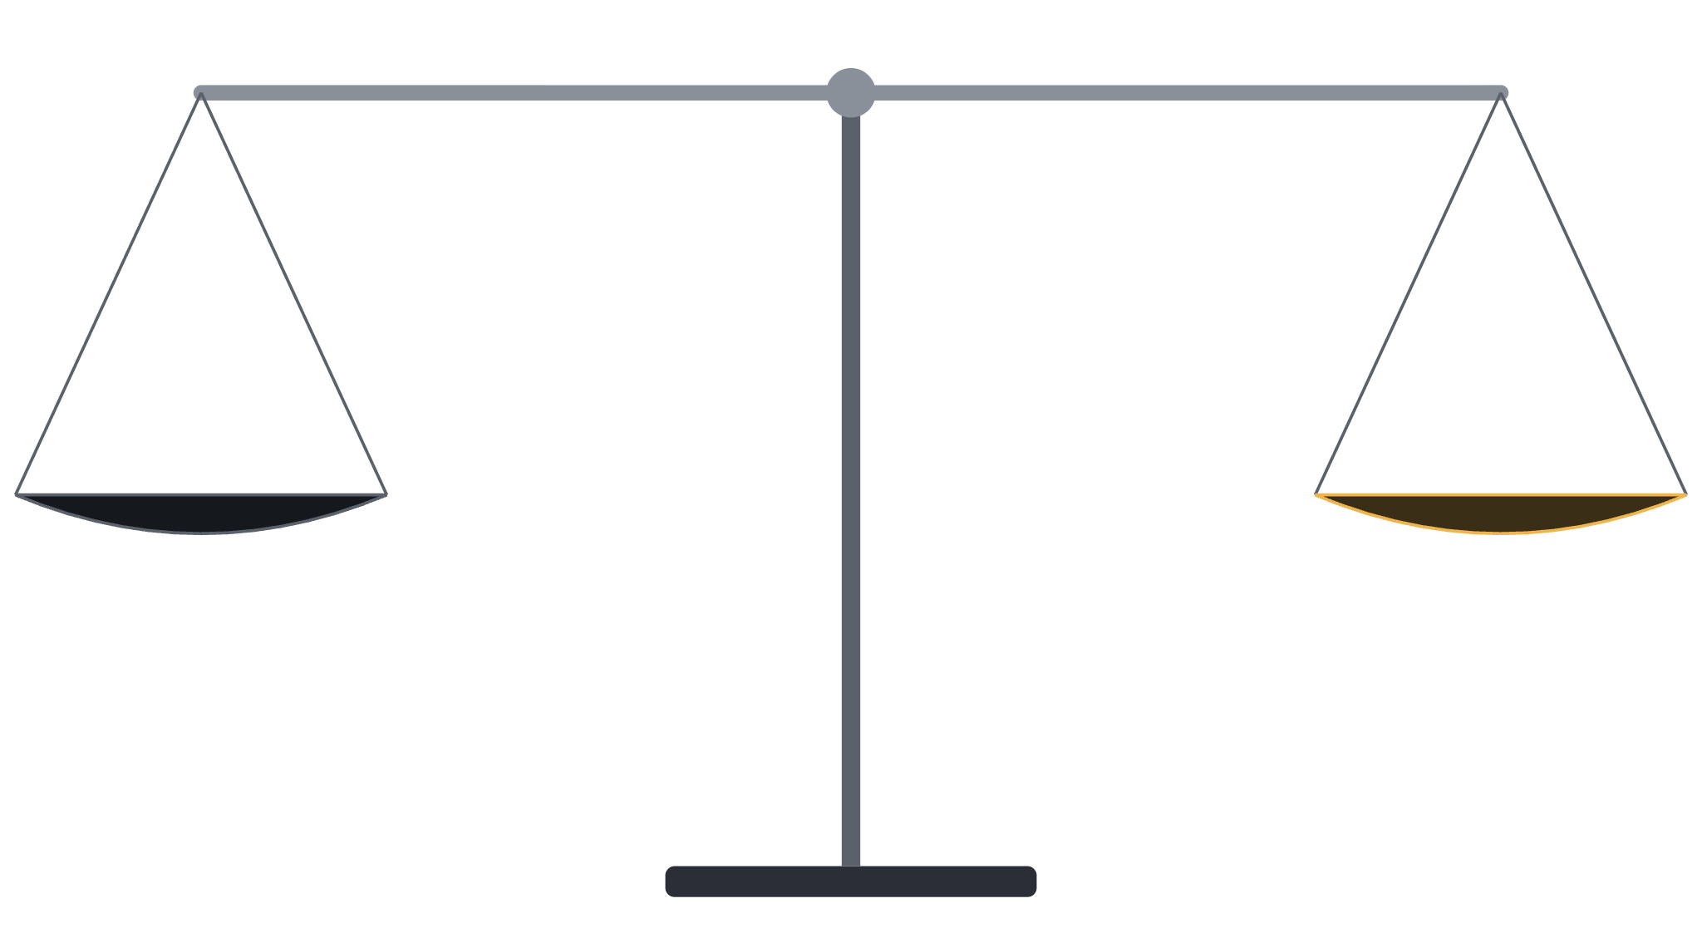
RL
skills
preference tuning
longer prompts
fine-tuning (SFT)
model selection
Training
Inference
Notes:
Every agent’s quality comes from two places: what the model learned in training, and what we hand it at inference time. On one side: fine-tuning, preference tuning, RL. On the other: skills, longer prompts, model selection. A good agent needs both sides pulling their weight. [click to next slide]

Slide 13

RL
preference tuning
skills
fine-tuning (SFT)
longer prompts
model selection
Training
Inference
Notes:
But that’s not what we’ve been doing. For the last two years we’ve treated training as fixed — something only labs do — and piled every fix onto the inference side: skills, longer prompts, model selection — paying for a bigger, pricier model on every call. Notice the model’s own pre-training sits here too: you don’t pay for it once, you rent it per token. The scale keeps tipping one way. And everything on that side has something in common…

Slide 14
Inference is paid on every request.
Training is paid once.
Notes:
Here’s the thing all three have in common: we pay for them all the time. A stronger model costs more on every call. A longer prompt is extra tokens on every call. A skill gets loaded and read again on every call that needs it. The fix never becomes part of the model — so the bill never stops. Training is the one fix you pay for once.

Slide 15
So why aren’t we training agents with enterprise data?
Notes:
So if training is the fix you pay for once, why aren’t we doing it? Train the agent on enterprise data until it answers reliably, including knowing when not to answer. That would be amazing. So why isn’t everyone doing it? Two reasons: the data, and the grading.

Slide 16
Enterprise data is off limits
and very hard to fake.
Notes:
First challenge: the data. Real customer data is off-limits for training — and it should be. Contracts, privacy rules and plain trust all say no. So you need data that behaves like the real thing. And that’s hard, because enterprise data has four properties that synthetic data almost always loses.

Slide 17
High-volume
2.4M
4.2M
210K
Slack messages
objects in cloud storage
Salesforce opportunities
120K
65K
18K
Zendesk tickets
Jira issues
recorded Gong calls
Illustrative figures for a ~1,000-person company over one year .
Notes:
Real companies are big. A mid-size company produces millions of Slack messages, millions of objects in storage, hundreds of thousands of deals and tickets — every year. Any question an agent answers sits on top of that volume.

Slide 18
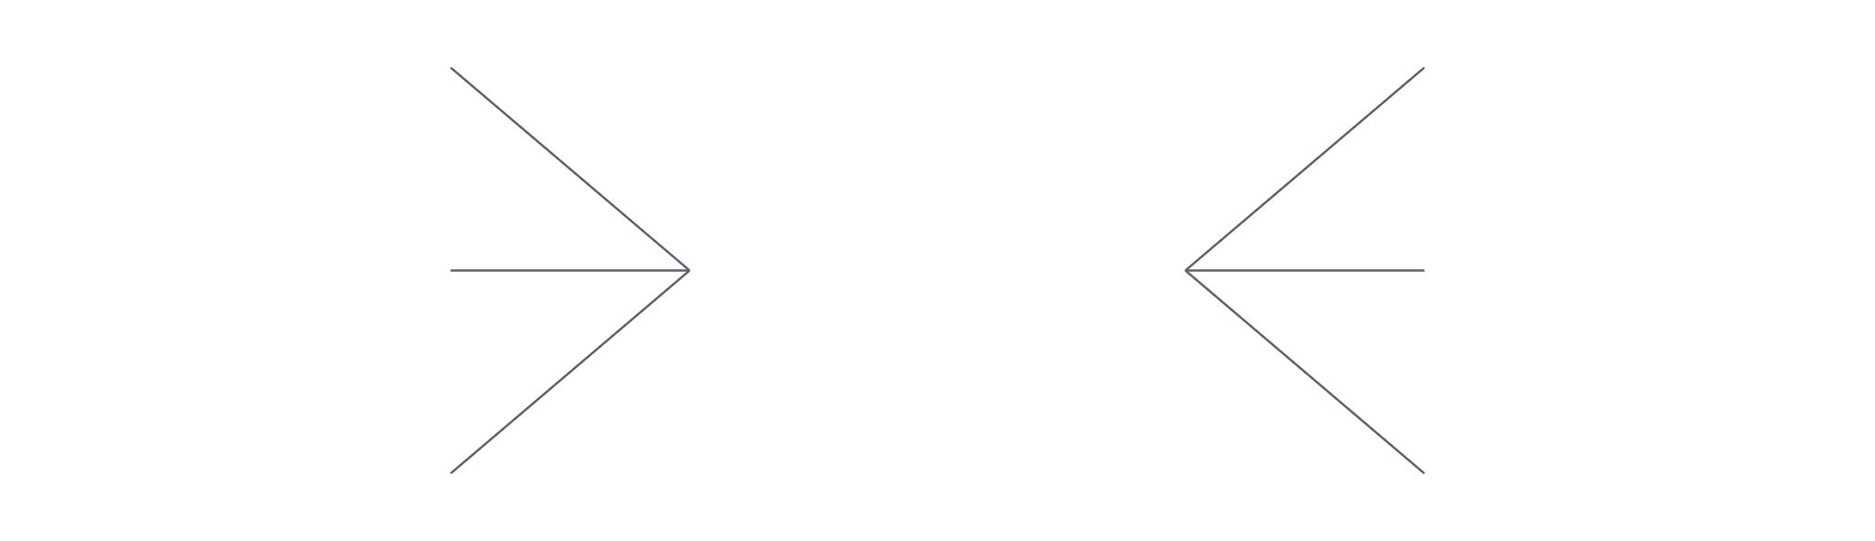
Siloed, yet connected
Salesforce
HR system
owner of 9 deals
Account Exec, EMEA
Gong
dana.k@northwind.io
Zendesk
14 recorded calls
CC’d on 31 tickets
Slack
Jira
#deal-northwind
reported 4 bugs
Notes:
Every system is its own silo — but they all describe the same people and events. Dana is an Account Exec in the HR system, owns nine deals in Salesforce, is on fourteen Gong calls, CC’d on Zendesk tickets, filed Jira bugs and lives in a Slack channel. To answer “how is Dana’s pipeline doing?”, an agent has to join across all of them. LLM-written data invents each system separately, so the joins don’t hold.

Slide 19
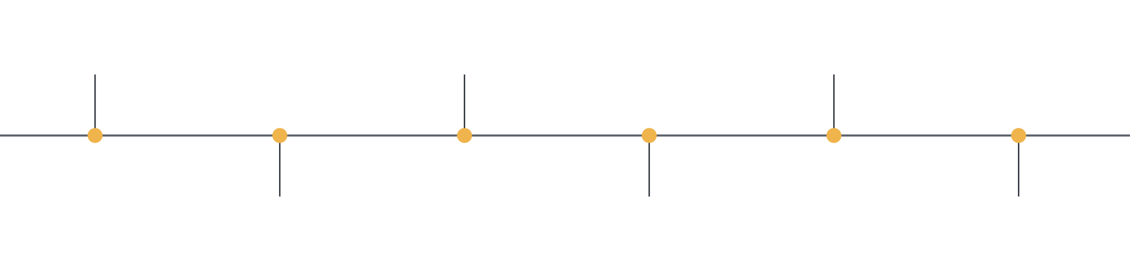
Time-based
Mar 1 · Gong
Mar 9 · Zendesk
Mar 18 · Jira
Intro call
SSO ticket
Bug from ticket
Mar 3 · Salesforce
Mar 12 · Slack
Mar 24 · Salesforce
Deal opened
Deal thread
Closed Won
Notes:
One deal, six systems, one timeline. The intro call in Gong, the opportunity in Salesforce, the support ticket, the Slack thread, the Jira bug, the close. Real questions are about order and change over time. LLM-generated records rarely line up in time across systems — so “before” and “after” questions have no true answer.

Slide 20
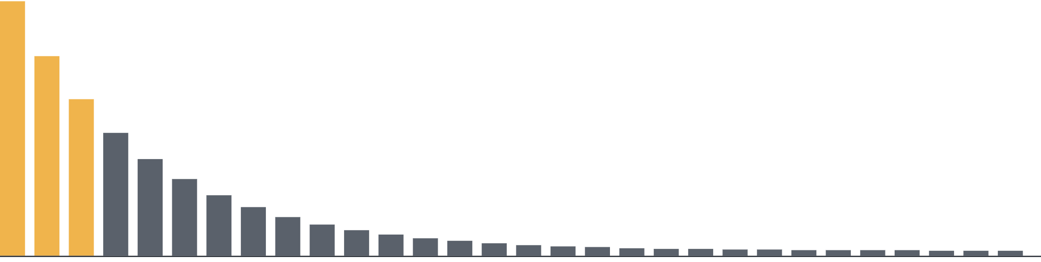
Skewed
Deals, tickets and calls per customer — a few dominate, most barely register.
← a few big customers dominate
…and a long tail of everyone else
Notes:
Real companies are lopsided. A handful of big customers generate most of the deals, tickets and calls; everyone else is a long tail — and the tail is where fields go empty. Averages lie, “which customer had the most?” turns into a pagination problem, and nulls hide in the small customers. Generated data spreads everything evenly.

Slide 21
What usually happens when a LLM fakes enterprise data
Notes:
So the obvious shortcut: just ask an LLM to generate a company for you. Here’s what goes wrong when you do — four pitfalls, side by side with what real data looks like.

Slide 22
Too clean and tidy- no nulls or dups
written by an LLM
a real CRM
{
{
"name": "Northwind",
"Name": "Northwind Inc.",
"industry": "Fintech",
"Industry__c": "",
"mrr": 12000,
"MRR__c": null,
"owner": "dana@northwind.io"
vs
"MRR_Legacy__c": "12k",
}
"Owner": "dana.k@northwind.io"
}
Notes:
Ask an LLM for a CRM record and you get the brochure version: every field filled, one clean schema. A real CRM has an empty industry, a null MRR next to a legacy text field someone migrated from, and a second “Northwind, Inc” record nobody merged. That null is exactly where our agent answered “0”.

Slide 23
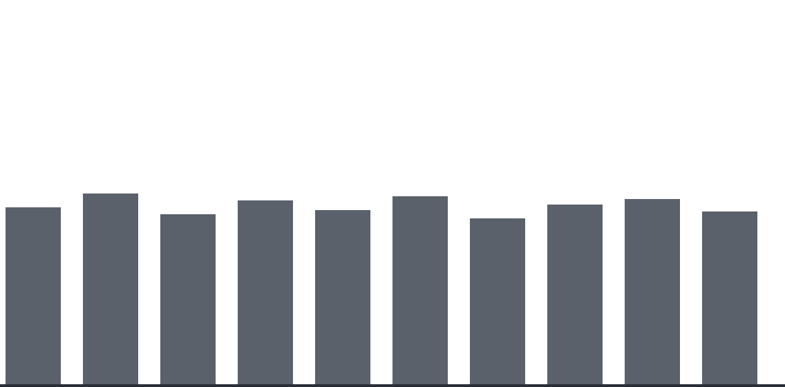
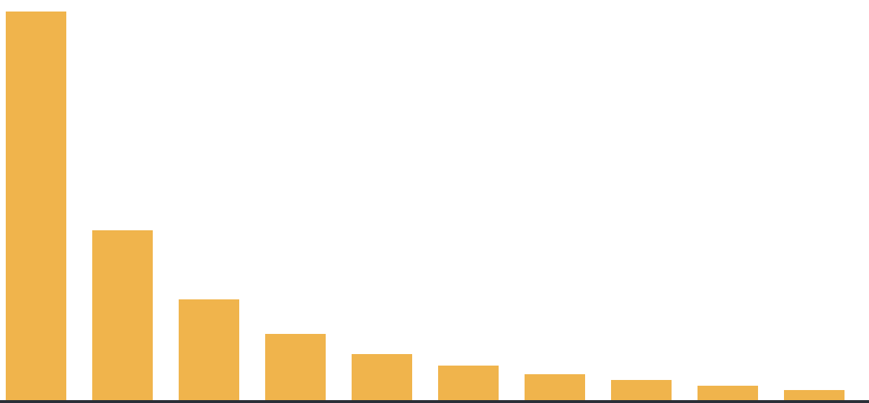
Too even
written by an LLM
a real support desk
vs
tickets per account — one giant, a long tail
tickets per account
Notes:
LLM-generated data spreads things out evenly. Real companies don’t: one enterprise customer files most of the tickets and the rest is a long tail. “Which account had the most?” is trivial on the left and a pagination problem on the right — and medians and averages behave completely differently.

Slide 24
Too consistent- no conflicts between systems
written by an LLM
a real company
salesforce
salesforce
$120,000 · Closed Won · Mar 3
$120,000 · Closed Won · Mar 3
hubspot
hubspot
$120,000 · Closed Won · Mar 3
$118,500 · Contract sent · Mar 5
gong
vs
gong
“great, we’re signed!” · Mar 3
“still negotiating price” · Mar 4
Every system agrees.
Which one is true?
Notes:
Ask an LLM to invent a deal and every system tells the same story. In a real company the same deal is Closed Won in Salesforce, still at contract stage with a different amount in HubSpot, and a Gong call the day after says they’re still negotiating. The agent has to work out which record is current — LLM-written data never makes it try.

Slide 25
Doesn't represent real scale
written by an LLM
a real API
→ list_tickets("Northwind")
→ zendesk.list_tickets("Northwind")
←
←
"tickets": [ … 12 items ],
"count": 100,
"total": 12
"total": 3412,
vs
"next_cursor": "eyJwIjoyfQ",
"truncated": true
Answer from page 1 → wrong count.
Notes:
An LLM won’t generate representative volumes — you get a dozen tickets, not thousands. So everything comes back in one response, and the agent never learns to page through results and aggregate across them, which is exactly what real enterprise questions require. A real API hands you 100 of 3,412 tickets and a cursor. An agent that answers from page one is confidently wrong — and in the benchmark, re-reading truncated results was a big chunk of what we trained on.

Slide 26
Even if you have the data-
how do you know it’s right?
Notes:
Second challenge. Say you solved the data problem. You still need to know whether the agent’s answers are right — to grade them, to pick training examples, and to prove the model actually improved. Three ways that goes wrong.

Slide 27

A typical SFT post-training cycle
Build cases
Train
Evaluate
Find failures
add cases for what failed · repeat
Notes:
Here’s a typical supervised fine-tuning cycle, the training loop in its simplest form. You build cases, you train, you evaluate, you find where the model still fails — and you go around again, adding cases that target those failures. The benchmark stays fixed; the training cases grow with every lap. The run in this talk went around four times. Two of those steps depend on knowing the right answer: building the cases, and evaluating the result. If your ground truth is wrong in either place, the loop doesn’t fix the model — it trains the mistake in, lap after lap. So let’s look at both.

Slide 28
A typical SFT post-training cycle
needs ground truth
needs ground truth
Build cases
Train
Evaluate
Find failures
add cases for what failed · repeat
Notes:
Here’s a typical supervised fine-tuning cycle, the training loop in its simplest form. You build cases, you train, you evaluate, you find where the model still fails — and you go around again, adding cases that target those failures. The benchmark stays fixed; the training cases grow with every lap. The run in this talk went around four times. Two of those steps depend on knowing the right answer: building the cases, and evaluating the result. If your ground truth is wrong in either place, the loop doesn’t fix the model — it trains the mistake in, lap after lap. So let’s look at both.

Slide 29
Looking for cases doesn’t scale.
Creating them does.
Notes:
To train for a behavior — like abstaining when the data isn’t there — you need examples of exactly that case. And searching for them in real data isn’t practical, for two reasons: you need a lot of them, and every one has to be right. So you have to be able to create them.

Slide 30
Missing a point in time can change the whole story:
Jan 10 · Zendesk
Jan 24 · Gong
Feb 15 · Salesforce
Mar 9 · Salesforce
Mar 9 · Salesforce
SSO outage — ticket escalated
“We’re evaluating other vendors.”
Renewal → Closed Lost
Renewal reopened → Closed Won
Renewal reopened → Closed Won
“Did Northwind renew?”
Yes, renewed.
Yes, renewed.
No, churned.
Notes:
Here’s the whole story for Northwind. January: an SSO outage, ticket escalated. A Gong call — “we’re evaluating other vendors.” February: the renewal is marked Closed Lost. And on March 9th, the renewal is reopened and Closed Won. Did they renew? Yes. [click] Now imagine you miss that last event — it’s on page four of the opportunity history, or in an object you didn’t query. [click] Suddenly the answer is “no, churned.” Same company, same question — opposite label. Train on that, and the model learns the wrong story.

Slide 31
Misplacing a point in time can change the whole story:
sorted by created_at
Jan 10 · Zendesk
created Jan 15
Feb 20 · Gong
Feb 22 · Slack
SSO outage — ticket escalated
Salesforce: renewal → Closed Lost
“Verbal yes — sending the contract.”
“Northwind is signing!”
“Did Northwind renew?”
Yes, renewed.
Notes:
Second problem: order. You pull Northwind’s records and sort them by created_at. The renewal opportunity was created back in January, so it lands early. After it: a Gong call — “verbal yes, sending the contract” — and a Slack message, “Northwind is signing!” Last word wins: yes, they renewed. [next slide] But the opportunity wasn’t closed in January — it was last updated on March 9th, when the deal fell through. Sort by updated_at…

Slide 32
Misplacing a point in time can change the whole story:
sorted by updated_at
Jan 10 · Zendesk
Feb 20 · Gong
Feb 22 · Slack
updated Mar 9
SSO outage — ticket escalated
“Verbal yes — sending the contract.”
“Northwind is signing!”
Salesforce: renewal → Closed Lost
“Did Northwind renew?”
Yes, renewed.
Yes, renewed.
No, churned.
Notes:
Sorted by updated_at, the opportunity moves to where it really belongs: March 9th, after the verbal yes and the Slack celebration — the contract never got signed, and the renewal closed lost. [click] “Yes, renewed” becomes “no, churned.” Every record is real; we just placed one of them at the wrong point in time. When you build cases by hand, every timestamp you pick is a chance to get the story wrong.

Slide 33

You have to be sure that you are right
“What’s Northwind’s current MRR?” You search, find nothing, and label the case.
your search
Salesforce · MRR__c → null
what you missed
HubSpot · mrr → null
Slack · #finance · result 47 of 312
“Northwind renewed at $12k/mo, starting March.”
S3 · billing docs → 0 results
Gong · last 10 calls → no mention
right answer → $12,000/mo
your label → abstain
Label it wrong, and you train the model on your mistake.
Notes:
Same question as the start of the talk: what’s Northwind’s MRR? You do the work. Salesforce — null. HubSpot — null. No billing docs. Nothing on the calls. Confident, you label it: the right behavior is to abstain. [click] But the answer was sitting in a Slack thread in #finance — result 47 of 312. You missed it. [click] Now you’ve trained the model to say “I don’t know” when the answer exists. When you search for cases yourself, you can never be fully sure you didn’t miss something — and the model learns your mistakes.

Slide 34
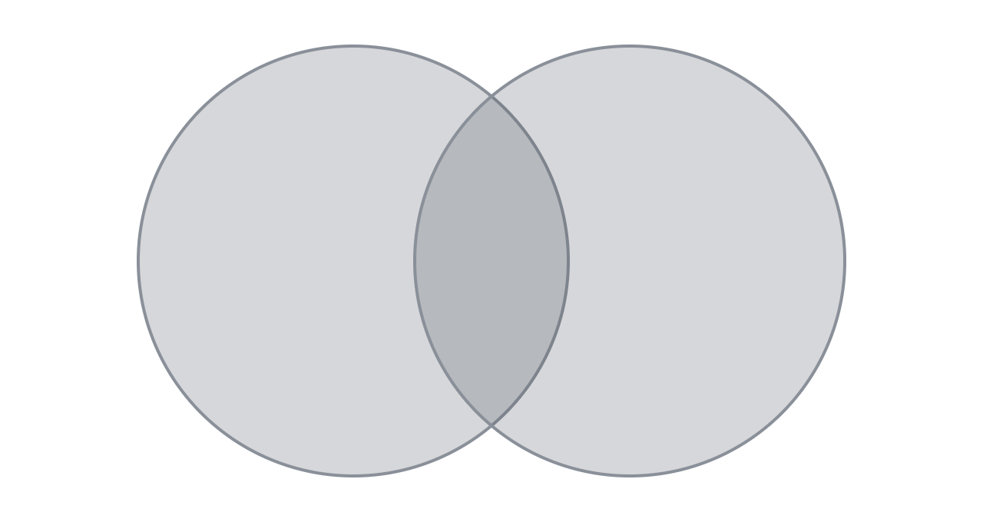
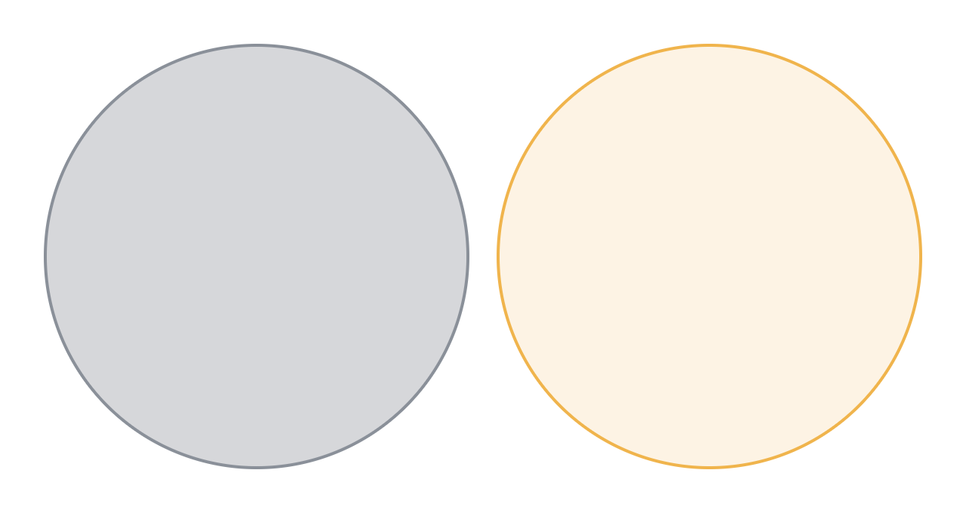
Avoiding overfitting
train
test
vs
train
test
If you test on what you trained on- you’re measuring memory, not skill.
Notes:
If your benchmark overlaps your training data, a good score proves nothing — the model may have just memorized the records. So the test set has to be disjoint: different customers, different deals, different numbers. With real enterprise data that’s hard; you rarely have a second company lying around. You need to be able to make a fresh one.

Slide 35
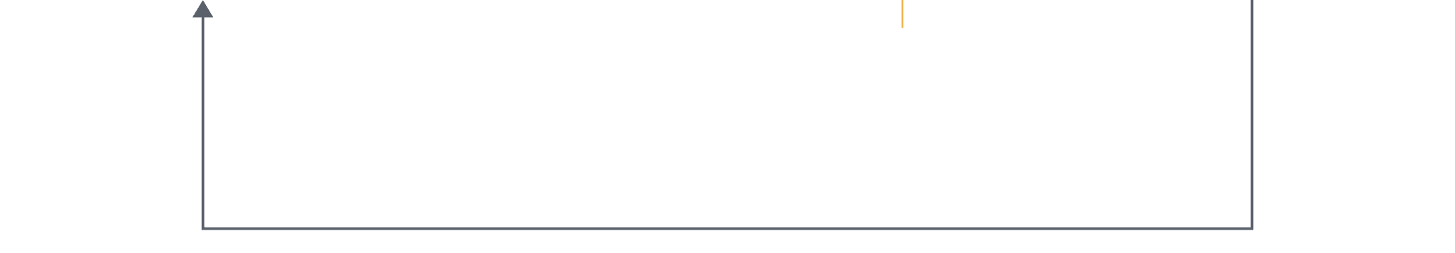
Avoiding overfitting
Northwind
Northwind
Northwind again
none found
Build cases
Train
Evaluate
Find failures
Q: What’s Northwind’s MRR?
A: $12,000 · correct
tool calls: 0
nothing to fix · ship it
Correct — for the wrong reason
Notes:
Here’s what that looks like on our loop. We build cases on Northwind and train on Northwind. Then we evaluate on Northwind again. “What’s Northwind’s MRR?” Twelve thousand. Correct! But look: zero tool calls. It didn’t look anything up; it remembered the number. So the loop finds no failures, there’s nothing to fix, and we ship a model that can only answer for a company it has already memorized. [click] That’s why the benchmark has to be a company the model has never seen.

Slide 36
Two obstacles stand between us and post-training on enterprise data
Real enterprise data is off limits and faking it is really hard
Even if we do have the data how do we create reliable cases?
Notes:
Let’s take stock. We want to post-train agents on enterprise data, and two things stand in the way. The data: real customer data is off limits, and data an LLM makes up is too clean, too small and too disconnected to teach anything. And the grading: finding cases doesn’t scale, our own labels can be wrong, and testing on what we trained on just measures memory. [click] So what if one tool removed both obstacles? [click] Something that generates a realistic company, with all its mess, and knows every right answer in it, because it wrote them. That’s exactly what Era is.

Slide 37
Meet Era
Simulated companies to benchmark models and train agents.
Free for builders
by Eon
Notes:
Meet Era, from Eon. It’s free for builders, and the examples are on GitHub. Era doesn’t generate tables; it generates companies, as many as you need. Realistic, high-volume data across cloud and SaaS systems, served the way production is, so you can benchmark models and train agents on it.

Slide 38
Realistic enterprise data, entirely synthetic
// download
$ curl -fsSL https://console.era.eon.io/install.sh | sh
// generate a company
$ era init
$ era new --industry fintech --size mid --systems salesforce,zendesk,slack
A whole business
Consistent across systens
Years of history
Synthetic
Answers built in
what it sells, to whom and how, set by industry, size and business model
move the company forward, quarter by quarter
never scraped, sampled or derived from any real company’s data
planted benchmark records with precomputed correct answers
the same customers, deals and employees in every system
CONNECTORS · VENDOR-COMPATIBLE APIS AND MCP SERVERS
Salesforce
HubSpot
Zendesk
Gong
Jira
Slack
SharePoint
Drive
Deel
Eon
AWS RDS
S3
EC2
and more
Notes:
Before we go system by system, what does Era actually simulate, and how do you get one? Creating a company is this small. Download the CLI, add the plugin to your coding agent (I’m showing Claude Code, but there are plugins for Cursor, Codex and Devin too), sign in with era init, and one era new: a mid-size fintech company on Salesforce, Zendesk and Slack. What you get: [click] a whole business: what it sells, to whom and how, driven by its industry, size and business model. [click] One timeline across every system: the same customers, deals and employees everywhere, so a Slack thread talks about the same deal that’s in the CRM and the same call that’s in Gong. [click] Years of history, and you can move the company forward a quarter at a time. [click] All of it synthetic: nothing scraped, sampled or derived from a real company. [click] And because Era built it, it plants benchmark records with the correct answers precomputed. [click] And it plugs in the way production does: Salesforce, HubSpot, Zendesk, Gong, Jira, Slack, SharePoint, Drive, Deel and Eon itself, plus the AWS cloud underneath, all through vendor-compatible APIs and MCP servers.

Slide 39
How is Era different from
simulating a company with an LLM?
Notes:
So why not just prompt an LLM to make up a company? Let’s go back through every problem we listed and see how Era handles each one, starting with volume.

Slide 40
High volume, behind real APIs
→ zendesk.list_tickets("Northwind")
←
"count": 100,
"total": 3412,
"next_cursor": "eyJwIjoyfQ"
Agents query Era the way they query production.
Real requests, quantities, pagination and errors — so the agent learns to page and aggregate.
Notes:
Remember the toy data that fits in one response? Era serves its companies through vendor-compatible APIs and MCP servers — familiar requests, responses, pagination and errors. Ask for a customer’s tickets and you get a page of them and a cursor, just like production. The agent has to page, and then aggregate — the exact skills the benchmark tests and the training reinforces.

Slide 41
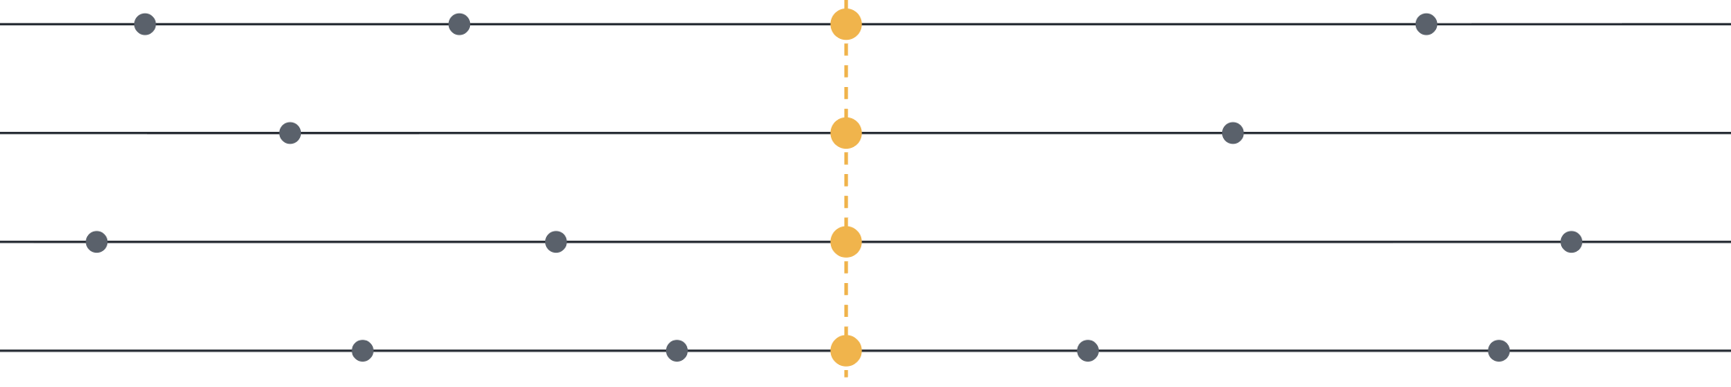
One company, one clock
Salesforce
Gong
Zendesk
Slack
Feb 20 · one moment, every system
Every system is generated on the same timeline.
So all the systems tell one consistent story.
Notes:
Remember the created_at versus updated_at story? In Era, every system is generated from one company on one timeline. When the deal moves in Salesforce, the Gong call, the Zendesk ticket and the Slack thread line up with it in time. So “what happened after the call?” has one true answer — and Era knows it.

Slide 42

Siloed, yet connected
Salesforce
HubSpot
opportunity.owner
9 deals
contact.owner
22 contacts
Gong
dana.k@northwind.io
Zendesk
call.participants
14 calls
ticket.cc
31 tickets
Slack
Jira
@dana.k
#deal-northwind
issue.reporter
4 bugs
One employee, generated once — the same person in every system.
Notes:
Remember Dana? With LLM-written data, each system invents its own Dana, so the joins don’t hold. Era generates one business and projects it into every system. Dana is generated once, and then she shows up everywhere she should: she owns nine opportunities in Salesforce, owns contacts in HubSpot, joins fourteen Gong calls, is in the deal channel on Slack, is CC’d on Zendesk tickets and reported four Jira bugs. Same person, same identity, every connector. So when the agent asks “how is Dana’s pipeline doing?”, the joins hold, and there’s a right answer to join towards.

Slide 43
A Simulated Mess
Missing fields
Duplicate records
Systems that disagree
"MRR__c": null
Northwind Inc.
Northwind, Inc
$120,000 vs $118,500
Era generates the mess a real business has - on purpose.
Because your agent will meet all of it in production.
Notes:
The brochure-clean records an LLM writes? Era does the opposite on purpose. It generates missing fields, duplicate records and systems that disagree with each other — the cross-system inconsistency of a real estate. That’s where agents fail in production, so that’s where you want to test and train them.

Slide 44

Skewed like a real company
Distributions come from real aggregated enterprise metadata.
Notes:
LLM data spreads everything evenly. Era’s distributions are drawn from aggregated metadata sketches of the enterprise data Eon backs up — across cloud databases, object storage and SaaS apps — never from customer records. So a generated company carries the skew of a real one: a few giant customers, a long tail, and empty fields hiding in the tail. [click] In this example, the top three of thirty customers drive almost half of all activity. Spread it evenly, the way LLM-written data does, and they’d get ten percent. [click] And the biggest customer has fifty times the activity of the smallest. That’s the gap that breaks averages and makes “who had the most?” a pagination problem. And it solves the first problem we had: you get data that behaves like real enterprise data without touching anyone’s real data.

Slide 45
Designed for Post training
Notes:
And here’s the shift. With real data, you have to infer what the right answer is, and as we saw, that’s where the mistakes creep in. With Era you don’t infer the truth. You create it, and then you build the data around it. Let’s go back through every problem we just listed and see how Era handles each one.

Slide 46
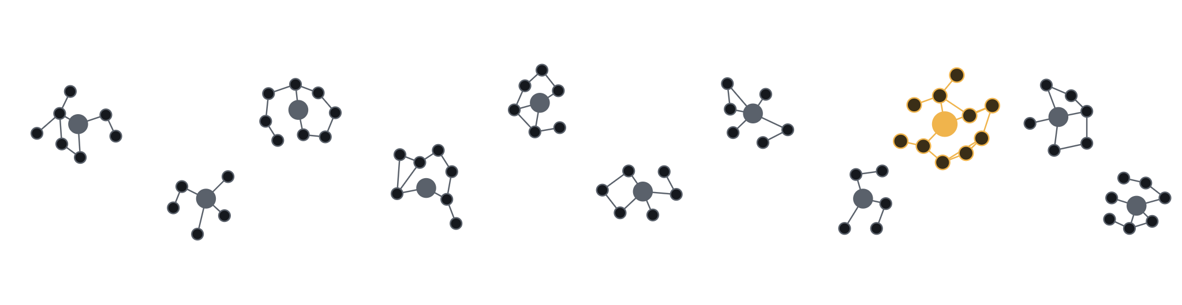
Disjoint by design
Every company is generated from a seed. The same seed rebuilds the same company; a new seed builds a new one, with its own customers, contracts, tickets and calls.
train · seeds 1–10
test · seed 11
measure skill, not memory.
Notes:
Alternative version of the previous slide. Era companies are disjoint by design, and the seed is the control. Same seed, the identical company, byte for byte. New seed, a new company. So you train on seeds one to ten and test on seed eleven. Think of all the data as one big graph: customers, deals, people and the links between them. Every seed grows its own component, with its own shape and its own entities, and no edges run between components. The gray ones are the training companies, seeds one to ten. The amber one is the test company, seed eleven, sitting right in the middle of the graph but not connected to any of it. The model never saw a single node of it. So when the score goes up, it’s because the model learned a behavior, not memorized Northwind’s MRR.

Slide 47
With Era, you don’t infer the truth.
You create it.
Notes:
And here’s the shift. With real data, you have to infer what the right answer is, and as we saw, that’s where the mistakes creep in. With Era you don’t infer the truth. You create it, and then you build the data around it. Let’s go back through every problem we just listed and see how Era handles each one.

Slide 48
Create cases on ground truth
01
02
03
04
Pick the answer
Plant the records
Serve via APIs & MCP
Grade in code
Q: Did Northwind renew?
salesforce:
agent sees:
mode: exact
key = "churned"
renewal → Closed Lost
salesforce, slack,
"renewed" → ✗
slack #deals:
gong, zendesk…
"churned" → ✓
"Northwind is signing!"
key: hidden
Never planted? Then “I don’t know” is the right answer — and it’s graded too.
Notes:
Here’s how Era answers “finding cases doesn’t scale.” It doesn’t find cases; it creates them. Take our Northwind story. [click] Step one: pick the answer first. The question is “did Northwind renew?”, and the key is “churned.” [click] Step two: plant the records that make it true. The Salesforce renewal ends up Closed Lost, and the noise goes in too: a Slack message saying “Northwind is signing!” [click] Step three: serve it through the same APIs and MCP servers as production. The agent sees Salesforce, Slack, Gong, Zendesk. It never sees the key. [click] Step four: grade in code. Every question declares how it’s compared: an exact value, a set, an ordered list, a per-key mapping, or abstention. This one is exact. “Renewed” is wrong, “churned” is right. No partial credit, no judge model, no labeling by hand, and none of the mistakes we saw earlier, because the generator knows the true story; it wrote it. [click] And the unanswerable case is just as exact: if a fact was never planted, the only correct answer is “I don’t know,” and that’s graded too.

Slide 49
Same accuracy. A fraction of the cost.
An open-weights mixture-of-experts model, self-hosted on one node of 8×H100 fine-tuned with LoRA-SFT (rank 32, base weights frozen) on 324 examples taken from its own correct runs: 142 final answers, 61 re-reads of truncated results and 121 abstentions. All the compute came to $609, over 29 hours and four iterations.
THE RESULT ON EVERYDAY ANALYST QUESTIONS, STRICT GRADING
 | Open model | Frontier API
Accuracy | 88.9% | 88.9%
$ per correct | $0.067 | $1.80
False refusals | 0 | 3
27×
lower cost per correct answer
Notes:
Here’s the whole setup. An open-weights mixture-of-experts model, self-hosted on one node of eight H100s rented on Spot. 324 training examples taken from the model’s own correct runs, and notice that a third of them are abstentions: we’re explicitly teaching it what “I don’t know” looks like. Another chunk teaches it to re-read a truncated tool result instead of guessing. LoRA fine-tuning at rank 32 with the base weights frozen. All the compute came to $609: 29 hours, four iterations. And the economics: before any tuning, that open model already ties a frontier API model on strict accuracy, at roughly 27 times lower cost per correct answer, and it never refused a question that had an answer. Be upfront that this is Spot pricing; we’ll get to the on-demand caveat.

Slide 50
Teaching the model to say “I don’t know”
 | Before | After LoRA-SFT
Correct abstentions | 65 / 90 | 74 / 90
Malformed abstentions | 3 | 0
Empty fields answered right | 0 / 6 | 2 / 6
Context overflows | 6 | 0
Tokens per task | 1.96M | 1.20M
Cost per task (Spot) | $0.26 | $0.16
Notes:
On a company it had never seen: correct abstentions went from 65 to 74 out of 90. Malformed abstentions — writing the string “None” in the answer field — went to zero. It also got cheaper and stopped blowing the context window, because it learned to stop searching once it was sure the fact isn’t there. Be honest about what it didn’t fix, because this audience will respect it. Empty fields are still the hard case: only 2 of 6 right after tuning, up from 0, and most are still answered as zero. That’s the case from the start of the talk, and the obvious next experiment is contrast pairs, an empty field next to a real zero. Everyday accuracy moved two points, which is within run-to-run noise, and it wasn’t the target. At on-demand GPU rates, cost lands near the cheaper frontier APIs. And the scope is one held-out company in one industry, with LoRA rather than full fine-tuning.

Slide 51
Ground truth is the unlock.
A deterministic grader is a benchmark, a label factory and a reward function — the same code.
Notes:
This is why post-training is back. The expensive parts — labeling and judging — collapse into code once you have exact ground truth. And the grader that filtered SFT data is already a reward signal for RL.

Slide 52
Thank you
X @ariel_shulman_
in linkedin.com/in/ariel-shulman
The views represented are my own and do not represent those of my current or former employers.
Notes:
Thanks. Happy to take questions.

