Slide 1
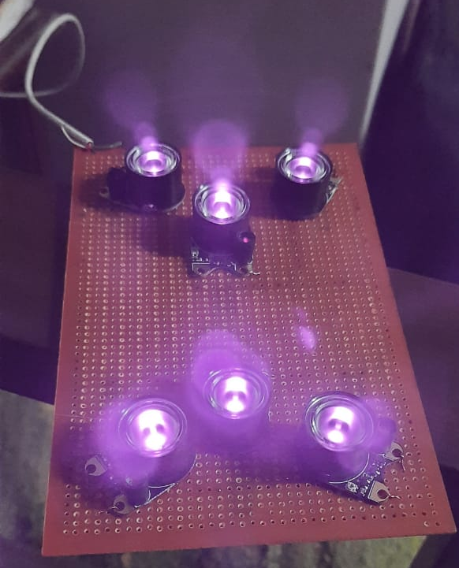
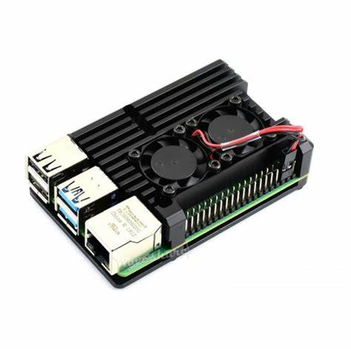
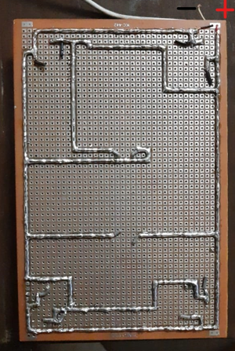
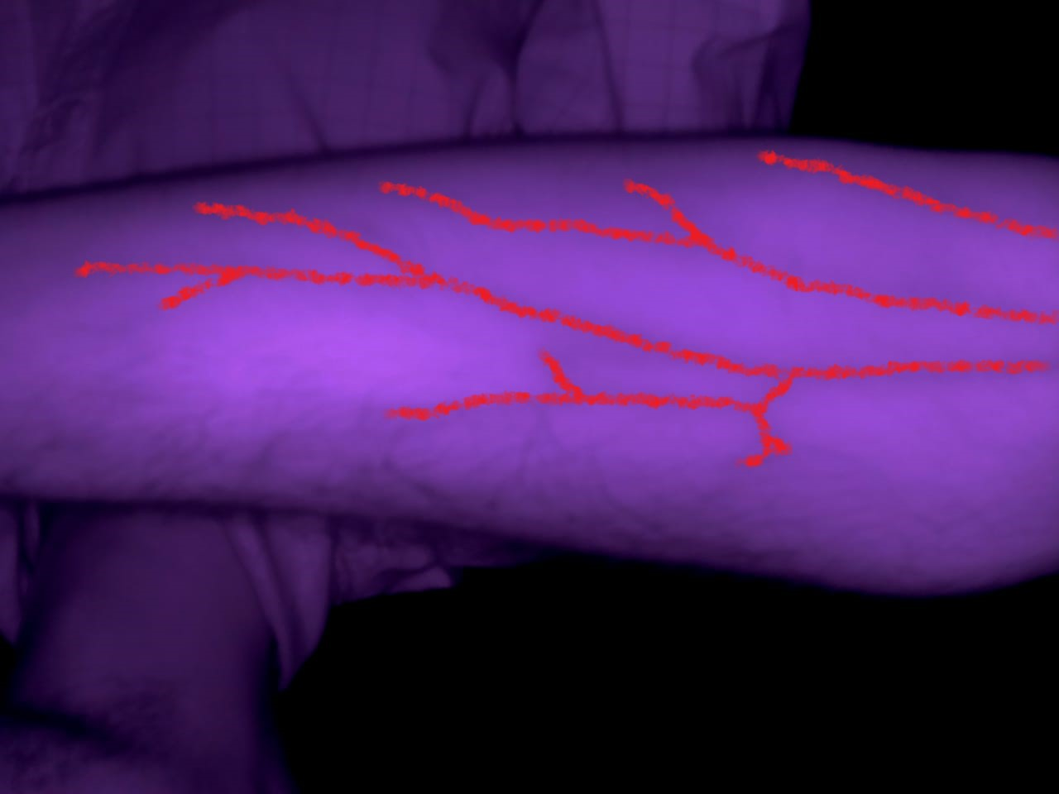
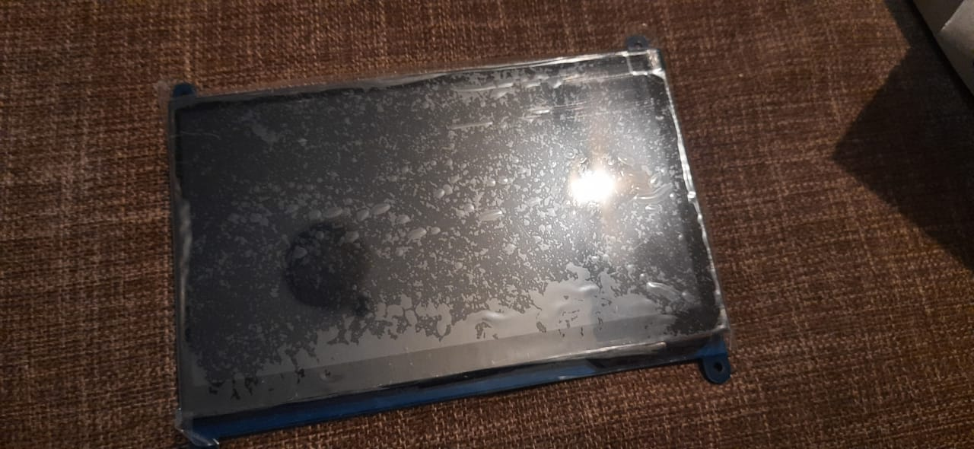
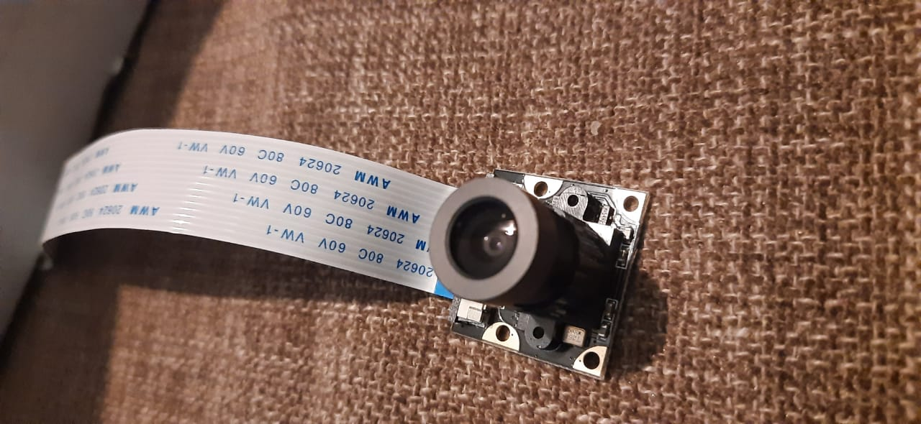
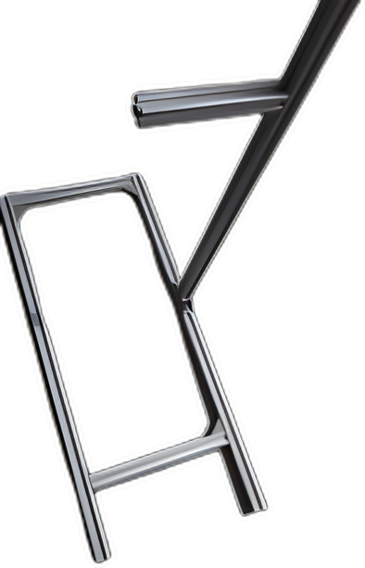
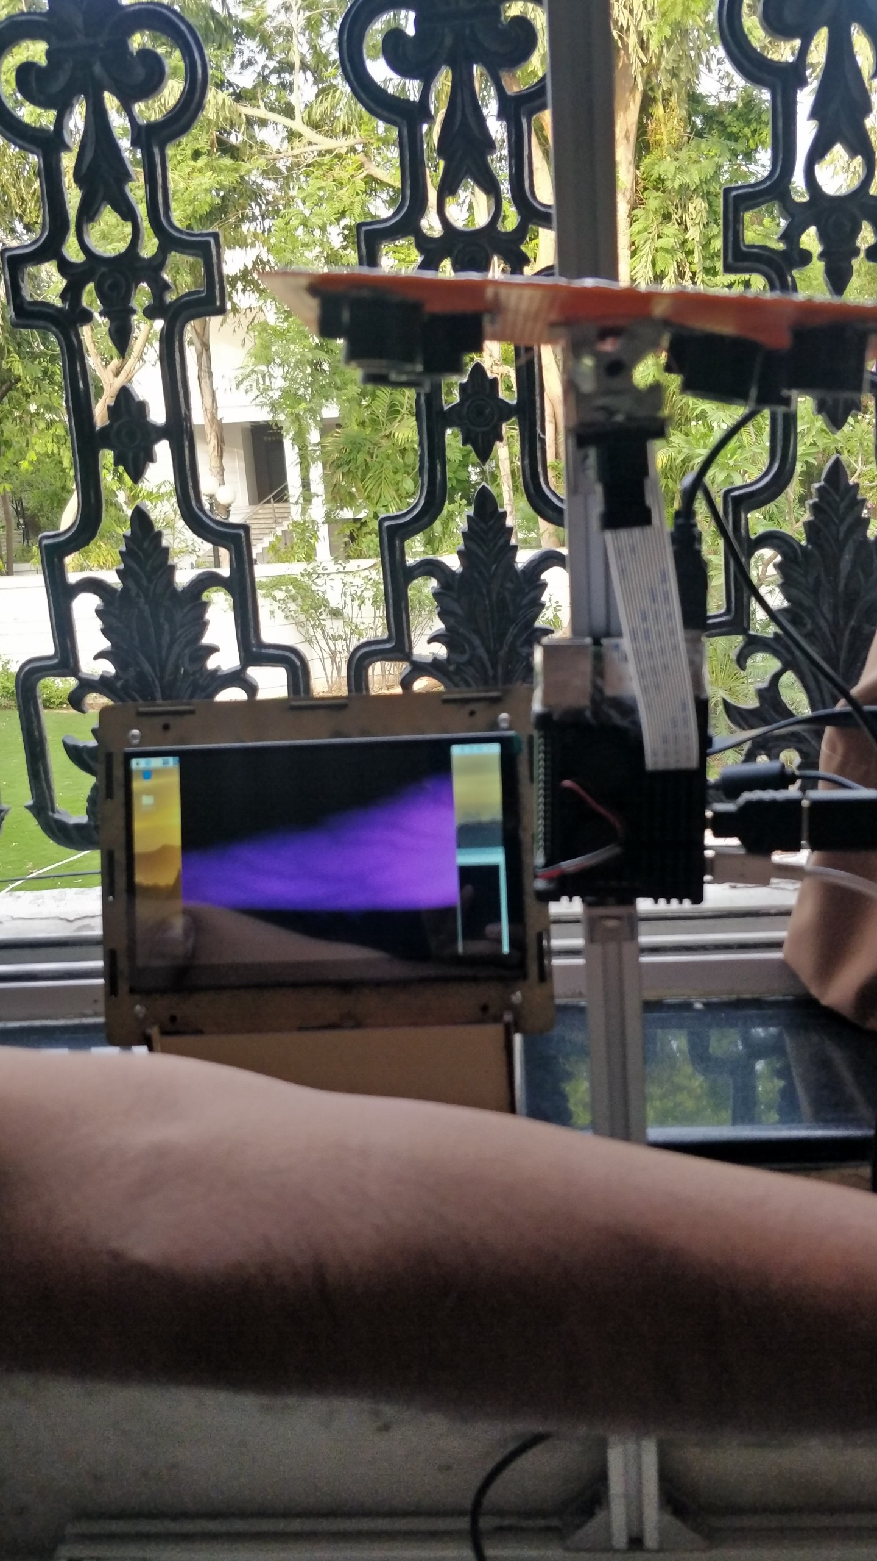
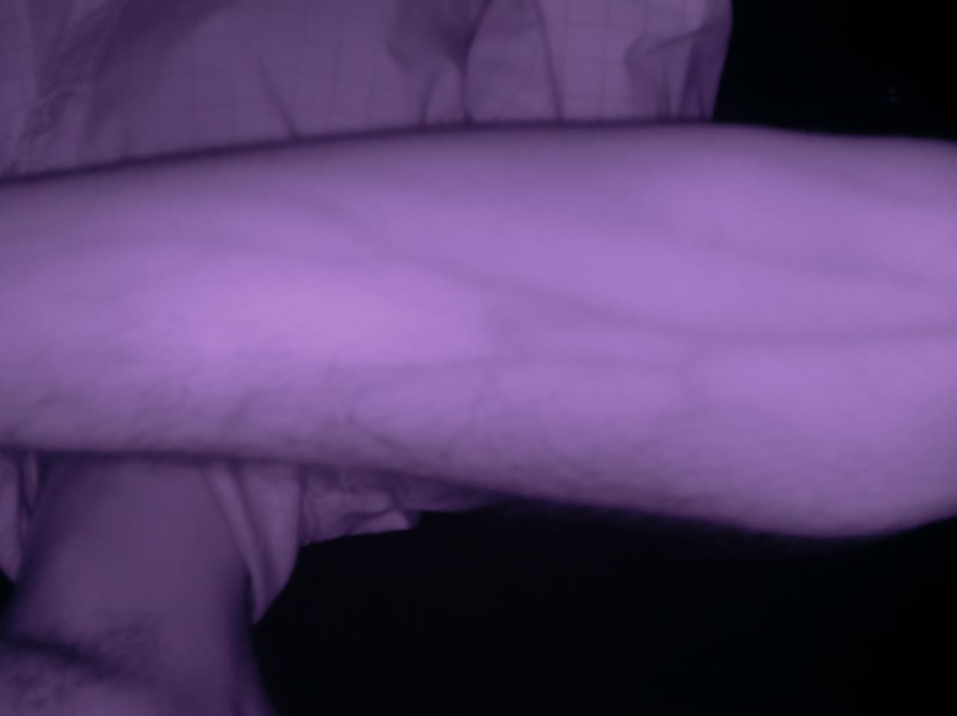
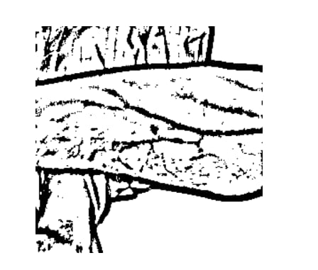
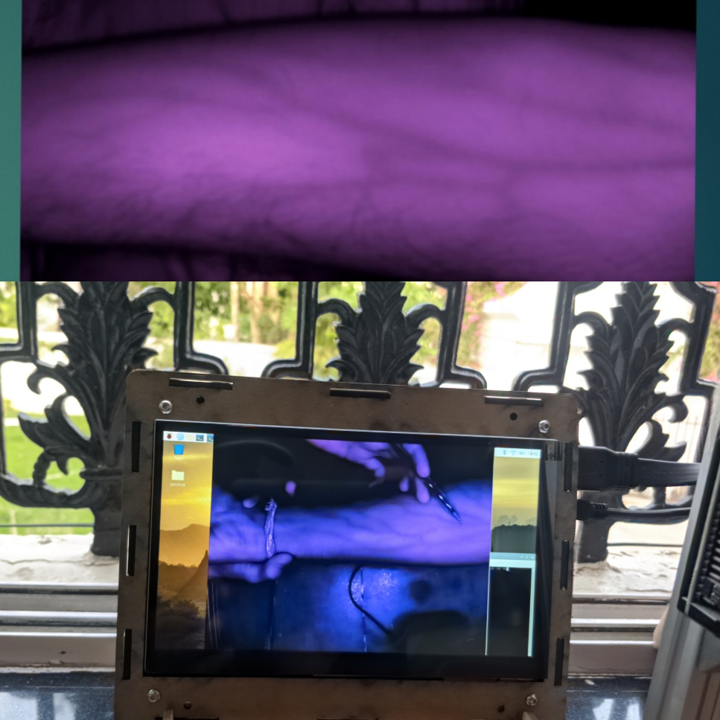
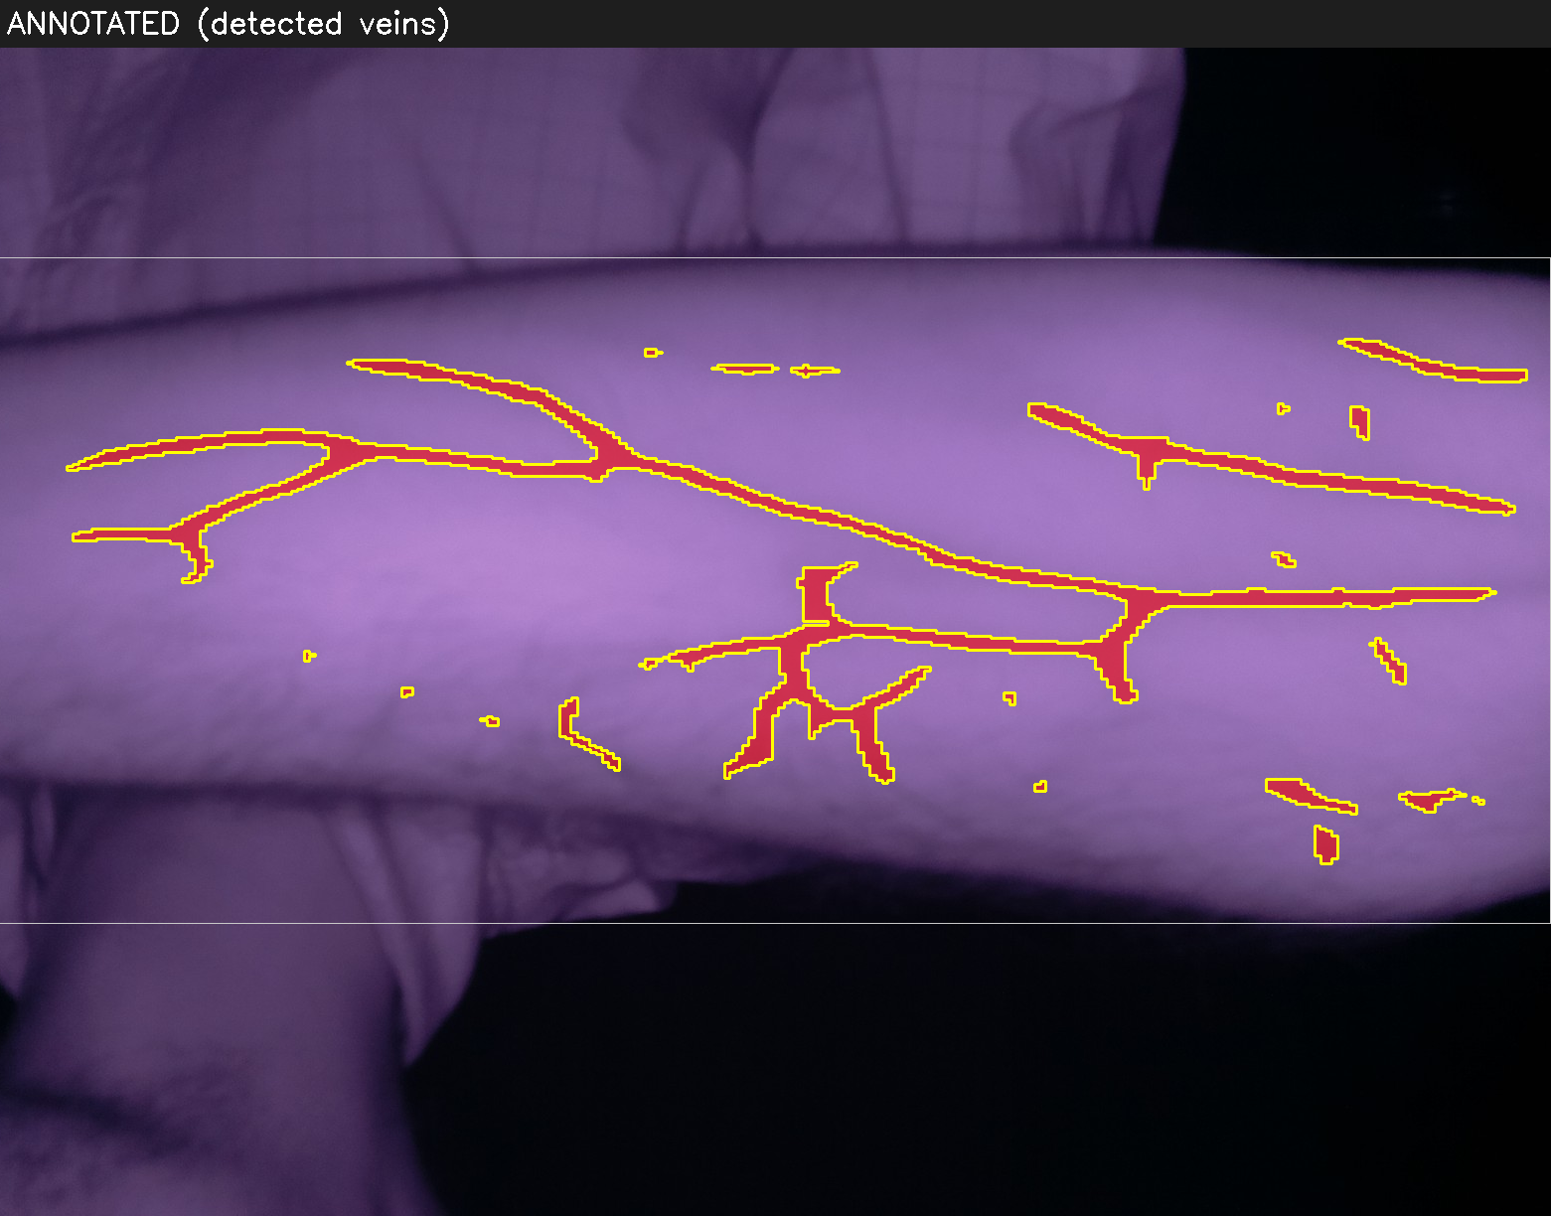
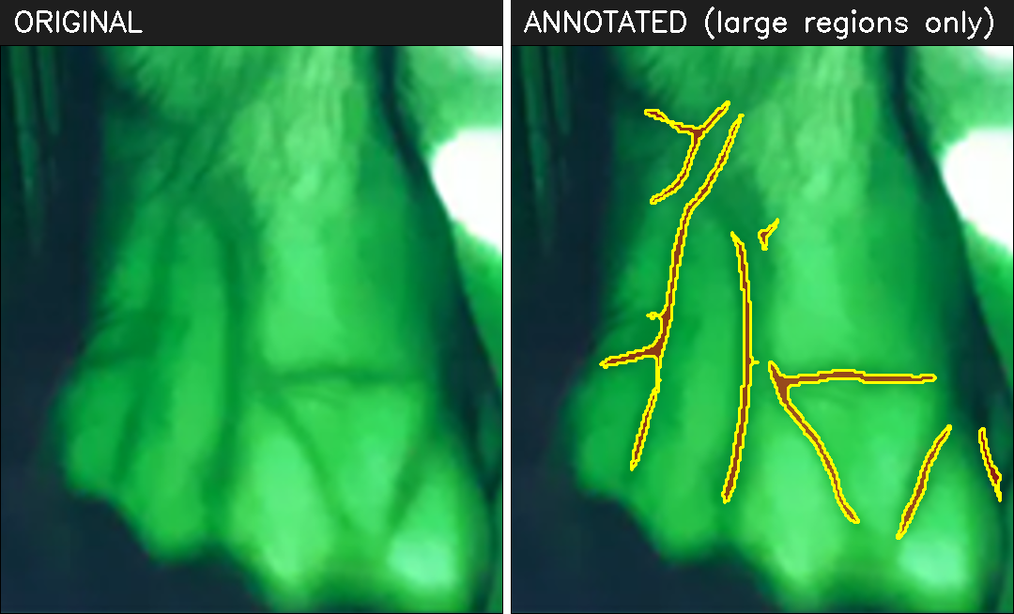
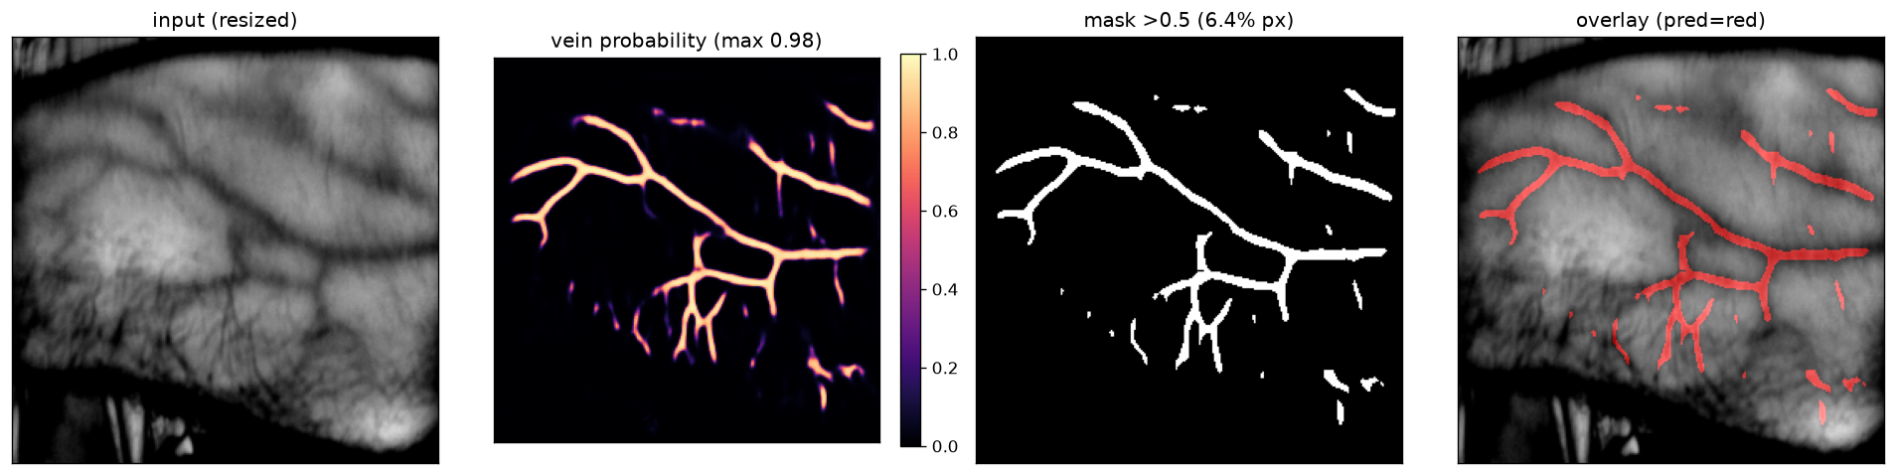
AugVein - Vein detection through Augmented Reality
Presenters: Vishal Jaimin Vakil, Dr. Harsh Kapadia
Facilitator: Jaimin Vakil, Plus Medica (India)
INTRODUCTION
HARDWARE
Accurate vein identification is crucial during venipuncture. Much of a medic's time is wasted locating veins, and incorrect venipuncture can cause painful complications such as permanent nerve damage from bruising. Advanced vein detectors use Augmented Reality and image processing, but their high-cost pushes hospitals toward cheaper, less capable devices. AugVein is a low-cost accurate vein identifier that enhances the patient's veins in a live stream, displaying them darker for clear venipuncture guidance.
• Raspberry Pi 4B (8GB)
• 850nm IR LEDs
• NoIR Camera
• 7-inch LCD display
• Aluminum sections for adjustable length via screws, so height and distance can be tuned. They provide strong support for the camera, Raspberry Pi, and lights.
MAJOR OBJECTIVES
Develop a low-cost device that identifies veins fast and accurately.
• Identify the veins.
• Enhance the veins so they appear darker.
• Back-project the veins for an augmented-reality view on the patient's hand.
IR LED Lights
Raspberry Pi
LED lights connections
Expected Outcome
CONCEPT
Touchscreen Display
NoIR Camera
The idea is based on light absorption.
Veins carry deoxygenated blood which absorbs IR light, so in the reflected image veins appear darker than surrounding tissue.
Approach:
Capture Image → Enhancements through Filters → Image Processing → Feeding to an AI model → Back Projecting
METHODOLOGY
• Project IR light onto the patient's hand.
• Camera captures the live video.
• Raspberry Pi enhances veins through filters.
• Image processing extracts the veins.
• Highlight the extracted vein layer in red.
• Display the red-enhanced veins in the live output.
• Back project the veins on the hand.
Aluminum mechanical frame
Final Setup
IMAGE PROCESSING, FILTER ENHANCEMENTS & Classification
Captured image
Processed image
Filter enhancement
Extracted veins
Model used & Back Projection
• U-Net — a compact (~7.76M-param) encoder–decoder CNN with skip connections, built from scratch in PyTorch, that segments veins pixel-by-pixel from NIR images.
• The encoder learns what a vein looks like while the decoder + skip connections recover where they are, outputting a per-pixel vein mask (256×256 input, runs on-device on a Raspberry Pi).
• Trained in PyTorch with a BCE + Dice loss and GPU acceleration, then INT8-quantized for efficient edge inference.
• Detected mask → upscaled & re-aligned to the live frame → projected back onto the arm by a calibrated projector, overlaying veins directly on the skin (AR).
• Trained on: https://universe.roboflow.com/ismail-681lq/dorsal-hand-vein-images-database-multiclass-db2 Dataset
Input vs Output Image
Code: https://github.com/VishalVakil/AugVein
Contact: Vishal Vakil (linkedin.com/in/vishal-vakil), Dr. Harsh Kapadia (linkedin.com/in/hkkapadia)
NIR capture to vein map: U-Net probability heatmap → binary mask → red overlay.

