Slide 1

Notes:
title — Contributors use agents. Bots use agents. Everyone uses agents. All of it lands on the same small set of maintainers. This talk is about the tools we built so maintainers can keep up without lowering the bar.

Slide 2
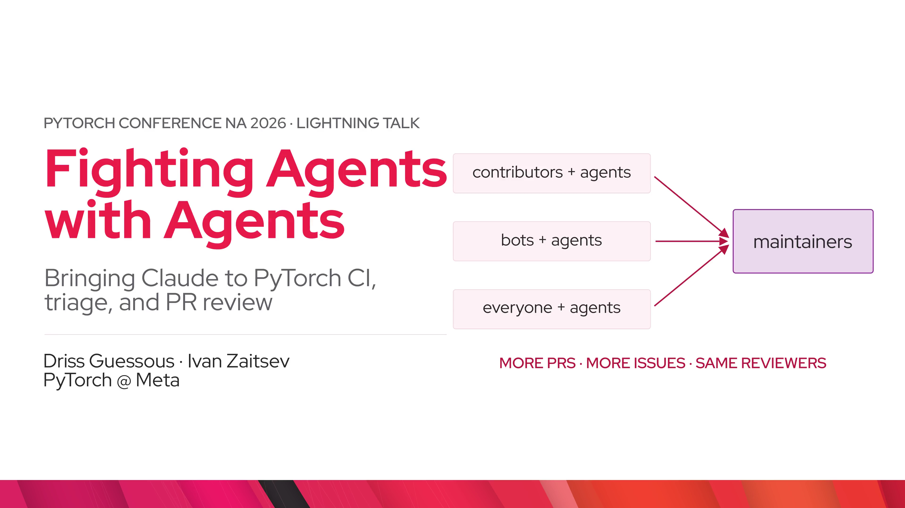
Notes:
problem.first_time — PRs opened on pytorch/pytorch per month, from HUD's ClickHouse. Roughly 1.5k a month in early 2025, about 3k a month by August 2026. Amber is 2026. The sharpest change is who is sending PRs. PRs from authors with no prior association went from 190 a quarter to over 1,800. Issue volume is flat; the growth is in PRs.

Slide 3
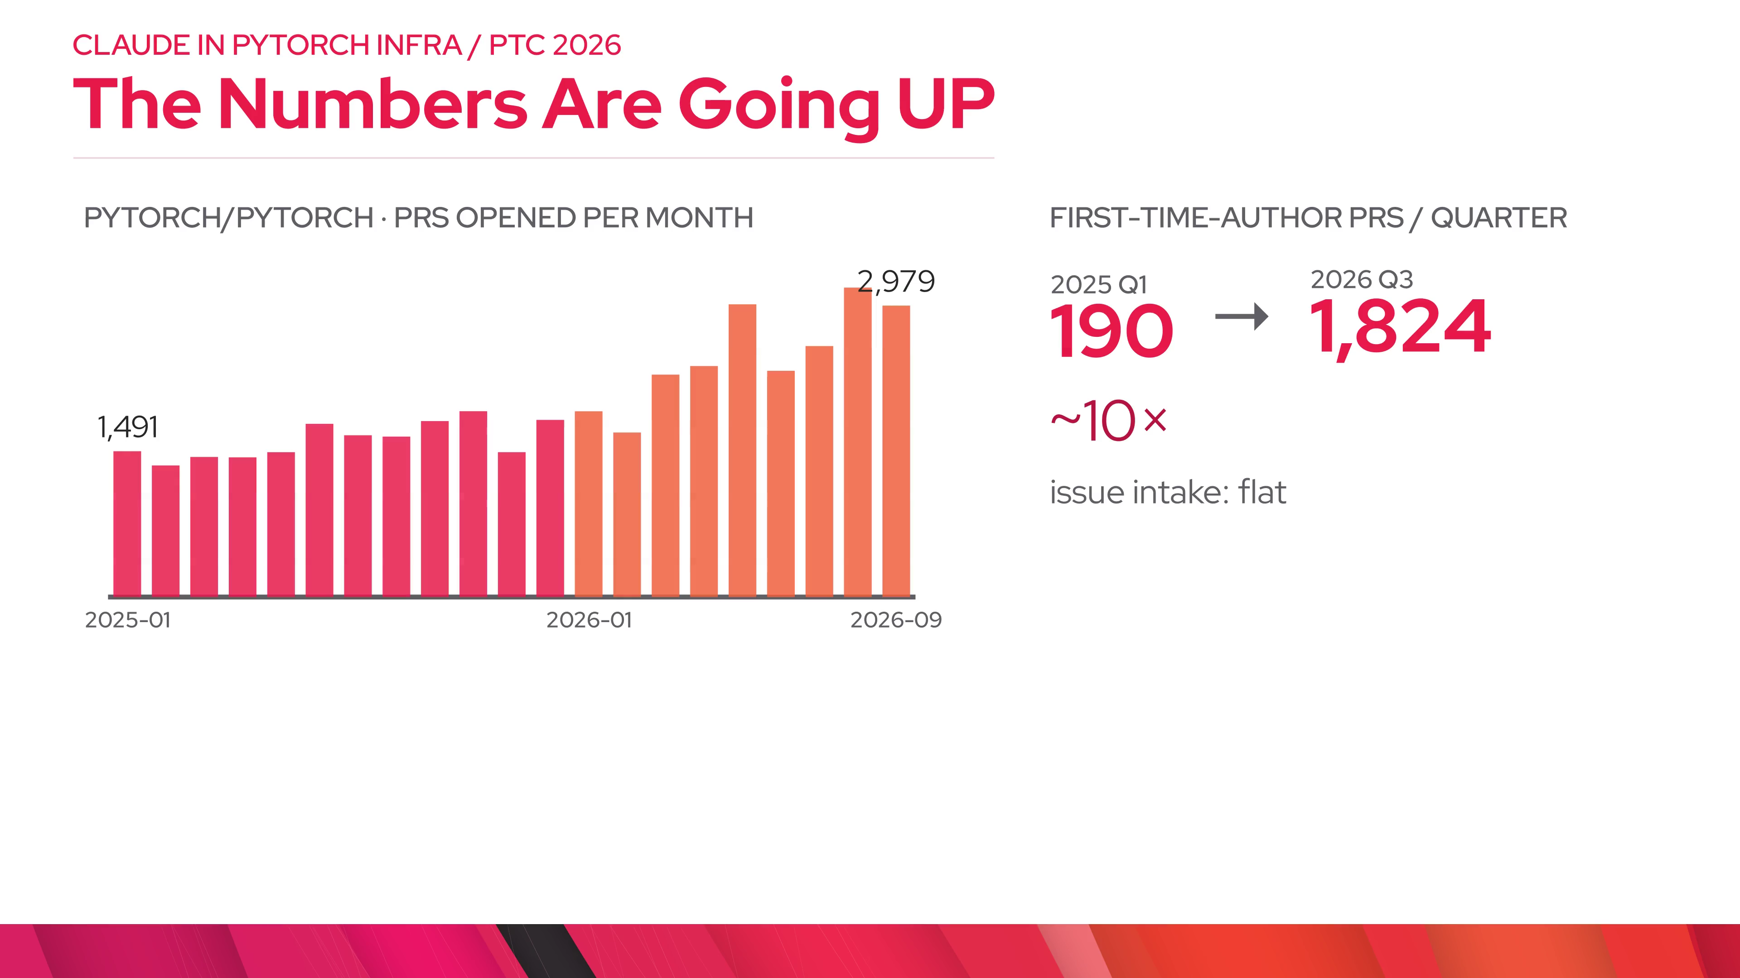
Notes:
problem.question — So the question was direct: what tools do maintainers need? The policy side says no fully autonomous agent contributions. The infra side is this talk: bounded agents that work for maintainers.

Slide 4
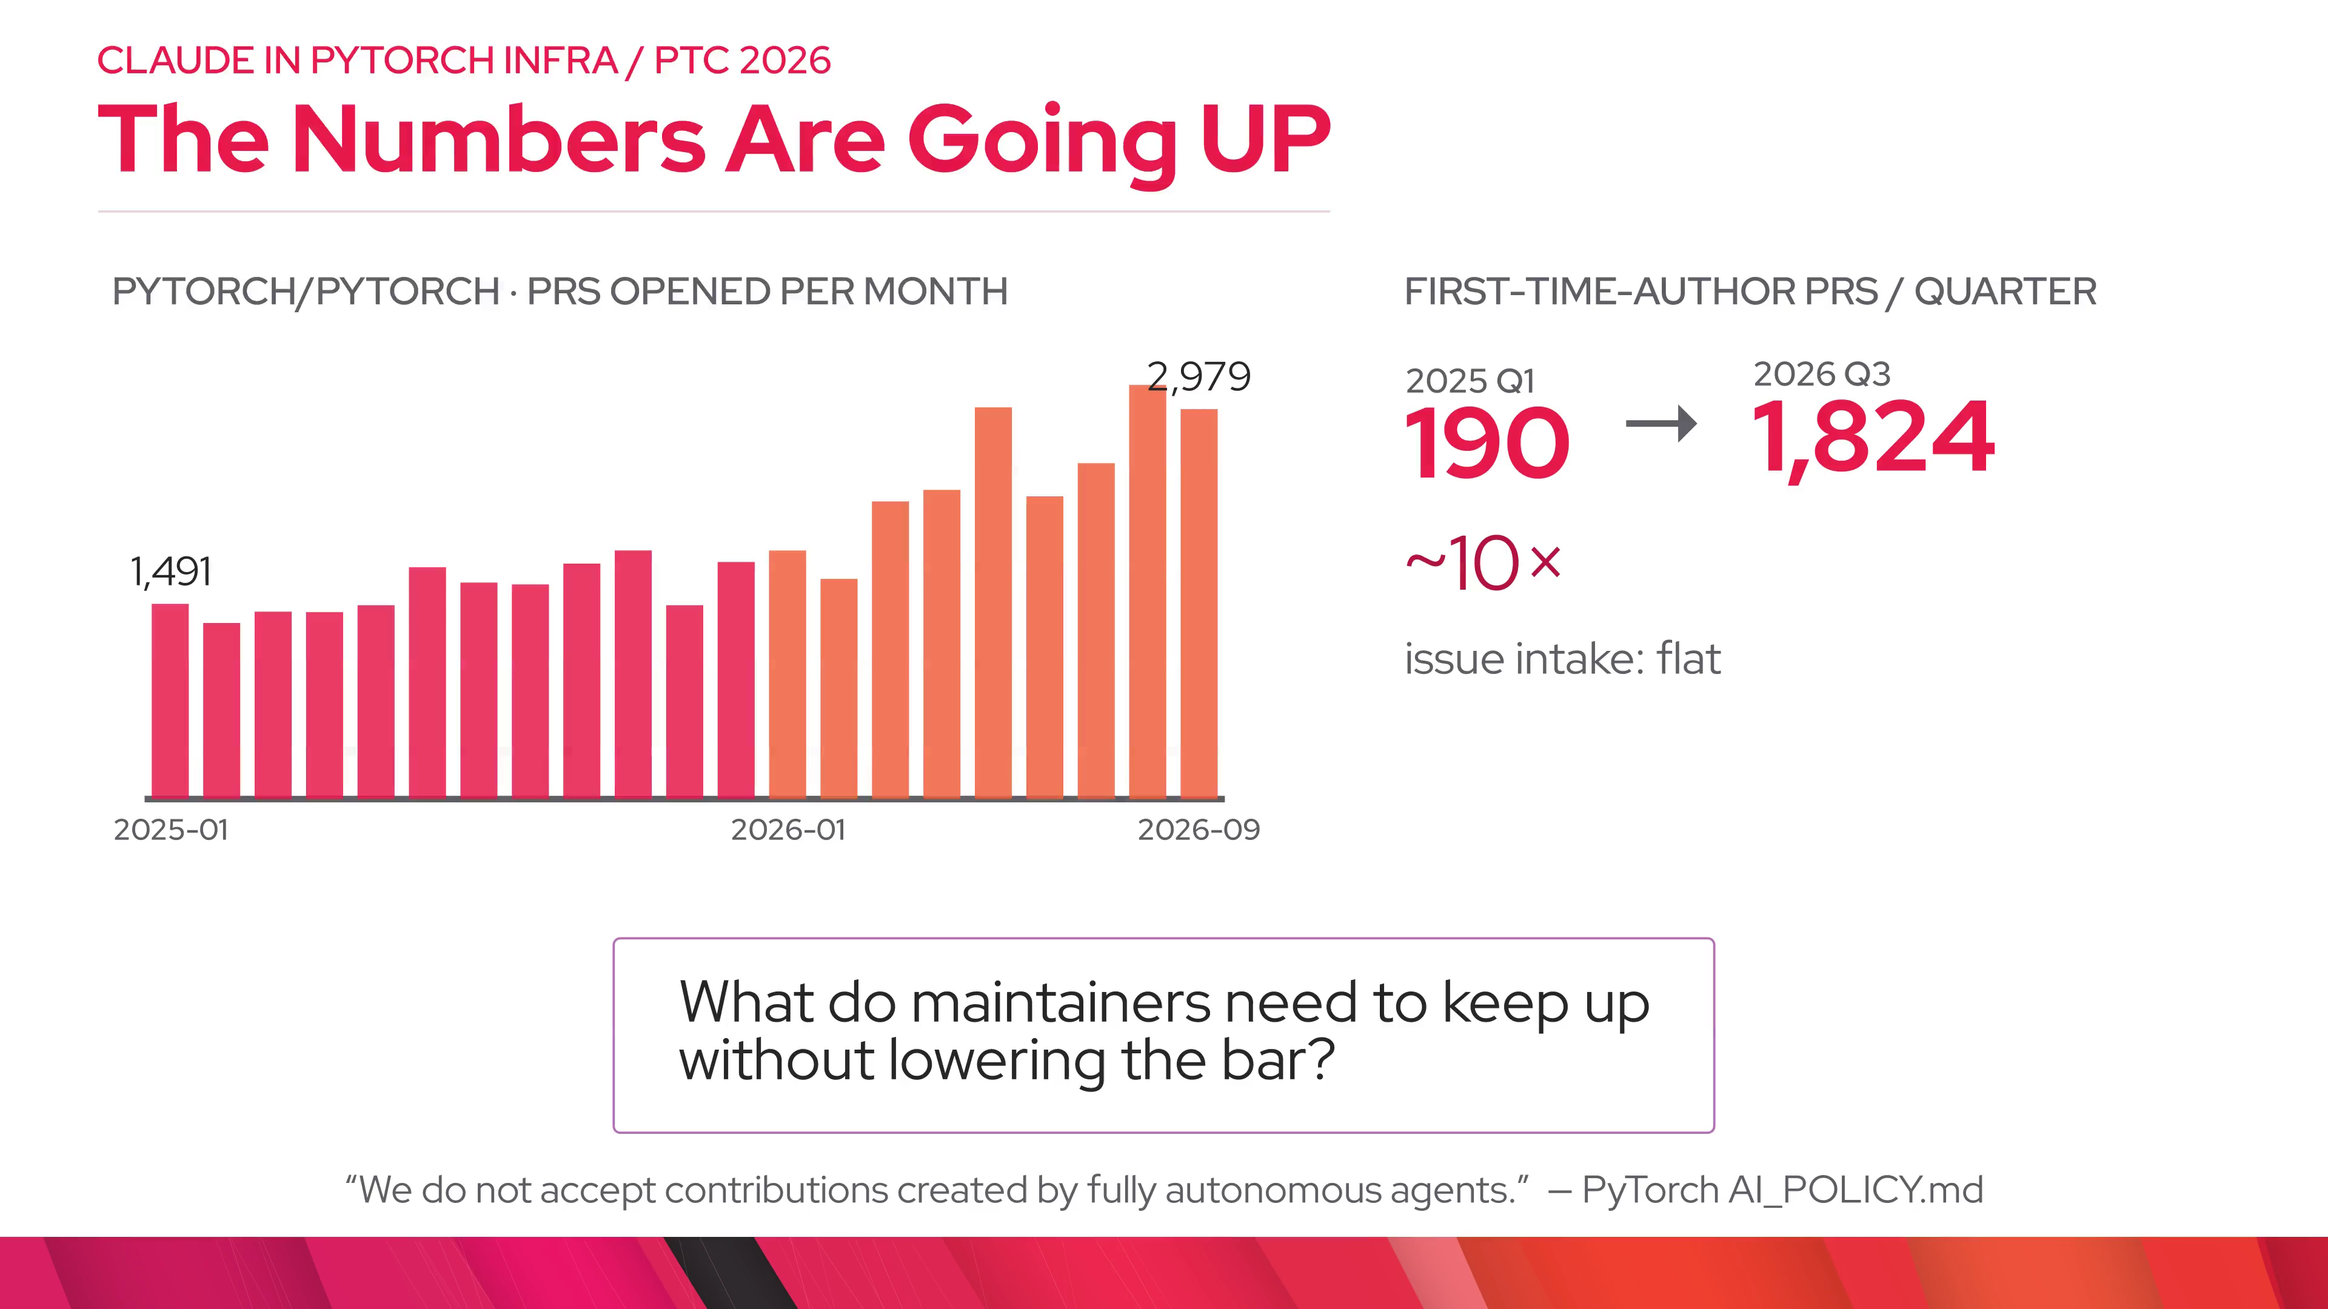
Notes:
example.reply — An external contributor's FP8 PR adding a CPU path for scaled_mm. I asked @claude to look for subtle bugs. This is the whole interface: a comment. Four and a half minutes later: a compile error in the MKLDNN branch that only some platforms build, and a copy-paste bug where scale_b came from scale_a. Both real.

Slide 5
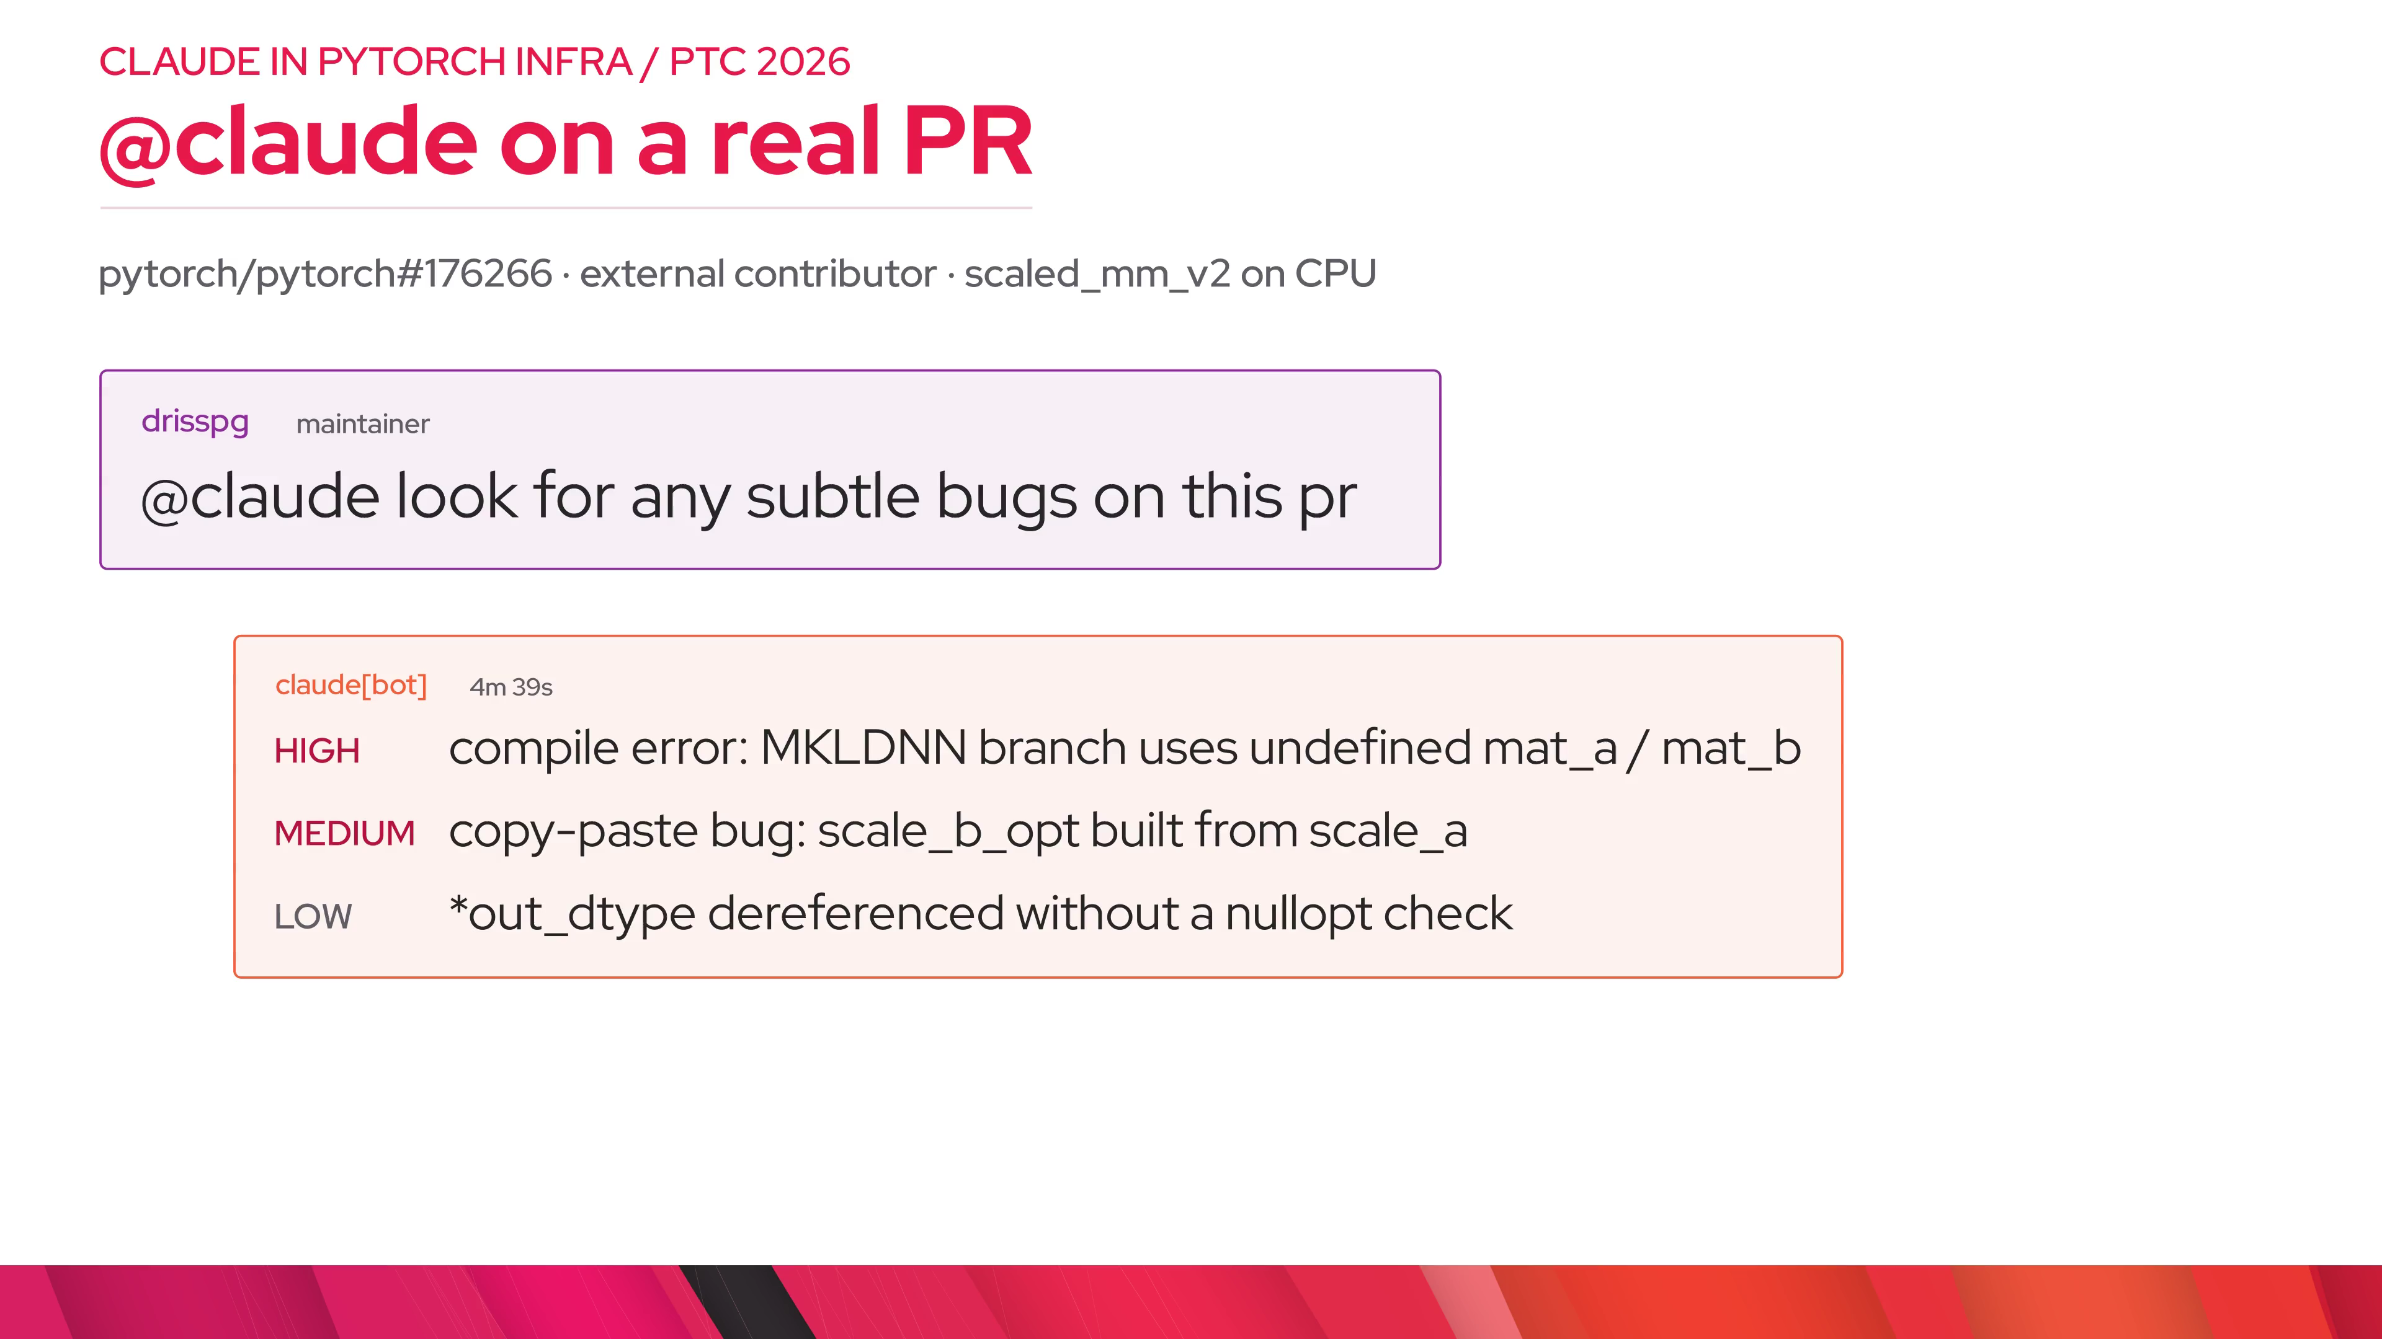
Notes:
example.outcome — Both were fixed before landing. The low-severity note got pushed back on by humans, who picked their own fix. That is the shape we want: Claude finds things, maintainers decide.

Slide 6
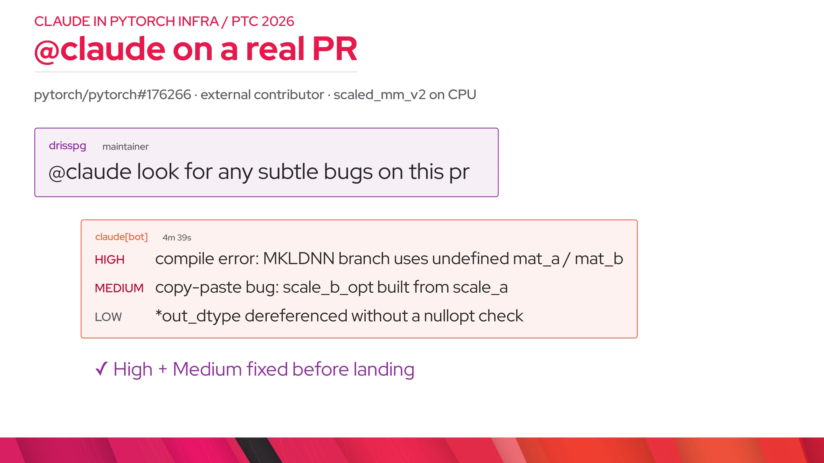
Notes:
shape.auth — History: Ivan shipped @claude on Jan 16 for a 20-person pilot, issue triage followed on Jan 28, and on Feb 27 Ivan replaced the allowlist with this permission check. In March Zain moved it into test-infra as a reusable workflow. A comment is untrusted text. Before any runner does real work, the job-level if: checks the org, the mention, and the author association; then an API call confirms write permission. Anyone with write access can use it; nobody else can. No API keys in GitHub. The job runs in a GitHub environment called bedrock, mints an OIDC token, and assumes one AWS role whose trust policy names each onboarded repo's bedrock environment. That environment only deploys from main, so a PR cannot change the workflow and get credentials.

Slide 7
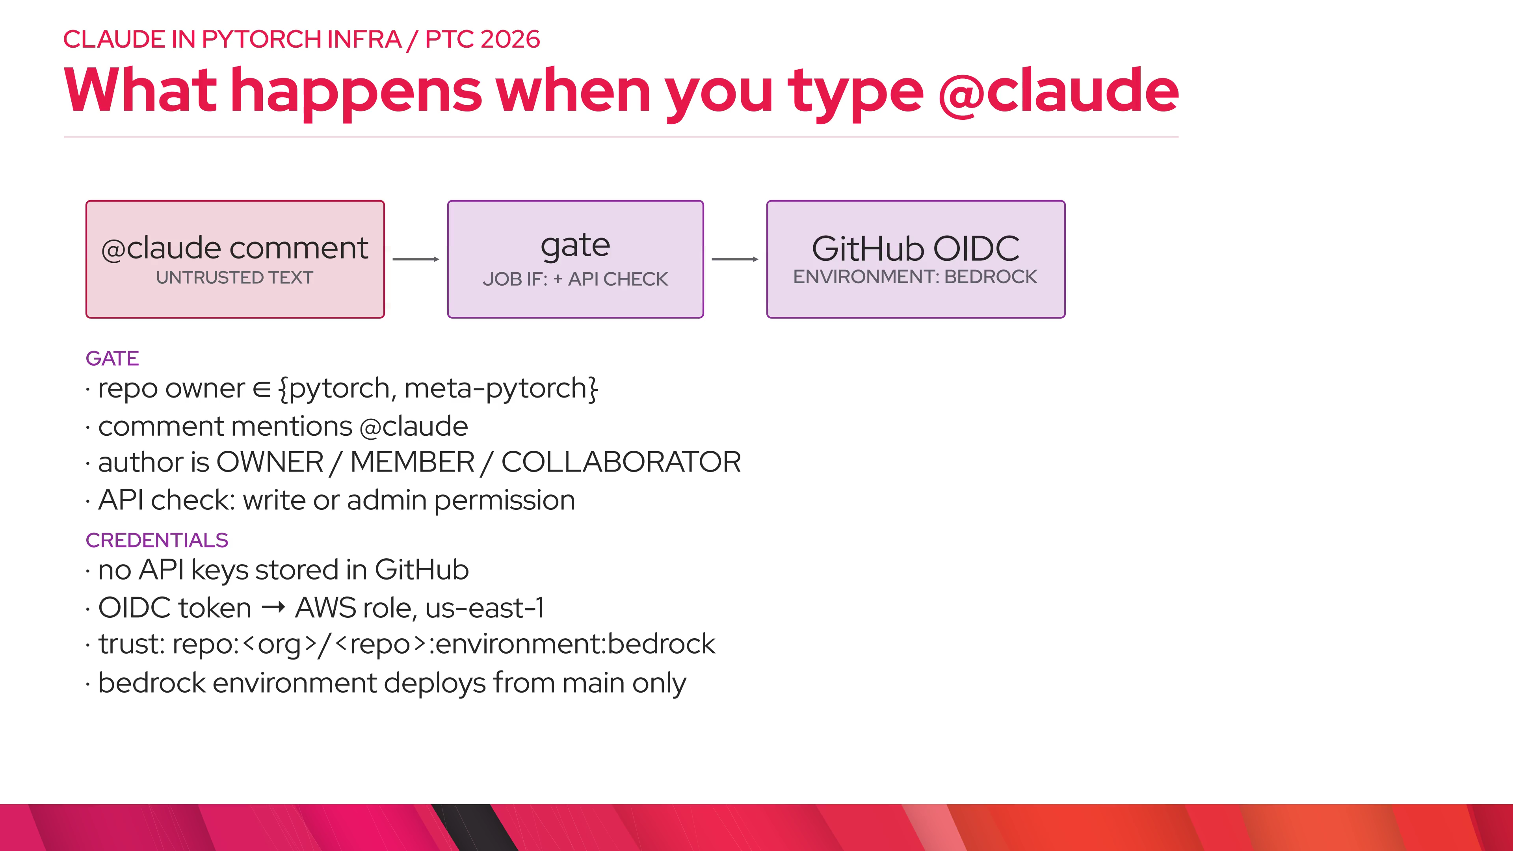
Notes:
shape.outputs — claude-code-action runs on Bedrock. Every run leaves three things: the reply, a public transcript in S3 so anyone can audit what it did, and a usage row in HUD's ClickHouse. That last one is where our adoption numbers come from.

Slide 8
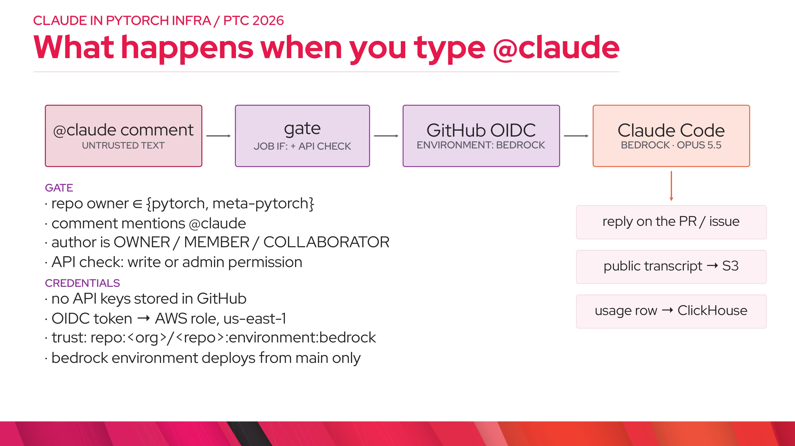
Notes:
two_stage.privileged — The first version of triage was one job with Bedrock credentials triggered by issues: opened. A day later we split it. Stage 1 runs in the issue author's context, has no secrets, and does one thing: write the issue number to an artifact. Stage 2 is triggered by workflow_run, so its code always comes from main. It holds the bedrock environment and issues: write, and it re-validates the one number it received. Claude still reads the issue body, so prompt injection is not gone; what the split removes is untrusted code running next to credentials. The injection risk is handled by the next slide: five tools and hooks. The same split is used by the hardened PR review, Green Light, and ao's CI-failure bot.

Slide 9
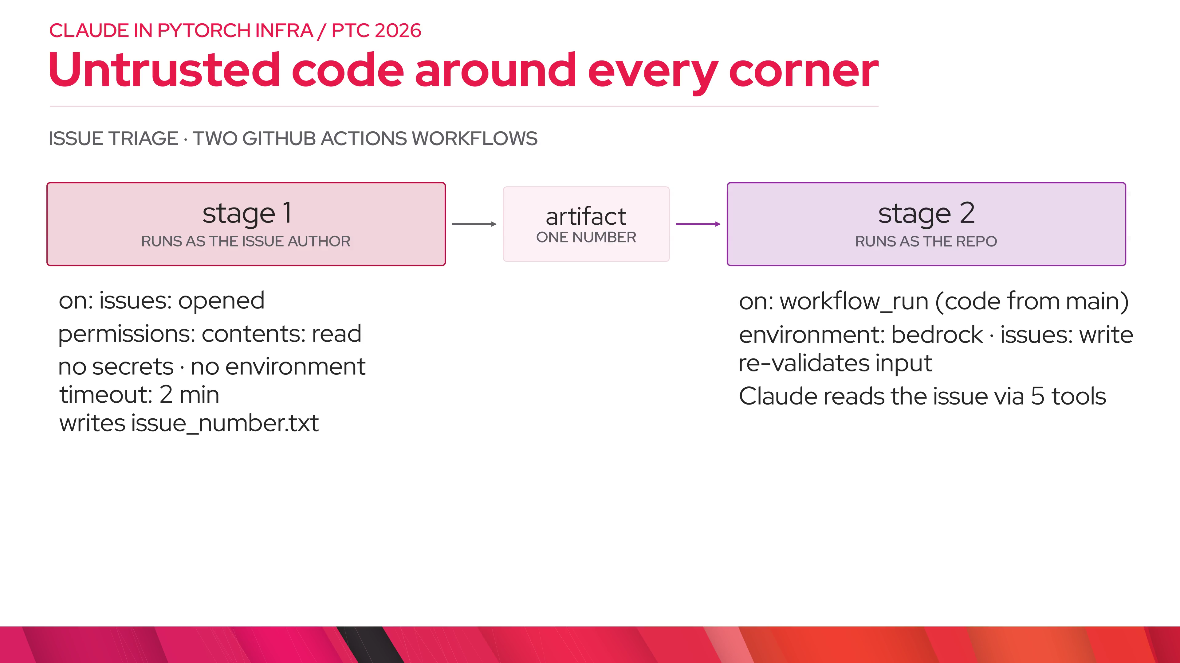
Notes:
two_stage.result — And it pays off for reporters. From HUD: before bot triage, 90% of new issues got their first module or oncall label within about 39 hours, and the median wait was 84 minutes. Since Jan 28 the p90 is 3 minutes and the median is 1 minute. Issues that waited more than a day went from 14% to 3%.

Slide 10
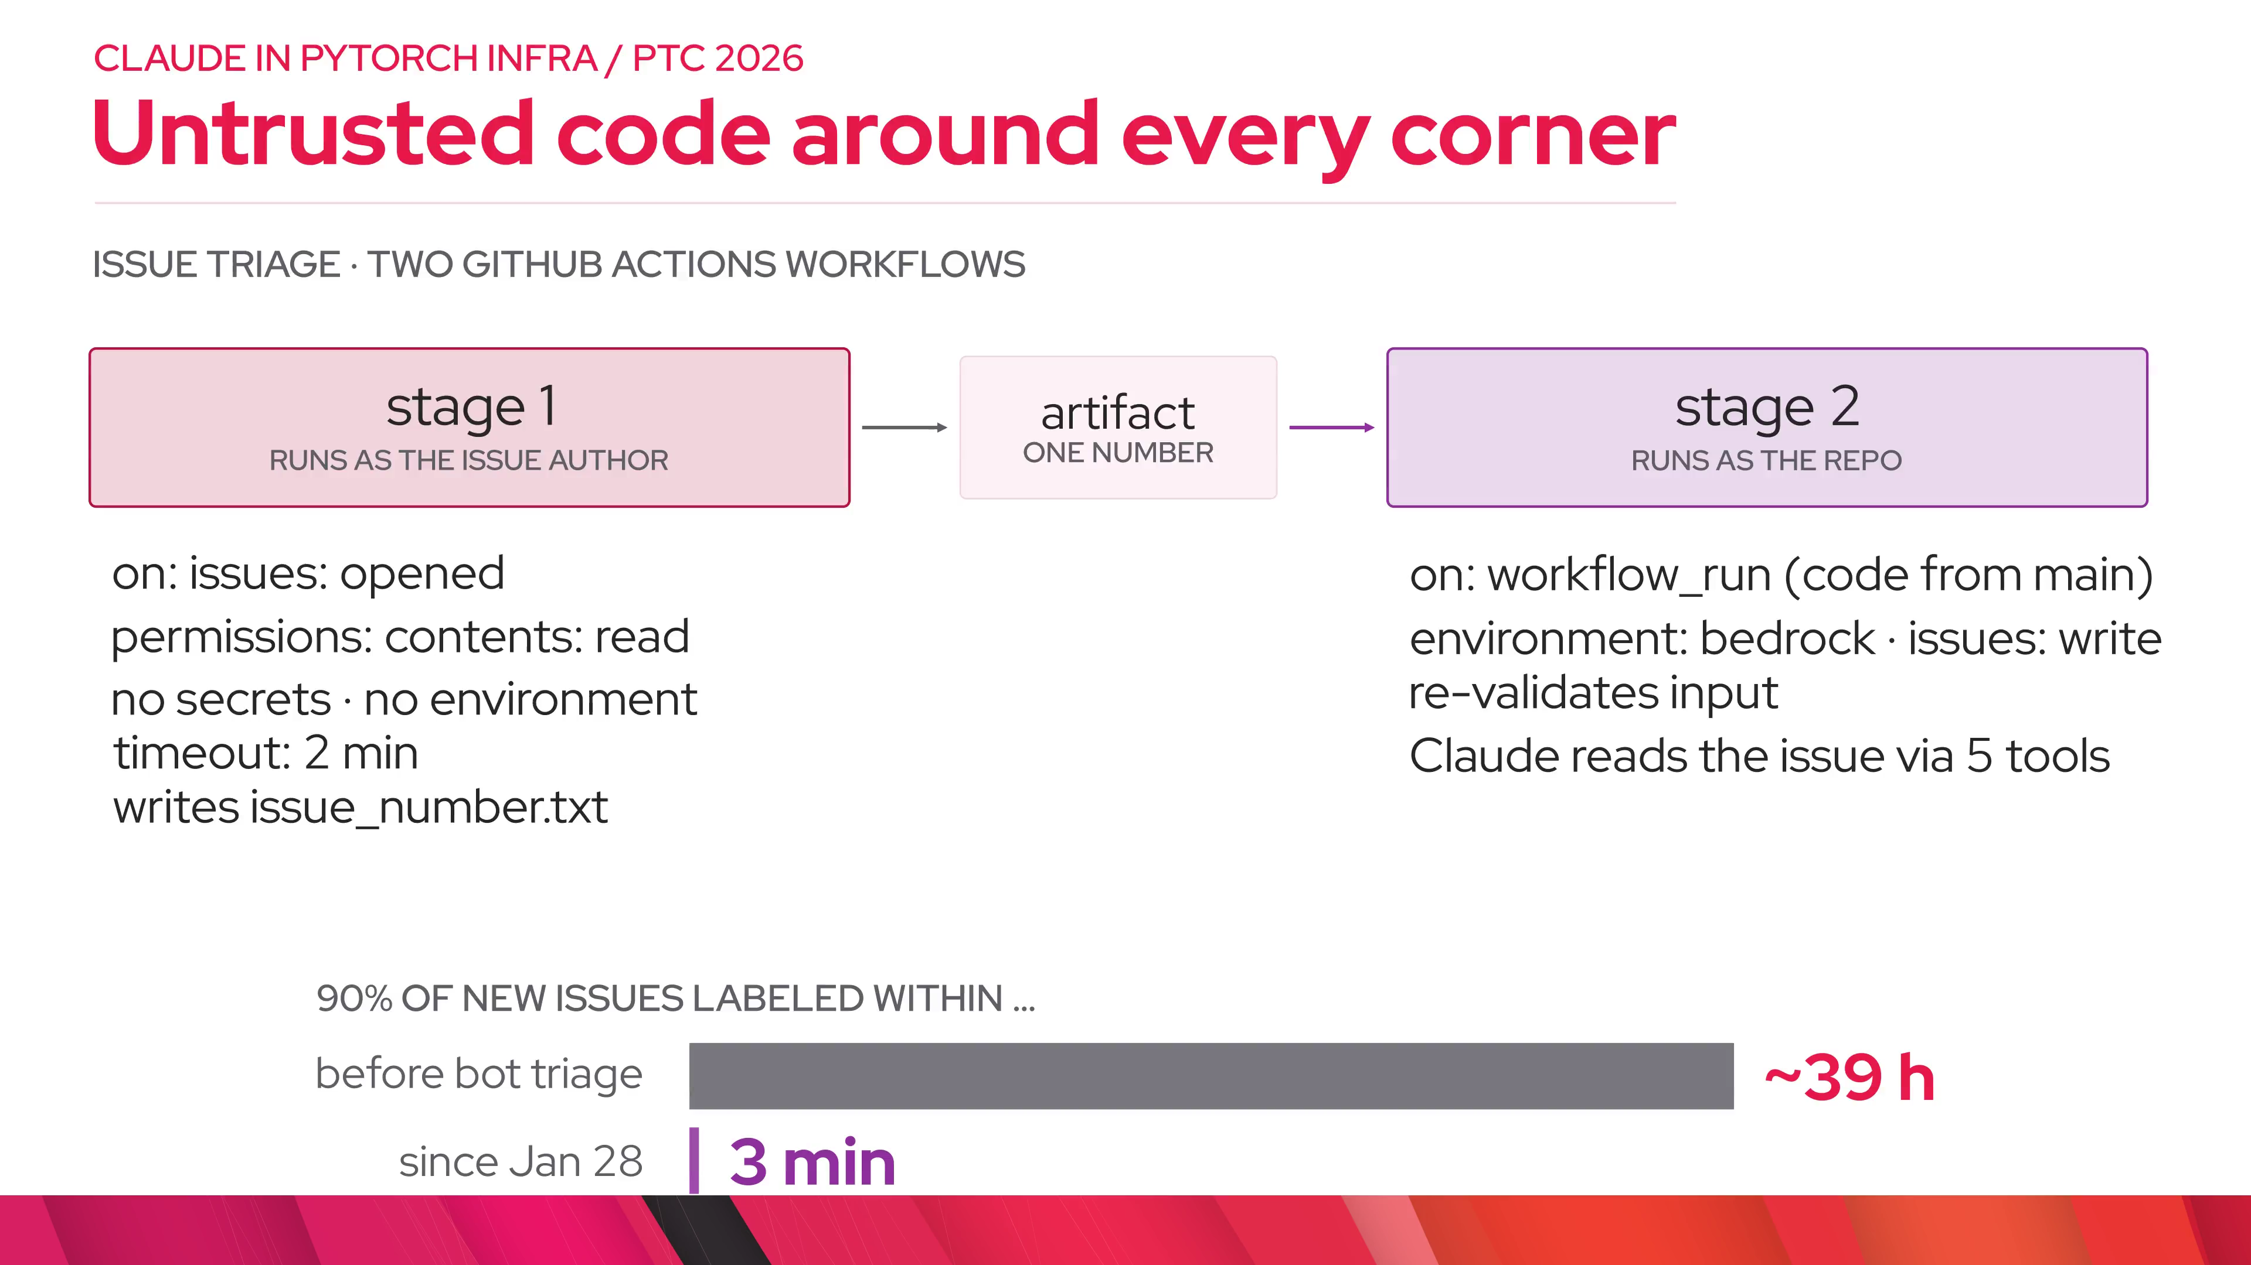
Notes:
guardrails.hooks — Triage runs on Sonnet with exactly five GitHub tools: read the issue, read comments, update it, comment, search. No shell, no file access. The smallest tool surface that can do the job. The prompt says only touch this issue. A hook enforces it in code. Another hook strips any label outside a 282-label allowlist, so a prompt injection cannot add ciflow or sev labels. Every change gets bot-triaged so we can audit it.

Slide 11
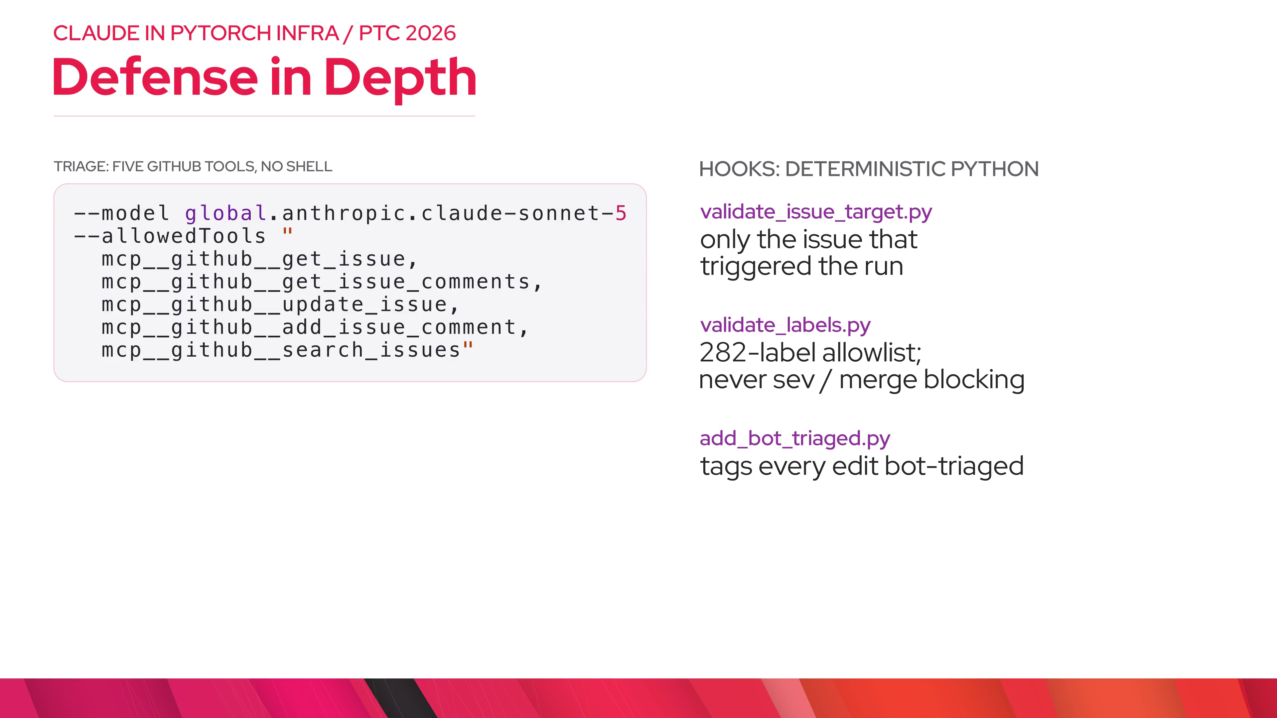
Notes:
guardrails.human — Consequential calls stay human. The bot cannot set high priority; it flags triage review and a person decides.

Slide 12
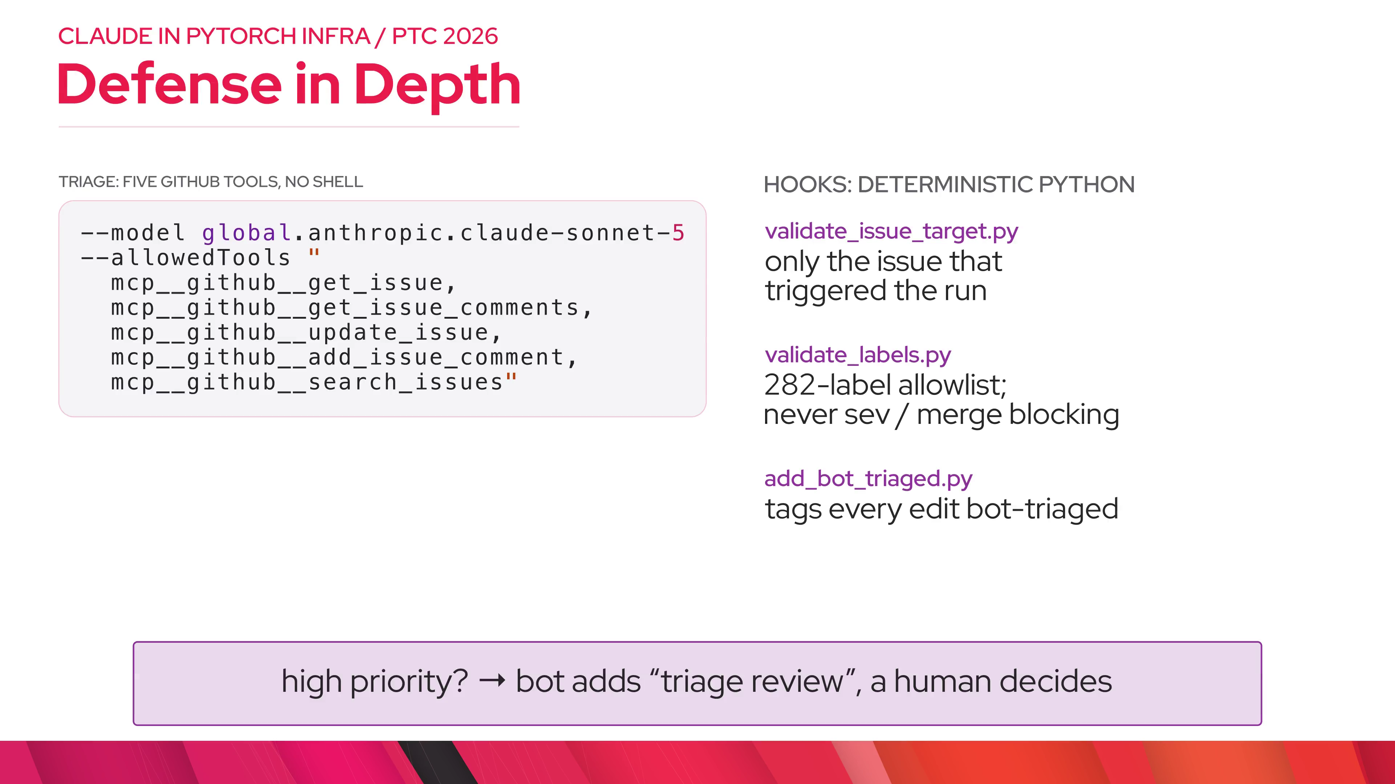
Notes:
skills.repo — The model is generic; PyTorch knowledge lives in the repo as skills. pr-review encodes our checklist and BC rules and is used both by @claude and by humans locally. Triage and readiness review are bot-only skills. AGENTS.md is a symlink to CLAUDE.md so every agent reads the same rules.

Slide 13
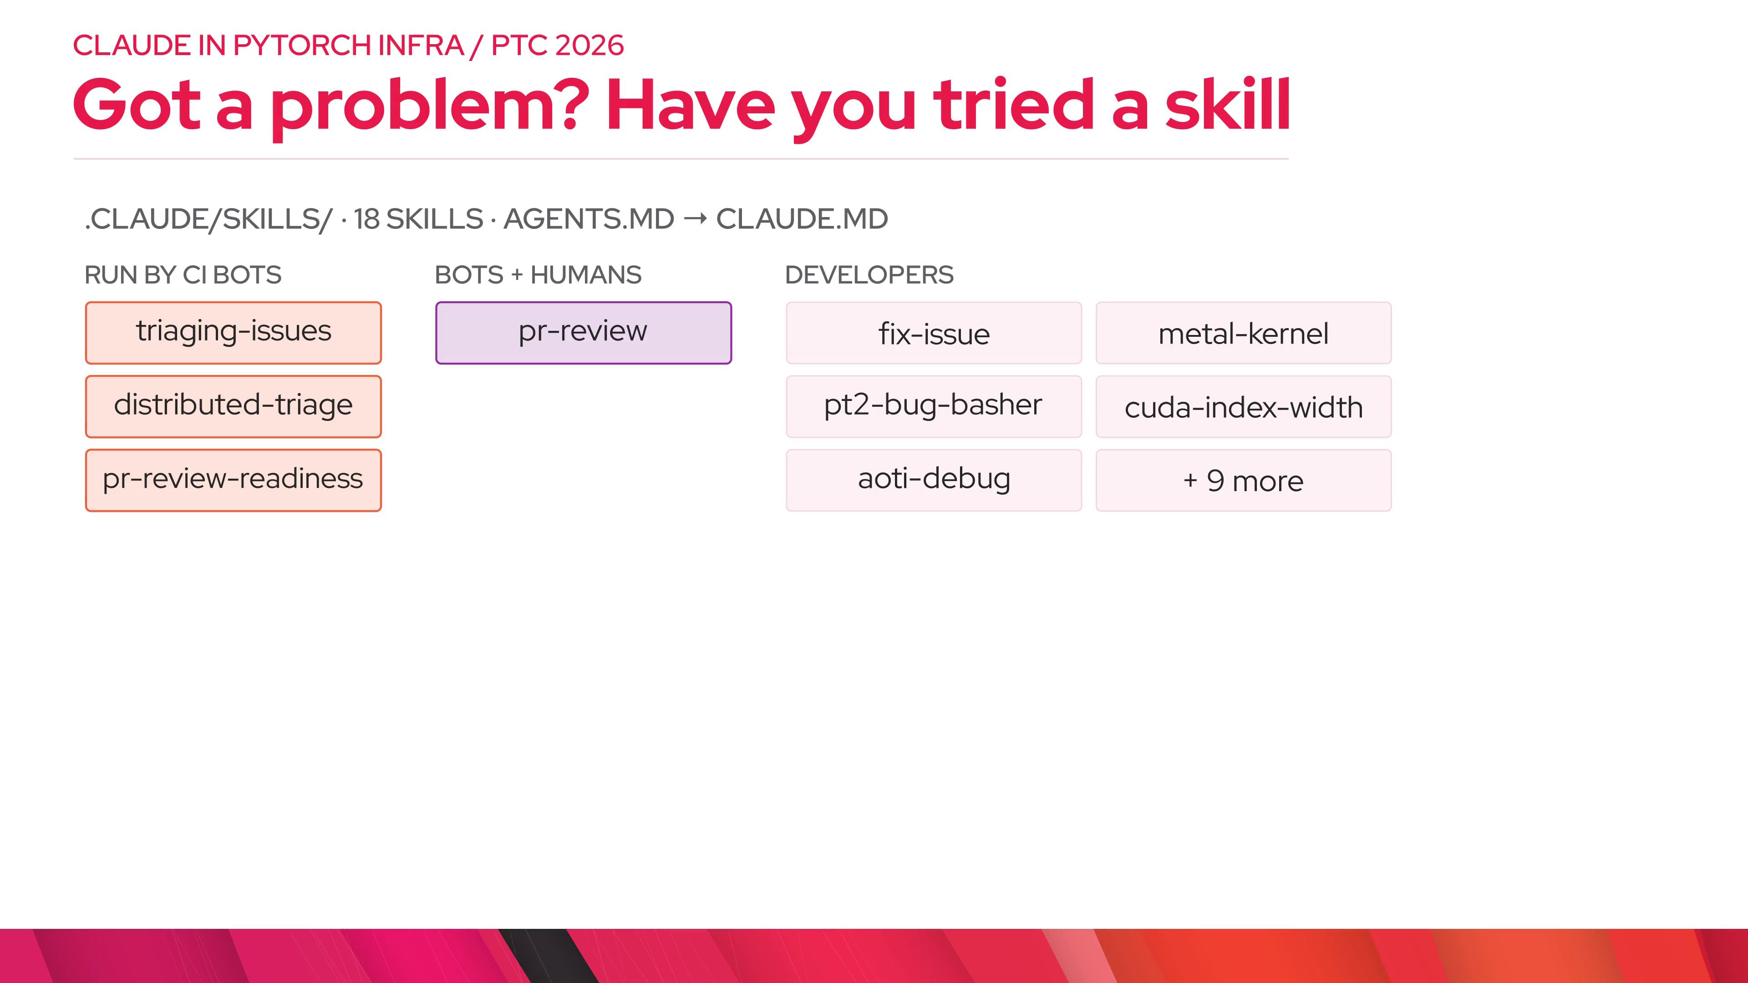
Notes:
skills.onboard — For other repos, Zain moved the workflow into test-infra. A new repo adds this file, runs one setup script that creates the bedrock environment, and adds one line to the IAM trust policy. Thirteen repos across pytorch and meta-pytorch report usage today.

Slide 14
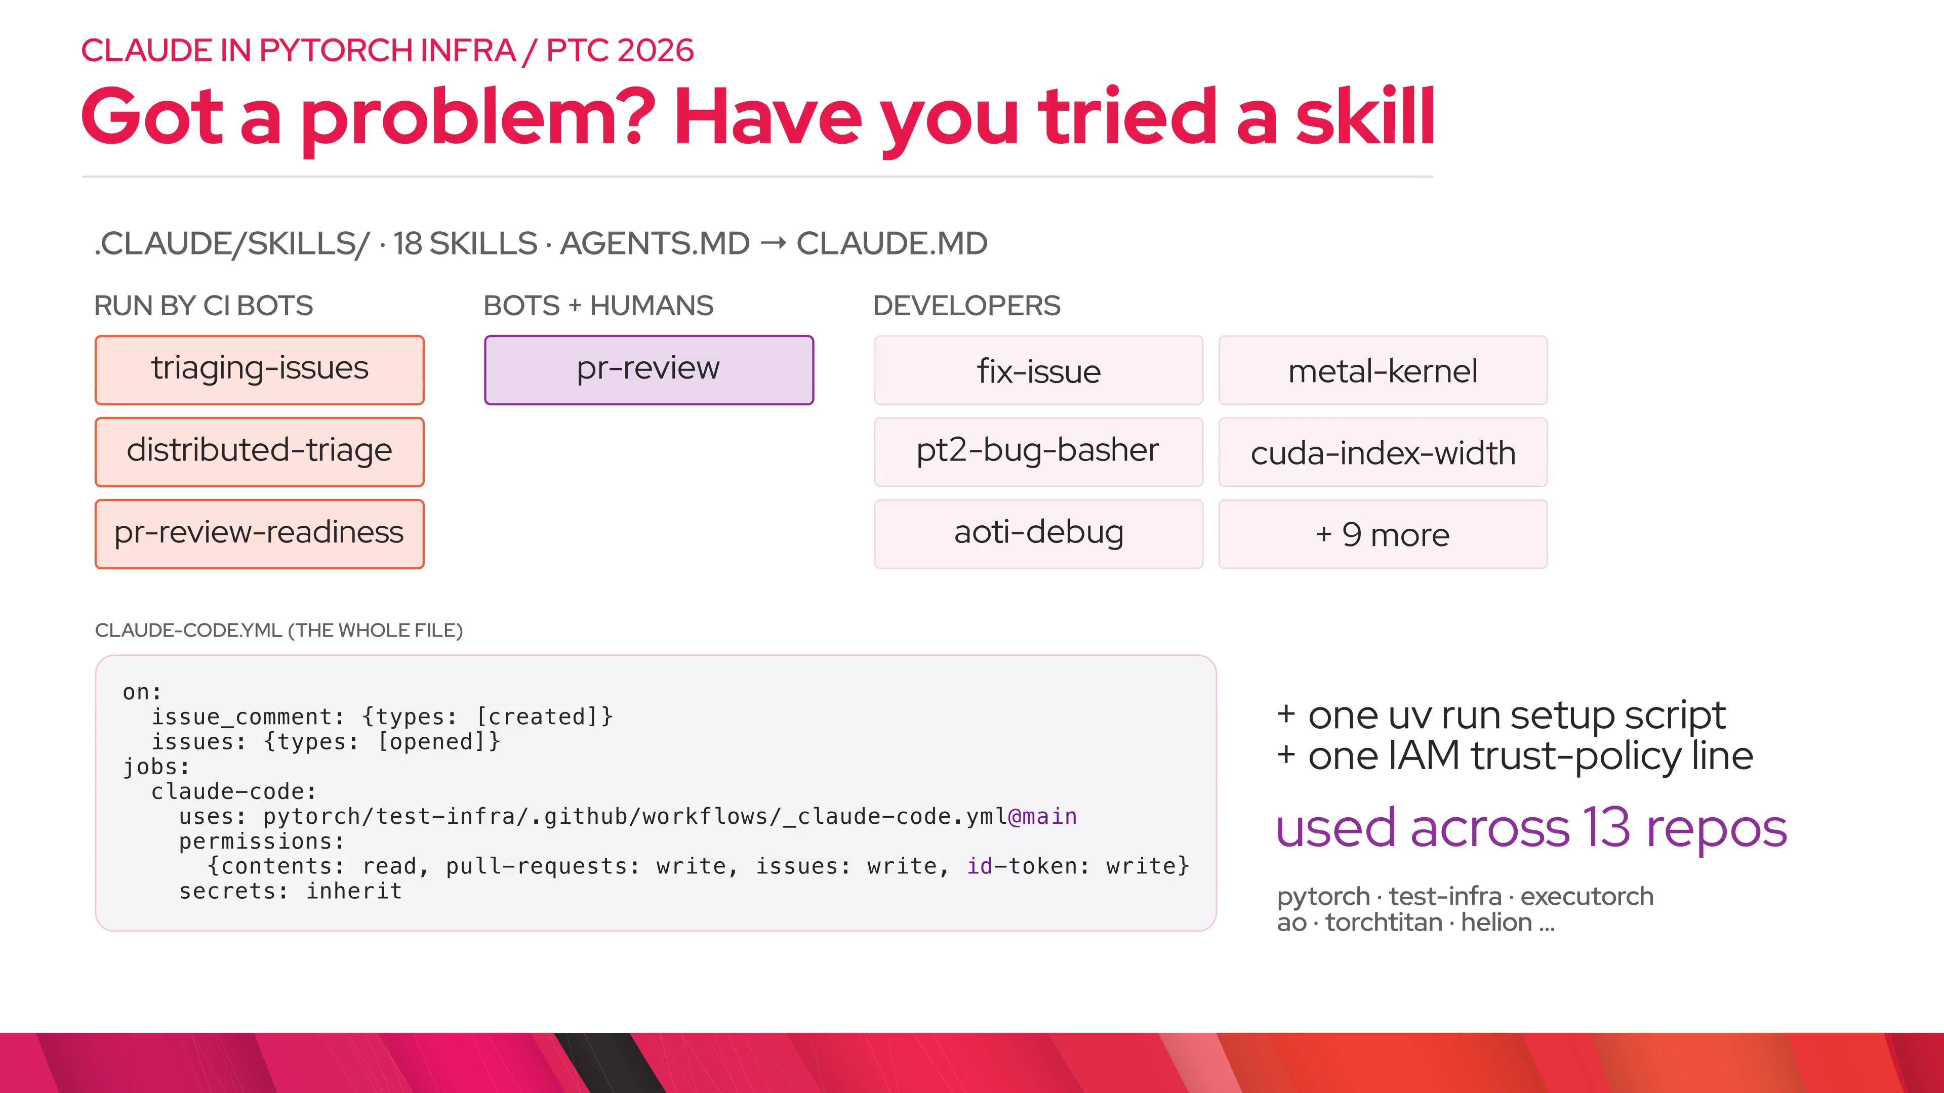
Notes:
agents_vs_agents.loop — Autorevert is itself an automated agent watching trunk. When it sees an early failure pattern it dispatches the Claude CI Advisor, which reads the logs and the suspect diff and must answer in a JSON schema: related, unsure, not_related, infra_issue, or garbage, with confidence and reasoning. It launched at 13 of 13 on its eval set. Verdicts land in ClickHouse and autorevert reads them back when deciding whether to revert. Dr.CI dispatches the same advisor on PR failures and renders the verdict inline in its comment.

Slide 15
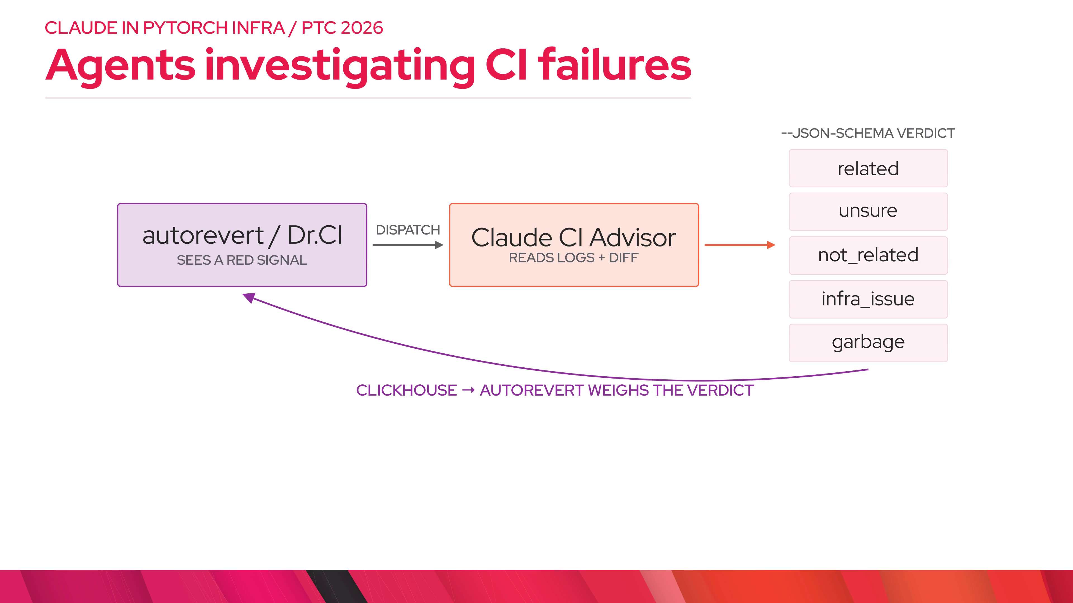
Notes:
agents_vs_agents.principles — The prompt encodes CI reasoning maintainers learned the hard way, and biases toward unsure over a false dismissal. In August Jean added a coverage lambda: about 40% of trunk reds never got a verdict, so it backfilled roughly 22 thousand historical reds in three days. Those verdicts are tagged so they can never trigger a revert; they are data for understanding flaky jobs.

Slide 16
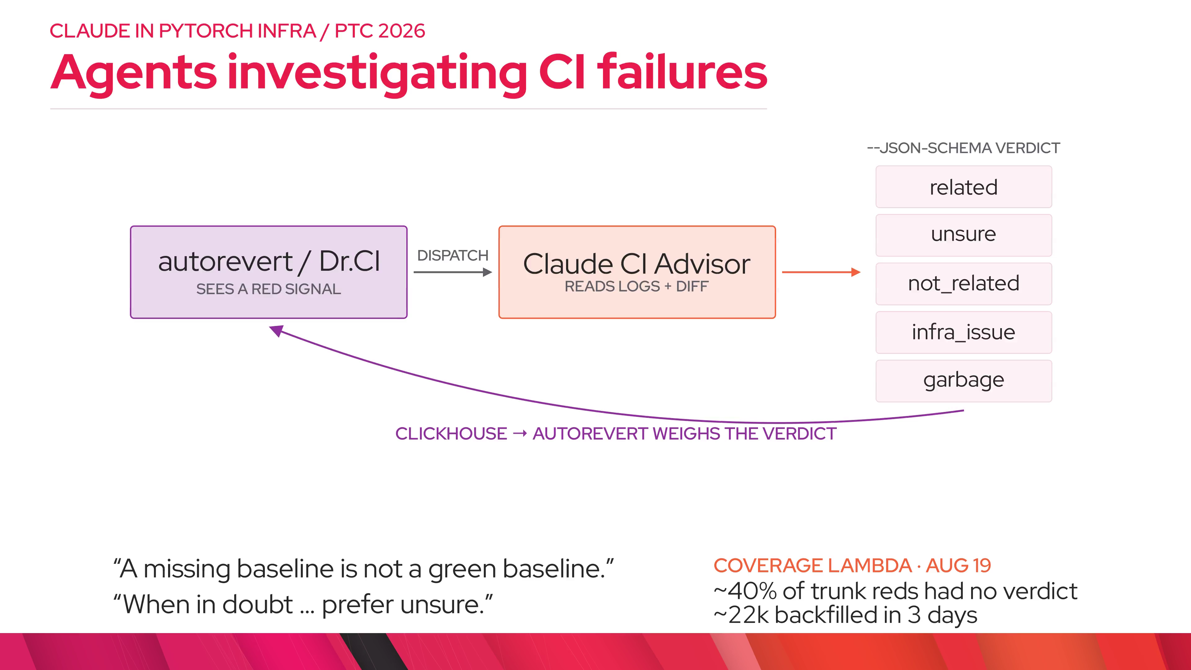
Notes:
adoption.stats — Human @claude invocations per week on pytorch/pytorch, from HUD's usage table. A trickle during the pilot; it picks up after Feb 27 when anyone with write access could use it, peaks around 900 a week in early June, and settles at a few hundred a week, with 25 to 40 distinct people every week. Since Feb 28: 135 people, 8.7k runs on 4.1k distinct PRs and issues. Triage has touched 4.4k issues from 1,375 different reporters. Thirteen repos report usage.

Slide 17
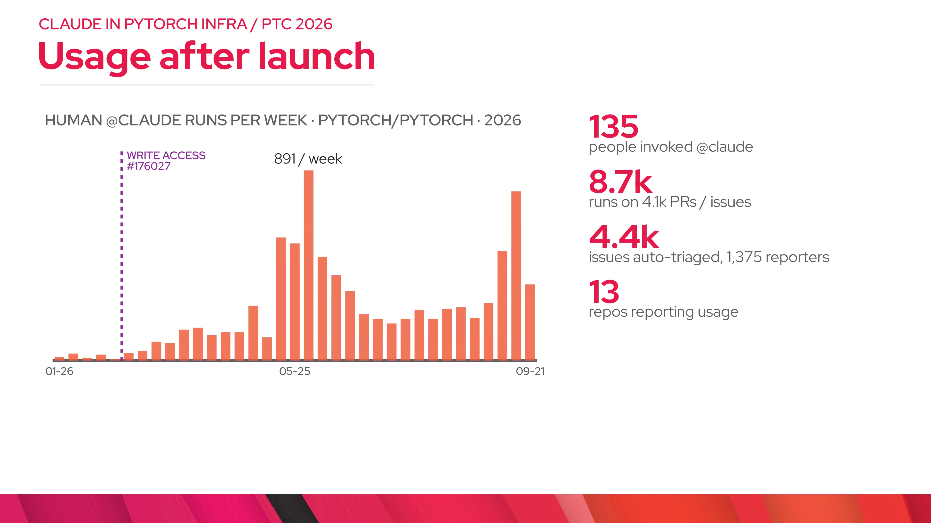
Notes:
adoption.split — The surprise: most Claude runs are not humans at all. CI advisors dispatched by autorevert, Dr.CI, and the coverage backfill are 81% of runs, at about a minute each; the August backfill alone was about 22 thousand. Human sessions are 11% of runs but much longer: median three minutes, p90 almost half an hour.

Slide 18
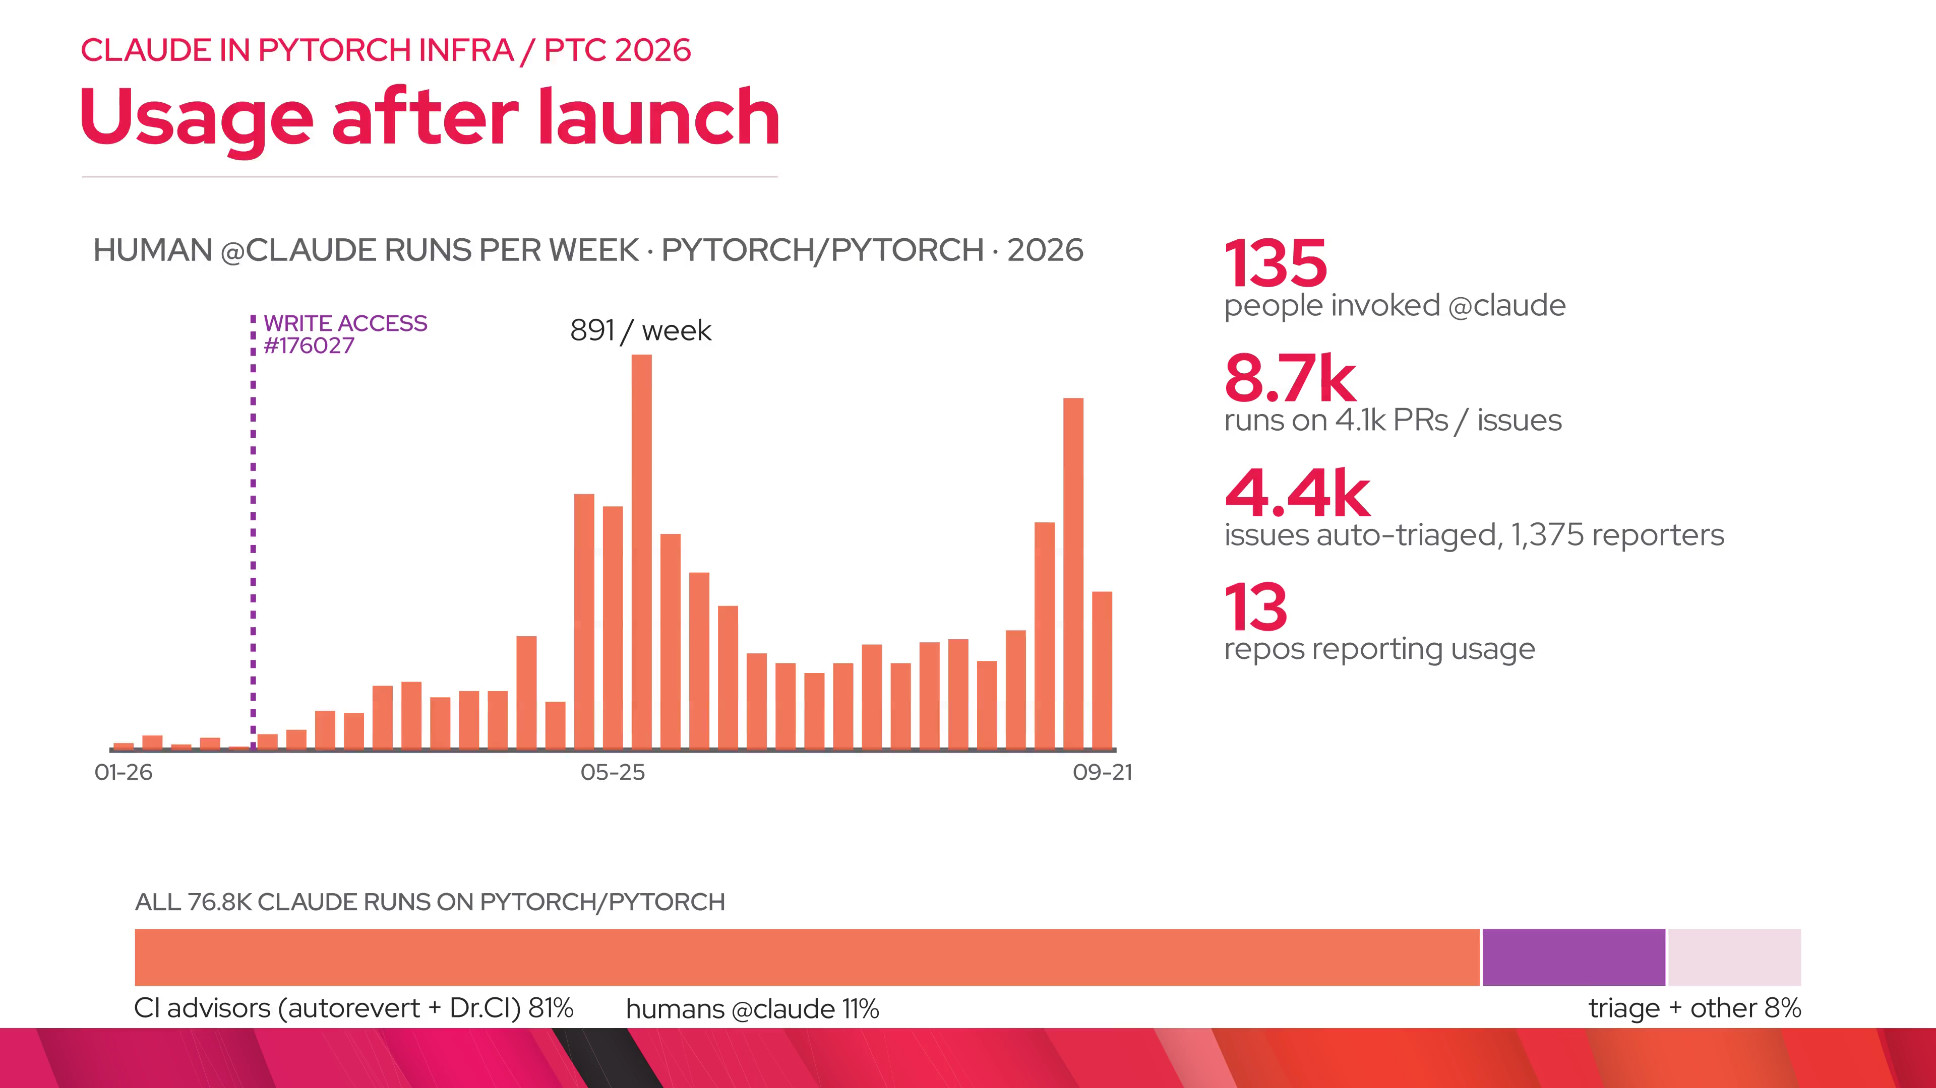
Notes:
lessons — Bots trigger bots: autorevert tags @claude on its own revert comments, and Dr.CI dispatches the advisor. Only one bot passes the @claude gate, and Dr.CI caps advisor runs per PR and skips during outages. Second: the AWS session and the GitHub App token last one hour and are never refreshed, so jobs stop at 55 minutes and a hook tells Claude when to converge and post. Some GitHub triggers run code from the PR branch; we removed pull_request_review_comment because tricking a maintainer into running it was easier than prompt injection. And trust needs receipts: every transcript is public, every bot edit is labeled.

Slide 19
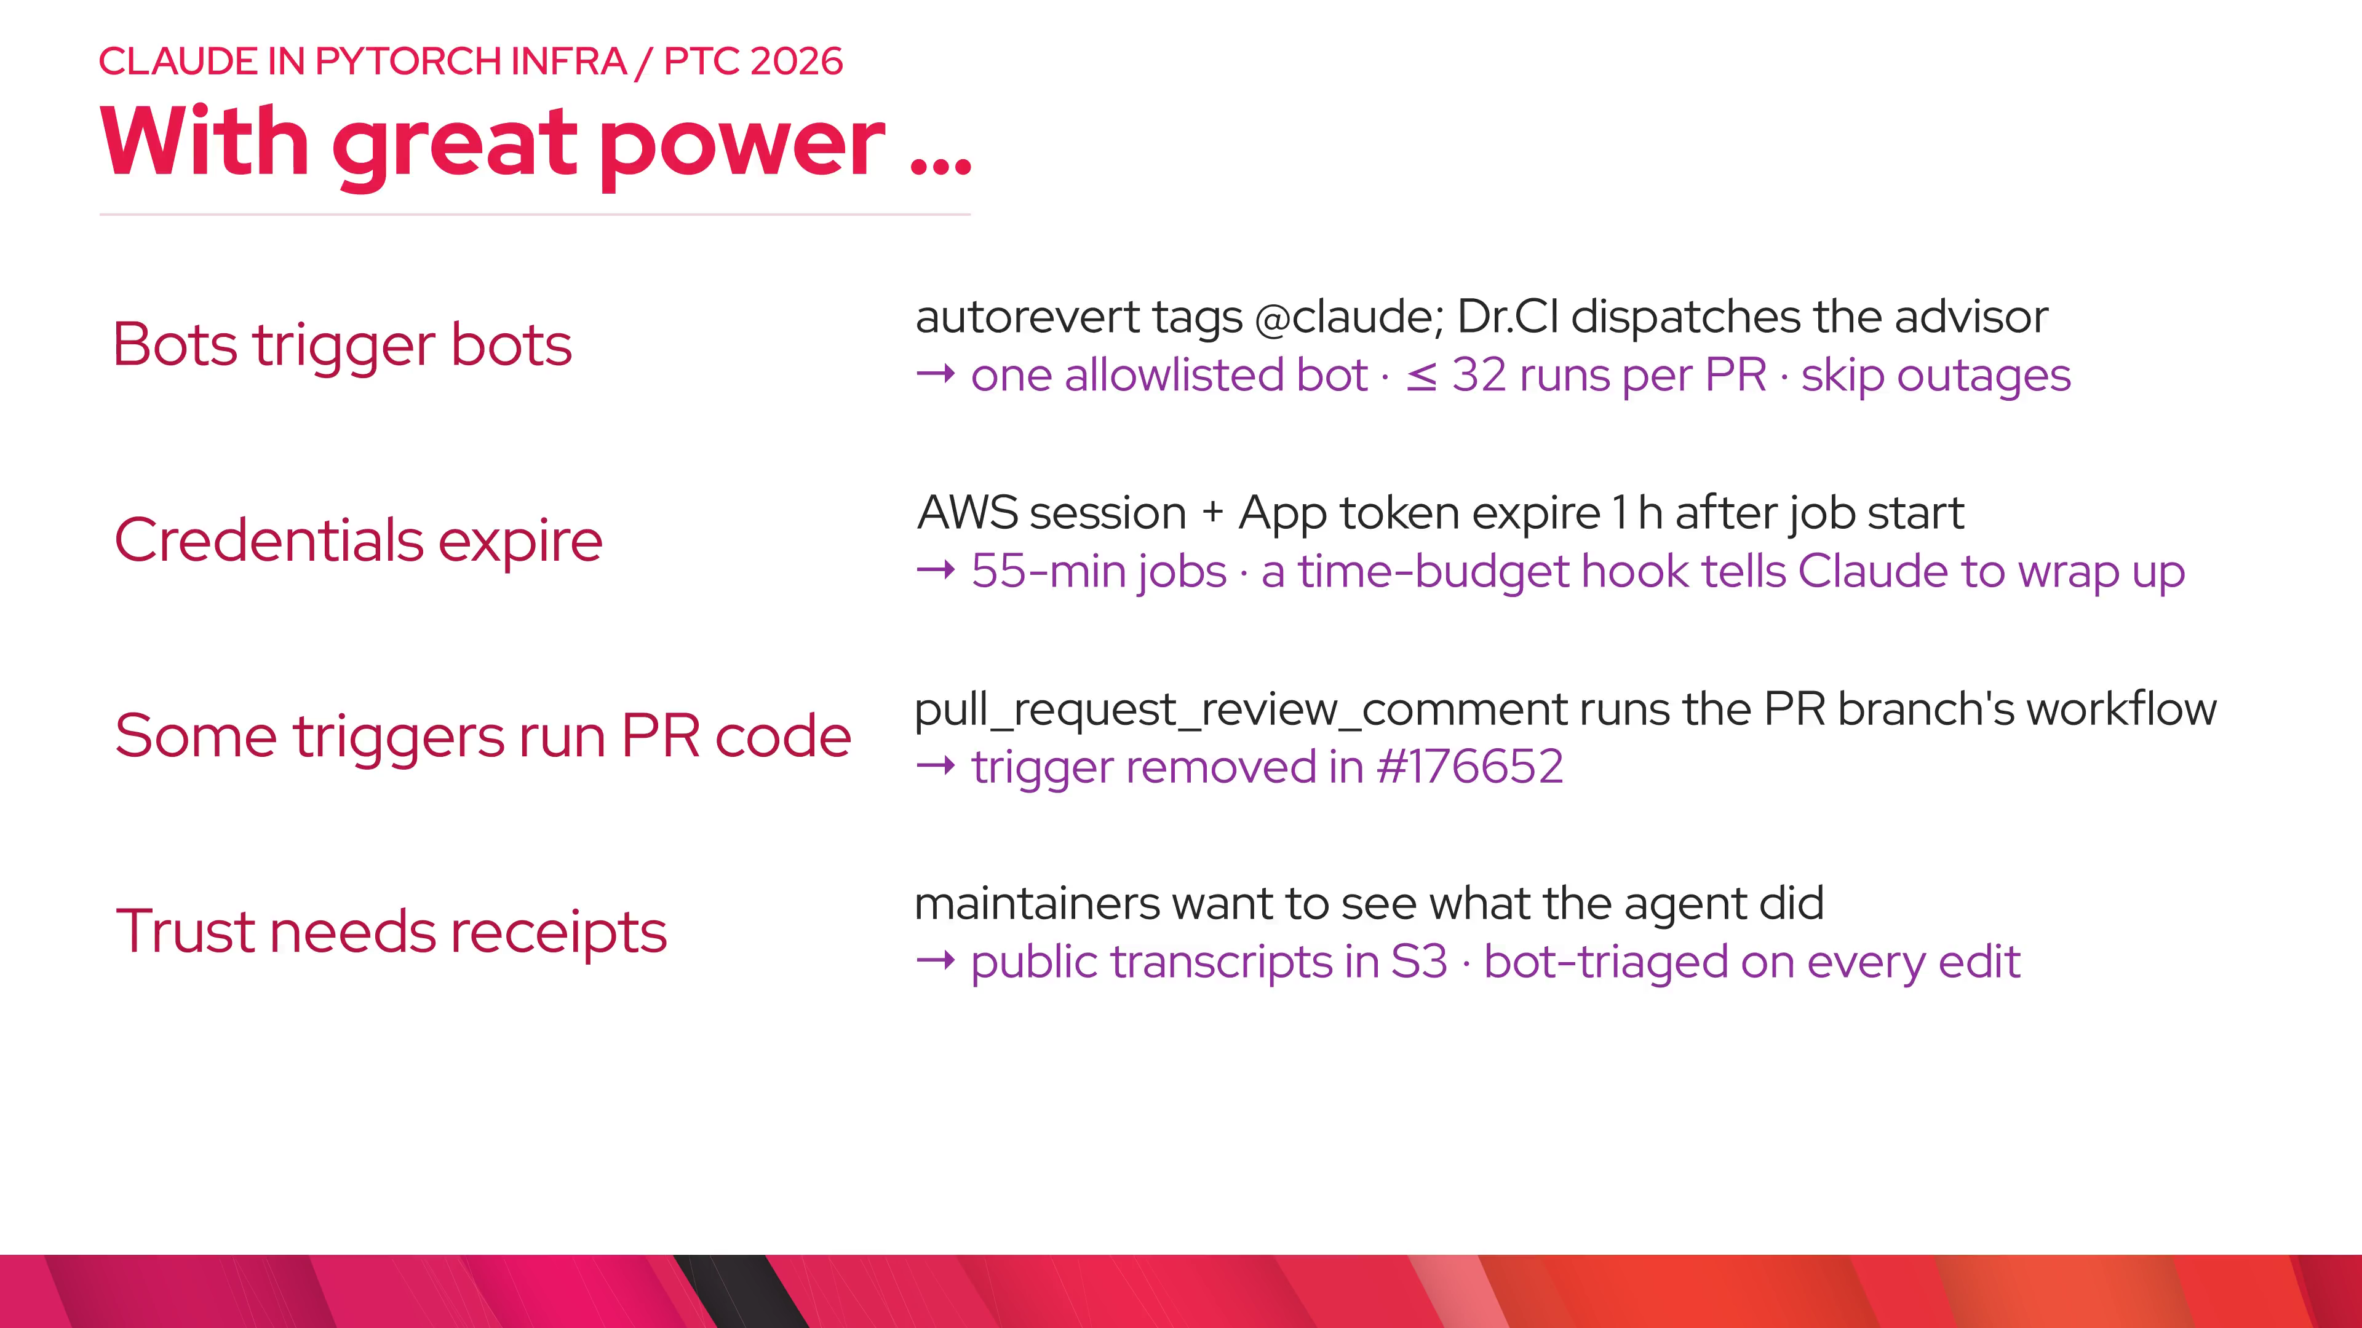
Notes:
closing — Three properties: scoped, auditable, repo-aware. If you have write access, try @claude today, including /pr-review and the fable and effort knobs. If you own a pytorch or meta-pytorch repo, onboarding is one script. The goal is not to replace maintainers; it is to keep the bar while the volume doubles.

