Slide 1
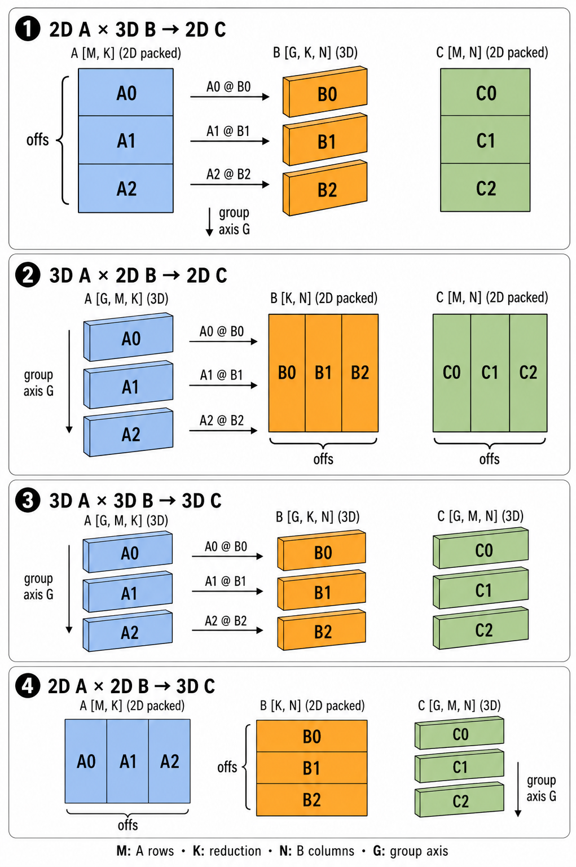

Grouped GEMM on AMD ROCm in PyTorch
Jagadish Krishnamoorthy | AMD
1. What Grouped GEMM Does
2. Composable Kernel on ROCm
Grouped GEMM performs multiple matrix multiplications in a single operation. It is commonly used for Mixture of Experts (MoE) models, where tokens are routed to different experts. Instead of launching a separate GEMM per expert, inputs are grouped and processed with one API call:
torch.nn.functional.grouped_mm(mat_a, mat_b, offs=None, bias=None, out_dtype=None)
mat_a holds input activations, mat_b holds expert weights, and offs defines the boundaries between groups in packed inputs.
The diagram shows four supported layouts:
• 2D × 3D → 2D — the primary MoE case: packed token activations are partitioned into groups and multiplied by the corresponding expert weights.
• 3D × 2D → 2D — each group has its own activation matrix and uses a shared packed weight matrix.
• 3D × 3D → 3D — a batched GEMM in which each group performs an independent matrix multiplication.
• 2D × 2D → 3D — packed matrices are partitioned into groups and produce one output matrix per group.
Grouped GEMM reduces kernel launch overhead and improves efficiency by executing multiple related GEMMs within a single operation.
On AMD Instinct™ MI250X (gfx90a), AMD Instinct™ MI300X (gfx942), and AMD Instinct™ MI350X (gfx950), set ROCM_ALLOW_GROUP_GEMM_CK=1 to select AMD Composable Kernel. When unset, PyTorch falls back to a for-loop — one hipBLASLt GEMM per expert group.
Workspace and kernel arguments are managed by the HIP Caching Allocator, eliminating per-call allocation overhead critical in layer-by-layer MoE inference.
Two kernels:
• When all experts share the same K, CK dispatches DeviceGroupedGemmXdlSplitKCShuffle — avoids per-group stride recomputation and writes results directly to output.
• When K varies across groups, DeviceGroupedGemmMultipleDSplitKXdlCShuffleTwoStage accumulates partial sums in an fp32 workspace and commits in a second pass.
Key takeaway: one grouped kernel launch replaces one GEMM per expert — enabled by a single environment variable, with no model code changes.
CK launches one kernel for all experts; the for-loop path launches one GEMM per expert.
How to use
export ROCM_ALLOW_GROUP_GEMM_CK=1
out = torch.nn.functional.grouped_mm(mat_a, mat_b, offs=offs)
Requires a ROCm build of PyTorch on gfx90a / gfx942 / gfx950.
The four supported grouped GEMM input/output layouts.
© 2026 Advanced Micro Devices, Inc. All rights reserved. AMD, the AMD Arrow logo, AMD Instinct, ROCm and combinations thereof are trademarks of Advanced Micro Devices, Inc. PyTorch, the PyTorch logo and any related marks are trademarks of The Linux Foundation.

