Slide 1
Mapping from Native Data to CDM
A Stepwise Guide

Slide 2



We’ve all been there before…
This piece of our stack is rubbish. Bloated. Out of date. Not fit for purpose!
THIS NEW THING IS AMAZING AND SOLVES ALL THE PROBLEMS WE HAVE. Let’s rip everything out and build it all over again!
“No, let’s not, because we don’t have the budget or the risk appetite”

Slide 3
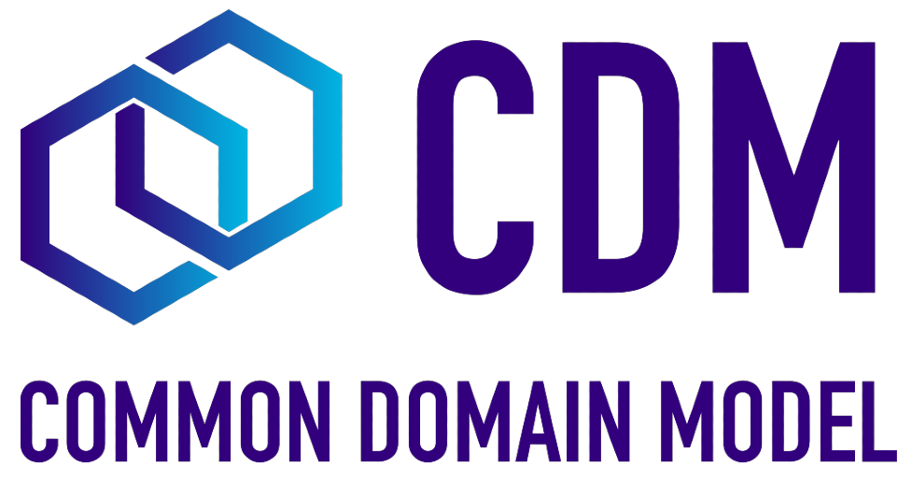
Where does CDM fit in?
CDM works as common language, for data.
But clients and institutions have been using their ‘own’ language for years, decades. And it’s built into every system.
Is it really realistic to strip everything out and to simply start again?

Slide 4
Can’t rip it all out – so where do we go?
Fundamental to remember that CDM is just a way to represent data.
Lots of value in everyone having that same representation
  Reduce discrepancies
  Resolve disputes
  Interconnectivity and communication between different applications
Changing from one data source to another to unlock CDM is a reasonable step to take to unlock its power without rebuilding the whole foundation.

Slide 5
VIDEO OF ARK 51 functionality

Slide 6


Slide 7
Before we even begin!
What is the use case that could give us an MVP?
Are the right people and resources available for the project?
Is the native data good enough?

Slide 8
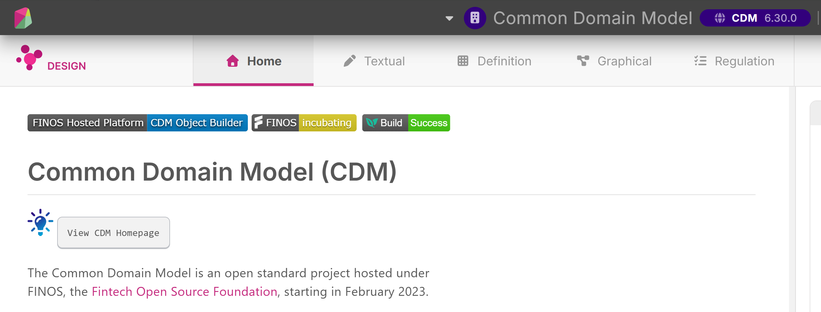
Lets start building our mapper
Various tools available to help you understand and dissect CDM.
To build our mapper we used Rosetta – a platform provided by Regnosys
https://ui.rosetta-technology.io/workspace-manager

Slide 9
Video of Rosetta Functionality

Slide 10
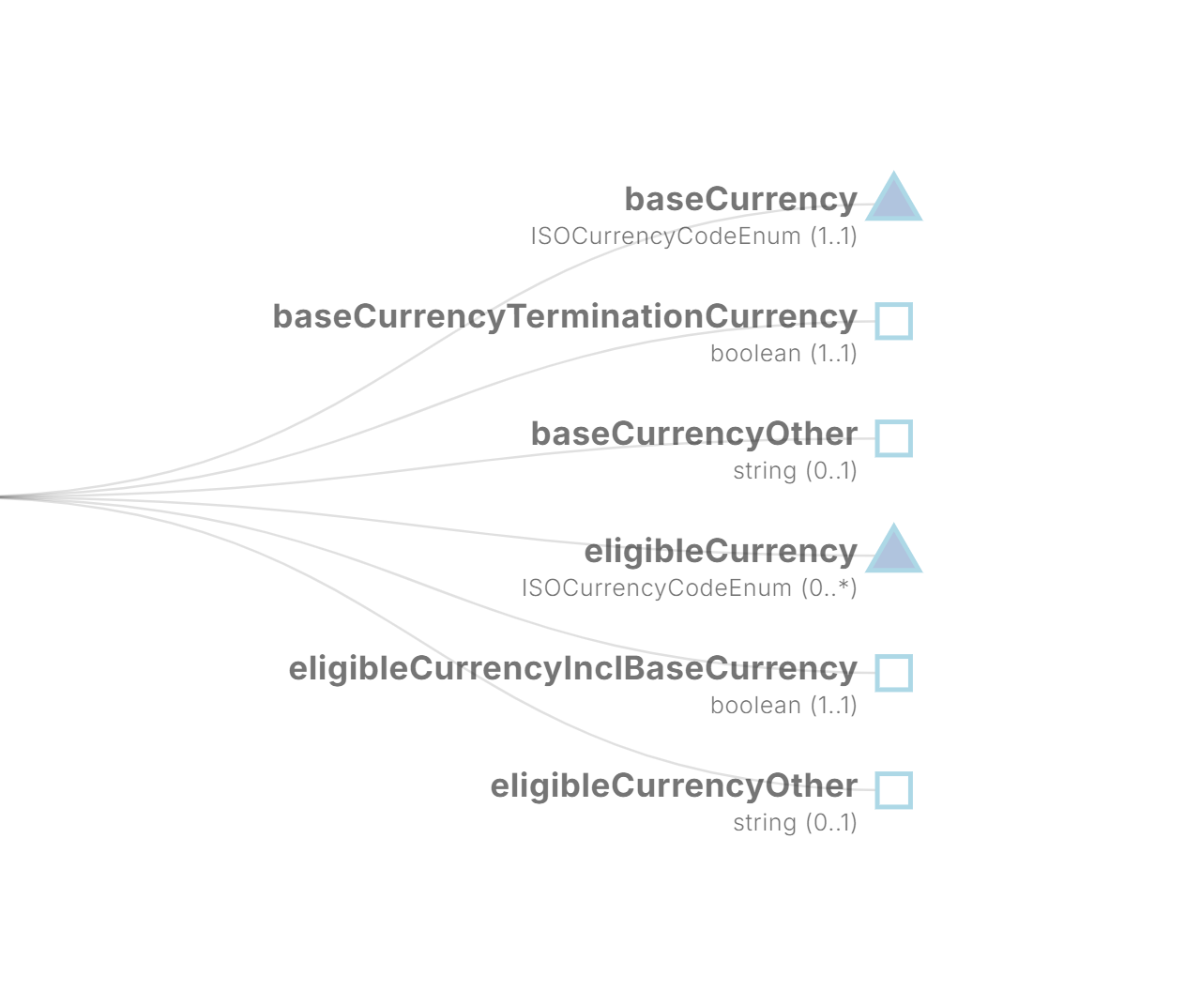

Start at the bottom, and work our way up.
Here we’ve got triangles (enumerated lists)
And squares (primitive values)
Sensible place to start!
Warning! This is the part where Paul boots up VS Code and things can go dramatically (and probably hilariously) wrong

Slide 12
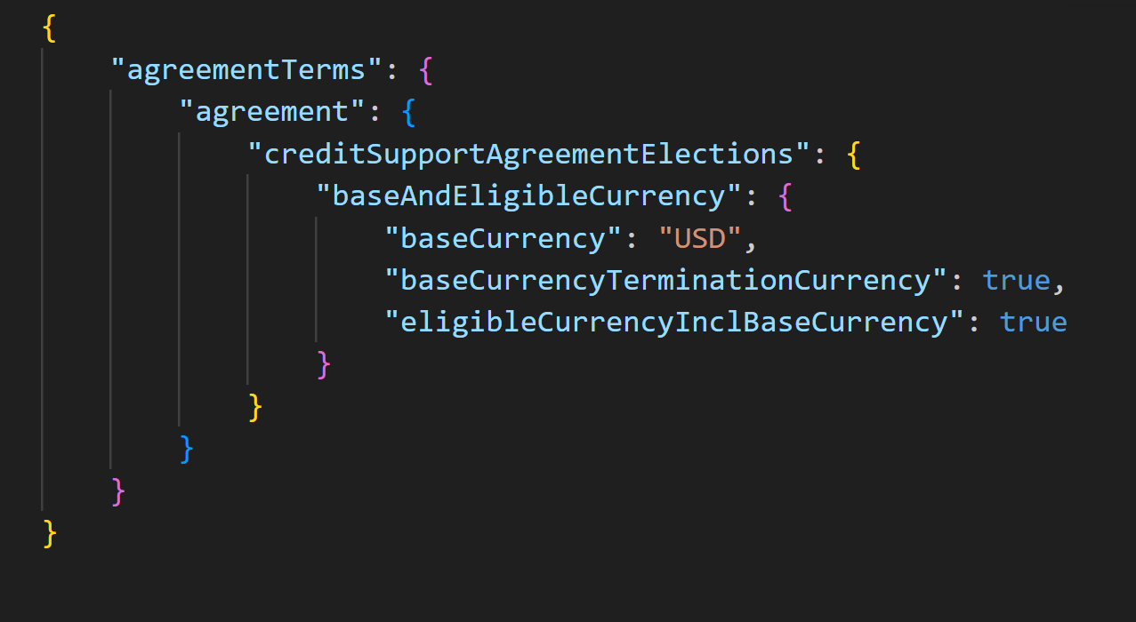
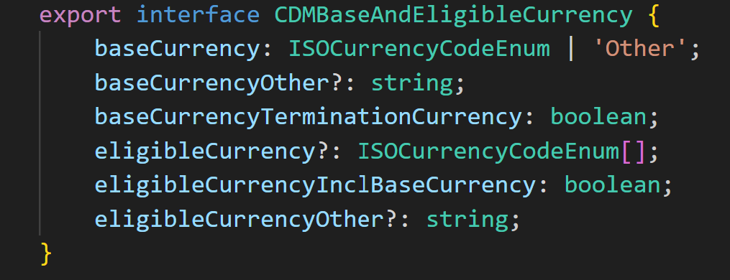
1 down… Eleven thousand million to go!
Note: right now, this is NOT valid CDM!

Slide 13


We wrote a white paper on it!

Slide 14

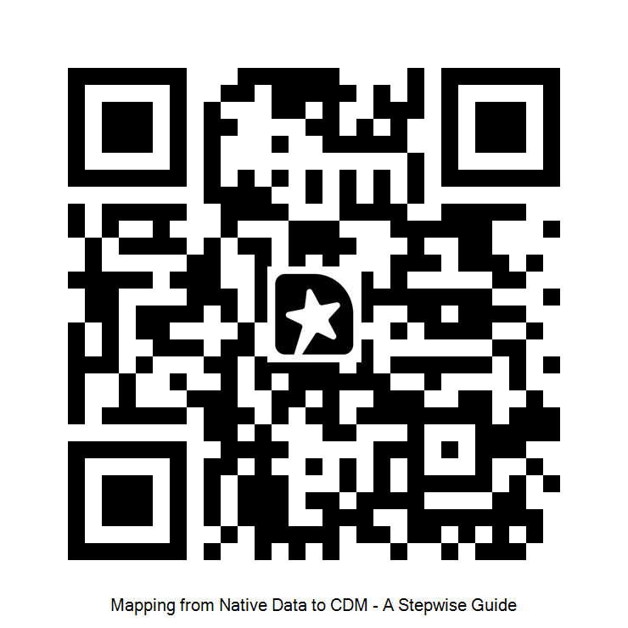
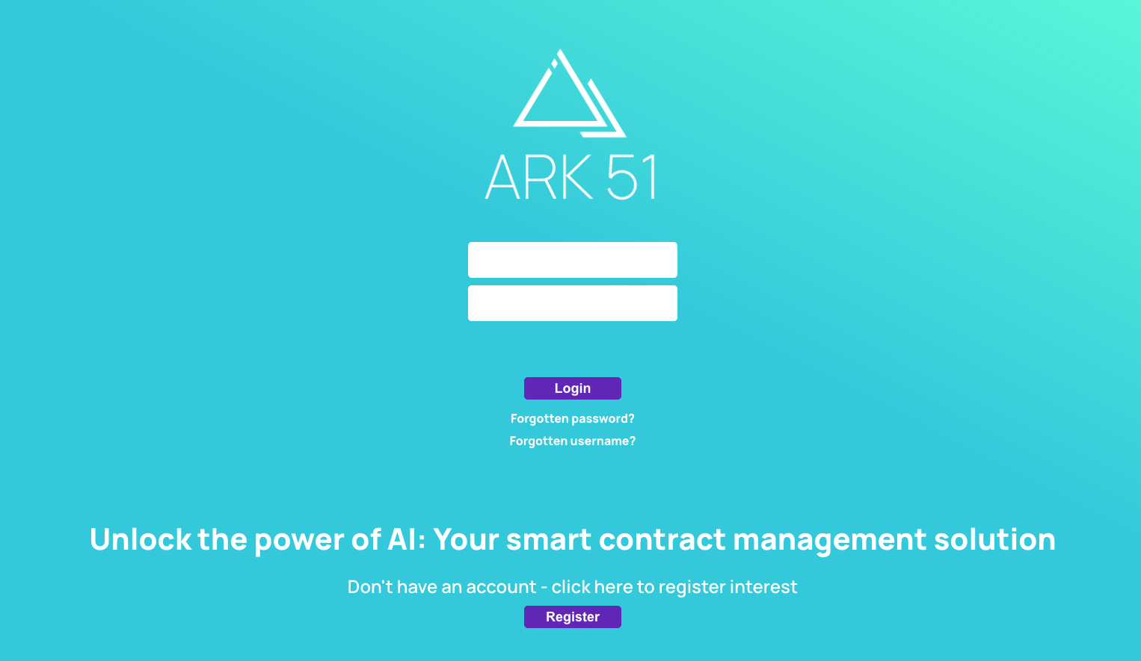

Paul Hands
Chief Technology Officer
Happy to answer any questions or queries, please get in touch!
E: paul.hands@ark-51.com

