Slide 1
TorchTitan RL: A Scalable and Extensible Training Framework for Agentic Tasks
Felipe Mello
Software Engineer, Meta
Jiani Wang
Software Engineer, Meta

Slide 2
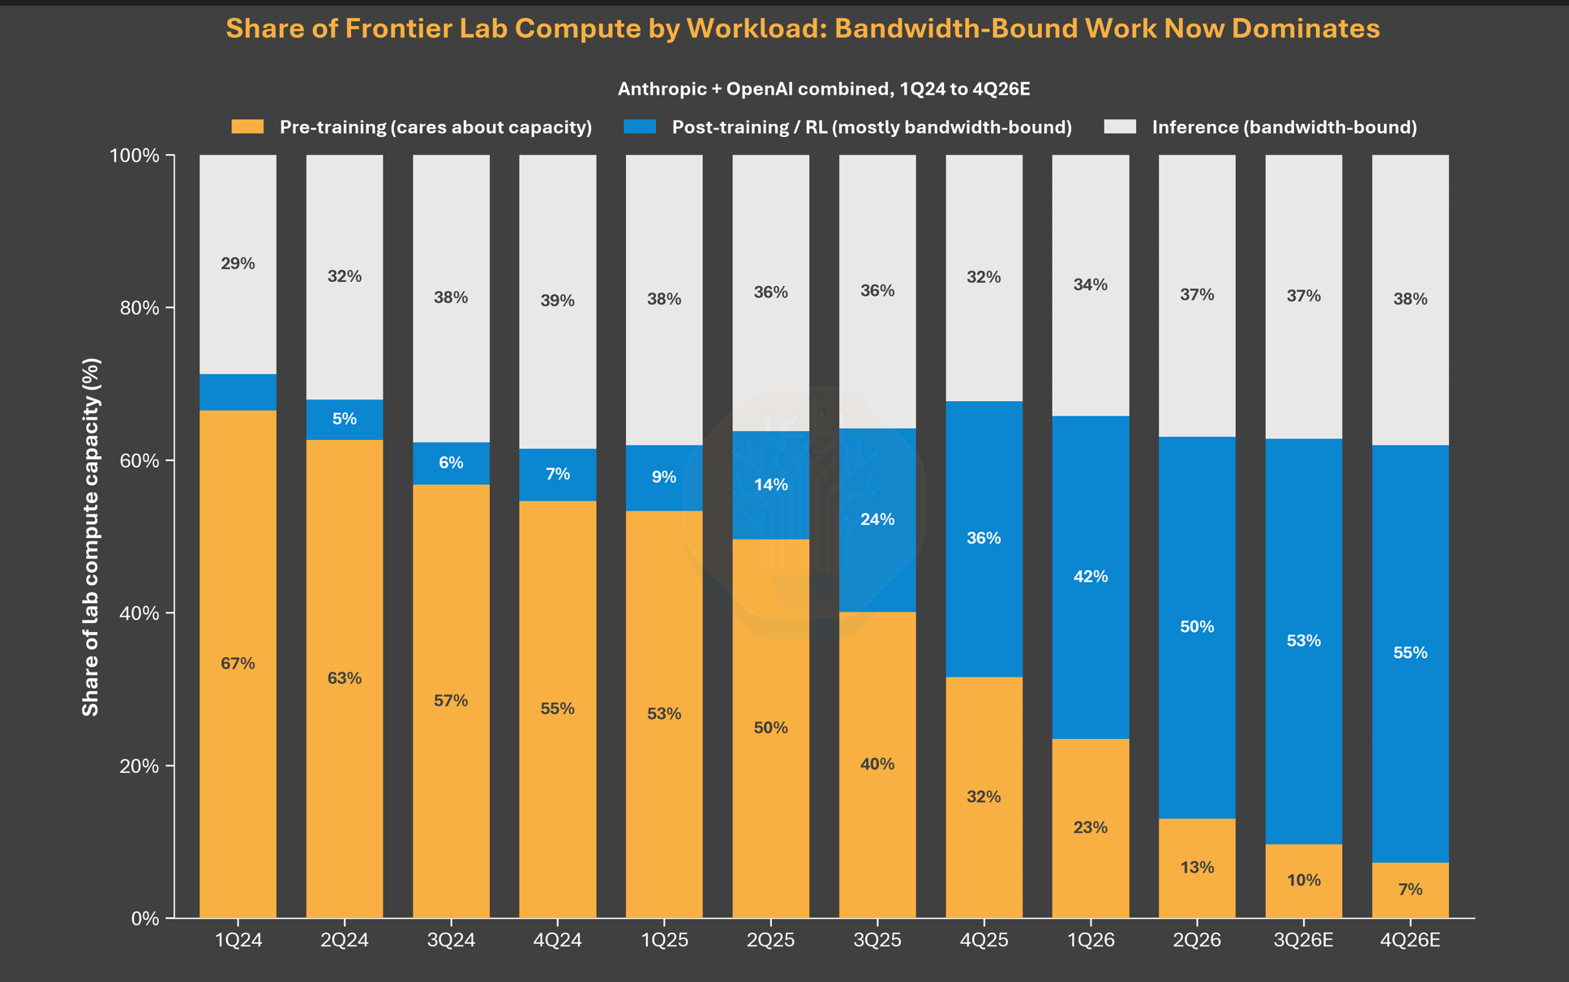
One model definition, from pretraining to post-training
CONTEXT
TorchTitan is a PyTorch-native large-scale training framework that, until recently, was focused on pretraining.
In 2026 TorchTitan decided to invest in building an RL solution.
TORCHTITAN USERS
Hardcore users
Fork and hack
Scale
Own model architecture
Source: https://newsletter.semianalysis.com/p/long-live-the-short-king-why-4-hi

Slide 3
Getting everyone up to speed…
Pretraining / SFT
RL
We have the data
We generate the data on-the-fly
We score it
We do next token prediction
We do weighted-next token prediction
PyTorch code
PyTorch code
logits = model(input_ids)
loss_per_token = F.cross_entropy(logits, targets)
mean_loss = loss_per_token.mean()
generated_response, scores = generate(prompt)
logits = model(generated_response)
loss_per_token = F.cross_entropy(logits, targets)
mean_loss = (scores * loss_per_token).mean()

Slide 4
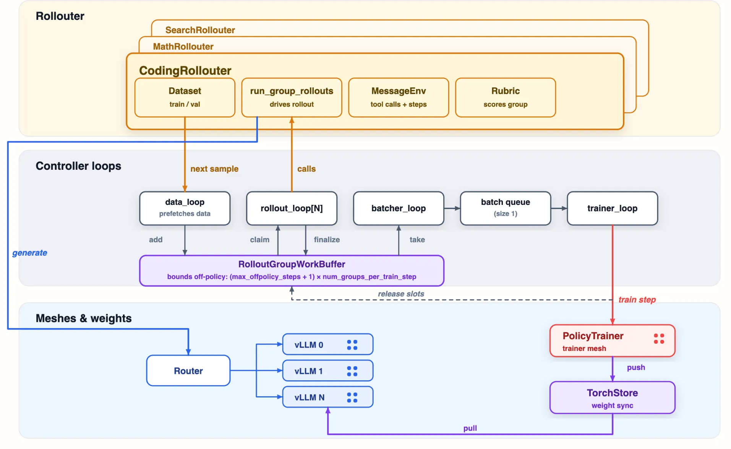
Fully-Async Architecture
The pretraining / SFT trainer
everything else exists for RL

Slide 5
One model definition, from pretraining to post-training
The same model definition for pretraining, RL training, and generation inside vLLM.
model.py
model definition
class Muse(Decoder):
...
Pretraining
TorchTitan Trainer
FSDP, TP, PP, CP, EP
RL training
TitanRL Trainer
on the same training engine
Generation
inside vLLM
through inference adapters
Shared model code. Execution adapted to each workload.

Slide 6
One model definition, from pretraining to post-training
Typical RL library
TitanRL
RL library
torchtitan/.../model.py
class Muse(Decoder)
Some Trainer
vLLM
trainer/.../muse.py
class SomeTrainerMuse
vllm/.../muse.py
class vLLMMuse
TorchTitan trainer
vLLM
with TorchTitan's model
π_{θ}
≠
μ_{θ}
π_{θ}
=
μ_{θ}
trainer
vLLM
trainer
vLLM
3 libraries, 2 model definitions
1 model definition, no wrapper
Aligned numerics
Easy maintenance
Decoupling model and infra
Reduced trainer-generator mismatch from first principle
Share underlying kernels and optimization
Keep modeling research experiment logic independent of trainer and inference infrastructure
Notes:
- Typical RL libraries glue a training engine (e.g. Megatron) to an inference engine (e.g. vLLM), each with its own implementation of the model. TitanRL runs the same TorchTitan model definition in the trainer and inside vLLM.
- Write each model once: no second implementation to maintain, which matters most for research models that have no OSS implementation yet.
- Fewer mismatch bugs: with one definition it is hard to create a trainer/generator mismatch by accident.
- Bitwise-identical mode: the unified model is what makes batch-invariant mode possible, where trainer and vLLM log-probs match bitwise (next slides).
- If asked 'doesn't one definition cost inference speed?': inference-only speed was 80-87% of the vLLM-native model, depending on workload (H1 doc).

Slide 7




Experiments
Composable parallelism
Verifiers integration
Trainer: FSDP · TP · PP · CP · EP
Generators (vLLM): DP · TP · EP
Bring Verifiers environments as they are: harnesses, sandboxes, subagents, context compaction
Low-level control
Batch invariance
One codebase you own: model, kernels, KV cache, scheduling. Change what your research needs.
Bitwise-identical trainer and vLLM log-probs in supported configs: a clean baseline for debugging

Slide 8
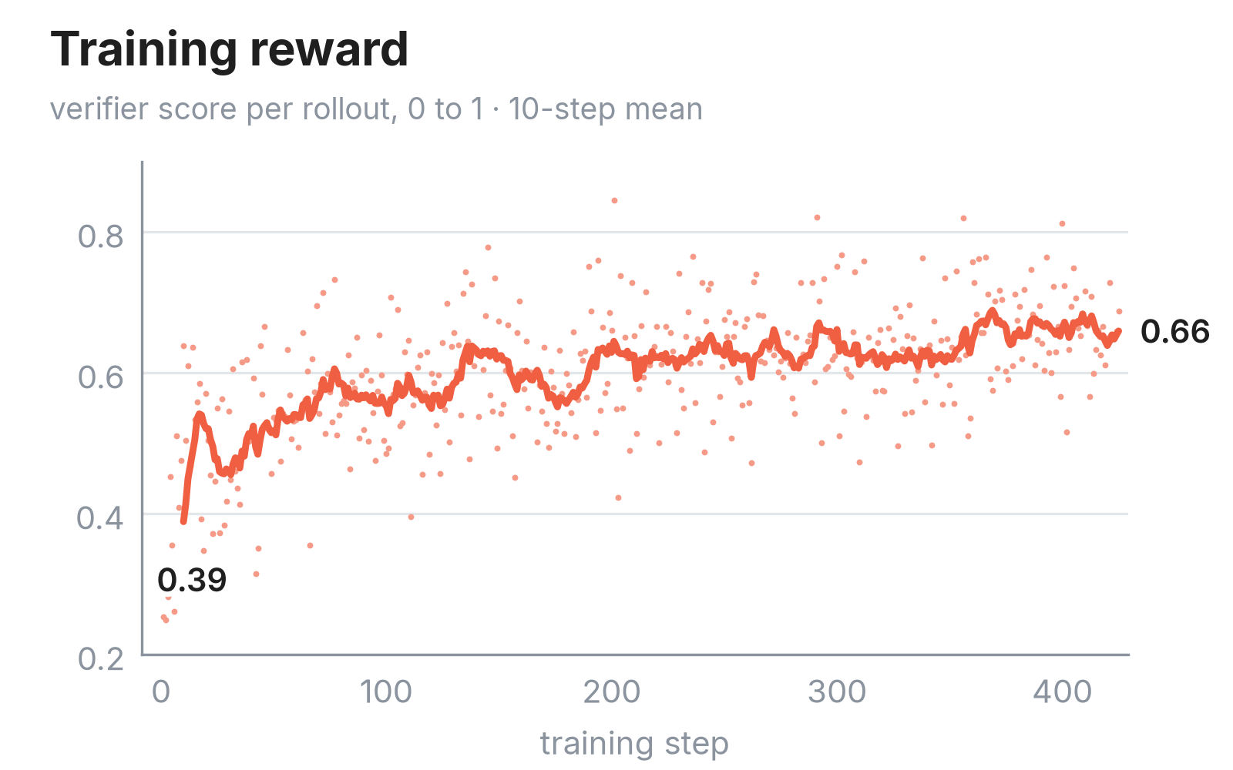
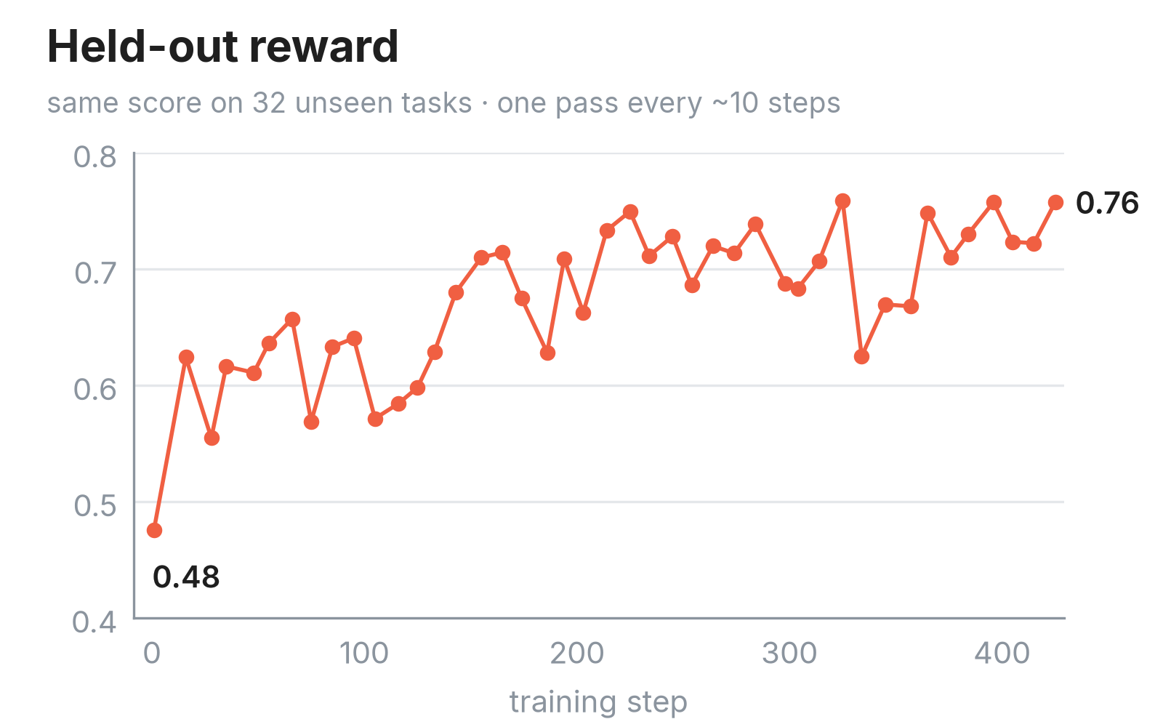
Experiments
SWE-Rebench agent
TRAIN
SWE-Rebench, easy Python tasks
EVAL
Held-out easy tasks
MODEL
Qwen3.5-35B-A3B base
64K context
HARDWARE
40 GB300
Notes:
W&B: https://meta.wandb.io/torchforge/sandoq-swerebench-v2-agent-in-sandbox/runs/c3n8uonq?nw=nwuserfelipemello

Slide 9
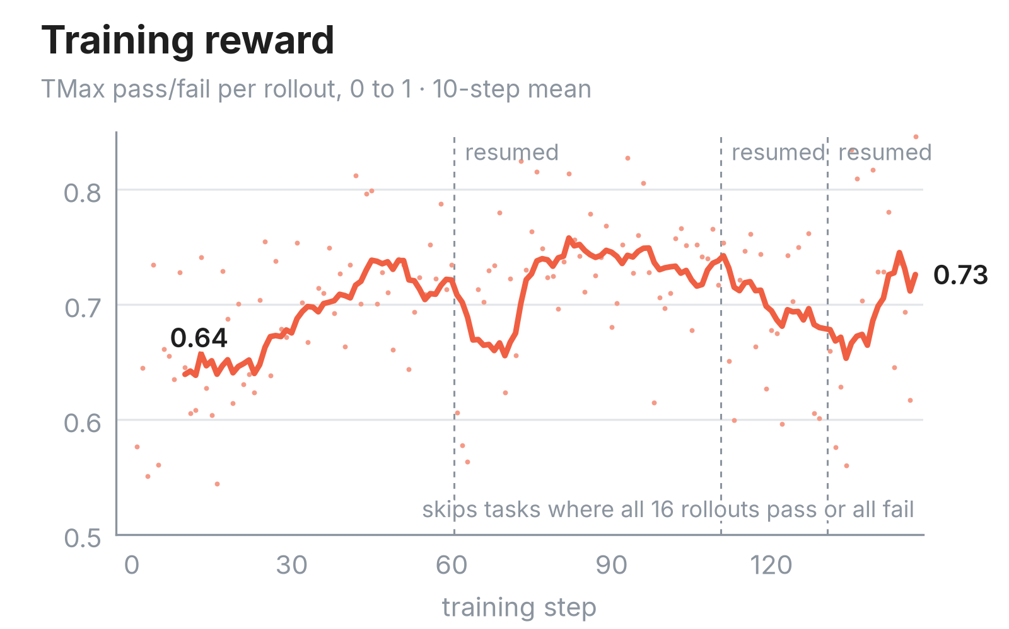
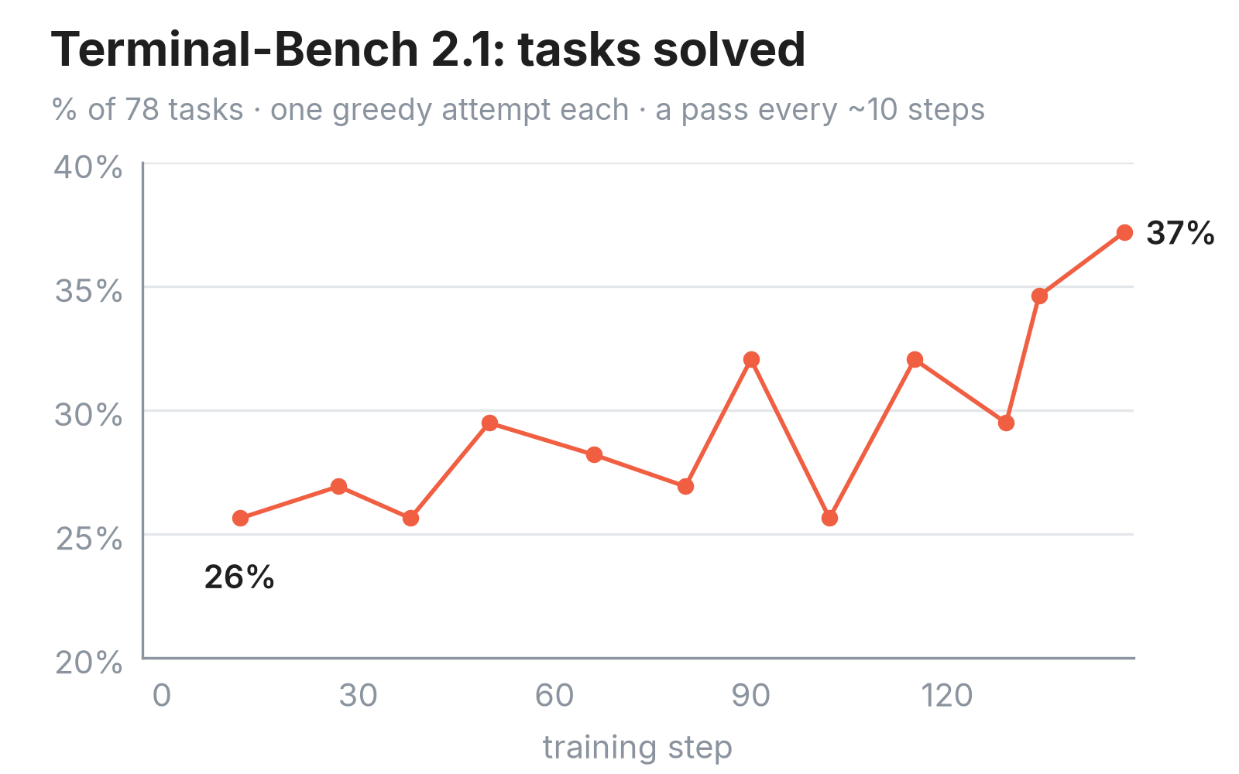
Experiments
Terminal-Bench agent
TRAIN
TMax, 15K tasks
EVAL
Terminal-Bench 2.1 (78 tasks)
MODEL
Qwen3.5-35B-A3B base
128K context
HARDWARE
20 GB300
Notes:
W&B: https://meta.wandb.io/felipemello/tb-gb300/runs/tbv2_c57bbdc9?nw=nwuserfelipemello

Slide 10
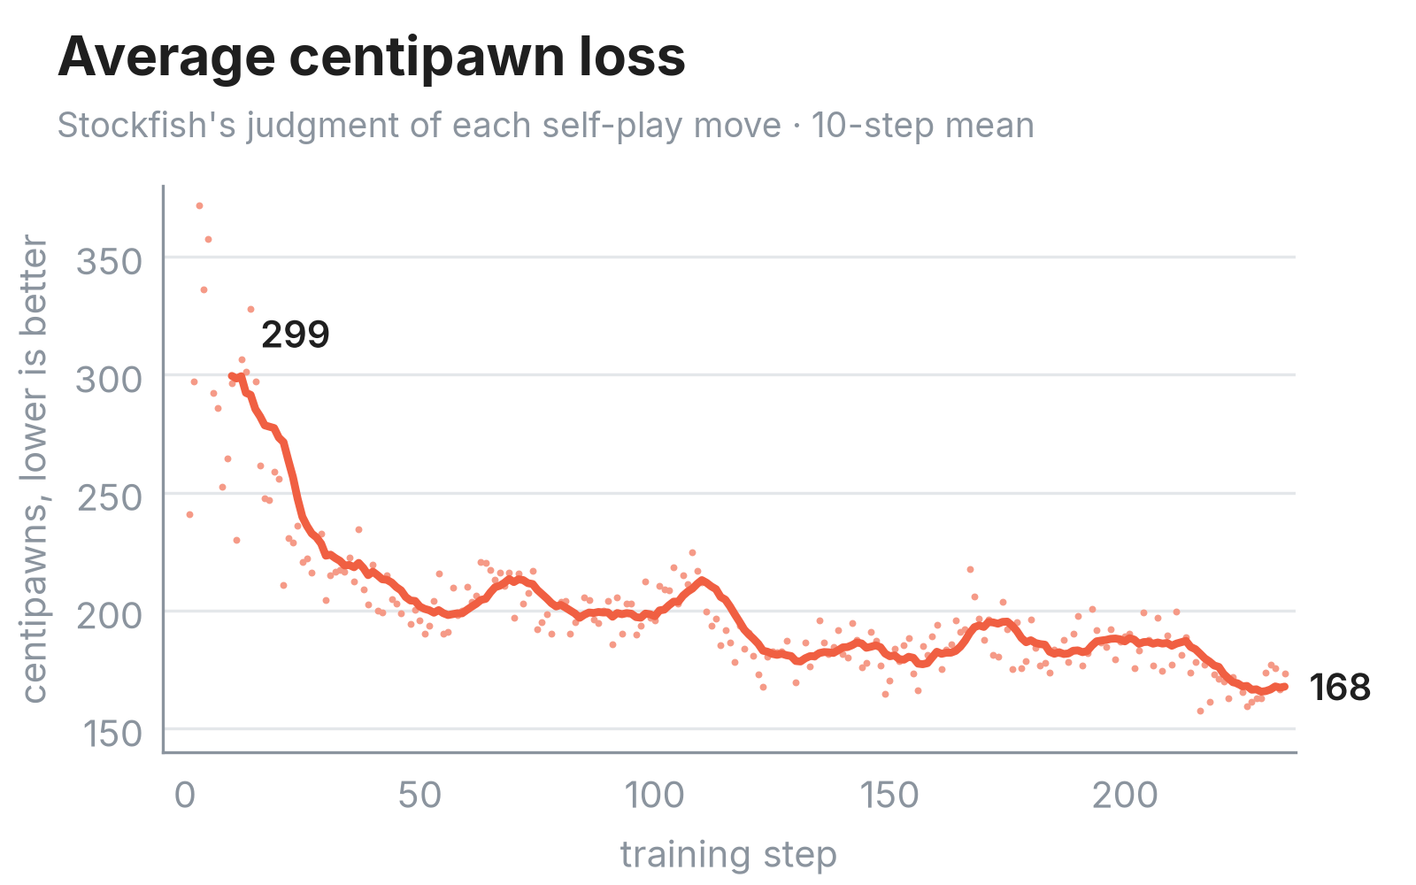
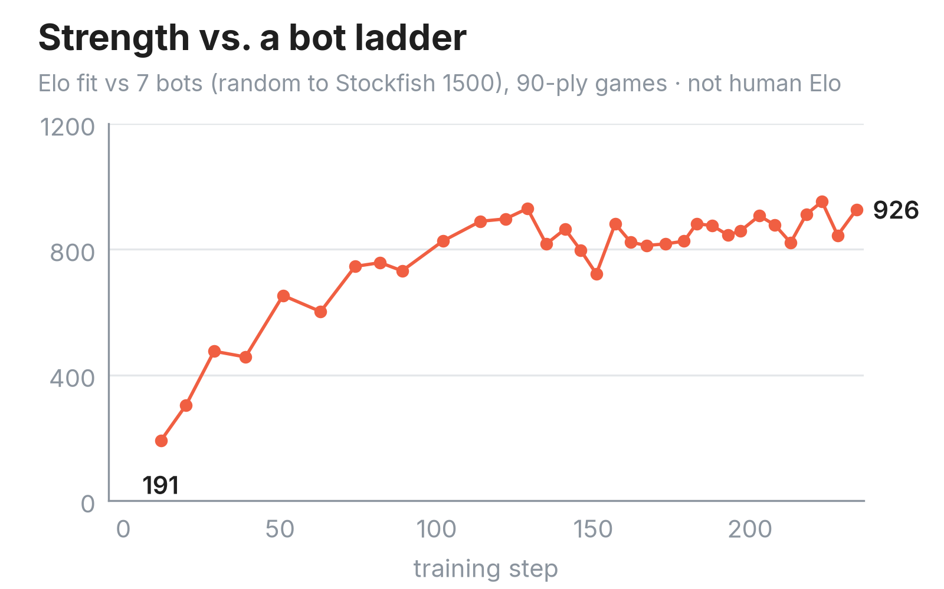
Experiments
ACPL is "average centipawn loss": how much worse your moves are than the best move, measured in hundredths of a pawn, averaged over your moves.
Chess self-play
TRAIN
Self-play from random openings
EVAL
Bot ladder up to Stockfish 1500
MODEL
Qwen3.5-4B base
131K context
HARDWARE
20 GB300
Notes:
W&B: https://meta.wandb.io/felipemello/chess_118?nw=nwuserfelipemello

Slide 11
Experiments
TitanRL allows you to train:
Dense/MoEs
>130k
>100
>100s
seqlen
turns
Stable steps
Subagent, compaction, self-play, toolcalling, sandbox, etc…
Performant
Close support from pytorch, on par with megatron
You are in control of the entire stack

Slide 12
Under the hood

Slide 13
Distributed execution with Monarch
Controller
one Python process
Trainer
GPU mesh
Generators
N vLLM GPU meshes
Rollout workers
CPU pool
TitanRL uses Monarch to run the whole job from one Python process: the controller spawns the trainer, generators and rollout workers on the cluster, and calls them with async messages.
# 1. spawn processes, then actors on them
procs = host_mesh.spawn_procs(per_host={"gpus": 8})
trainer = procs.spawn("trainer", TrainerActor, cfg)
# 2. an endpoint is an async method
@concurrent_endpoint
async def forward_backward(self, batch): ...
# 3. call it on every rank
await trainer.forward_backward.call(batch)
simplified from torchtitan/rl: controller.py, actors/trainer.py
Notes:
(~1 min) TitanRL's controller iis one Python program. With Monarch it allocates process meshes on hosts, spawns actors on them, and talks to them with async messages: a trainer mesh, N vLLM generator meshes, a router, and a pool of CPU rollout workers. Each mesh is sized for its job and they all run at once.
The code is the real API, trimmed: spawn_procs puts processes on hosts; mesh.spawn puts an actor on every process; endpoints are plain async methods marked @concurrent_endpoint, so each message runs as its own asyncio task; and calls return futures: call() hits every rank, call_one() one rank, choose() any one worker, stream() yields per-rank replies.
The Trainer and VLLMGenerator are plain Python classes; the Monarch actors are thin wrappers. That's what lets the controller start weight sync and rollouts in the background and keep training.
Not claimed: TitanRL does not use Monarch's supervision or recovery today (errors fail fast), and it doesn't call monarch.rdma directly (RDMA reaches it only through TorchStore).
Sources: torchtitan/rl/train.py, controller.py, distributed/monarch_actors/trainer.py, rollout/rollouter.py, router inter_generator.py.

Slide 14
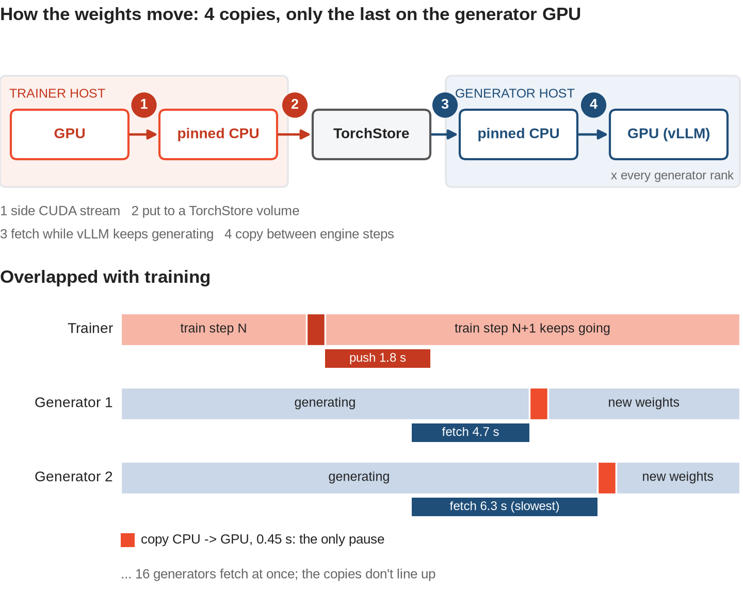
Weight sync with TorchStore
Qwen3.5-35B-A3B · 5 GB300 hosts · 16 generators
ACTUAL
EXPOSED
trainer push
1.8 s
~0 s
generator pull
7.1 s
~0 s
median per step, 124 steps
No lockstep barrier
each generator pauses only for its 0.45 s CPU → GPU copy: ~0.25% of a 185 s step
Notes:
(~1 min) After each optimizer step, the weights travel in four copies, and only the last one touches the generator GPU:
1) the trainer copies GPU -> pinned CPU on a side CUDA stream;
2) a worker thread puts that copy into a TorchStore storage volume on the same host;
3) every generator fetches its copy into a pinned CPU buffer while vLLM keeps generating;
4) the generator copies CPU -> GPU between engine steps; in-flight requests are not drained.
No lockstep barrier: the controller only checks that push N finished before the next optimizer step and pull N finished before push N+1, so the trainer waits only if a sync outlasts a training step.
Numbers: chess run chess118gm, Qwen3.5-35B-A3B-Base on 5 GB300 hosts (host 0 trains, hosts 1-4 run 16 single-GPU generators), steps 91-214, medians per step. Push 1.8 s actual, ~0 exposed (14 us). Pull 7.1 s actual (slowest fetch + copy), ~0 exposed (13 us). All 16 generators pull at once (started within 10 ms in all 125 syncs). Per generator: fetch into CPU 4.7 s while still generating (slowest of the 16: 6.3 s), then a 0.45 s CPU -> GPU copy during which that generator pauses. The pauses don't line up. Generation lost is ~0.45 s per generator per step, ~0.25% of a median 185 s step.
Hidden cost if asked: the slots for new rollout groups open only after the slowest of the 16 finishes, ~7 s in; in-progress requests keep running.
Sources: 118_chess_selfplay/ANSWERS.md sections 150-151 (TensorBoard + generator structured logs).
Credit: Tushar Jain's PRs #4945 (generator CPU prefetch), #5061 (routing plan), #5103 (NUMA-local pinned buffers), #5107 (trainer GPU -> CPU staging on a side stream + put from a worker thread).

Slide 15
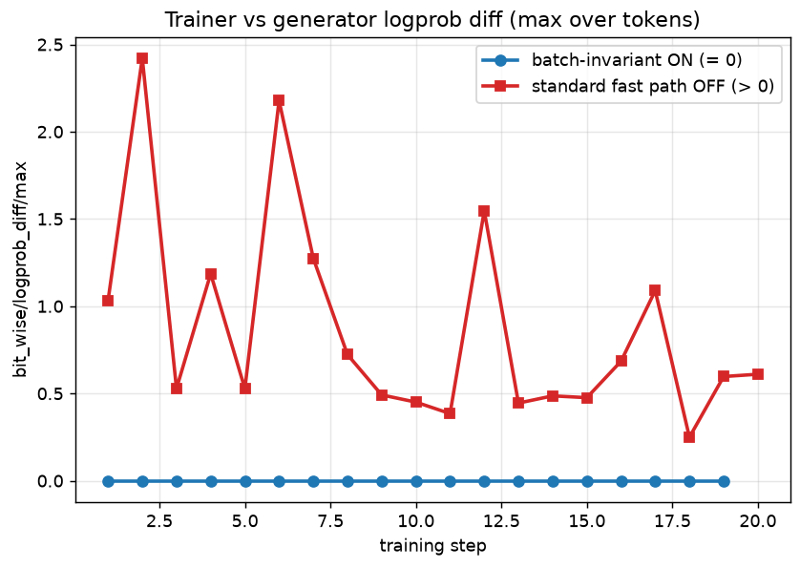
Batch-invariant mode
True-On-policy: Qwen3-8B, Search-R1, 8xH100
When an RL run misbehaves, "Is this just infra issue caused by trainer-generator mismatch?"
Batch-invariant mode
Originally proposed by Thinking Machine Labs
Batch-invariant ops: GEMM / log-softmax, FlashAttention;
Extended to linear attention

Slide 16
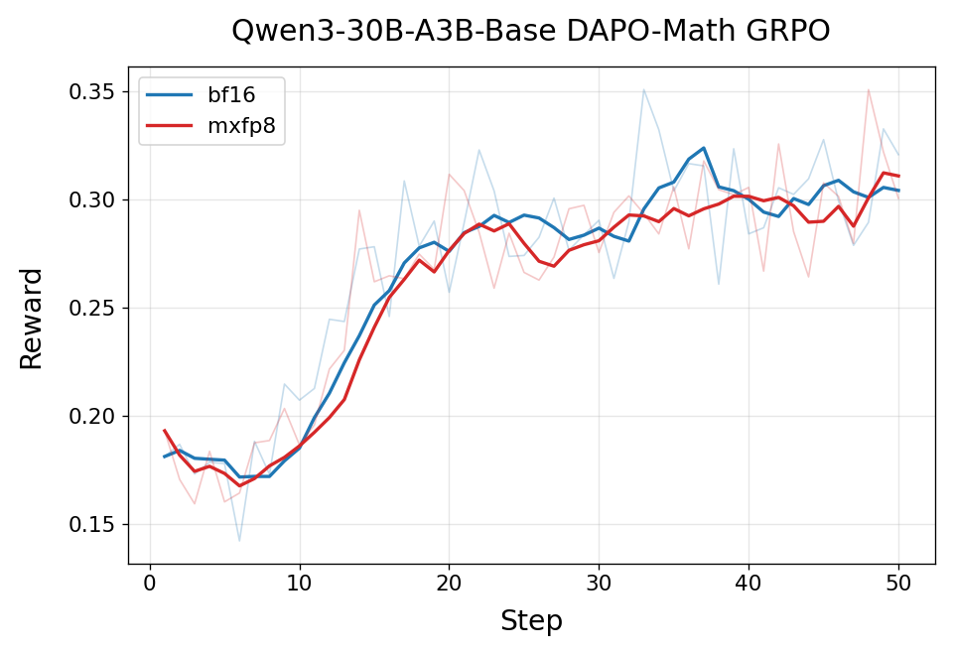
Quantized Training
Training + rollouts
Reward: MXFP8 matches BF16
Simulate target precision during training for best numerics
Currently supports MXFP8, with 1.1x speedup against BF16 and matching rewards
MXFP4 / NVFP4 support coming soon

Slide 17
vLLM KV-cache optimization for RL sessions
Rollouter
agent, tools, sandbox
turn k: full previous turns + new tokens
Generator
vLLM + KV cache
response
× N turns
KV cache for this rollout
system + task
turn 1
turn 2
turn 3
turn 4 (new)
reused
computed
Keep it between turns: each turn prefills only its new tokens. Lose it, and the whole conversation is recomputed.
KV cache = the model's precomputed context

Slide 18
vLLM KV-cache optimization for RL sessions
R6 arrives and the KV cache is full. What do you evict?
✓ TitanRL evicts
✗ vLLM evicts
New request R6
R1
R2
R3
R4
R5
decoding
decoding
waiting on a tool
finished
waiting on a tool
most recently used
least recently used
Native vLLM
TitanRL
Least recently used first: R5, still running. Its next turn recomputes the whole context.
Finished rollouts first: R4. Running rollouts keep their cache.
TitanRL's low-level vLLM integration makes this possible: it knows which rollouts are finished.

Slide 19
TitanRL: experiment interface with Verifiers
VerifiersRollouter.Config(
training_dataloader=IterableRLDataLoader.Config(
dataset=VerifiersTaskDataset.Config(...), # 1
),
verifiers_env_server=VerifiersEnvServer.Config(
environment=HarborEnvConfig( # 2
agent=vf.AgentConfig(harness=..., runtime=...),
),
),
rubric=Rubric.Config(reward_fns=[...]), # 3
)
1
Dataset
any Verifiers taskset
2
Environment
Harbor tasks: your harness, in any sandbox
3
Rubric
the reward Verifiers computed
Verifiers runs the agent loop (tools, sandbox). TitanRL keeps tokens in/out, scheduling, rewards and training.
sketch of torchtitan_recipes/rl/verifiers_terminal_bench.py, the recipe behind the Terminal-Bench results
Notes:
Same three slots as the native config (dataset, environment, rubric); here the environment is a Verifiers HarborEnvConfig: Harbor tasks, your agent harness, and a sandbox runtime.
The difference: Verifiers owns environment execution (its process pool, the message/tool loop, the sandbox), so this path bypasses TitanRL's RolloutWorker and MessageEnv. Verifiers' model requests go through a GenerationServer to TitanRL's generators, token in / token out. TitanRL keeps dataset and group scheduling, generator routing, policy versions, rewards and advantages, and training (VerifiersRollouter docstring, torchtitan/rl/examples/verifiers/rollouter.py).
The Terminal-Bench run on the results slide used this recipe with the Terminus harness and a remote VM sandbox per rollout; the public recipe defaults to Docker (runtime=vf.DockerConfig()).
No harness yet? Write a MessageEnv with init() and step() and use the native config.

Slide 20
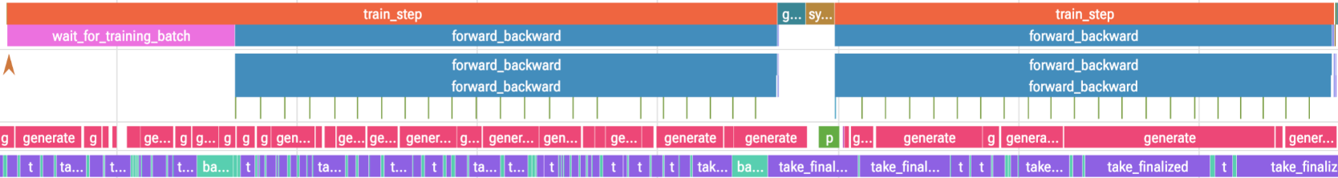
TitanRL: observability
Metrics
Timelines
vLLM engine
Rollouts
Monarch logs
W&B, TensorBoard
every actor, from structured logs
JSONL or OTLP
every rollout, in JSONL
actor output on the controller (opt-in)
controller_train_loop
trainer_actor
generator_actor
batcher_actor
one async run in Perfetto – trainer, generator and batcher actor working in parallel
Notes:
- The trace is one async TitanRL run in Perfetto, built from the structured logs. Rows: the controller's train loop (train_step, sync), one generator's request lane (generate_request, vLLM engine steps, pull/apply of new weights), and the trainer actor (forward_backward microbatches, push_model_state_dict).
- Point at the purple push_model_state_dict: the weight push runs while the next forward/backward is already going.
- Below the trace, the four outputs: metrics to W&B or TensorBoard; timelines for every actor; vLLM engine stats as JSONL or OTLP; every rollout in JSONL.
- Monarch logs (opt-in): every TitanRL actor is a Monarch actor, so Monarch can stream all their stdout/stderr to the controller and batch repeated lines across ranks. Turn it on with HYPERACTOR_MESH_ENABLE_LOG_FORWARDING=true and proc_mesh.logging_option(stream_to_client=True); TitanRL does not enable it by default.

Slide 21
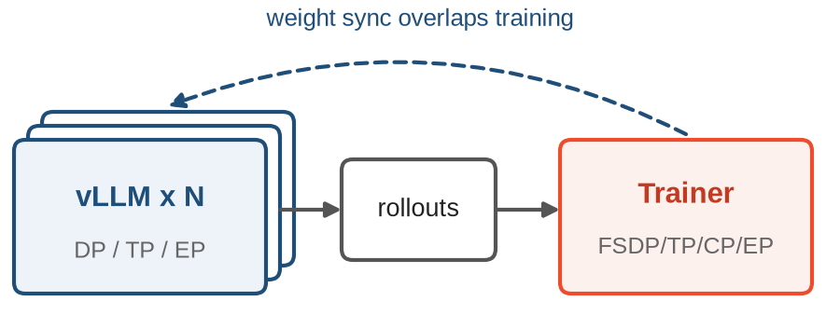
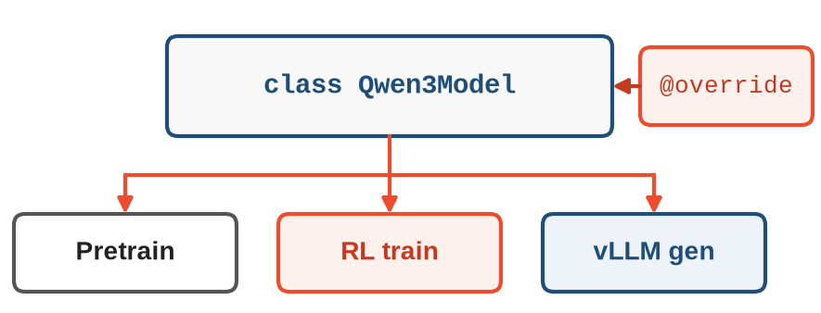
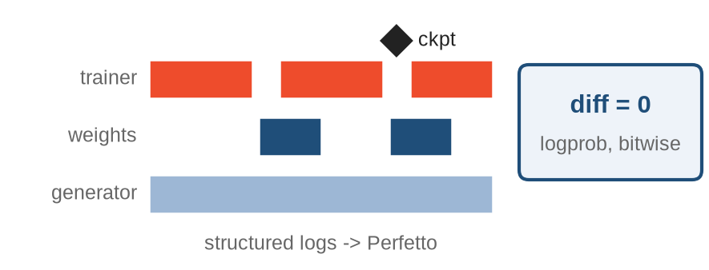
Recap: Scalable, Hackable, Production-Ready
class Muse
Scalable
Hackable
Production-Ready
Fully async loops
N-D parallelism
MoE, 128K context
One model definition
Flexible experiment interface
MessageEnv or Verifiers
Bitwise logprob parity
Logs, metrics, rollout samples
Checkpoint and resume
One model definition, from pretraining to post-training
Notes:
(~1 min) To wrap up, TitanRL in three words: scalable, hackable, production-ready.
Scalable: the whole system is fully asynchronous. Data, rollouts, batching and training run as independent loops, and weight sync overlaps the next training step. The trainer reuses TorchTitan's FSDP, TP, CP and EP; generators scale out with DP, TP and EP; MoE and long context, up to 128K tokens, are supported.
Hackable: one TorchTitan model definition runs in pretraining, RL training, and inside vLLM. Configs are plain Python, and @override swaps any component, from kernels to MoE dispatch, without touching the recipe. New tasks plug in as a MessageEnv plus a rubric, or any Verifiers environment.
Production-ready: the unified model keeps trainer and generator numerics aligned, and batch-invariant mode gives bitwise parity when you need to debug. Structured logs, a Perfetto timeline, metrics and rollout samples show what the system is doing. Checkpointing and CI on CPU, 8-GPU and B200 keep it reliable.
One model definition, from pretraining to post-training.

Slide 22
Thank you!
TitanRL team and all contributors
github.com/pytorch/torchtitan/torchtitan/rl
Notes:
Thanks to the TitanRL team and all contributors. TitanRL lives in the TorchTitan repo under torchtitan/rl: github.com/pytorch/torchtitan.

Slide 23
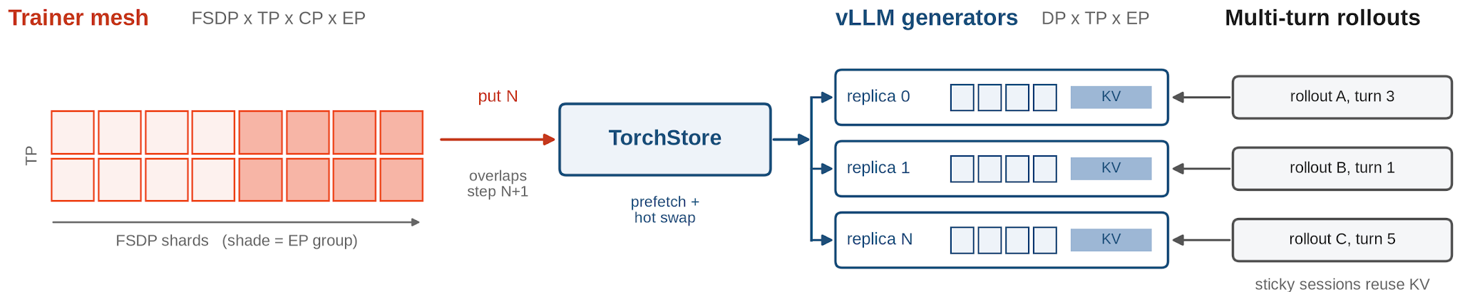
TitanRL: Trainer & Generator
Trainer
Shared engine: same TrainingEngine as pre-training (checkpointing, profiling, SDC replay)
Parallelism: FSDP / HSDP, TP, CP, EP, PP
Efficiency: AC, torch.compile, efficient lm_head
Generator
vLLM engine: integrate torchtitan model to vllm engine
Parallelism: DP x TP x EP, efficient EP backends
Multi-turn ready: sticky sessions reuse KV cache; weights prefetched and hot-swapped
Notes:
Trainer (sources on main):
- TrainingEngine is shared with the pre-training Trainer: distributed execution, optimization, checkpointing, profiling, GC, SDC replay (torchtitan/training_engine.py; torchtitan/rl/README.md).
- Parallelism: FSDP / HSDP, TP (+ SP), CP (incl. GDN / KDA CP), EP. RL pipeline parallelism is still disabled on main; the PP PR is in progress.
- Efficiency: activation checkpointing, per-region torch.compile (local_compile_regions), fused QKV and fused gate-up (#3714), ChunkedLossWrapper, MXFP8 linear converter (rl_grpo_qwen3_0_6b_varlen_mxfp8 applies it to trainer and generator).
- Numerics: fp32 master weights with FSDP bf16 mixed precision; batch-invariant mode for bitwise trainer/generator parity (docs/bitwise_parity.md).
- RL-native: Batcher packs variable-length samples into fixed-token microbatches per DP rank; losses in torchtitan/rl/losses (GRPO, DAPO).
Generator:
- VLLMModelWrapper runs the TorchTitan model inside vLLM: paged KV cache, continuous batching, prefix caching.
- InferenceParallelismConfig: DP x TP x EP (+ optional SP); DeepEP / HybridEP MoE dispatch.
- CUDA graphs FULL_DECODE_ONLY by default (~1.6x generation throughput on Search-R1, PR #3685); vLLM torch.compile support (#2486).
- StickySessionRoutingStrategy keeps a session (multi-turn rollout) on the generator that holds its KV cache.
- Weight updates: prefetch into pinned CPU memory during generation (#4945), engine-thread apply (#5029), hot swap by default; per-group prefix-cache salt preserved across policy updates (#4761).

Slide 24
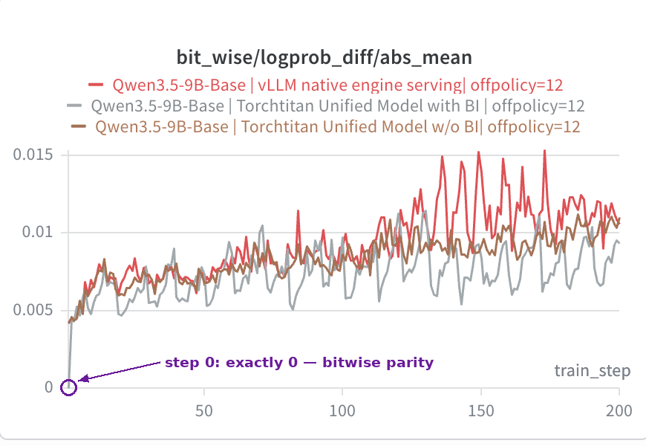
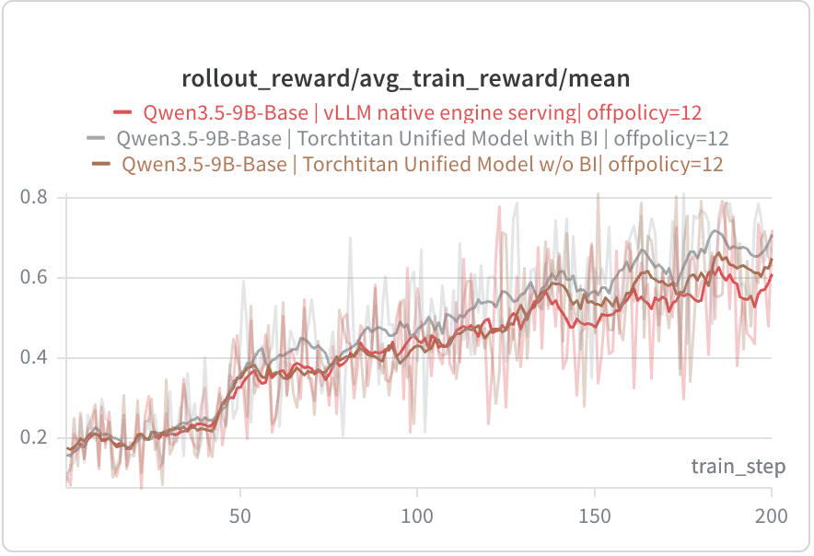
TitanRL: Batch-invariant mode in practice
True-On-policy: Qwen3-8B, Search-R1, 8xH100
Logprob diff = 0 at every step (OFF: 0.25 to 2.4)
Async RL: Qwen3.5-9B, DAPO, off-policy 12
Step 0 is exactly 0; later gaps are staleness
This run: unified + BI has the lowest gap and the highest reward (~0.7 vs ~0.6 for native vLLM)
Source: Yichuan Wang's blog
Notes:
Left (on-policy, our run): dense Qwen3-8B on Search-R1, 8xH100, matched TP2/TP2, max_offpolicy_steps=0, 20 steps. bit_wise/logprob_diff/max is exactly 0 at every step with batch-invariant mode, vs 0.25-2.4 on the standard fast path. Rollout reward (EM) tracked closely between the two over 20 steps (panel omitted). Cost on this workload (torchtitan/rl/docs/bitwise_parity.md): kernels 2.4-2.9x slower, wall-clock per step ~1.0x because multi-turn orchestration and retrieval dominate.
Right (async, Yichuan Wang's blog, https://yichuan-w.github.io/blog/GDN-train-inference-mismatch-asyncRL/): Qwen3.5-9B-Base, DAPO-Math-17k, off-policy 12, 200 steps. Red = native vLLM model, brown = TorchTitan unified model without BI, grey = unified model with BI. Step 0 is exactly 0 with BI; afterwards the gap reflects off-policy staleness, not numerics. In this run the unified + BI arm has the lowest gap and the highest reward (~0.7 vs ~0.6). The blog cautions this is "not a clean yes" across settings and calls batch invariance "a debugging tool, not a production default".

