Slide 1
Business-owned HR processes
with governed agent execution
AT&T’s approach to reusable skills and process controls
Notes:
Conference draft. Business-owned processes is the target operating model. Architecture claims and external disclosure require approval. No production-maturity or superiority claim.
Evidence added for this revision: HR Assist high-level design describes versioned skill packages with persona/scope, preconditions, allowlisted tools, steps, policy checks, outputs and failure handling. The AI-driven requirements proposal describes business-owner review, technical review and gap analysis. A follow-up email documents planned business-owner approval of business requirements before generating technical requirements. The release checklist asks for integration testing, formally approved business UAT, go/no-go approval, monitoring and tested rollback. Checklist existence does not prove that each gate passed for a particular release.
BRD-to-Skill is a proposed operating-model synthesis, not evidence of a fully deployed automatic compiler or no-code business administration. AI-generated drafts require review. Skill instructions do not guarantee process safety and do not replace runtime authorization. Nonstandard steps, new integrations and broader permissions require engineering/security review. No reduction in engineering effort or industry superiority is quantified. External disclosure approval remains necessary.
[Sources]
HR Assist high-level design (reference design).
April 2026 HR Transformation Vision Brainstorming, proposed AI-driven requirements process.
Follow-up on AIFC/AIFP for HR Transformation, June 2026 email.
PI 3 Go/No-Go and Test Owners and Cases, release criteria.
[/Sources]

Slide 2
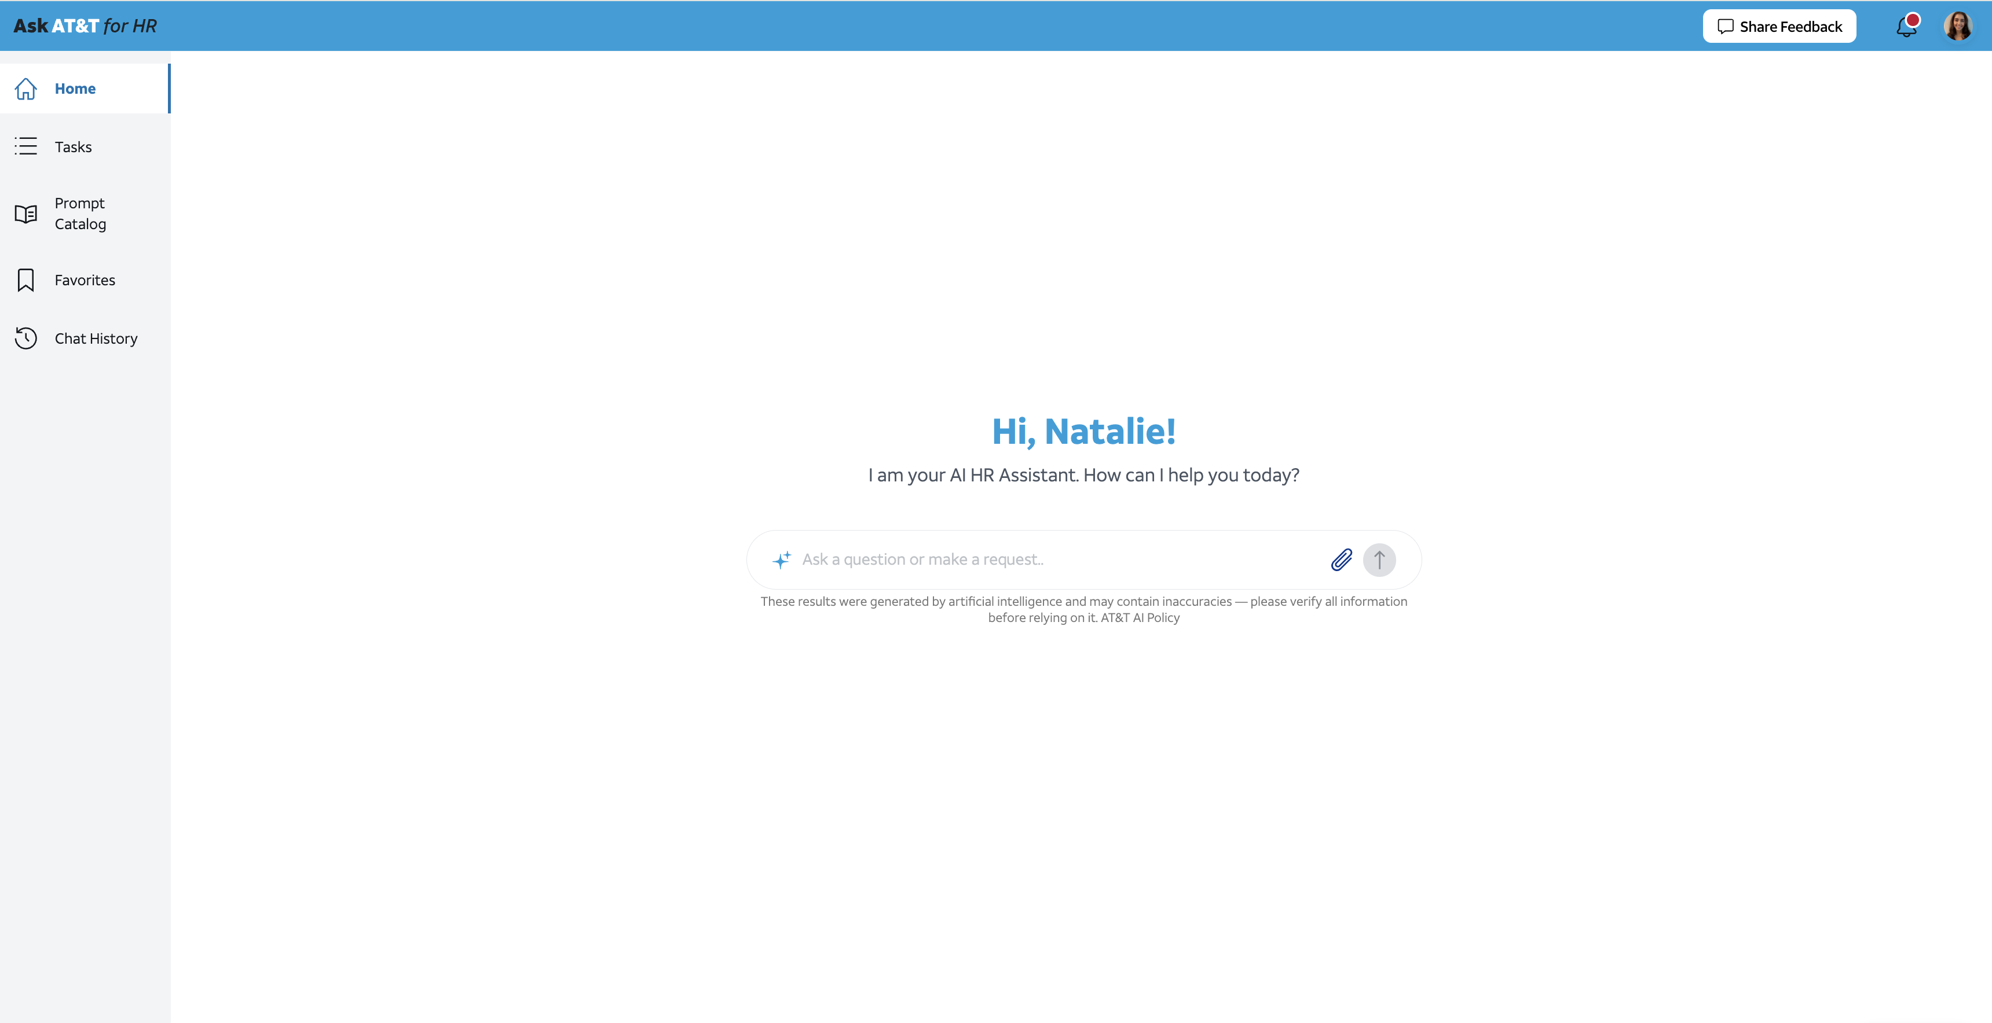

Slide 3
Ask AT&T for HR: systems and call flow
100+ workflows decomposed into skills and subskills
130,000-employee enterprise
Tool gating: persona + skill definitions. MCP authorization: OBO delegated scopes.
1 Capture need
2 Delegate process
3 Gate + invoke tool
4 Submit action
7 Execute approved action
Ask AT&T
for HR
Orchestrator
Skills +
subskills
MCP
integrations
Backend HR
systems
Single interface for
requests and outcomes
Select workflows
Coordinate agents
Agents execute
reusable process steps
Public and bespoke
OBO delegated scopes
Perform approved
HR actions only
HITL GATE
Direct backend
execution
Designated
approver
5 Request approval
Task engine
8 Result + resume
saved workflow
Review action
Approve or reject
Enforce HITL approval
Execute deterministically
6 Decision
Human approval precedes execution. The task engine performs approved actions directly in backend systems.
Notes:
Ask AT&T for HR action execution architecture
100+ business workflows translate into reusable skills and subskills. The orchestrator coordinates agents executing those skills. Tool gating depends on persona and skill definitions. MCP integrations use on-behalf-of (OBO) authorization with delegated scopes.
Corrected action path: the agent/MCP path submits an action request to the task engine. The engine obtains a designated human's approval before execution. The task engine works directly with the backend system to perform the approved action deterministically. The diagram intentionally provides no direct agent/MCP action-execution bypass. A rejected action does not proceed to execution. Backend completion returns to the task engine and allows the paused workflow to resume.
This slide depicts the action path, not every possible read-only integration. Exact protocols, retry semantics and deployment topology are outside its scope. Deterministic refers to controlled execution of the approved action, not to deterministic language-model reasoning.
[Sources]
User-provided talk excerpt and architecture corrections, October 12, 2026. Latest correction places HITL task-engine approval before backend execution and specifies direct task-engine/backend interaction. This supersedes the earlier optional human-task branch depiction.

Slide 4
Business skills, enforced by the platform
AT&T’s design separates process intent from permission to act
01 REQUEST + CONTEXT
02 BUSINESS SKILL
03 CONTROLLED EXECUTION
04 RECORD + EVIDENCE
One HR front door
Versioned workflow
MCP tool boundary
System of record
Verified identity and
employee context
Steps, preconditions
and exception rules
Allowlisted tools and
execution-time authorization
Record the transaction
and return its status
Policy and data relevant
to the request
Eligible skills load
on demand
Separate reads from writes
Confirm before submission
Trace actions and route
unsupported cases to HR
ILLUSTRATIVE HR PROCESS
Check eligibility now and on
the requested absence date
Confirm the details, then verify
the recorded result
Record vacation taken last week
The skill describes the process. Runtime controls decide whether each action may execute.
Notes:
Public-discussion candidate: recording a missed vacation entry. This is an illustrative, generalized workflow based on HR Assist / Ask HR conversations. It is not a report of a live employee case or a production success claim. User confirmation is not the same as manager approval. Final execution remains subject to the system of record and its policies. The eligibility check on both the current date and requested absence date comes from a documented workflow requirement, not proof of deployment. Verify the final transaction result is a recommended public-facing control.
Internal evidence, paraphrased: Time Off Assist Deployment Planning Team discussion, 1 October 2026; Time Off Assist MCP filtering email thread, 1 October 2026; Time Off Assist process discussion; Ask HR personalization discussion, August 2026. No names, employee identifiers, internal endpoints, policy thresholds, internal volumes, delivery dates, or vendor-specific defects are reproduced.
[Sources]
Workday Self-Service Agent: https://www.workday.com/en-us/artificial-intelligence/ai-agents/self-service.html (accessed 2026-10-12). Public example supports industry relevance: check PTO balance, confirm dates, submit a request.
[/Sources]
Company-specific architecture statements require external disclosure approval before public presentation.
Evidence added for this revision: HR Assist high-level design describes versioned skill packages with persona/scope, preconditions, allowlisted tools, steps, policy checks, outputs and failure handling. The AI-driven requirements proposal describes business-owner review, technical review and gap analysis. A follow-up email documents planned business-owner approval of business requirements before generating technical requirements. The release checklist asks for integration testing, formally approved business UAT, go/no-go approval, monitoring and tested rollback. Checklist existence does not prove that each gate passed for a particular release.
BRD-to-Skill is a proposed operating-model synthesis, not evidence of a fully deployed automatic compiler or no-code business administration. AI-generated drafts require review. Skill instructions do not guarantee process safety and do not replace runtime authorization. Nonstandard steps, new integrations and broader permissions require engineering/security review. No reduction in engineering effort or industry superiority is quantified. External disclosure approval remains necessary.
[Sources]
HR Assist high-level design (reference design).
April 2026 HR Transformation Vision Brainstorming, proposed AI-driven requirements process.
Follow-up on AIFC/AIFP for HR Transformation, June 2026 email.
PI 3 Go/No-Go and Test Owners and Cases, release criteria.
[/Sources]

Slide 5
Manageable processes, independent controls
The value is a reviewable process contract backed by independent controls
FOUNDATION | MECHANISM | BUSINESS / CONTROL VALUE
Manageability Reference design | Package scope, steps, preconditions and expected outputs in a versioned skill. | Review process changes without rebuilding the orchestration for every workflow.
Authorization Reference design | Filter skills by persona. Enforce tool allowlists and authorization again at execution. | A skill edit cannot grant access or override the user’s permissions.
Process controls Design + workflow rules | Validate inputs and policy preconditions. Confirm writes and define exception paths. | Business rules remain reviewable. Runtime checks restrict permitted actions.
Release discipline Documented checklist | Integration tests, business UAT, go/no-go approval, monitoring and tested rollback. | A process change requires evidence and accountable release approval.
INDUSTRY CONTEXT
HR transactions and durable tasks already exist. The distinction to demonstrate is integrated process ownership and control.
Process instructions guide the agent. Enforced checks, testing and approvals constrain execution.
Notes:
Positioning: claim architectural specificity and integrated controls, not an industry first or a measured lead over competitors. Public vendor descriptions establish available capabilities, not independently verified performance. This is a generalized technical discussion draft.
Evidence status by row:
1. Documented behavior: Ask HR personalization discussion describes employee-attribute filters on every retrieval query. This supports an implementation discussion but not a claim of externally audited effectiveness.
2. Reference design: HR Assist high-level design specifies progressive skill loading, pre-model eligibility filtering, minimal tool allowlists and execution-time authorization. The source labels the design proposed. Do not describe every element as deployed.
3. Workflow requirement: Time Off Assist scope discussion specifies checks at the current date and absence date. No company-specific employee categories or thresholds are reproduced.
4. Proposed hardening: persisted state, revalidation, deduplication and read-back verification form a recommended extension. Internal evidence reviewed does not establish this full sequence as deployed.
Industry comparison: Workday markets PTO balance checks, confirmation and submission. ServiceNow describes HR transactions and cross-system integrations. MCP Tasks provides durable task handles, polling and deferred results. Therefore transactional HR, integrations and durable tasks alone are not a novelty claim. Differentiation requires an integrated demonstration and outcome evidence. Potential demonstration: a past-dated request after an employee status change, a delayed confirmation and a duplicate retry. These are illustrative test cases, not actual employee events.
[Sources]
[1] Workday Self-Service Agent: https://www.workday.com/en-us/artificial-intelligence/ai-agents/self-service.html
[2] ServiceNow HR Service Delivery Integration with Workday, June 2026: https://www.servicenow.com/community/hrsd-articles/hr-service-delivery-integration-with-workday/ta-p/3565161
[3] Model Context Protocol Tasks: https://modelcontextprotocol.io/extensions/tasks/overview and https://github.com/modelcontextprotocol/ext-tasks/blob/main/specification/2026-07-28/tasks.md
Accessed 2026-10-12.
Internal design basis: HR Assist high-level design and draft integration architecture; Ask HR personalization discussion, August 2026; Time Off Assist scope discussion, October 2026. Paraphrased without identifying or operational details.
[/Sources]
External disclosure approval required for company-specific design attribution. No proprietary counts, release dates, internal endpoints, staff identities or vendor defects appear on these slides.
Evidence added for this revision: HR Assist high-level design describes versioned skill packages with persona/scope, preconditions, allowlisted tools, steps, policy checks, outputs and failure handling. The AI-driven requirements proposal describes business-owner review, technical review and gap analysis. A follow-up email documents planned business-owner approval of business requirements before generating technical requirements. The release checklist asks for integration testing, formally approved business UAT, go/no-go approval, monitoring and tested rollback. Checklist existence does not prove that each gate passed for a particular release.
BRD-to-Skill is a proposed operating-model synthesis, not evidence of a fully deployed automatic compiler or no-code business administration. AI-generated drafts require review. Skill instructions do not guarantee process safety and do not replace runtime authorization. Nonstandard steps, new integrations and broader permissions require engineering/security review. No reduction in engineering effort or industry superiority is quantified. External disclosure approval remains necessary.
[Sources]
HR Assist high-level design (reference design).
April 2026 HR Transformation Vision Brainstorming, proposed AI-driven requirements process.
Follow-up on AIFC/AIFP for HR Transformation, June 2026 email.
PI 3 Go/No-Go and Test Owners and Cases, release criteria.
[/Sources]

Slide 6
BRD-to-Skill lifecycle and release controls
Target operating model: business owners maintain the process,
engineering maintains the tools and enforcement
01 APPROVED BRD
02 VERSIONED SKILL
03 TEST + APPROVE
04 RELEASE + LEARN
Define the process
Package the process
Prove the behavior
Control every change
Business owner
Business + engineering
Business UAT + engineering
Platform + business owner
Scope and actors
Decision rules
Exceptions and acceptance cases
Reviewed SKILL.md
Preconditions and outputs
Allowed tools and failure paths
Happy and denied paths
Policy edge cases
Integration tests and sign-off
Versioned release
Monitoring and audit
Rollback and reviewed updates
CHANGE BOUNDARY
Engineering / security review
Business-led changes
Process steps, language and acceptance cases within approved scope
New tools, broader permissions, write behavior or control changes
Proposed lifecycle synthesis. Business ownership expands through governed changes, not direct unreviewed production edits.
Notes:
Evidence added for this revision: HR Assist high-level design describes versioned skill packages with persona/scope, preconditions, allowlisted tools, steps, policy checks, outputs and failure handling. The AI-driven requirements proposal describes business-owner review, technical review and gap analysis. A follow-up email documents planned business-owner approval of business requirements before generating technical requirements. The release checklist asks for integration testing, formally approved business UAT, go/no-go approval, monitoring and tested rollback. Checklist existence does not prove that each gate passed for a particular release.
BRD-to-Skill is a proposed operating-model synthesis, not evidence of a fully deployed automatic compiler or no-code business administration. AI-generated drafts require review. Skill instructions do not guarantee process safety and do not replace runtime authorization. Nonstandard steps, new integrations and broader permissions require engineering/security review. No reduction in engineering effort or industry superiority is quantified. External disclosure approval remains necessary.
[Sources]
HR Assist high-level design (reference design).
April 2026 HR Transformation Vision Brainstorming, proposed AI-driven requirements process.
Follow-up on AIFC/AIFP for HR Transformation, June 2026 email.
PI 3 Go/No-Go and Test Owners and Cases, release criteria.
[/Sources]

