Slide 1
Practical GPU Programming with Triton for PyTorch Developers
Suman Debnath, Janaki Ram Goteti
Notes:
Time 0:00 (1 min)
If you have used PyTorch, you have already launched thousands of GPU kernels. You just never had to write one. torch.compile and Triton do it for you.
Today we open that box. First what the GPU actually runs when you write one line of PyTorch, then how the GPU is built, then we write a vector add in Triton together, let the autotuner pick its block size, and finish with why fusion is the next step. No CUDA, no C++: plain Python.
Introduce Janaki and yourself in one sentence each. Everything measured today ran on one NVIDIA L40S on Crusoe; the code and the blog are linked at the end.

Slide 2
Write some code. Wait a year.
It runs twice as fast on new hardware. Those days existed. And then they ended.
- Inspired by Herb Sutter, “The Free Lunch Is Over” (2005)

Slide 3
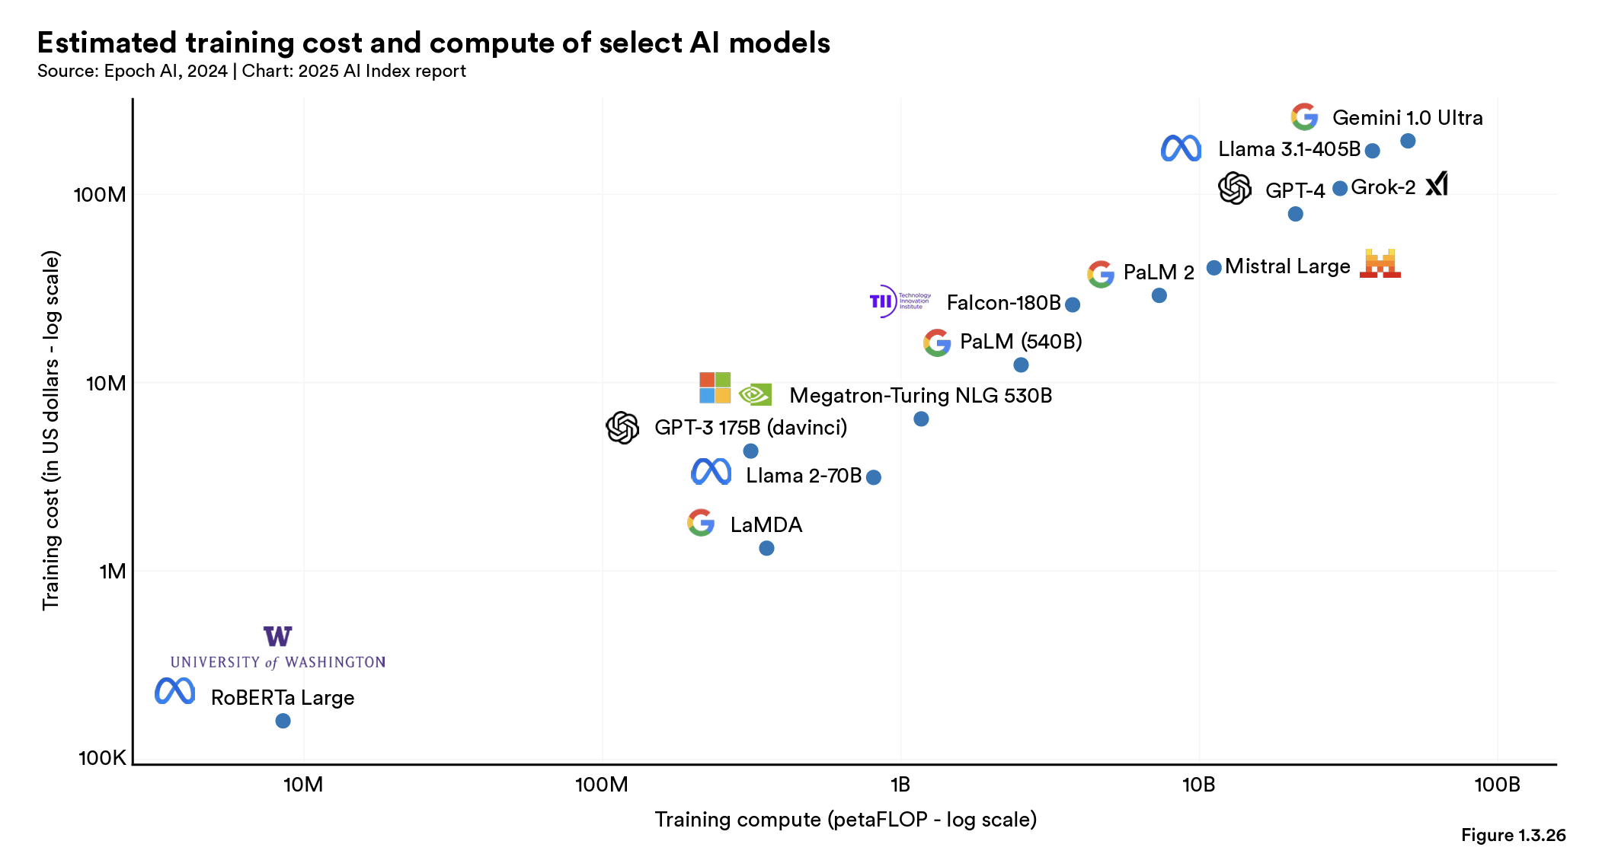

source: https://hai.stanford.edu/assets/files/hai_ai-index-report-2025_chapter1_final.pdf
Notes:
Time 1:00 (1 min)
Why should a PyTorch developer care what runs under a line of Python? This is figure 1.3.26 from the Stanford 2025 AI Index, data from Epoch AI: estimated training compute on the x axis in petaFLOP, estimated training cost in US dollars on the y axis, both log scale.
Read the trend, not the points: RoBERTa Large at the bottom left cost well under a million dollars; GPT-4, Llama 3.1-405B and Gemini 1.0 Ultra at the top right are estimated above a hundred million. Cost tracks compute almost linearly on a log-log plot.
At that scale every percent of GPU efficiency is real money, and efficiency is decided inside kernels: how many you launch and how many bytes each one moves. That is the level this talk works at.
Source on the slide: hai.stanford.edu, AI Index Report 2025, chapter 1.

Slide 4
What’s a Kernel ?
Notes:
Time 2:00 (15 s)
Section one. Two words we need before the hardware: kernel, and Triton. We define both with the same program written twice, once in CUDA and once in Triton.

Slide 5

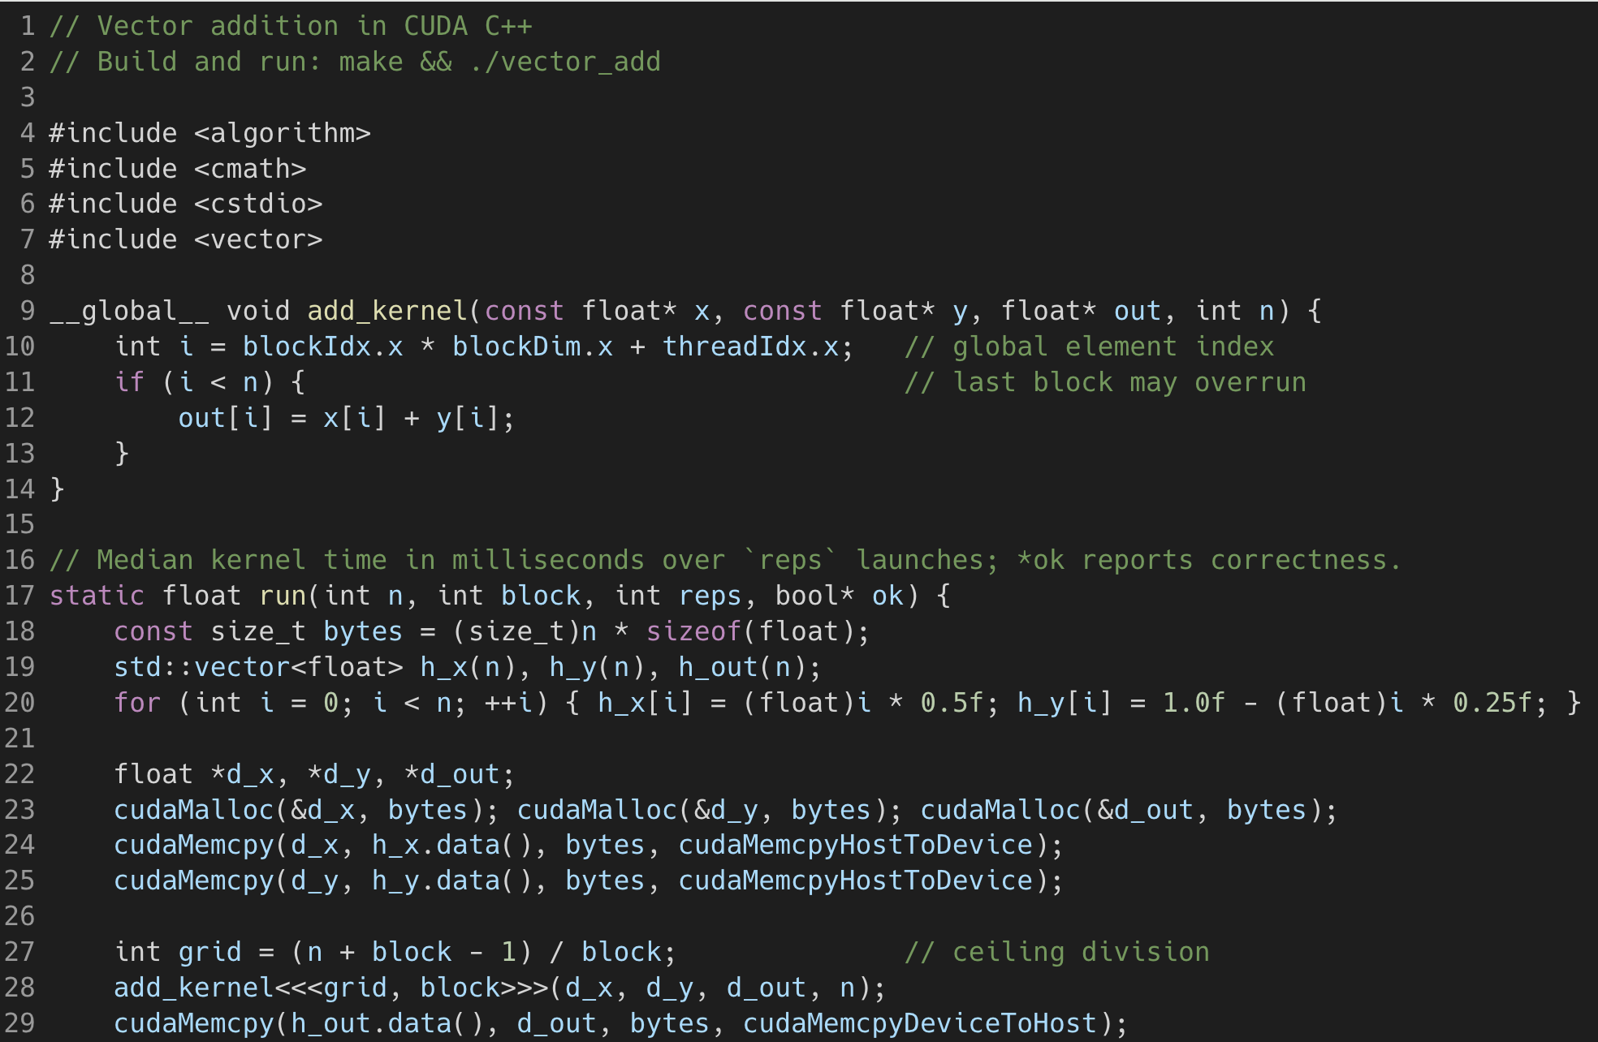
Function designed to execute in parallel on GPU
CUDA is a C++ extension to run on CPU/GPU
CUDA kernels require deep expertise
Notes:
Time 2:15 (1.5 min)
A kernel is a function that runs on the GPU, in parallel, across thousands of threads. Eager PyTorch launches one kernel per operation; (a + b).relu() is two launches. We will see that number again at the end.
This is vector addition in CUDA C++, the way most of us first met GPU programming. Point at the pieces, do not read every line:
Line 9: __global__ marks the function as a kernel, launched by the host and executed by the device.
Line 10: every thread computes its own element index from blockIdx.x, blockDim.x and threadIdx.x. One thread, one element.
Line 11: the guard. The last block almost always runs past the end of the array, so every thread checks before it touches memory.
Lines 22 to 25: the host allocates device memory and copies the inputs across PCIe by hand. Lines 27 to 29: ceiling division for the grid, the triple-chevron launch, and the copy back.
CUDA is a C++ extension with its own compiler, nvcc, and this is the simplest kernel there is. Everything about threads, indices and memory is yours to manage, which is why CUDA kernels are considered deep-expertise work.
Source: part 1 of our blog walks this exact file (https://www.crusoe.ai/resources/blog/gpu-programming-with-triton-part-1).

Slide 6

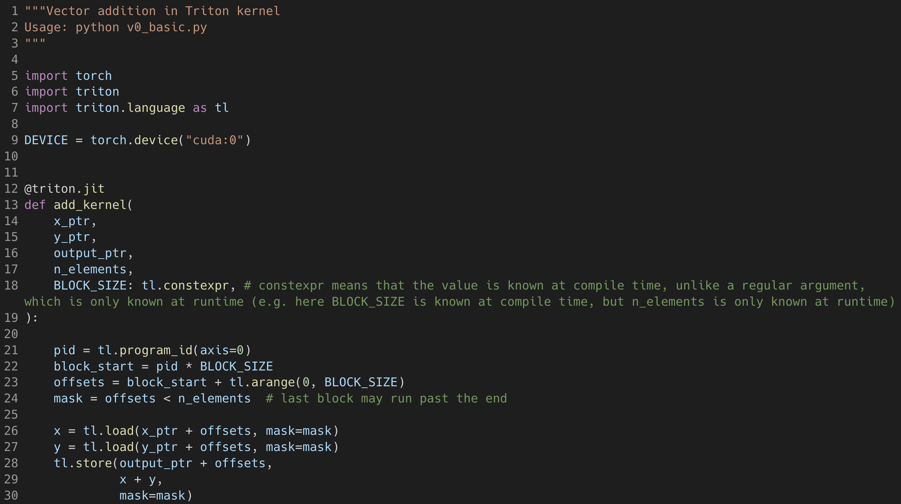
Python-like DSL for GPU kernels/programming
A compiler that transforms that DSL into optimized GPU kernels
Triton supports both NVIDIA and AMD GPUs
Notes:
Time 3:45 (1.5 min)
Same vector addition in Triton. Triton is a domain-specific language embedded in Python: a normal Python function with the @triton.jit decorator on line 12, plus a compiler and a runtime that turn it into GPU machine code and launch it.
Compare with the CUDA version. There is no thread index anywhere. Line 21: pid = tl.program_id(0) names a program instance, not a thread. Line 23: offsets is a whole vector of indices built once with tl.arange. Line 24: the mask replaces the if (i < n) guard. Lines 26 to 30: load, load, store, each one acting on a block of values at a time.
Line 18: BLOCK_SIZE is a tl.constexpr, known at compile time, unlike n_elements which is a runtime argument. The compiler uses it to decide how the threads inside the block share the work, how loads coalesce and when shared memory is worth it. In CUDA those decisions were ours.
Hardware: Triton targets NVIDIA GPUs (compute capability 8.0 and up) and AMD GPUs (ROCm), per the project README (https://github.com/triton-lang/triton#compatibility).
Hand-off: Triton writes for 'one block of data'. To see why the block is the right unit we need to look at the machine.

Slide 7
GPU Anatomy
Notes:
Time 5:15 (15 s)
Section two: GPU anatomy. The words grid, block, warp, thread and SM, and where data lives. Book chapter 1.3 and 1.4.

Slide 8
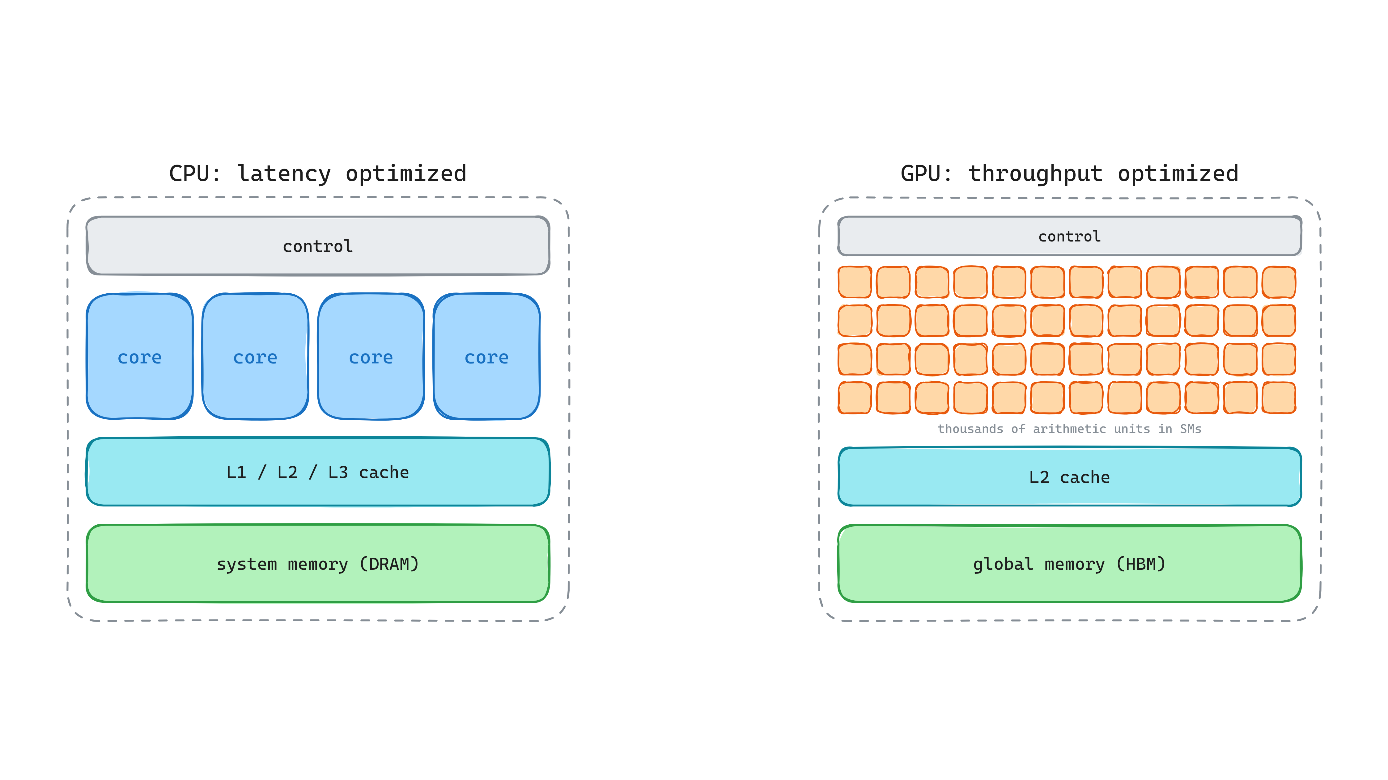
Notes:
Time 5:30 (1 min)
Left, a CPU: a few large cores, big caches, sophisticated control logic, branch prediction, out-of-order execution. All of it aimed at making one thread finish fast. Latency optimised.
Right, a GPU: the control logic is small and the silicon goes to thousands of simple arithmetic units, grouped into SMs, in front of an L2 cache and a very wide global memory, HBM. Throughput optimised.
Any single GPU thread is slower than a CPU thread; together they finish far more work per second. Elementwise ops, matmul, convolution and attention all apply the same instruction to many independent elements, exactly the shape this machine is built for.

Slide 9
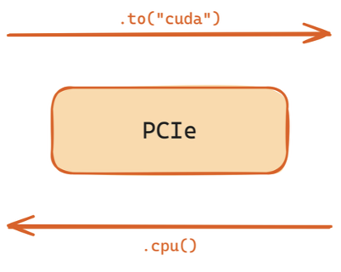
Triton kernel code runs on the GPU
Notes:
Time 6:30 (30 s)
Two machines, two memories. The CPU uses system memory; the GPU has its own global memory. Neither can read the other's memory directly, so data crosses the PCIe bus: .to('cuda') one way, .cpu() back.
The Triton kernel we just saw runs entirely on the right, on data that already lives in HBM.

Slide 10
Triton kernel code runs on the GPU
but it is always launched from the CPU
Notes:
Time 7:00 (30 s)
But it is always launched from the left. Python runs on the CPU; the kernel call is a short message across PCIe that names the compiled binary, the grid, and the tensor pointers. Keep this in mind; it is why timing GPU code has a trap, which we get to in a few slides.

Slide 11
Triton kernel code runs on the GPU
but it is always launched from the CPU
CUDA uses the term host for the CPU and device for the GPU
(to reflect the division of responsibility)
Notes:
Time 7:30 (30 s)
CUDA's vocabulary for this split: the CPU is the host, the GPU is the device. We use those two words from here on. The host organises and launches; the device executes.
Source: CUDA C++ Programming Guide, Programming Model; blog part 1, 'Squaring an array: two memories'.

Slide 12
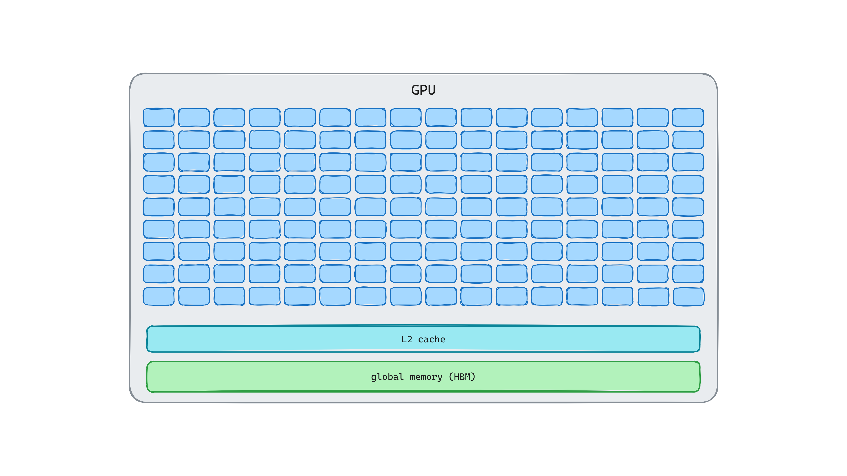
Notes:
Time 8:00 (30 s)
Zoom into the device. The arithmetic units are grouped into streaming multiprocessors, SMs. The L40S we use has 142 of them, sharing a 96 MiB L2 cache in front of 44 GiB of HBM. For comparison an A100 has 108 SMs, an H100 SXM 132.
Every piece of work we launch ends up on one of these.
Source: torch.cuda.get_device_properties on the L40S, printed in the blog.

Slide 13
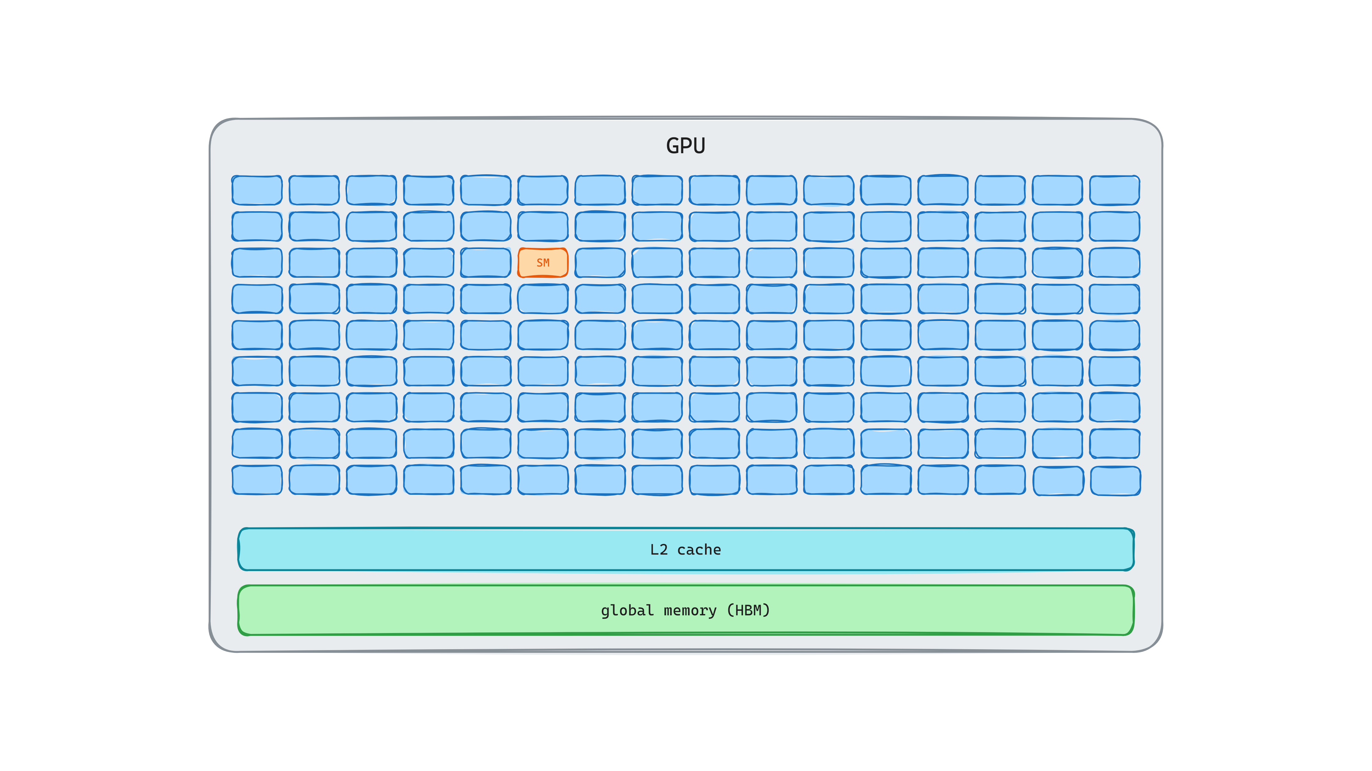
Notes:
Time 8:30 (30 s)
Pick one SM. Whatever the GPU is, 40 SMs or 142, the unit of execution looks the same, and the same kernel runs unchanged on all of them. The smaller GPU just takes more rounds. Let us open one.

Slide 14
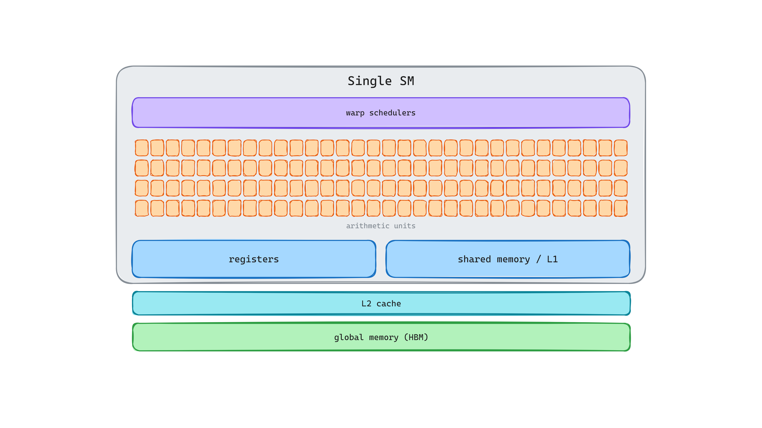
wrap 1
wrap 2
wrap 3
wrap 4
Notes:
Time 9:00 (1 min)
Inside a single SM. Top: warp schedulers. Middle: the arithmetic units, drawn as four rows of 32. Each row is one warp: 32 threads that receive the same instruction at the same time, each applying it to its own data. NVIDIA calls this SIMT.
That is why block sizes are multiples of 32. A block of 8 threads still occupies a whole warp, with 24 lanes idle. A block of 256 threads is eight warps, and the scheduler interleaves them.
Bottom: a register file, private per thread, where arithmetic happens; and shared memory with L1, on-chip, shared by the threads of a block. Below the SM, the path to L2 and HBM. Keep the words registers and shared memory; the next slide prices them.
Note: the four labels on the slide read 'wrap'; say 'warp'.
Source: CUDA C++ Programming Guide, SIMT Architecture and Hardware Implementation.

Slide 15
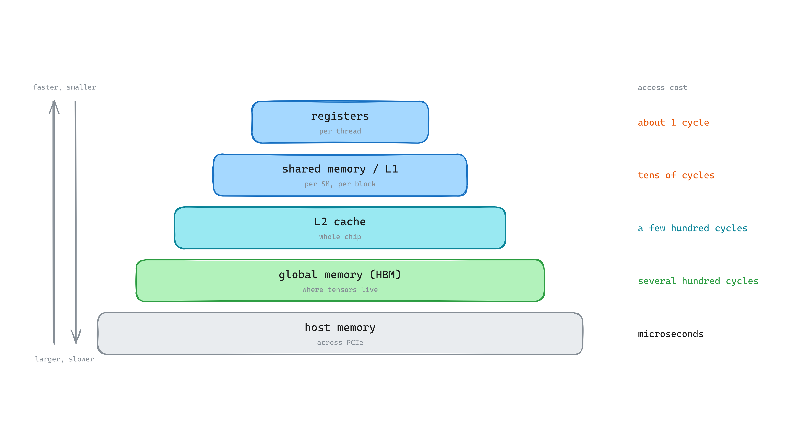
Notes:
Time 10:00 (1.5 min)
The single most important picture in GPU performance. Arithmetic happens in registers, about one cycle. Shared memory and L1 sit on the SM, tens of cycles. L2 is shared by the whole chip, a few hundred cycles. Global memory, the HBM where your tensors live, several hundred cycles for any single access. Host memory is on the other side of PCIe, microseconds.
The ratio of a few hundred to one between a load and an add is the cost model for everything we write today. A kernel that moves bytes it did not need to move is slow no matter how clever its arithmetic.
How does a GPU get anything done if every load takes hundreds of cycles? It keeps many warps resident on each SM and, while one warp waits for memory, the scheduler runs another. The fraction of warp slots in use is called occupancy, and it is capped by registers and shared memory per block.
Hand-off: we now have the machine and its cost model. Back to Triton, and the word block.
Source: CUDA C++ Programming Guide, Memory Hierarchy; CUDA Best Practices Guide, Occupancy; book 1.4.

Slide 16
Triton Block level execution
Notes:
Time 11:30 (15 s)
Section three: Triton's block-level execution model. One conceptual shift and four pictures. Book chapter 2.1.

Slide 17


Slide 20

Each block corresponds to a tile/grid, a small portion of your tensor

Slide 21
We describe the work for one block at a time
We then specify the grid (the total number of blocks) when calling the kernel

Slide 22
The GPU runtime dispatches those blocks across its SMs.

Slide 23
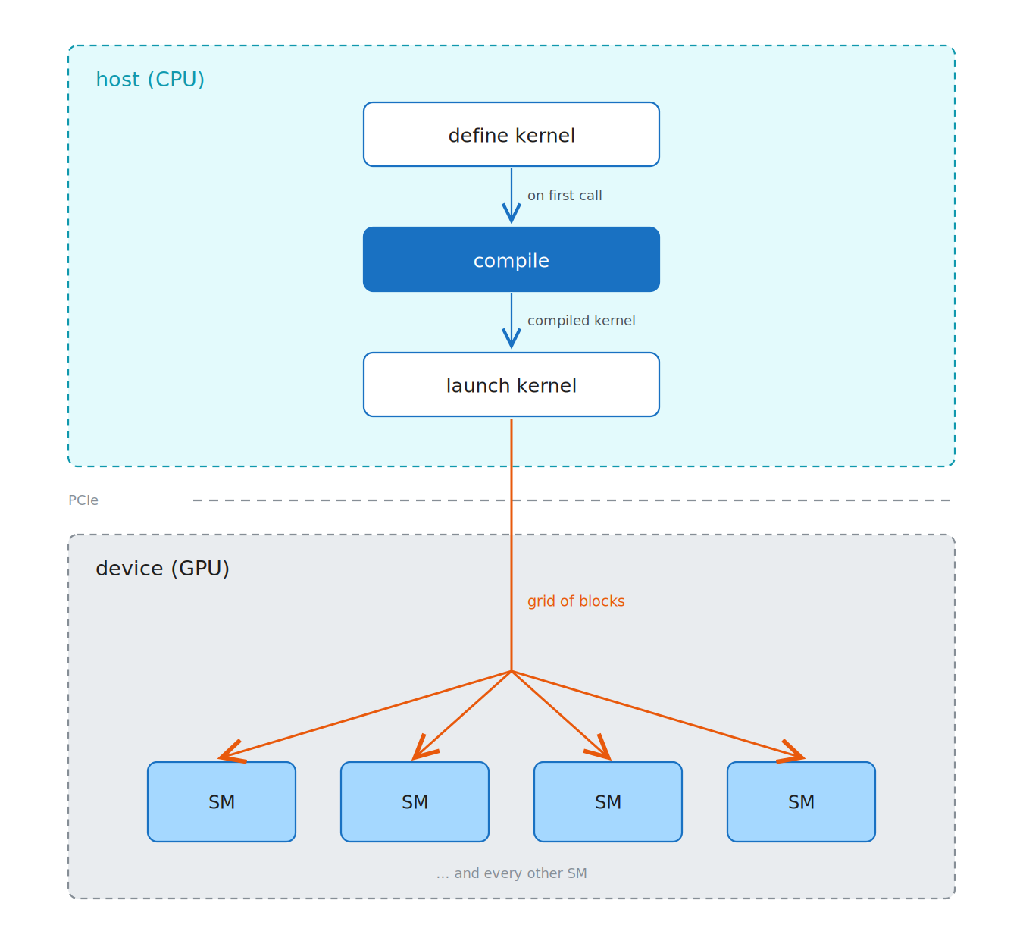

Slide 24

Example : Vector Addition
Notes:
Time 19:25 (15 s)
Section four: the vector add, start to finish, in Triton. The hello world of parallel computing. We read the whole file first, then zoom into each part.

Slide 25
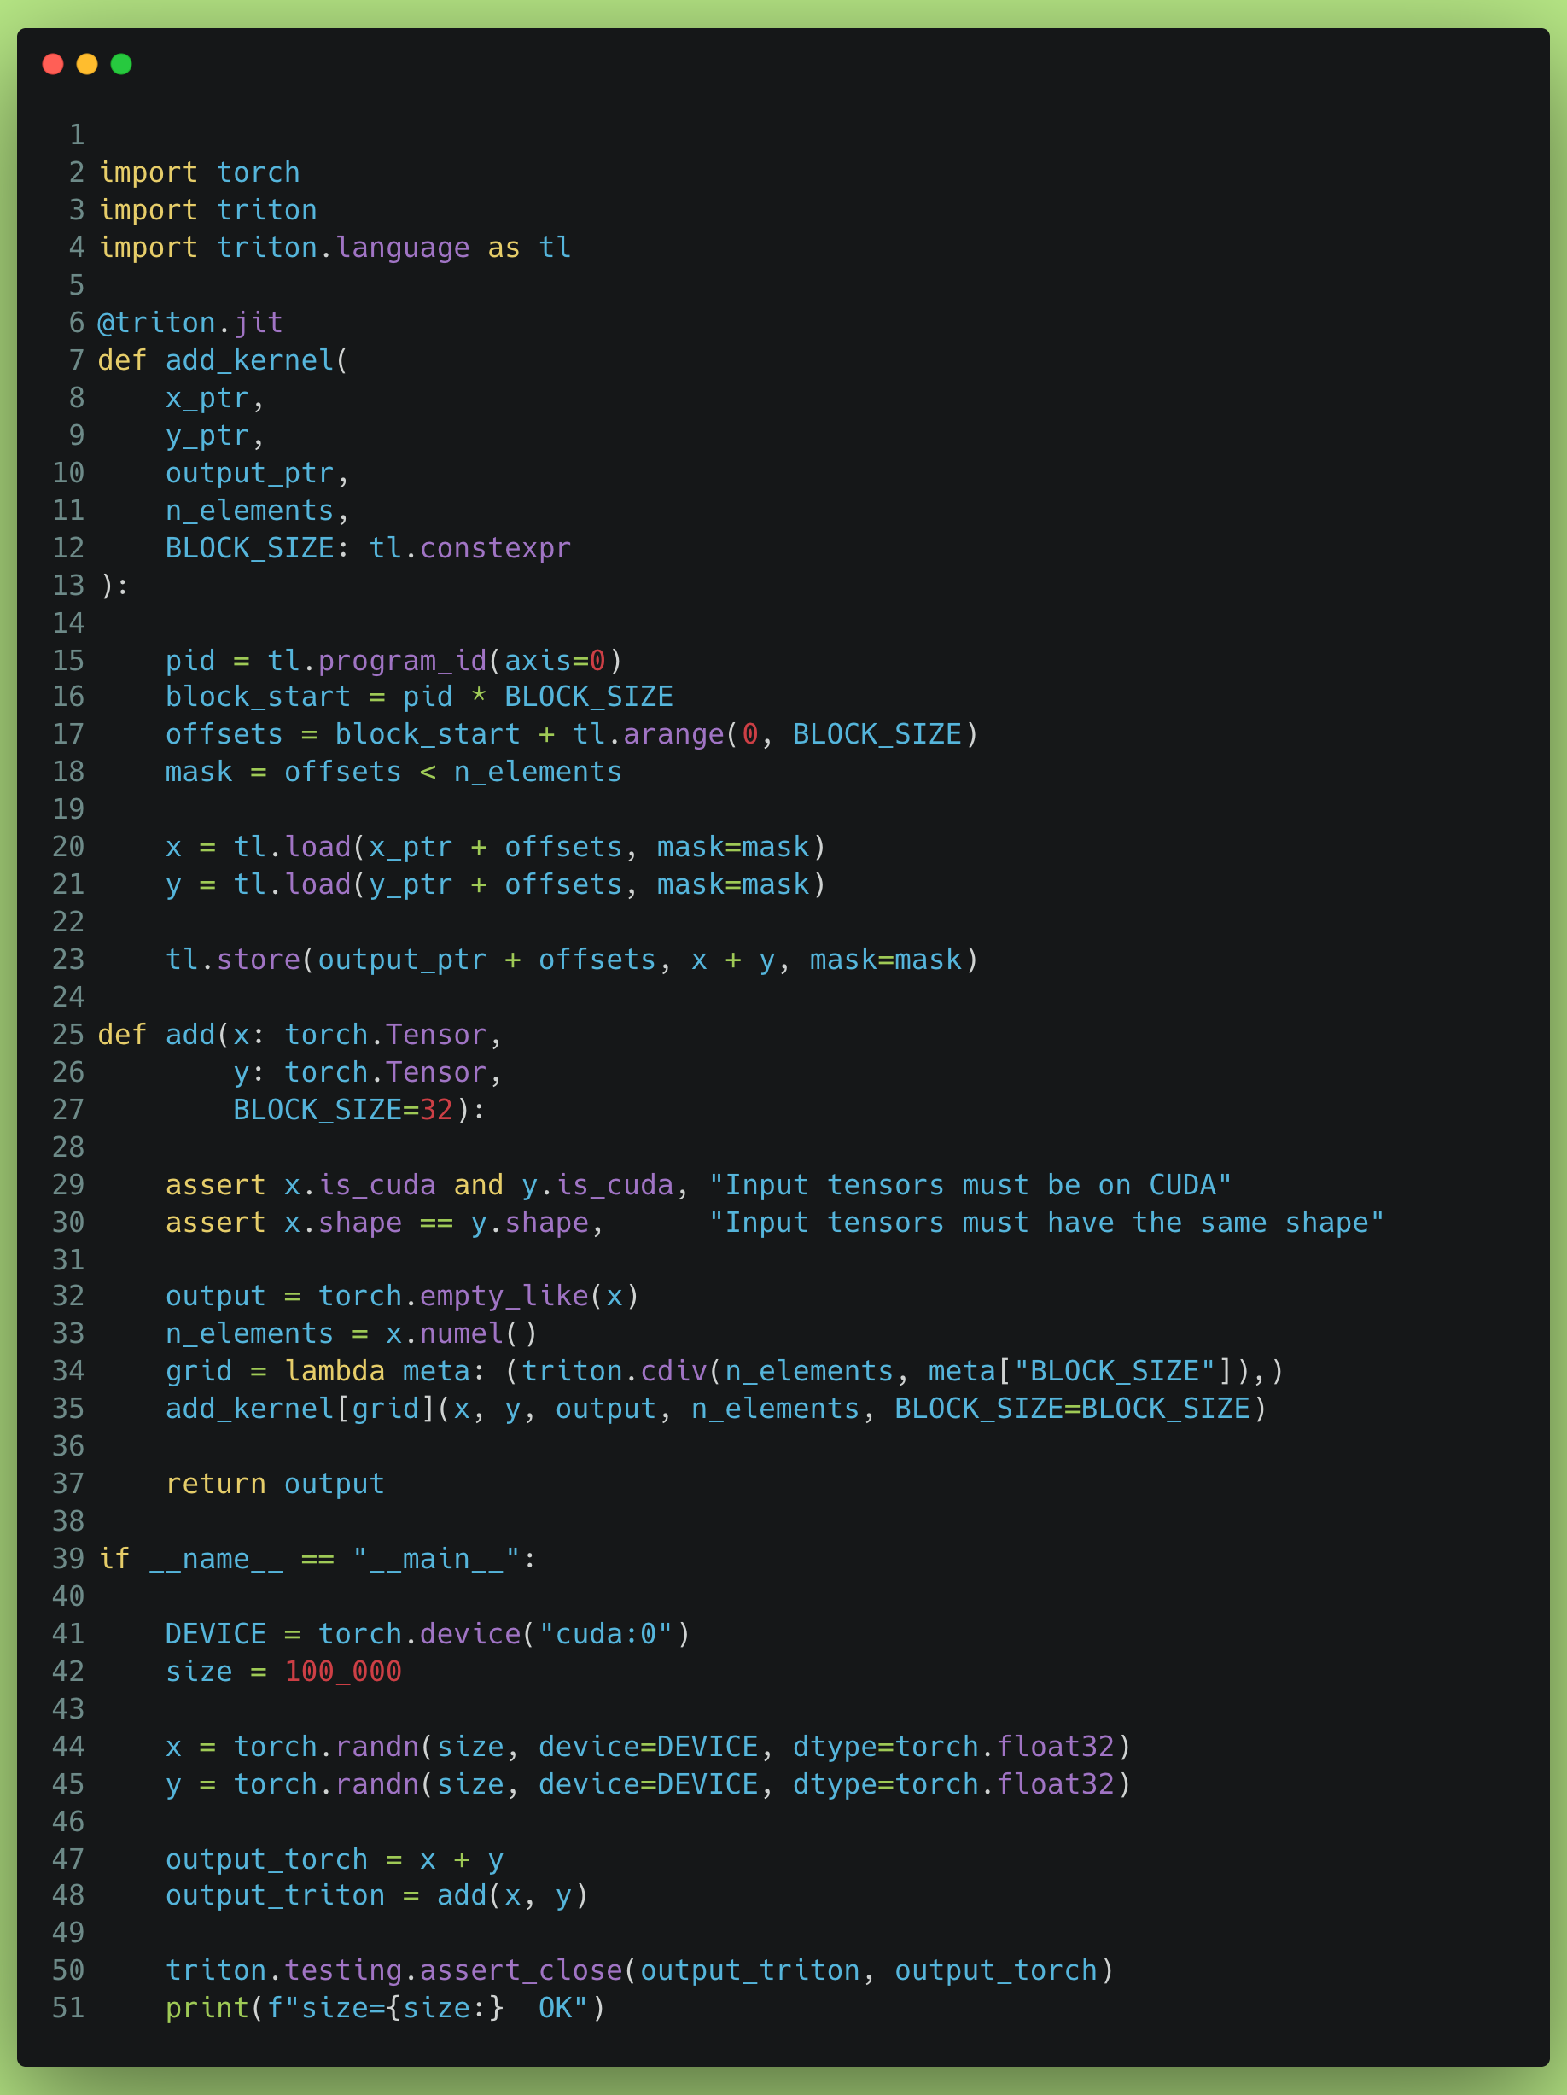
2
1
Notes:
Time 19:40 (30 s)
Fifty lines, three parts, numbered bottom-up because that is how we will read them. 1, the test harness at the bottom: make two tensors, add them twice, compare. 2, the Python wrapper add(): allocate the output, compute the grid, launch. 3, the kernel at the top: the only code that runs on the GPU.
Let the room take it in for a few seconds before zooming.

Slide 26
Device on which the kernel runs
GPU
2
Host-side wrapper to launch the kernel
CPU
1
Notes:
Time 19:40 (30 s)
Fifty lines, three parts, numbered bottom-up because that is how we will read them. 1, the test harness at the bottom: make two tensors, add them twice, compare. 2, the Python wrapper add(): allocate the output, compute the grid, launch. 3, the kernel at the top: the only code that runs on the GPU.
Let the room take it in for a few seconds before zooming.

Slide 27
Device on which the kernel runs
GPU
2
Host-side wrapper to launch the kernel
CPU
1
Notes:
Time 20:10 (15 s)
We start at the bottom, part 1: the harness. Correctness before anything else.

Slide 28
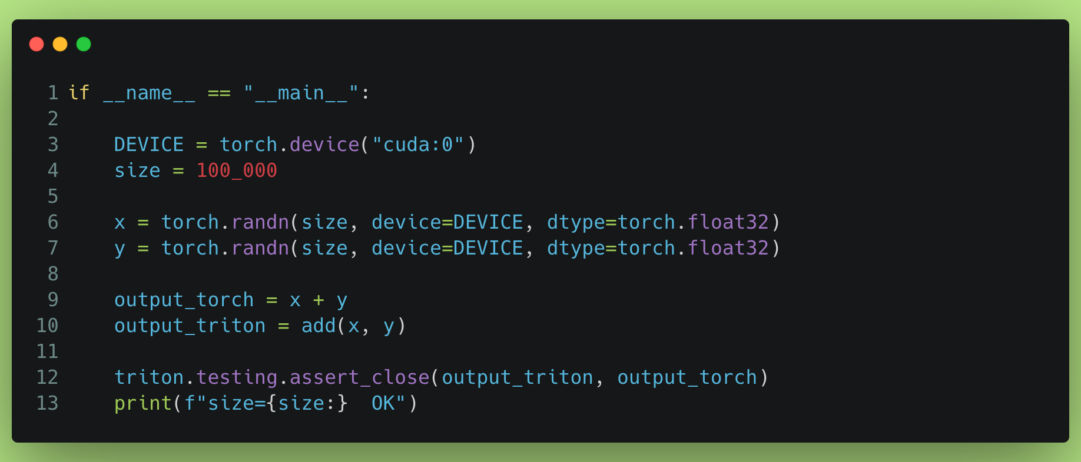
Notes:
Time 20:25 (30 s)
Lines 3 to 7: pick the GPU, 100,000 elements, two random float32 tensors created directly on the device, no copies. Lines 9 and 10: the same addition twice, once with PyTorch, once with our wrapper. Line 12: triton.testing.assert_close compares the two within a tolerance, because the GPU may round differently. Line 13: print OK.
100,000 is not a multiple of 32, so the mask is exercised on the last block. A fast wrong kernel is worthless; every number after this belongs to a kernel that passed this check.

Slide 29
1
Notes:
Time 20:25 (30 s)
Lines 3 to 7: pick the GPU, 100,000 elements, two random float32 tensors created directly on the device, no copies. Lines 9 and 10: the same addition twice, once with PyTorch, once with our wrapper. Line 12: triton.testing.assert_close compares the two within a tolerance, because the GPU may round differently. Line 13: print OK.
100,000 is not a multiple of 32, so the mask is exercised on the last block. A fast wrong kernel is worthless; every number after this belongs to a kernel that passed this check.

Slide 30
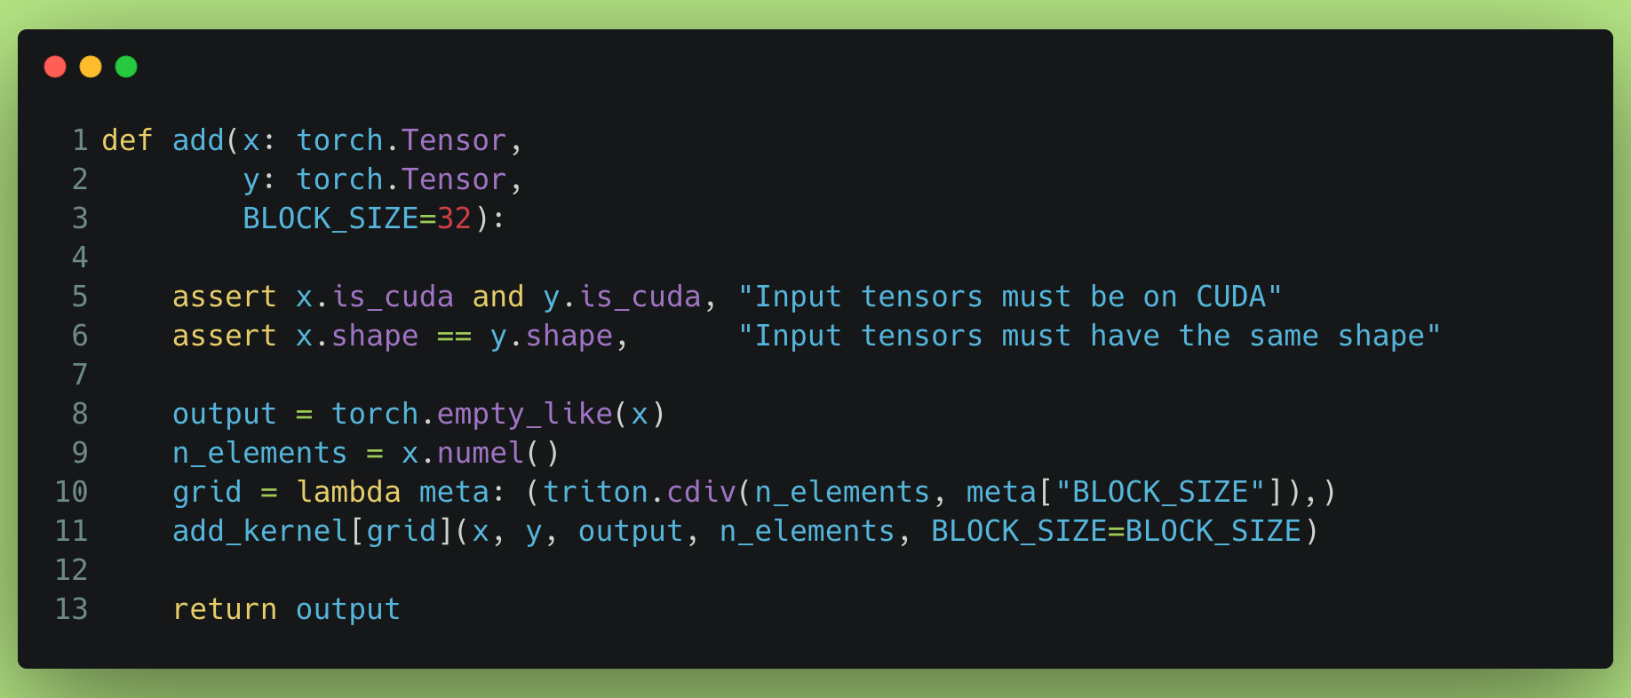
1
Notes:
Time 20:55 (45 s)
Part 2, the wrapper, plain Python on the host. Lines 5 and 6: both inputs must be on the GPU and the same shape. Line 8: allocate the output with empty_like; PyTorch owns the memory. Line 9: n_elements.
Line 10: the grid is a lambda over meta, the dictionary of compile-time constants, returning a one-element tuple: cdiv(n_elements, BLOCK_SIZE) program instances. Line 11: the launch, square brackets for the grid, round brackets for the arguments, BLOCK_SIZE passed as a keyword because it is a constexpr. Tensors are passed as tensors; Triton hands the kernel their data pointers.
BLOCK_SIZE defaults to 32 here, deliberately small. Keep that in mind for the autotuner section.
Source: tutorial 01 uses the same wrapper shape (https://triton-lang.org/main/getting-started/tutorials/01-vector-add.html).

Slide 31
1
Notes:
Time 20:55 (45 s)
Part 2, the wrapper, plain Python on the host. Lines 5 and 6: both inputs must be on the GPU and the same shape. Line 8: allocate the output with empty_like; PyTorch owns the memory. Line 9: n_elements.
Line 10: the grid is a lambda over meta, the dictionary of compile-time constants, returning a one-element tuple: cdiv(n_elements, BLOCK_SIZE) program instances. Line 11: the launch, square brackets for the grid, round brackets for the arguments, BLOCK_SIZE passed as a keyword because it is a constexpr. Tensors are passed as tensors; Triton hands the kernel their data pointers.
BLOCK_SIZE defaults to 32 here, deliberately small. Keep that in mind for the autotuner section.
Source: tutorial 01 uses the same wrapper shape (https://triton-lang.org/main/getting-started/tutorials/01-vector-add.html).

Slide 32
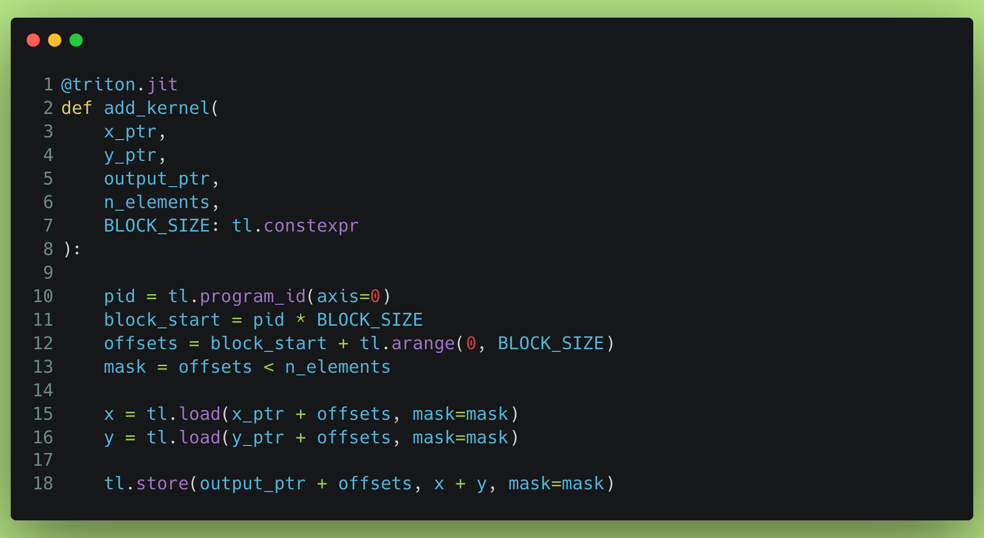
2
Notes:
Time 21:40 (1.5 min)
Part 3, the kernel. Six moves; every kernel we write has them.
Line 10: pid = tl.program_id(axis=0). Which block am I? Line 11: block_start = pid * BLOCK_SIZE, where my tile begins. Line 12: offsets = block_start + tl.arange(0, BLOCK_SIZE), the indices of my whole tile as one vector. This is CUDA's blockIdx.x * blockDim.x + threadIdx.x written once for the block instead of once per thread.
Line 13: mask = offsets < n_elements. The grid over-covers on purpose; the lanes past the end are masked, and masked lanes never touch memory. No branch, so no warp divergence.
Lines 15 and 16: tl.load brings x and y from HBM into registers, several hundred cycles each. Line 18: x + y runs in registers, about one cycle, and tl.store writes the result back, masked.
Two loads and one store, twelve bytes per element, for one addition. By the cost model from the memory pyramid this kernel is memory-bound, like almost everything elementwise. On the L40S it reaches about 630 GB/s, the same as torch.add, against a rated 864.
Hand-off: the kernel has one number we picked by hand, BLOCK_SIZE. Let the machine pick it.
Source: tutorial 01; CUDA to Triton mapping table in blog part 1.

Slide 33
Autotuner
Notes:
Time 23:10 (15 s)
Section five: the autotuner. One decorator and the kernel tunes itself.

Slide 34
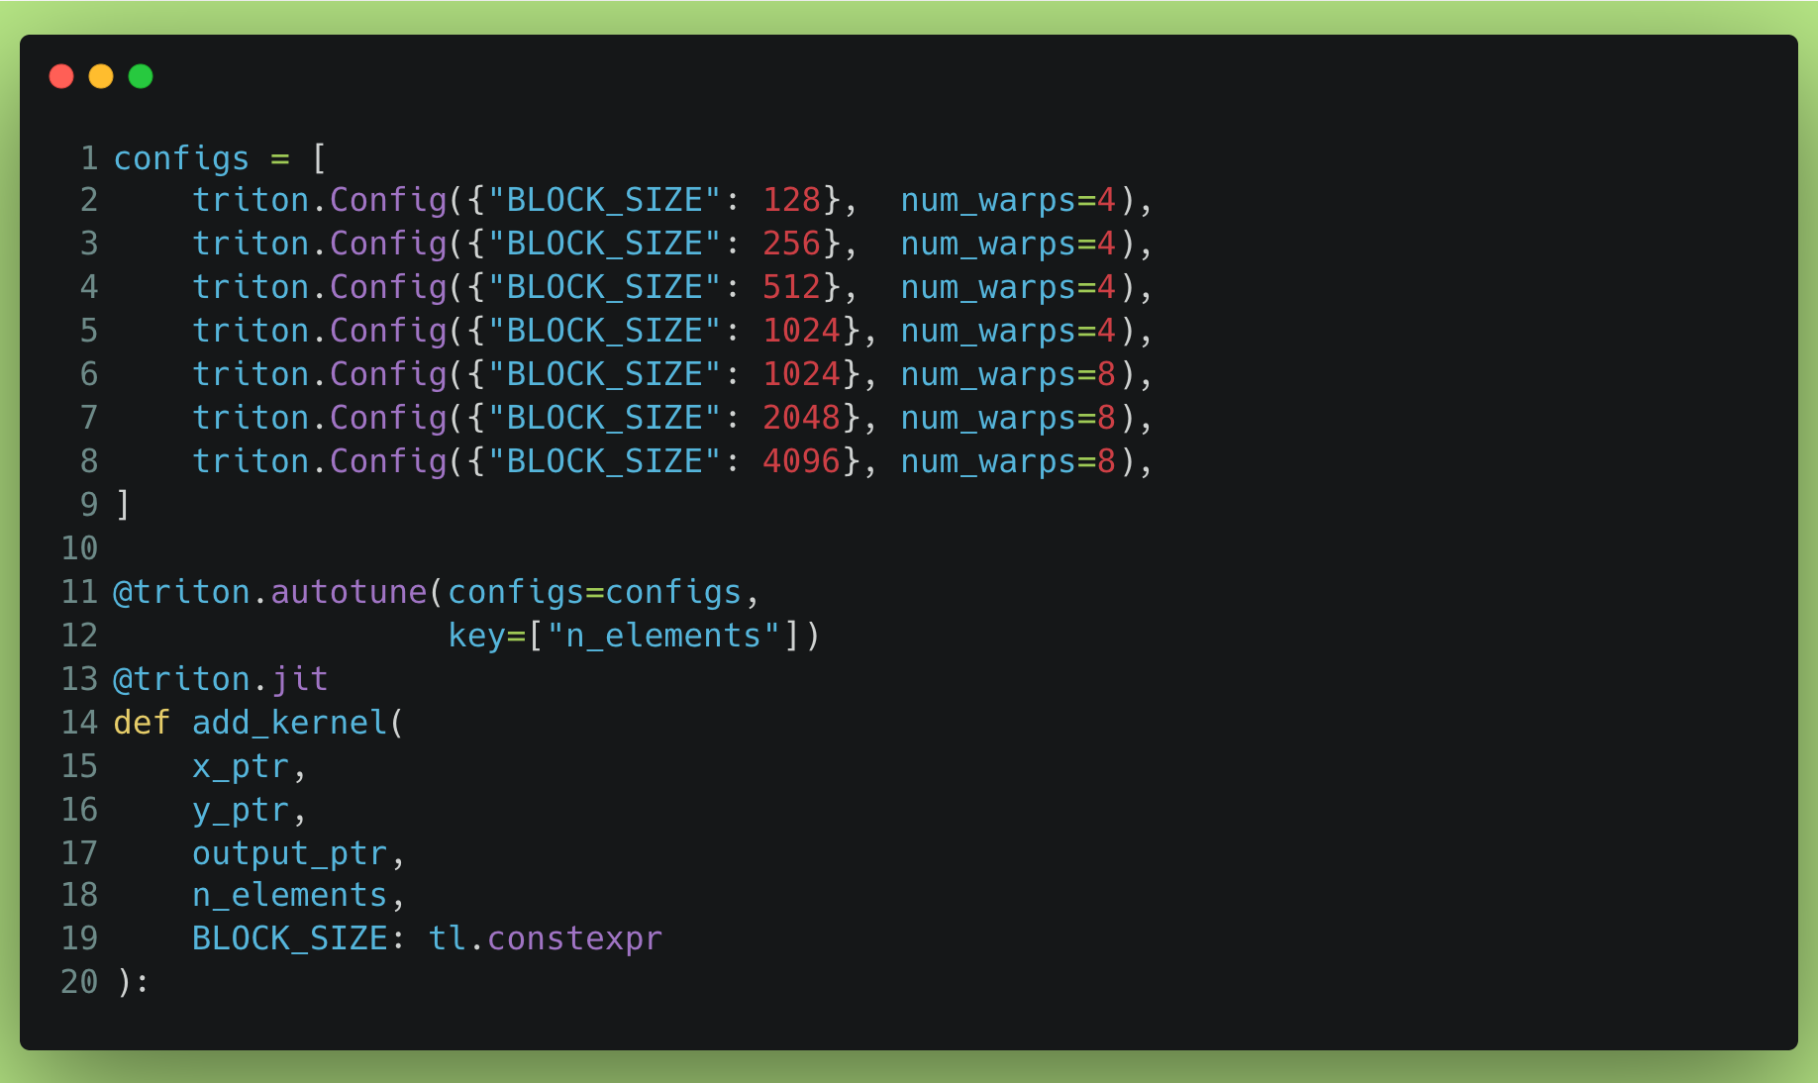

Notes:
Time 23:25 (20 s)
Start with what did not change: the kernel. Lines 13 to 20 are the same @triton.jit add_kernel with the same arguments, BLOCK_SIZE still a constexpr. The small image on the right is the original for reference.

Slide 35
Notes:
Time 23:45 (30 s)
Now the list of candidates. Lines 1 to 9: seven triton.Config objects. Each one is a value for BLOCK_SIZE, 128 up to 4096, plus num_warps, how many warps of 32 threads run one program instance, 4 or 8. These are exactly the knobs we would otherwise turn by hand, written down as candidates.

Slide 36
Notes:
Time 24:15 (45 s)
Lines 11 and 12 tie them together: @triton.autotune(configs=configs, key=['n_elements']) above @triton.jit.
configs is the list of candidates. key is the list of argument names whose change triggers a new search: the first call with a new n_elements benchmarks every config, keeps the fastest, and caches it for that value; later calls with the same n_elements launch the winner directly. The search cost is paid once per distinct key, which is why keys should be shapes, not data.
Source: triton.autotune docs: 'Decorator for auto-tuning a triton.jit'd function'; configs is 'a list of triton.Config objects'; key is 'a list of argument names whose change in value will trigger the evaluation of all provided configs' (https://triton-lang.org/main/python-api/generated/triton.autotune.html).

Slide 37
not needed
not needed
Notes:
Time 25:00 (20 s)
Two things in the wrapper are now not needed: the BLOCK_SIZE parameter on line 3 and passing BLOCK_SIZE=BLOCK_SIZE on line 11. The autotuner supplies it.

Slide 38
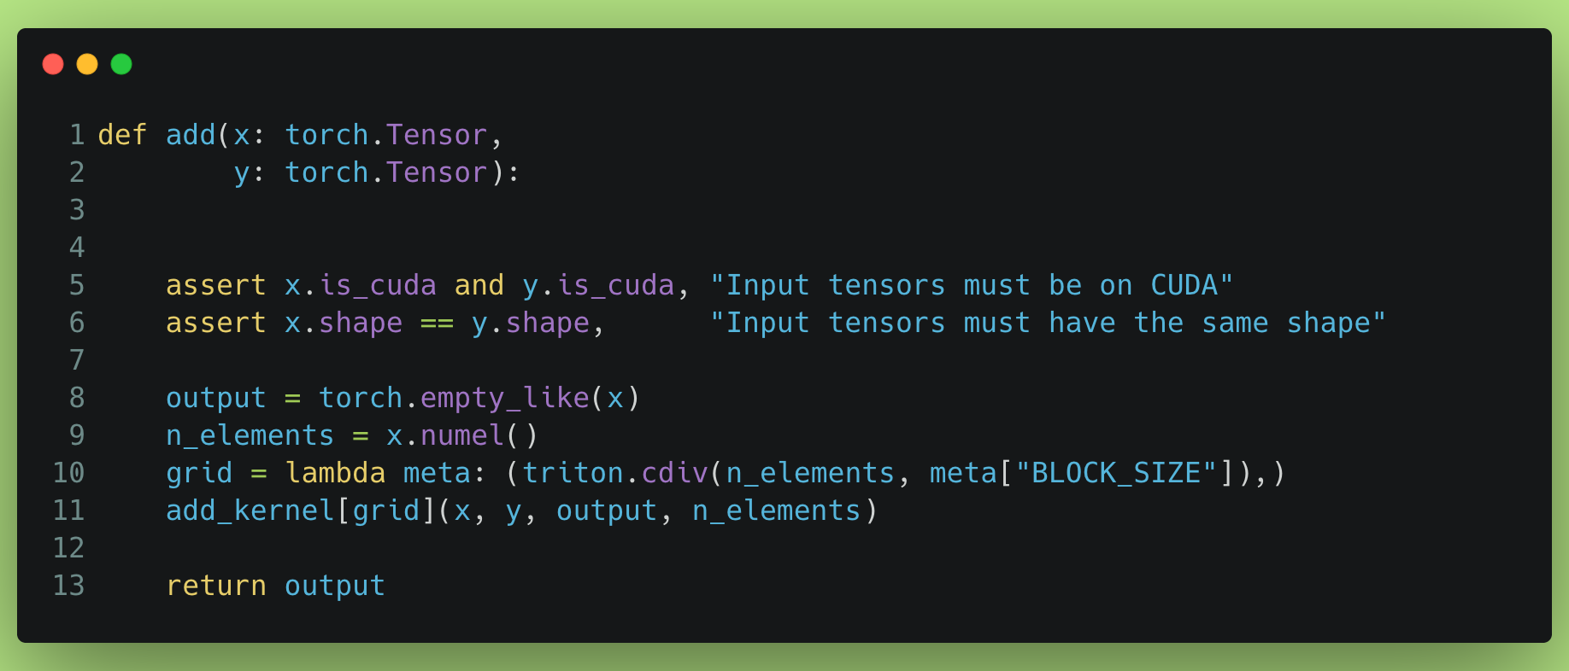
Notes:
Time 25:20 (20 s)
The new wrapper. Same asserts, same allocation. Line 10 still reads meta['BLOCK_SIZE'] in the grid lambda; that is the point of the lambda, the autotuner fills meta with the chosen config, and the number of programs follows the block size it picked. Line 11: the launch passes no block size at all.

Slide 39
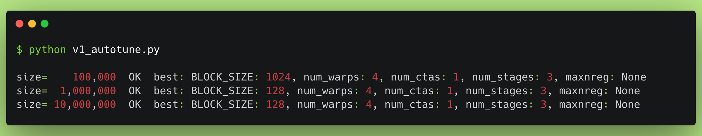
Notes:
Time 25:40 (45 s)
What the L40S picked. 100,000 elements: BLOCK_SIZE 1024 with 4 warps. 1 million and 10 million: BLOCK_SIZE 128 with 4 warps. All three correct.
Two lessons. The winner depends on the problem size, which is why the search is per key. And the differences between good configs on a memory-bound kernel are small; the autotuner is a cheap way to avoid a bad choice, like our hand-picked 32, not a way to beat the memory ceiling. To go faster than the ceiling there is exactly one way: move fewer bytes.
Hand-off: that is fusion.

Slide 40

Kernal Fusion : softmax()
Notes:
Time 26:25 (1.25 min)
The GIF is the fusion dance from Dragon Ball: two fighters, one stronger fighter. Let it land, then make the real point.
Softmax in eager PyTorch is five kernels: max, subtract, exp, sum, divide. Each reads the whole matrix from HBM and writes an intermediate back, so the same bytes make several hundred-cycle round trips. A fused Triton kernel reads each row once, keeps the max, the exponentials and the sum in registers, and writes once. Same arithmetic, roughly a quarter of the traffic; on the L40S the fused kernel matches torch.softmax at the memory ceiling.
You have already seen the small version: (a + b).relu() is two kernels and five array-sized trips in eager mode, 6.656 microseconds on our L40S. Under torch.compile it becomes one kernel named triton_poi_fused_add_relu_0, three trips, 3.392 microseconds, about half. Inductor wrote that kernel in Triton. The compiler fuses what it can see; for your own fused block you write it, and now you know how.
Note: the slide title reads 'Kernal'; it should be 'Kernel'.
Source: Triton tutorial 02, Fused Softmax (https://triton-lang.org/main/getting-started/tutorials/02-fused-softmax.html); blog part 1, final section; book chapter 3.1 and 4.2.

Slide 41
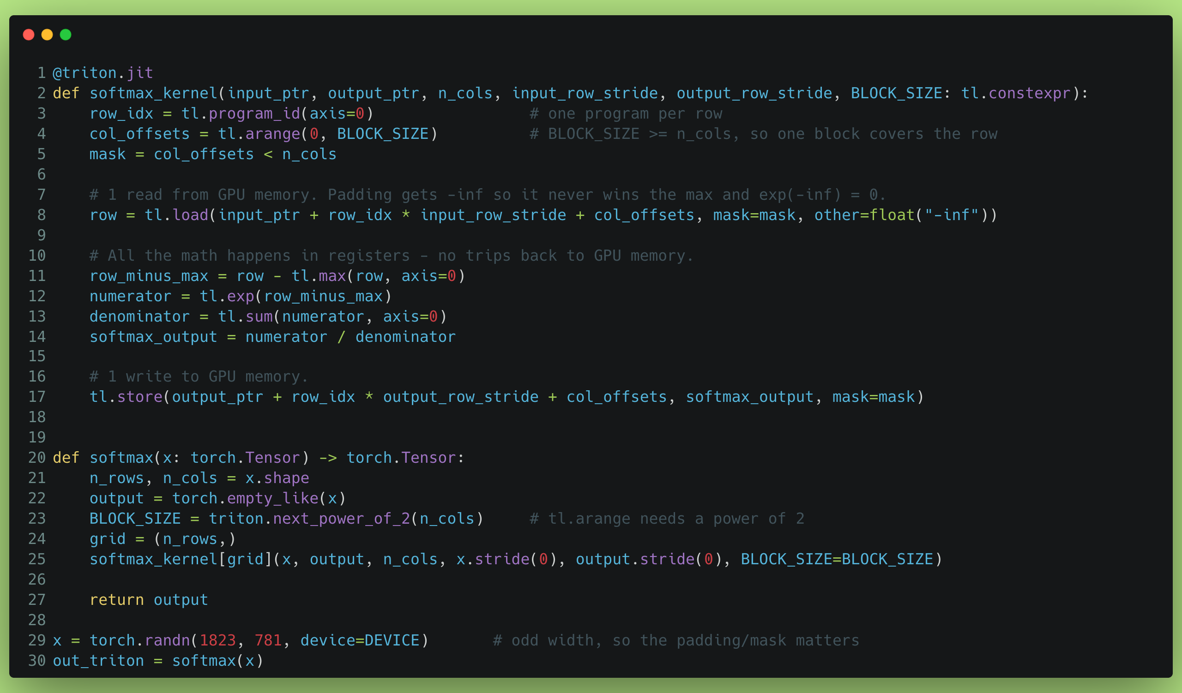

Slide 45



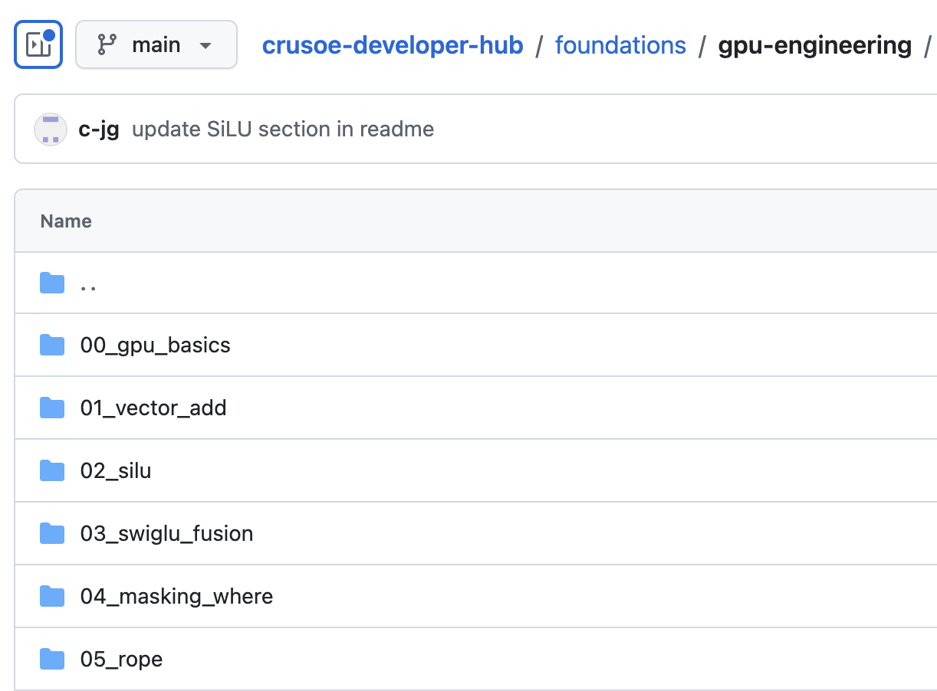
/crusoecloud/crusoe-developer-hub
Notes:
Time 27:50 (20 s)
All the code is in the Crusoe Developer Hub repo, foundations/gpu-engineering: 00_gpu_basics has the CUDA and profiler scripts from today, 01_vector_add the kernel and the autotuned version, then SiLU, SwiGLU fusion, masking with tl.where, and RoPE. One GPU is enough to run everything. Blog part 1 is live and part 2 takes the vector add apart line by line, with benchmarking.
Suggested first exercise: fuse relu(x + y) by hand and compare with the kernel torch.compile wrote.

Slide 46


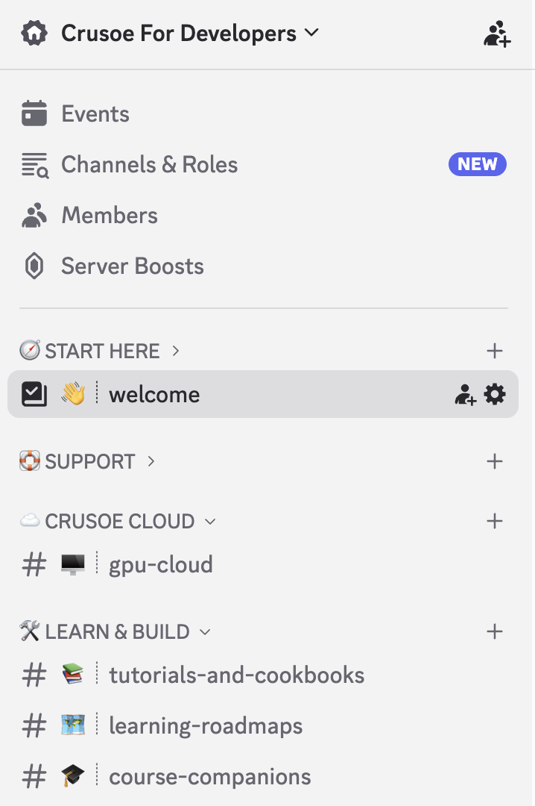
discord.gg/tRKs5bMyry
Notes:
Time 28:10 (15 s)
Questions after today go to the Crusoe For Developers Discord, discord.gg/tRKs5bMyry: tutorials-and-cookbooks and learning-roadmaps channels. Scan the code.

Slide 47
Thank You
JanakiRam Goteti
jgoteti@crusoe.ai
Suman Debnath
sdebnath@crusoe.ai
JOIN US
We’re Hiring
Distributed Training Experts
Applied Researchers
Product Managers
Software Engineers
Notes:
Time 28:25, then questions
Thank you. Our emails are on the slide, and Crusoe is hiring: distributed training, applied research, product, software engineering. Open the floor for questions.

