Slide 1
MCP at the Edge
Lessons from Running Agentic AI on KubeEdge
Israel Olatunji Tijani
ChatVE / Pan-Atlantic University, Lagos, Nigeria
Notes:
Introduce yourself and the one-line thesis: on the edge, MCP mattered less as a way to give a model more tools and more as a stable contract between a local agent and a device layer that never stops changing.

Slide 2
Session Roadmap
1
2
3
4
5
Why the Edge
Architecture
Implementation
Results
Lessons
The integration gap for local agents
KubeEdge, SLM agent, local MCP server
MCP server, GraphQL, PostgreSQL, YAML
Latency heatmap, success rate ρ
Trade-offs, benefits, open questions
Notes:
Five stops: why the edge needs MCP, the architecture, the implementation, what the numbers show, and the lessons and open questions for the MCP ecosystem.

Slide 3



The Integration Gap at the Edge
MCP is moving to production
OUR APPROACH
but its use at the network edge remains largely unexplored
Treat MCP as the integration boundary
between a local agent and a constantly changing device layer.
SLM agents can reason locally
inference agents on KubeEdge nodes, next to the devices
Device integration is ad hoc
data, metrics and management tools wired one by one
Notes:
MCP is moving into production, but nearly all public examples assume an always-connected client and a remote server. At the edge, small language models can reason locally on KubeEdge nodes, yet the wiring to device data, metrics and management tools has been ad hoc. We framed MCP as the integration boundary between the agent and the device layer.

Slide 4



What We Now Understand Differently
STABLE, VERSIONED CONTRACT
Device layer: always changing
C : Agent → Device Layer
Firmware updates
Local SLM agent
Sensor swaps
sees only tool schemas, never SQL or device-twin internals
MCP tool definitions, independent of cloud connectivity
Schema migrations
MCP became a decoupling boundary more than an AI-enablement layer: the contract survives change below it.
Notes:
The headline lesson. MCP's value at the edge was not giving the model more tools. It was giving a local agent a stable, versioned contract against a device layer that keeps changing: firmware updates, sensor swaps, schema migrations. MCP became a decoupling boundary more than an AI-enablement layer, and that contract holds even when the cloud link is down.

Slide 5
Architecture and Implementation
Notes:
Now the build: how the pieces fit on a KubeEdge node, which language models can run there, and the code behind the MCP server, the data contract and the deployment.

Slide 6






End-to-End Architecture on KubeEdge
Edge Node (EdgeCore) · runs local workloads, works offline
GraphQL
PostgreSQL
gateway: query / mutate telemetry
telemetry + tool-call log
SLM agent
MCP server
KubeEdge cloud core
local inference, MCP client
exposes tools, resources
policy sync, node management (intermittent link)
Device twin
Devices, sensors
mapper: reads / writes devices
metrics, control
Arrows show the direction of data and tool-call flow
Notes:
Walk the data path left to right. The KubeEdge cloud core syncs policy and node management down to the edge node, and that link can drop. Everything inside the dashed boundary runs locally: the SLM inference agent is an MCP client; it calls a local MCP server, which fans out to a GraphQL gateway backed by PostgreSQL (telemetry plus a tool-call audit log) and to a device twin mapper that reads and writes physical devices.

Slide 7
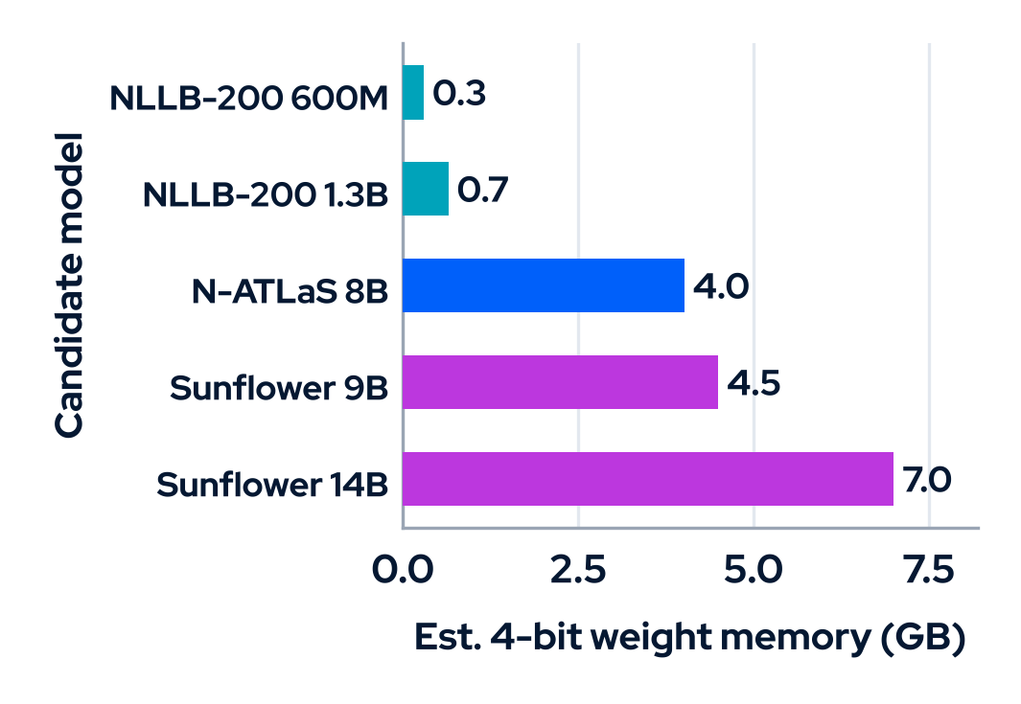
Choosing the On-device Language Stack
Option | Type | Sizes | Role at the Edge
N-ATLaS | Multilingual LLM (Llama-3 8B base), NCAIR Nigeria | 8B | Agent SLM: Hausa, Igbo, Yoruba, Nigerian-accented English
Sunflower | Multilingual LLMs, Sunbird AI Uganda | 9B, 14B, 32B | Agent SLM; 4-bit and GGUF builds for small nodes
NLLB-200 | Translation model, Meta | 0.6B, 1.3B, 3.3B | MCP tool: translate_text across 200 languages
WAXAL | African speech dataset, Google | Dataset | Fine-tune on-device speech-to-text and text-to-speech
M ≈ P × 0.5 bytes
4-bit weights only; excludes KV cache
Memory bars are estimates (P = parameters), not measurements. Sizes from each model’s Hugging Face release.
Notes:
The paper describes a generic SLM inference agent. These are the African-language options we can run in that slot. N-ATLaS or a quantised Sunflower model can act as the reasoning agent; NLLB-200 fits better as an MCP tool for translation; WAXAL is a speech dataset for fine-tuning on-device speech recognition and text-to-speech, not a model. The chart estimates weight memory at 4-bit precision, so treat it as a sizing guide, not a measurement.

Slide 8
A thin, Stateless MCP Server in Front of PostgreSQL
edge_mcp_server.py (Python MCP SDK)
1
One tool, one JSON schema
@app.list_tools()
async def list_tools():
return [Tool(
name="read_device_metric",
description="Read latest metric from a KubeEdge device twin",
inputSchema={"type": "object",
"properties": {"device_id": {"type": "string"}},
"required": ["device_id"]})]
@app.call_tool()
async def call_tool(name: str, arguments: dict):
if name == "read_device_metric":
cur = psycopg2.connect(dsn=PG_DSN).cursor()
cur.execute(
"SELECT metric, value, recorded_at FROM device_metrics "
"WHERE device_id = %s ORDER BY recorded_at DESC LIMIT 1",
(arguments["device_id"],))
return [TextContent(type="text",
text=json.dumps(cur.fetchone(), default=str))]
the agent’s entire view of the device layer
2
Stateless shim
parameterised SQL; no state held between calls
3
Standard MCP output
TextContent with JSON; timestamps serialised
Notes:
The whole agent-facing surface is a tool name, a description and a JSON input schema. The handler runs a parameterised query and returns MCP text content. Because the server is a stateless shim, firmware or schema changes are absorbed behind it, and the agent never sees SQL.

Slide 9
One Data Contract, Two Consumers
GraphQL: shared by dashboard and MCP server
PostgreSQL: telemetry + tool-call audit log
type DeviceMetric {
deviceId: ID!
metric: String!
value: Float!
recordedAt: String!
}
type Query {
latestMetric(deviceId: ID!): DeviceMetric
metricHistory(deviceId: ID!,
limit: Int = 50): [DeviceMetric!]!
}
type Mutation {
actuateDevice(deviceId: ID!,
command: String!): Boolean!
}
create table device_metrics (
id bigserial primary key,
device_id text not null,
metric text not null,
value double precision not null,
recorded_at timestamptz not null default now());
create index on device_metrics
(device_id, recorded_at desc);
-- every MCP tool call is audited
create table mcp_tool_calls (
id bigserial primary key,
edge_node text not null,
tool_name text not null,
latency_ms integer not null,
succeeded boolean not null,
called_at timestamptz not null default now());
Notes:
GraphQL sits between PostgreSQL and its consumers, so the dashboard and the MCP server share one data contract and no query logic is duplicated. PostgreSQL holds the telemetry and an audit log of every MCP tool call, which is where the latency and success-rate numbers come from.

Slide 10

Pinning the agent and MCP server to the edge
edge-mcp-agent.yaml (abridged)
Edge-only scheduling
apiVersion: apps/v1
kind: Deployment
metadata:
name: edge-mcp-agent
spec:
replicas: 1
template:
spec:
nodeSelector:
node-role.kubernetes.io/edge: ""
containers:
- name: slm-agent
image: registry.local/slm-mcp-client:latest
- name: mcp-server
image: registry.local/edge-mcp-server:latest
env:
- name: PG_DSN
value: postgresql://.../telemetry # localhost
nodeSelector keeps the pod on KubeEdge edge nodes
Agent and server in one pod
MCP calls stay on localhost, with no network hop
Local telemetry store
PostgreSQL reached on the node; works through outages
Notes:
One Kubernetes Deployment, scheduled by KubeEdge onto edge nodes only. The SLM agent and the MCP server run as two containers in the same pod, so tool calls go over localhost, and the telemetry store is reached locally too. Nothing in the call path depends on the cloud link.

Slide 11
Results and Lessons
Notes:
What the logs showed: latency by node and tool, the overall success rate, and the constraints that only appear on real, resource-constrained hardware.

Slide 12
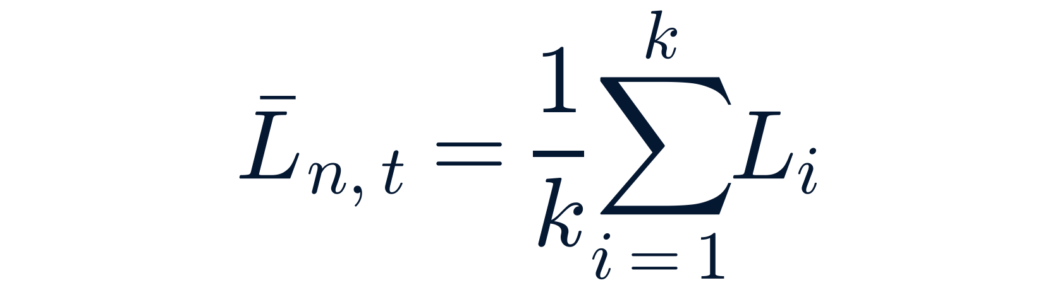
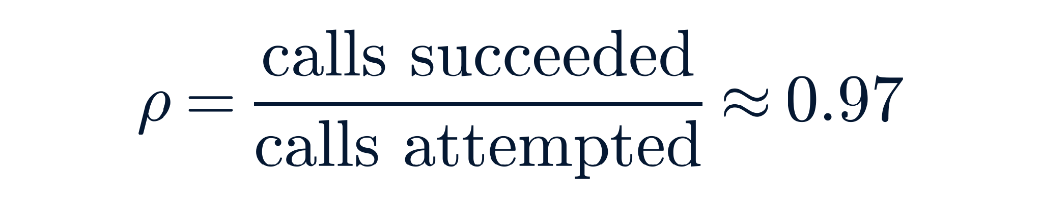
What We Measured, and How
Mean tool-call latency per node n and tool t
Logged field | Used for
edge_node | node index n
tool_name | tool type t
latency_ms | Lᵢ, then the mean per (n, t)
succeeded | success rate ρ
called_at | collection window
resource use | logged; not reported
Aggregate tool-call success rate
Lᵢ = latency of call i; k = calls observed for that (node, tool) pair in the collection window
Notes:
Every tool call writes a row to mcp_tool_calls: node, tool, latency and whether it succeeded. Mean latency is averaged per node and tool type over the collection window; the success rate is calls succeeded over calls attempted. Resource use was also logged, but the paper does not report those figures.

Slide 13
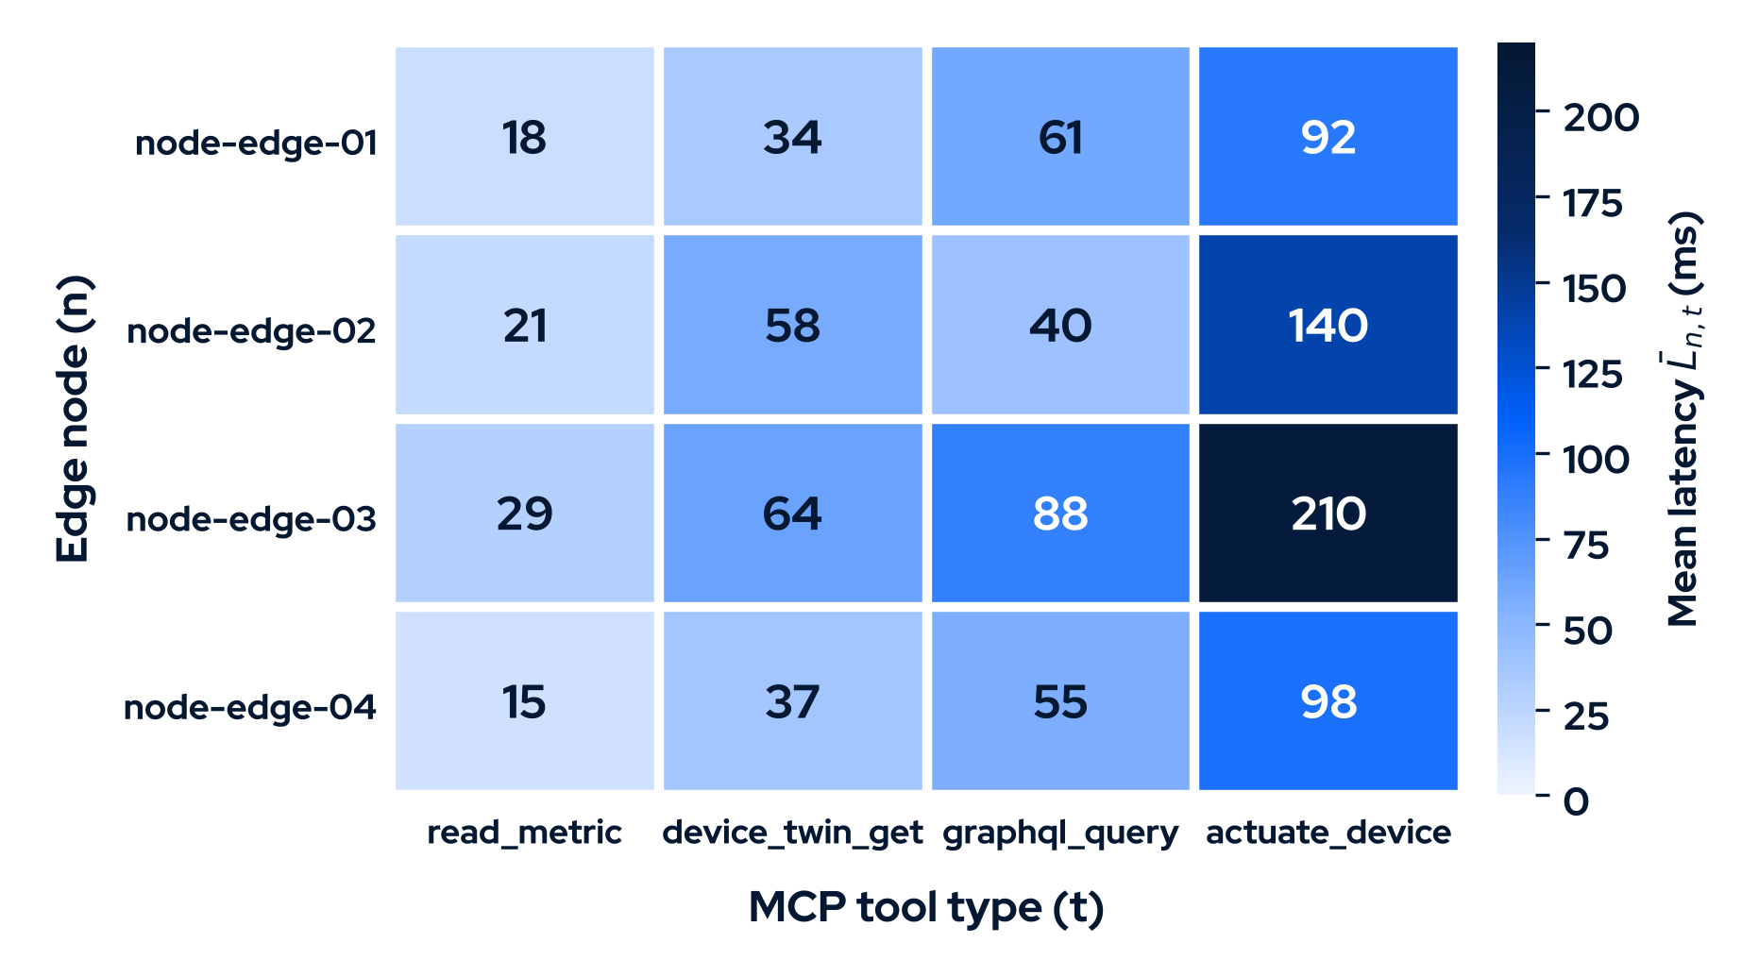

Tool-call Latency by Node and Tool
actuate_device is slowest
highest mean latency on all four nodes
Peak: 210 ms
node-edge-03, the least-cached node
Not protocol overhead
cold starts and device round trips drive it
Mean latency per node and tool (ms)
Notes:
Read across each row: actuate_device is the slowest tool on every node, peaking at 210 milliseconds on node-edge-03, the least-cached node. The pattern tracks cold starts and the physical device round trip, not MCP protocol overhead. Note the paper presents these values as illustrative.

Slide 14
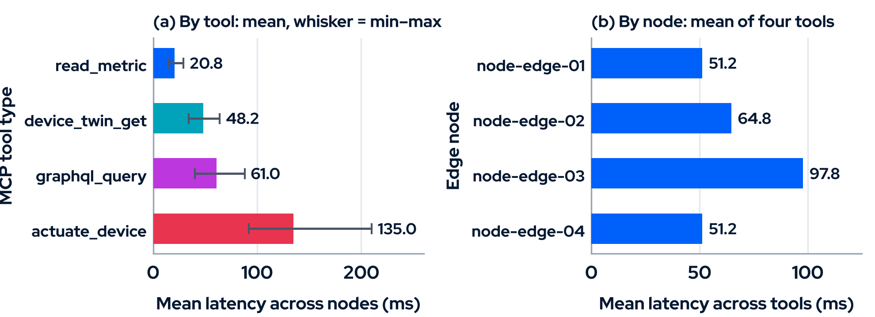
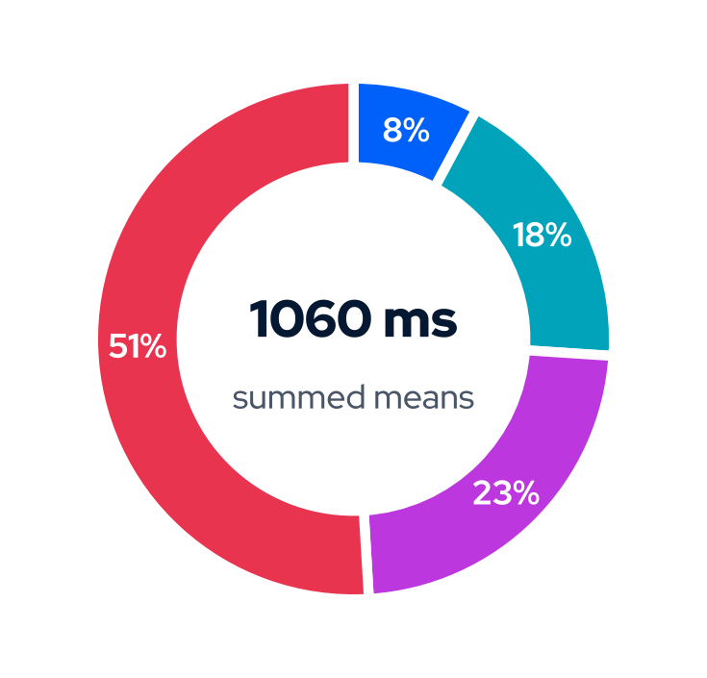
Where the latency goes
read_metric
51%
of summed mean latency comes from actuate_device: the device round trip, not MCP, dominates
device_twin_get
graphql_query
actuate_device
Derived from the paper’s Figure 2 values (illustrative). Donut: share of the 1,060 ms sum of the 16 cell means.
Notes:
Averaging the heatmap shows the spread. Reads are cheap, about 21 ms on average; actuation averages 135 ms and alone accounts for about half of the summed mean latency. Across nodes, node-edge-03 is the outlier at roughly 98 ms. These are derived from the paper's Figure 2 values, so they inherit its illustrative status.

Slide 15
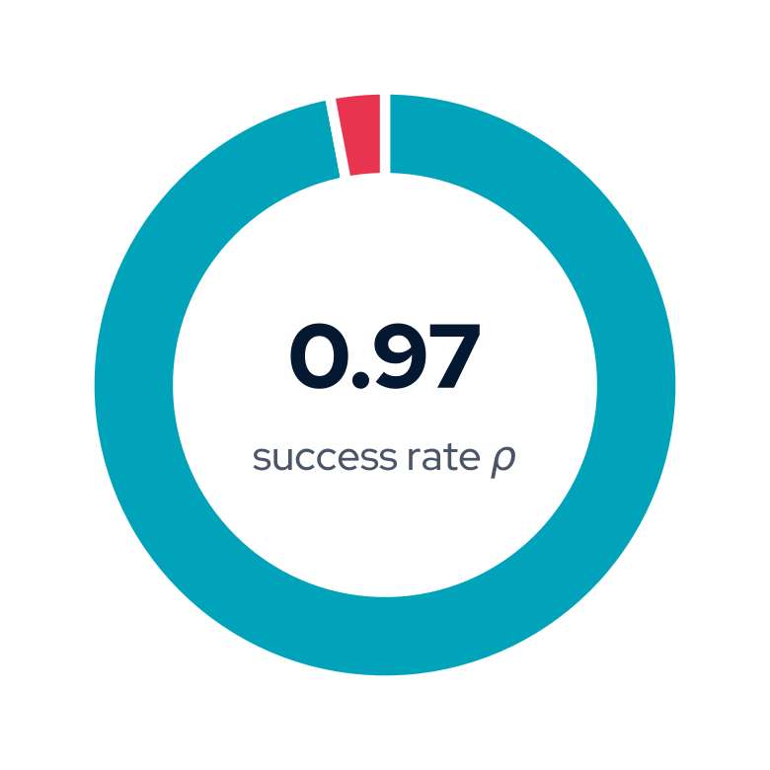

Reliable Overall, with Three Real Constraints
Intermittent connectivity
the cloud-core link drops; the local loop has to keep working
Schema drift
GraphQL gateway and updated MCP tool definitions fall out of step
Cold-start latency
■ succeeded ■ failed
up to ~210 ms for actuate_device on the least-cached node
Notes:
About 97 percent of tool calls succeeded across nodes. MCP reduced coupling and simplified multi-tool orchestration. But three constraints only showed up on real hardware: intermittent connectivity to the cloud core; schema drift between the GraphQL gateway and updated MCP tool definitions; and cold-start latency on resource-constrained nodes, up to about 210 ms for actuate_device.

Slide 16
Design Trade-offs We Made
Decision | What it gave us | What to watch
MCP server as a thin, stateless shim | Simple agent surface: tool schemas only, no SQL or twin internals | Tool definitions must track gateway changes
GraphQL as the shared data contract | Dashboard and MCP server share one contract; no duplicated queries | Schema drift between gateway and MCP tools
Fully local topology on KubeEdge | Agent keeps working through cloud outages | Cold starts on resource-constrained nodes
MCP as the decoupling boundary | Firmware, sensor and schema changes absorbed below the contract | No spec-level tool versioning or negotiation yet
Notes:
Each design choice bought simplicity or resilience and created something to watch. The thin shim and the GraphQL layer keep the agent-facing surface small, but they create two contracts that must stay in step, which is exactly where schema drift appeared. Running fully local survives outages, at the price of cold starts on small nodes.

Slide 17


What this Adds to the MCP Ecosystem
A non-cloud deployment pattern
Failure-mode data
Fully local, intermittently connected MCP on KubeEdge, beyond the always-connected default
ρ ≈ 0.97 and cold starts up to ~210 ms: grounds for timeout, retry and caching conventions
A worked integration
Early spec gaps
GraphQL, PostgreSQL and Kubernetes/KubeEdge: lower barrier for teams on these stacks
Tool versioning and negotiation; connection lifecycle on constrained hosts
Notes:
Four contributions: a validated non-cloud deployment pattern; failure-mode data the community can use to discuss timeouts, retries and caching; a worked integration with GraphQL, PostgreSQL and KubeEdge that lowers the adoption barrier; and early evidence of spec gaps before wider production use.

Slide 18
Open Questions for the Spec and SDKs
1
Timeouts, retries and caching
What should clients assume when a tool call takes 200 ms on one node and 20 ms on another, or the link drops mid-call?
2
Tool versioning and negotiation
How does a server change a tool schema without silently breaking an agent already deployed in the field?
3
Connection lifecycle on small hosts
When should a constrained host keep connections warm, and when should it release them?
Notes:
Where we would like the community's help. First, shared conventions for timeouts, retries and caching on slow or flaky links. Second, tool versioning and negotiation, so a server can evolve its tools without silently breaking a deployed agent. Third, connection-lifecycle guidance for hosts with little memory and slow cold starts.

Slide 19
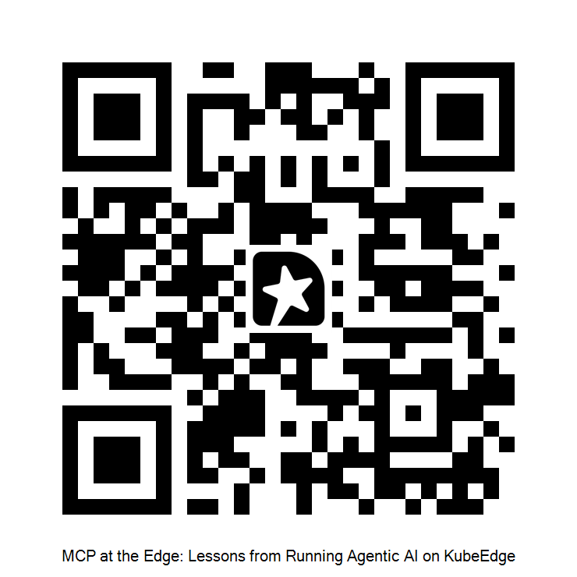
Thank you
Israel Olatunji Tijani · israel@chatve.co
Notes:
Thank the audience and invite questions, especially from people running MCP outside the always-connected cloud setting.

