Slide 1
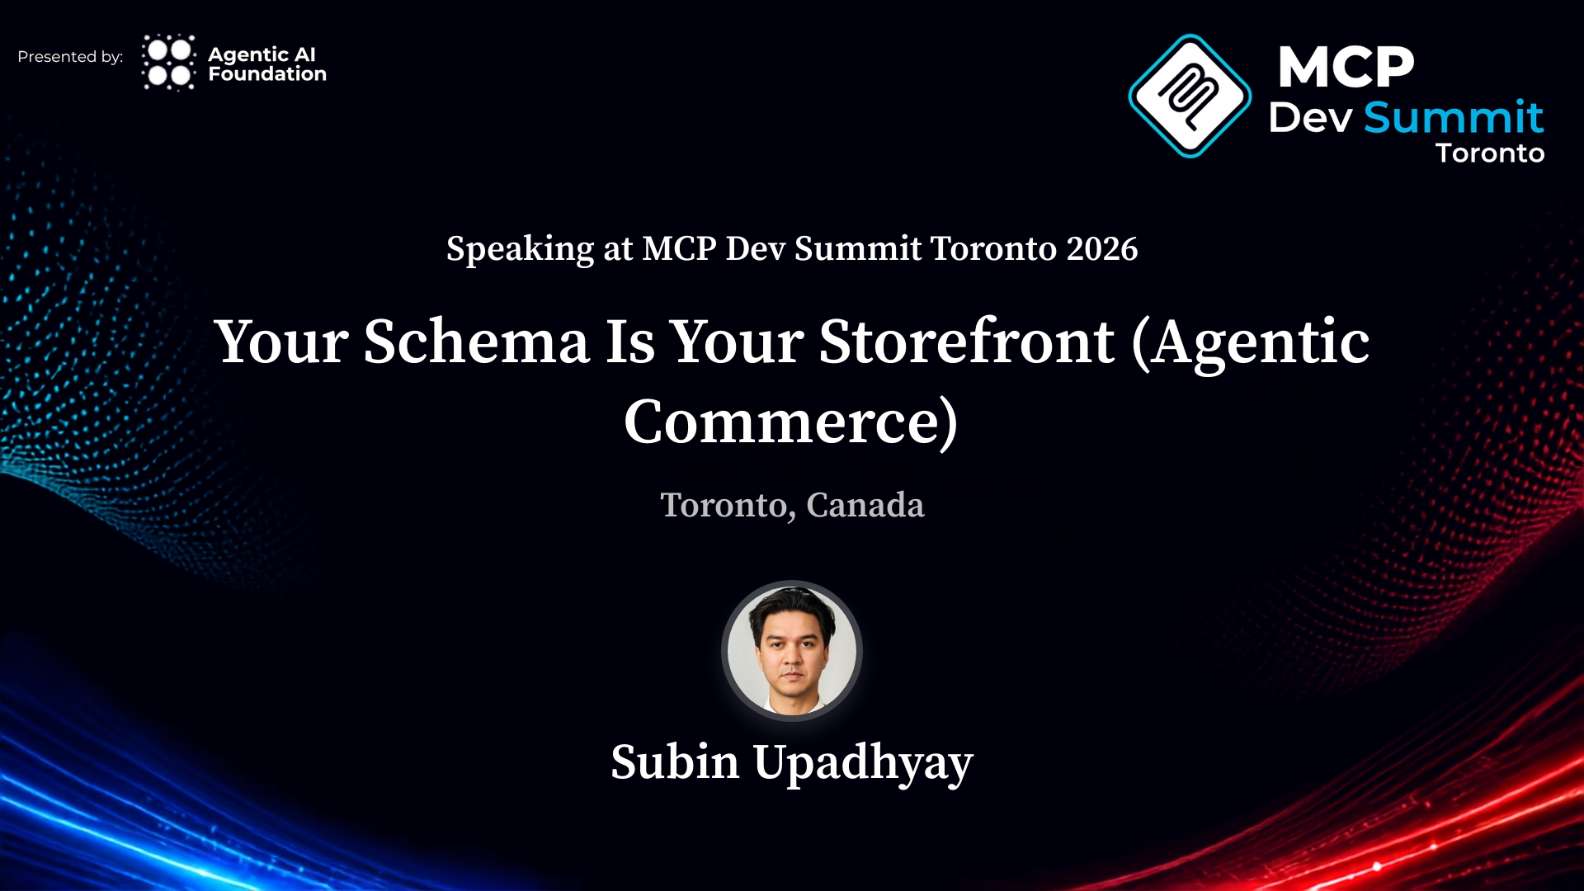

Slide 2
What makes a flight the best?
Raise your hand for the one that matters most to you.
Price
Total travel time
Fewest stops
Bags included
Departure time
Newest aircraft

Slide 3
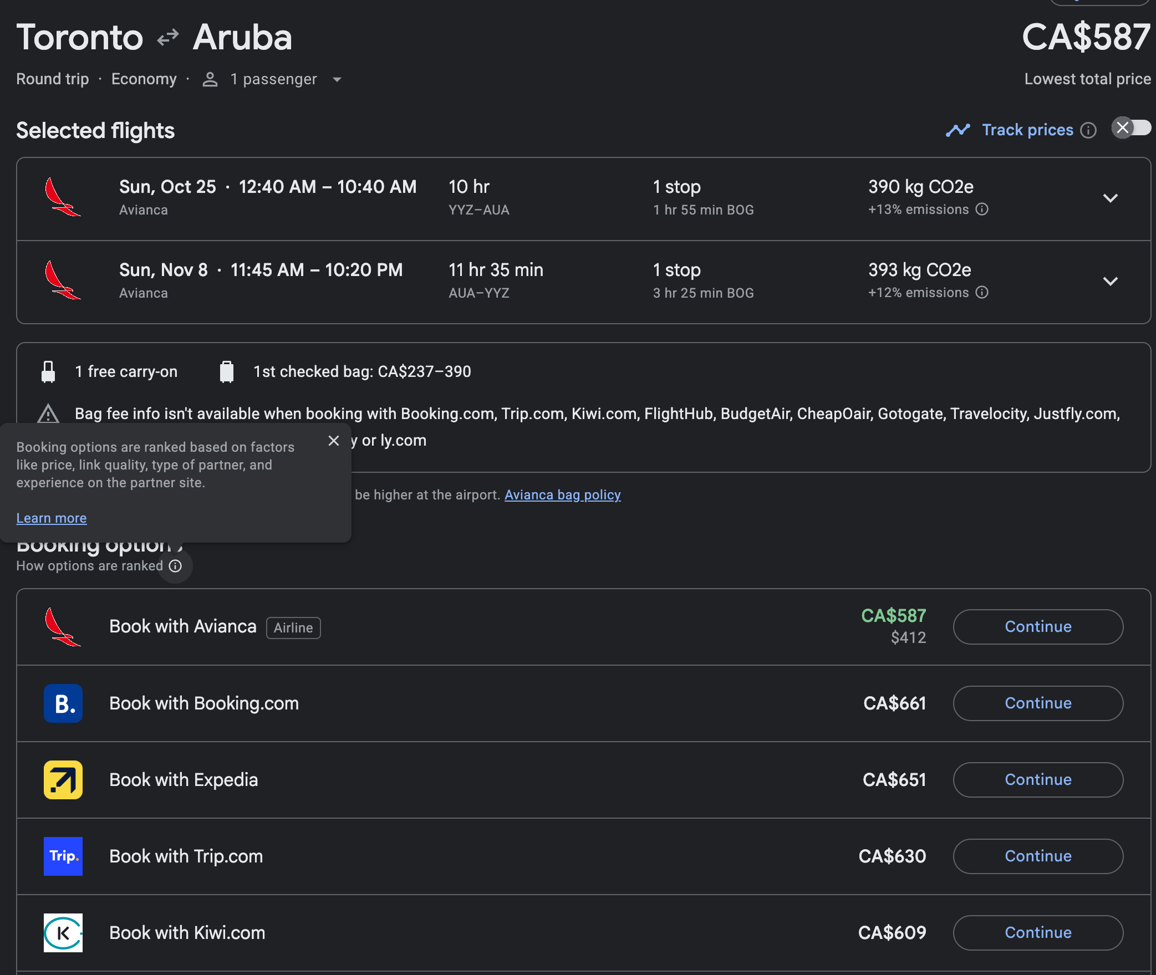
Toronto to Aruba.
CA$587.
Lowest total price.
What did CA$587 actually buy?
Google Flights booking page. Round trip, Avianca via Bogotá.

Slide 4
CA$390
for one checked bag, on a CA$587 round trip.
Up to two thirds of the fare. Even Google can't see the bag fees from at least ten sellers.
Google Flights booking page, Toronto to Aruba.

Slide 5
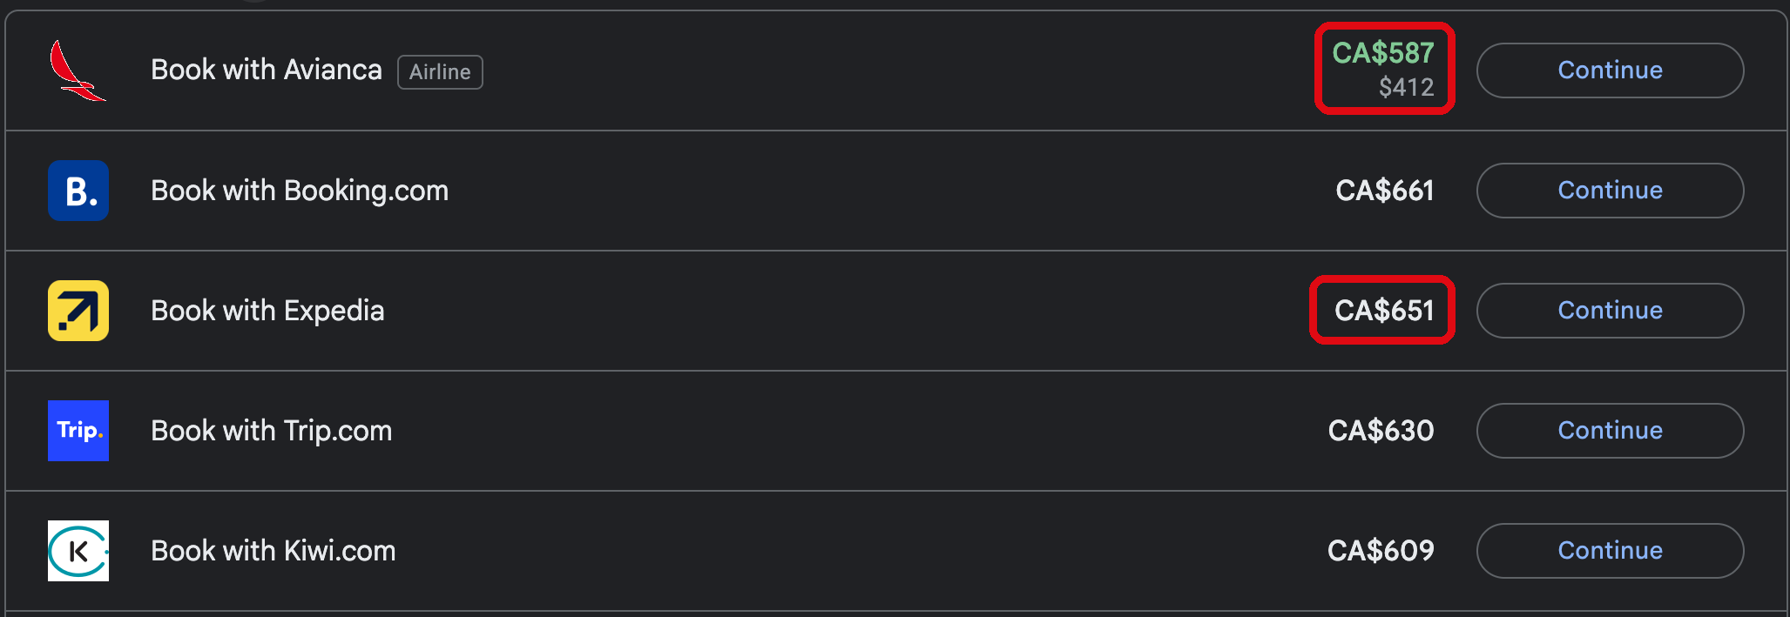
Which one is cheaper? It depends on my credit card.
What I saw
What my agent needs to know
"avianca": {
"shown": "CA$587",
"charged_in": "USD 412"
},
"expedia": {
"shown": "CA$651",
"charged_in": "CAD"
}
Google Flights booking options, Toronto to Aruba.

Slide 6
12:40 AM
CA$587 also bought a red eye departure.
For some people that's free. For me, it's a cost. Only my agent knows which.
Google Flights booking page, outbound flight.

Slide 7
Yes, Google has a Best tab.
Best by whose definition?
I'd pay $300 more to fly direct. Someone else would spend that $300 on a room upgrade.

Slide 8
Now switch seats.
For the rest of this talk, you're the store.
Sellers and aggregators: whoever answers the agent.

Slide 9
The storefront through history
Centuries
1900s
2000s
Now
Shop window
Billboard
Search
Agent
Who chooses for the customer
The customer's eyes
Whoever saw it
An algorithm
The agent
What you could buy
Location
Attention
Ranking (Sponsored)
?
How trust was proven
You met the owner
Brand repetition
Reviews and SEO
?

Slide 10
Every era of commerce answered the same question: how does a customer find you and decide to trust you? For the first time, customers hand that research to an AI agent.

Slide 11
It's naive to believe that simply hosting APIs as tools on FastMCP would solve the problem.
from fastmcp import FastMCP
mcp = FastMCP("flights")
@mcp.tool()
def search_flights(origin, dest):
return {"price": 587}
If it were, this talk would be a five minute chat at a café.
The five minute version: a FastMCP tool that returns a price.

Slide 12
The life of an MCP App call
The customer
MCP host
MCP App
MCP server
or a calling agent
the agent: Claude, ChatGPT,
Goose, VS Code
HTML in a sandboxed iframe
tools and ui:// resources
1 Discover tools/list returns the inputSchema and a ui:// pointer
2 Preload The host fetches the app's HTML before any call

Slide 13
The life of an MCP App call
The customer
MCP host
MCP App
MCP server
or a calling agent
the agent: Claude, ChatGPT,
Goose, VS Code
HTML in a sandboxed iframe
tools and ui:// resources
1 Discover tools/list returns the inputSchema and a ui:// pointer
2 Preload The host fetches the app's HTML before any call
3 Ask "Find me the best flight to Aruba"
4 Call tools/call with JSON that matches the inputSchema

Slide 14
The life of an MCP App call
The customer
MCP host
MCP App
MCP server
or a calling agent
the agent: Claude, ChatGPT,
Goose, VS Code
HTML in a sandboxed iframe
tools and ui:// resources
1 Discover tools/list returns the inputSchema and a ui:// pointer
2 Preload The host fetches the app's HTML before any call
3 Ask "Find me the best flight to Aruba"
4 Call tools/call with JSON that matches the inputSchema
5 Render The host draws the app in a sandbox, with the result
6 Interact A click becomes tools/call, relayed by the host over postMessage

Slide 15
If your schema only has a price field, you'll only ever compete on price.
What the customer saw
What a price only tool returns
{
"price": 587
}

Slide 16
Move every promise from the page into the payload.
{
"total_cad": 587,
"charged_in": "USD",
"fare_class": "light",
"checked_bag_cad": [237, 390],
"departs_local": "00:40",
"stops": 1,
"layover_min": 115,
"sponsored": false
}
If it isn't in the response, it doesn't exist.
Illustrative payload for the Aruba fare. Field names are examples.

Slide 17
Disclosure survival
Your tool returned
The model told the customer
"total_cad": 587,
"checked_bag_cad": [237, 390],
"charged_in": "USD"
"The cheapest option is CA$587 with one stop."
The bag fee and the currency didn't survive the retelling.
Illustrative. Test for this on every MCP host you ship to.

Slide 18
Measure the distance first
Scores what agents can discover, access, and use.
cbc.ca
1
shopify.com
60
vercel.com
97
Live scan: is-agentic.com
is-agentic.com, by Vercel and powered by Ora. Snapshot from September 30, 2026. Rescan before the talk.

Slide 19
The next generation of customers will shop like this:
1
My Smart fridge reorders my brand of yogurt: the right flavour, the right pack size, the quantity I actually eat.
MCP to find it, AP2 intent mandate to pay while I'm not there
2
My vacation planner finds the top ten things first time cruisers buy, and orders them from MEC and Amazon in one cart.
MCP across retailers, UCP Universal Cart to check out once
3
My flight gets cancelled, and my agent rebooks the ”next best” flight, based on my insurance allowance & submits my travel interruption claim
MCP to compare, my memory to decide

Slide 20
Your Agentic Commerce transformation checklist
1
Scan your public site at is-agentic.com.
2
Move every promise from the page into the payload.
3
Test what survives the paraphrase, on every MCP host.

Slide 21
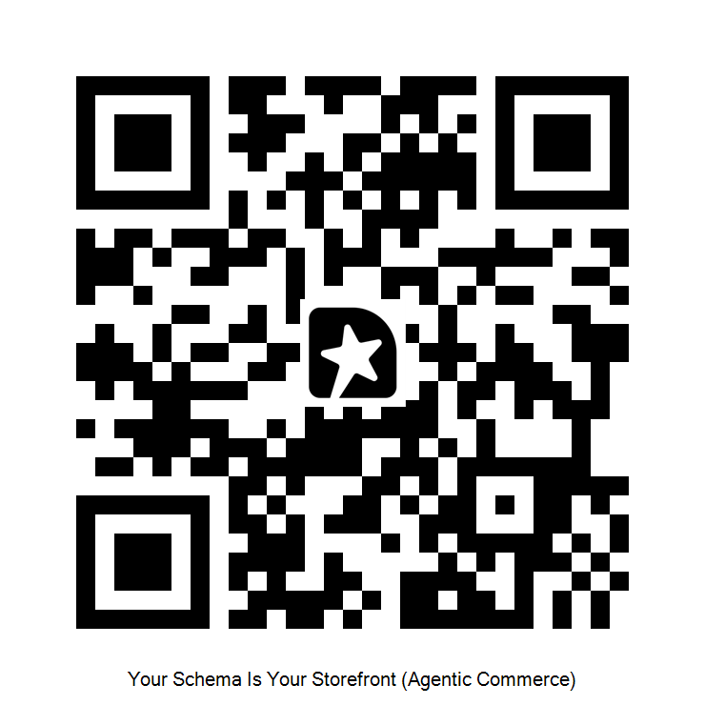
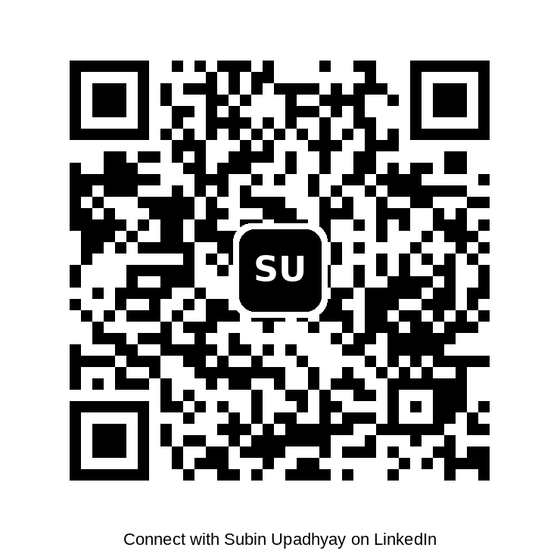
If we ran is-agentic.com on your enterprise storefront, what score would you bet the scan shows?
Rate this talk
Connect on LinkedIn
Subin Upadhyay, Agentic AI Foundation Ambassador

