Slide 1
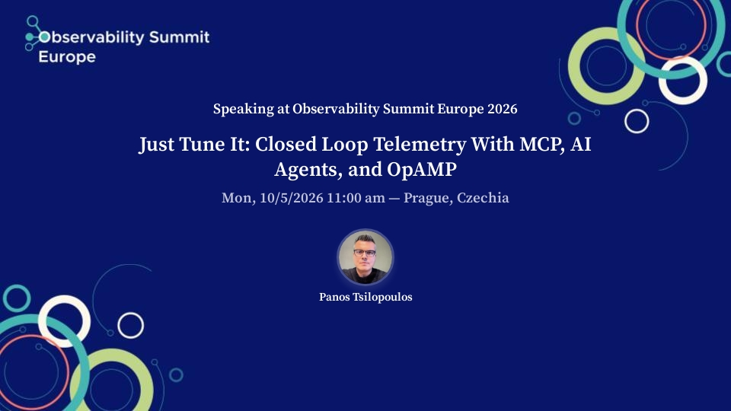
5/10
Notes:
Walk-in slide (session banner) while the room fills. Switch to the title slide when you start.

Slide 2



Three open standards, one loop
OTLP
OpAMP
MCP
The data
The control
The access
One protocol for logs, metrics and traces (and more) from any source to any backend.
One protocol for managing the collectors: remote config, health, status.
One protocol for giving an AI agent structured tools over both.
Put together: telemetry pipelines that tune themselves become testable.
Notes:
OTLP standardized the data.
OpAMP standardized control of the collectors.
MCP standardizes how an AI agent gets structured access to both.
Together they make a closed loop implementable with no proprietary glue.

Slide 3

100,000-ish
Which means
OpenTelemetry Collectors
A config push could be a fleet-wide event.
Blast radius is the first design constraint, but there will be more.
managed through one* enterprise-grade OpAMP control plane
*Control plane deep-dive: KubeCon NA 2025 · https://youtube.com/watch?v=J68ThM9DqQ0
Notes:
The control plane itself was covered at KubeCon NA 2025 (link on slide).
The number sets the design constraint: any change the agent proposes is, potentially, a 100k-collector change.
In reality, we segregate the collectors in the control plane’s database, grouping them by a number of common characteristics like topology or infrastructure they are deployed on (aka all EC2 collectors).

Slide 4


Two examples of agent tasks
Cardinality explosion
Incident declared
SIGNAL
SIGNAL
A label like sku_id lands on a metric. Active series jump 8x. Nike runs its own Observability platform, it’s possibly a stability concern for Mimir ingest pipelines, especially during high heat moments. It’s certainly company money needlessly spent on compute.
Traces are sampled down for cost, right when you need them most. Most trace-heavy telemetry pipelines for production systems will aggressively sample spans, to the tune of up to 90% depending on volume or other formulas.
AGENT'S JOB
AGENT'S JOB
Draft a filter or transform rule for the offending service.
Reduce trace sampling on the affected service for the incident's duration, to enable full fidelity and preserve context for agents (both humans & machine) operators running Ops.
Both are collector config changes, which is exactly what OpAMP pushes.
Notes:
Same shape: the signal is in the telemetry, the fix is a collector config change, and today a human stitches the two together at 3am.
For some sense of scale here: we had teams run large-scale Chaos Engineering experiments on their services in preparation of Single’s Day in China 11/11, which is a retail event that surpasses even Black Friday in many metrics, that caused a x30 increase in multiple metrics’ cardinality bringing our Mimir ring in the region down in the process :)

Slide 5





OBSERVE › PROPOSE › APPROVE › ACTUATE › VERIFY
The loop, and ownership boundaries
Observe
Propose
Approve
Actuate
Verify
AI agent
AI agent
Human
Control plane
Control plane
MCP read tools
propose_config_change
ctl approve
OpAMP canary
gates + rollback
fresh telemetry closes the loop
Notes:
The whole talk on one slide. The agent observes and proposes; a human approves; the control plane actuates and verifies. The agent never owns a stage that changes the fleet.

Slide 6
System design
Human
ctl approve / reject / rollback
human-only
AI agent
MCP server
Control plane
Collector fleet
MCP
proposal
OpAMP
any MCP client
8 read tools
1 propose tool
0 apply tools
policy engine
rollout engine: canary → verify → promote
OTel Collectors under an OpAMP server
queries
OTLP
Telemetry backends
metrics · logs · traces: any OTLP-compatible backend
Notes:
I am not going to debate the pros and cons of using MCP over CLIs for implementing such a system here. It’s like tabs vs spaces all over again; let’s instead consider how pointless those endless debates look from our vantage point nowadays that machines increasingly dominate writing code.
Left to right. The agent only speaks MCP. The MCP server reads backends and fleet state and creates proposals, nothing else. The only path to the fleet is control plane to OpAMP server, and the only way into the rollout engine is a human approval. The OpAMP server stays the single component with write access to collectors, so you can leverage your authentication provider’s machine identity features to implement properly scoped authorization, including read/write RBAC to each component.

Slide 7

MCP tools
READ
PROPOSE
fleet_overview
fleet_list_agents
fleet_get_config
query_metrics
query_logs
get_guardrails
list_proposals
get_proposal
propose_config_change
Stop asking your models nicely.
Guardrails enforced by CI.
APPLY
apply_config
approve
start_rollout
tests/test_loop.py::test_mcp_server_cannot_apply
Add an apply tool to the MCP server and the build fails.
Notes:
The core design interface between humans and agents.
Reads are broad: the agent needs context to be useful. Writes are a single tool that creates a proposal and changes nothing.
The MCP tools provide access to telemetry stores and the OpAMP server and guardrails policy of our control plane.
There is no apply, approve or rollout tool, and a test fails the build if someone adds one: a guardrail enforced by CI, not by asking the model nicely. That’s mainly because people tend to, ahem, experiment a lot in the age of AI.

Slide 8



Guardrails are code
# policy/guardrails.yaml (abridged)
allowed_config_paths:
- processors.filter
- processors.transform
- processors.attributes
- processors.probabilistic_sampler
- processors.tail_sampling
- service.pipelines.*.processors
forbidden_config_paths: # wins
- exporters # where data goes
- receivers # ingestion
- extensions # auth, health
- service.telemetry # the collector’s own o11y
max_canary_fraction: 0.05
protected_labels:
tier: payment-critical
Allowlist what may be shaped
Volume, cardinality, sampling: processors, and the pipeline lists that wire them in.
Denylist wins
Where data goes and how we authenticate are human-only, full stop.
Reviewed in a PR
Widening the agent's reach is a diff with an approver, not a prompt tweak.
Notes:
The policy is a YAML file in version control. What the agent may touch is a reviewable diff, not tribal knowledge. Changes to it get production config review, because that's what they are.
Show what the file looks like
A question we debated heavily was “what’s the point of both an allowlist and a denylist”. We ended up with both because
It guards against the allowlist being widened. The allowlist will grow over time, and a broad entry like processors or service is an easy mistake in review. The denylist says "even then, never these", and it always wins.
It records intent. The allowlist says what the agent may do today and should change. The denylist is the line you refuse to cross ("exporters: never let an agent redirect telemetry"), and it should almost never change. Keeping them separate makes a diff that touches the denylist stand out in code review.

Slide 9
Seven gates before the fleet
1
Path allowlist / denylist
Exporters, receivers, auth, or rewiring pipelines
propose
2
Evidence receipts
propose
No LLM summaries. Data and the queries the agent ran or no bueno
3
Protected labels
propose + approve
Unable to reach payment-critical collectors, by any selector
4
Human approval
approve
Good ol’ code review: no MCP tool for it deliberately
5
Canary ≤ 5%
rollout
Prevent fleet-wide blast radius on first contact
6
Verification gates
Unhealthy canaries, series increase, or signal loss
rollout
7
Auto-rollback + audit
Silent failures and unaccountable changes
rollout
Notes:
Seven gates, three phases.
The first three fire when the proposal is created, so a bad proposal can't even be registered as approvable.
The fourth is structural and possibly will change in the future as we grow our trust in agentic systems by building and testing additional guardrails.
The last three do damage control on the blast radius even of a bad idea a human approved.

Slide 10
LIVE DEMO
A cardinality explosion in checkout
1
make reset && make demo
checkout series jump ~8x
2
"Something is wrong with our telemetry volume. Investigate and fix it."
the agent, over MCP (make agent)
3
ctl show <id> → ctl approve <id>
a human, in a terminal
4
ctl audit
the full trail
Notes:
Switch to the terminal. The demo runs locally against a simulated collector fleet with the same MCP surface the production bridge exposes.
In case
Fallback: if Wi-Fi or the model misbehaves, run `make replay` or play the recording. Keep it one keypress away.

Slide 11
OBSERVE › propose › approve › actuate › verify
Observe: one service is 8x off
8x
checkout active series vs. baseline
EVIDENCE: query_logs
WARN checkout: metrics
client registered high-
cardinality label 'sku_id'
(61,204 distinct values)
Simulated collector fleet · same MCP surface as production
Notes:
Observe. The agent starts at fleet_overview, then query_metrics over time: one service is an order of magnitude off. query_logs gives it the why: a WARN line naming the label. Both come back with evidence receipts it must cite in the proposal.

Slide 12
observe › PROPOSE › approve › actuate › verify
AI Agent proposal: strip the label
processors:
transform/strip-sku:
metric_statements:
- context: datapoint
statements:
- delete_key(attributes, "sku_id")
where resource.attributes
["service.name"] == "checkout"
service:
pipelines:
metrics:
processors:
[batch, transform/strip-sku]
ATTEMPT 1
policy_rejected
selector {service: checkout} matches protected agents (tier=payment-critical). Narrow the selector.
ATTEMPT 2
pending_approval
selector {service: checkout, env: prod, tier: standard}: 40 agents. Nothing applied yet.
+ reason + evidence: [receipt ids from query_metrics, query_logs]
Notes:
Propose. The agent reads get_guardrails and drafts a transform that strips the label rather than dropping checkout's data, citing its evidence receipts.
Its first selector (service=checkout) is policy_rejected: it would reach payment-critical collectors.
It then narrows to tier=standard and re-proposes.
The policy talks back in plain language and the agent adapts.
The denylist wins. A rejected proposal can never be approved: exfiltration via config change is the scenario this rule exists for.

Slide 13



observe › propose › APPROVE › ACTUATE › VERIFY
Approve → canary → promote
ctl approve
Canary
Verify
Promote
Audit
human reviews patch + the data behind the evidence
2 of 40 agents (5%) via OpAMP
healthy ✓
no increase ✓
signal kept ✓
remaining 38 agents
every transition, every actor
start_rollout accepts only human:<name> approvers. The agent can watch the outcome via get_proposal, but never cause it.
Notes:
Approve, actuate, verify. The human sees reason, selector, patch, and the data behind each evidence receipt, and types part of the proposal id to approve.
The engine picks 5% (2 of 40), checks canary health and RemoteConfigStatus, no series increase, no service below half its baseline. Then promotes to the other 38.
Every transition hits the audit log.

Slide 14
Failure modes we hit
The selector never said "tier"
Fewer series ≠ better
Protected labels were matched against selector text. service=checkout reached 3 payment-critical collectors.
Verification only failed on increases. A filter that drops everything passed.
Fix: Check the resolved agent set, at propose and at approve.
Fix: Two-sided gate: no service below 50% of baseline.
Pipelines were on the allowlist
The agent had a shell
exporters: [ ] would have blackholed the fleet and verified clean.
No MCP apply tool, but a coding agent could run the approval CLI itself.
Fix: Allowlist only service.pipelines.*.processors.
Fix: MCP-only agent profile; approval outside its reach.
Notes:
The honest slide. Every one of these passed our own test suite. We found them by attacking the guardrails, not by reading them. Each fix is small; the lesson is that guardrails need adversarial tests like any other security boundary.
There are ways to run the agent as a continuous background task or fire it off based on existing alerts in your monitoring systems but these are beyond the scope of this demo.
There’s also something to be said about the form of the proposal itself; in the demo it’s just text in a local machine but what would that look like in a production system?
The immediate thought is probably a Pull Request in a repo, GitOps ‘n all, but this idea potentially conflicts with the fact that OpAMP in it’s simplest implementation form is stateless; but you can add a database to back the configurations up in a production system and then things get interesting.

Slide 15




Still open
Prompt injection via telemetry
Approval fatigue
Log lines are untrusted input. One can say "ignore your guardrails." The guardrails must hold when the agent is fooled.
Humans who approve everything are a rubber stamp. Make approvals rare and legible.
Slow-burn effects
Evidence beyond receipts
Changes that pass a canary but degrade data quality over days.
Receipts prove a query ran. They don't prove the agent read it right. The human still has to look.
Notes:
What's not solved. Prompt injection is the big one: the agent reads log lines, and log lines are written by whoever can make your service log. The guardrails hold even if the agent is fooled: an injected 'change the exporter' is still policy_rejected (scenarios.trigger prompt_injection shows it). That's the point of putting the boundary in the architecture.

Slide 16
Where the line moves next
01
Multi-wave rollouts
5% → 25% → 100%, with bake time and verification per wave.
02
Real OpAMP bridge
opamp-go example server first, then the production control plane. Same MCP surface.
03
Pre-approved change classes?
E.g. raise sampling for a declared incident, auto-expiring. Approved in policy, not by the agent.
04
Evals
Read-only tasks against a seeded fleet, to measure how well agents use these tools.
Notes:
Where the line might move. The open question for the community: is there a class of change, like raising trace sampling for a declared incident with an automatic expiry, that is safe to pre-approve? If so, that approval belongs in the policy file, reviewed like everything else, not in the agent.
[Speaker: align this slide with what Nike actually auto-applies today, if anything.]

Slide 17



Three takeaways
Put the boundary in the architecture, not the prompt.
No apply tool exists; a test proves it.
Guardrails are production config.
Review them, test them, and attack them.
Open standards make it portable.
OTLP, OpAMP, MCP: swap any backend, keep the loop.
Notes:
Three things to take home.

Slide 18
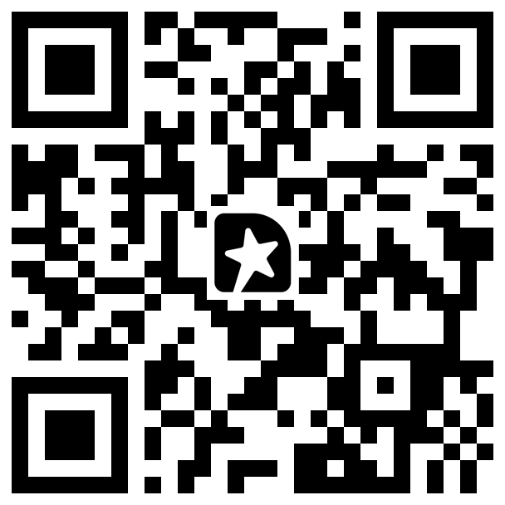
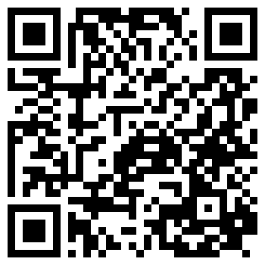
Thank you
Try the loop yourself: zero infrastructure.
git clone github.com/tsilopoulos/closed-loop-telemetry
make setup && make demo
Rate this session
Get the code
your feedback
closed-loop-telemetry
Notes:
Thank you. Leave this slide up through Q&A: ask people to scan the left code to rate the session (it helps the program committee) and the right one for the repo. Clone it, run make setup && make demo, and point your own MCP client at it. Questions.

