Slide 1
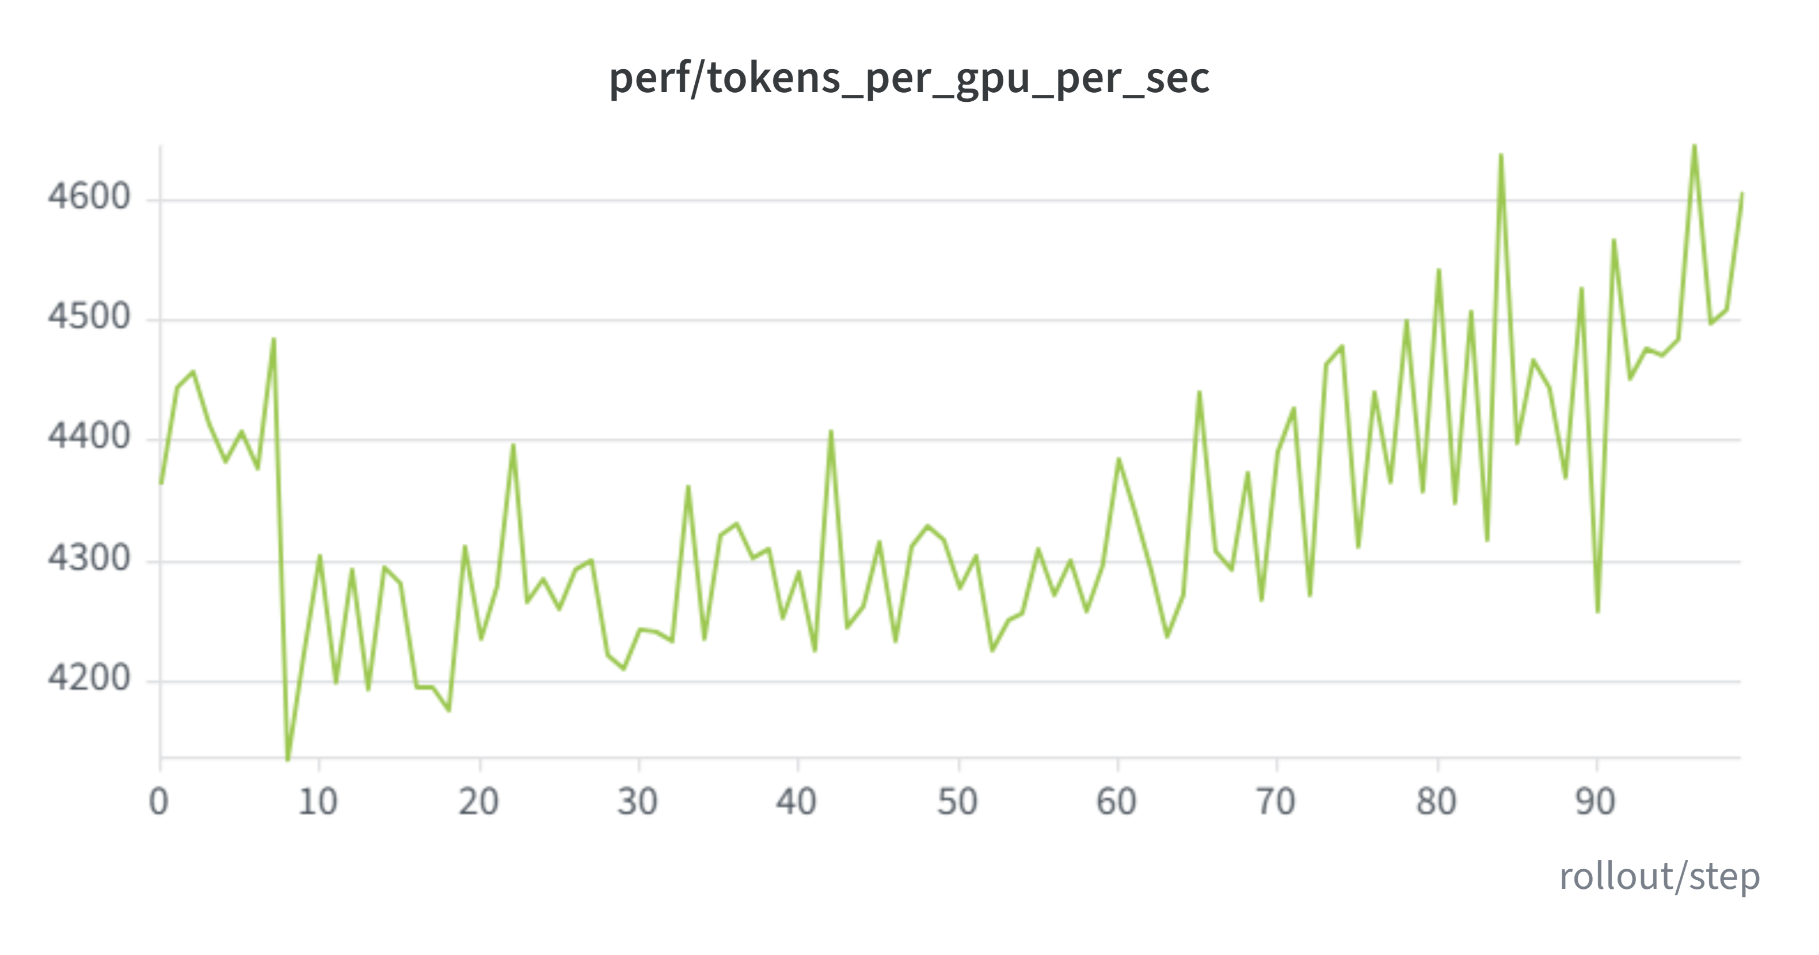
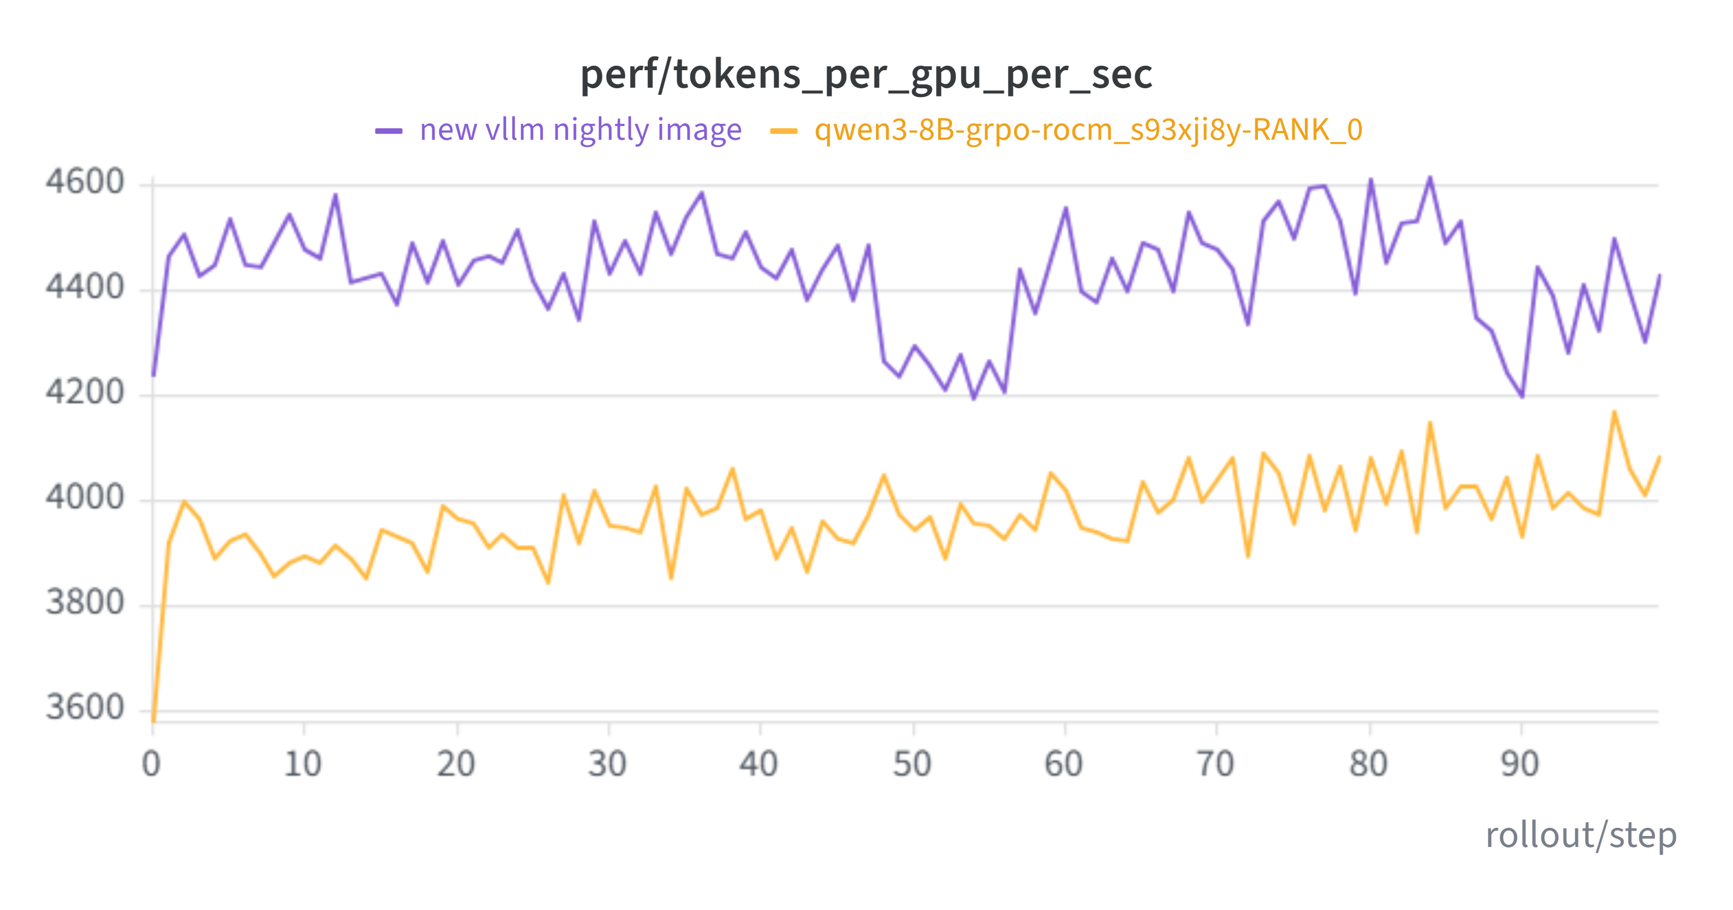
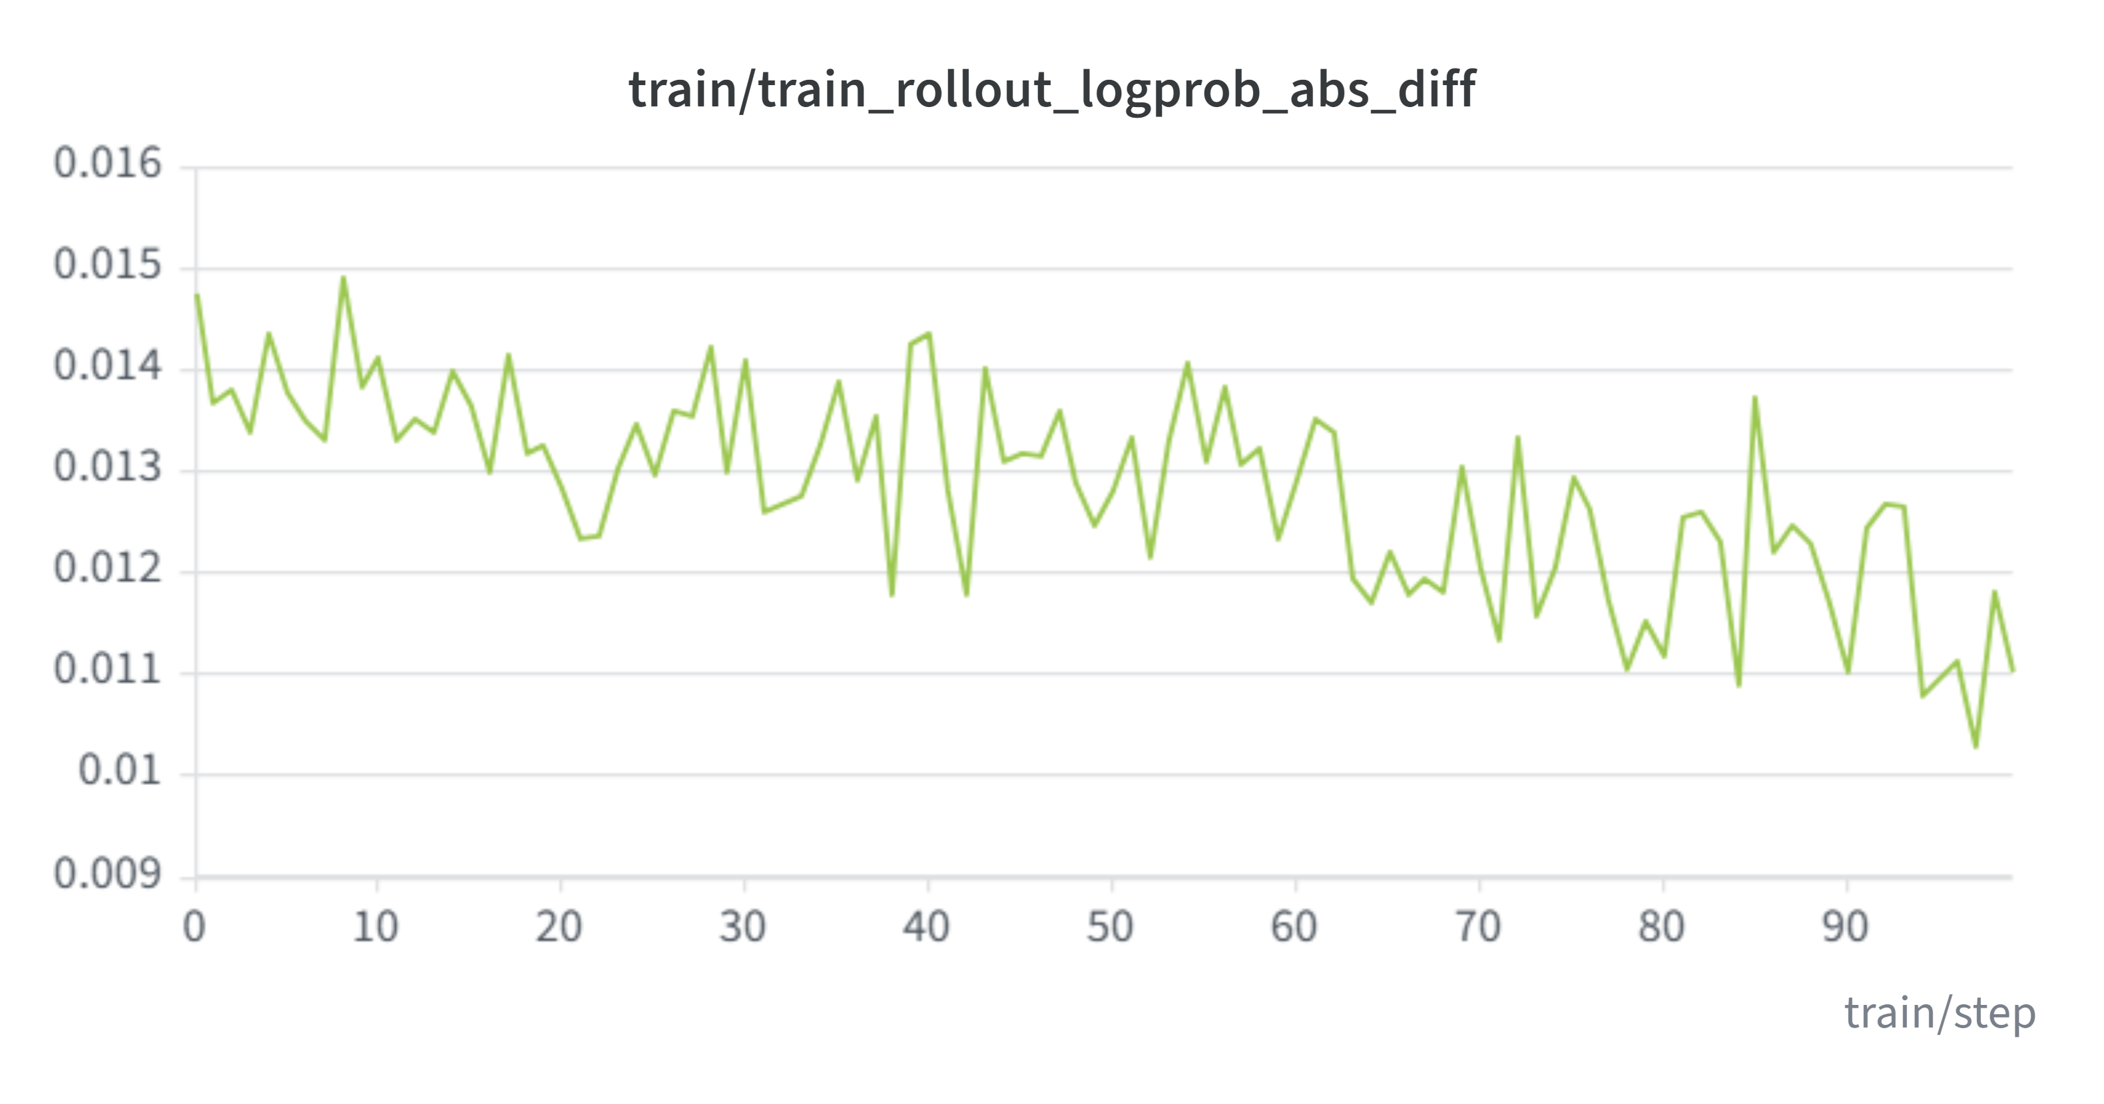
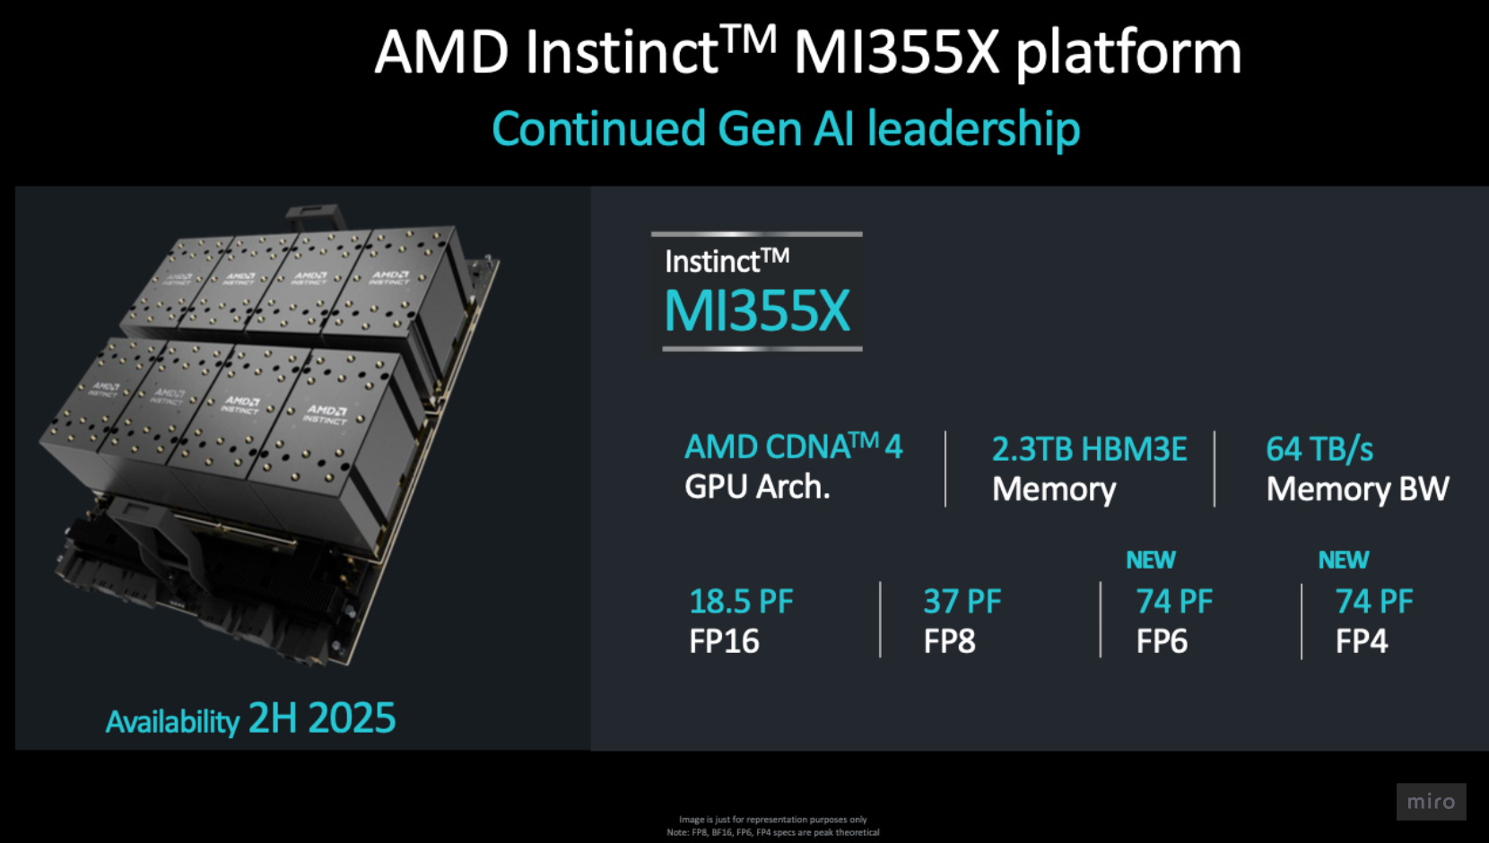
Vime + ROCm: End-to-End RL Post-Training on AMD Instinct™ GPUs
Joy Song, Shekhar Pandey, Liz Li, Ao Shen, vime team · reinforcement-learning post-training on ROCm
AMD-side Bring-up
CI & Image Updates
Results
+12%
Bringing vime's full RL post-training loop up on AMD Instinct™ GPUs with ROCm, from training through rollout.
End-to-end RL natively on ROCm
Megatron-LM training + vLLM rollout, running on AMD Instinct™ MI355X (CDNA™ 4)
Validated at parity with the NVIDIA path
CI enablement: active updates
Nightly base image: switched for better sustainability
Test coverage: wide variety of tests added and passing
Image updates: newest image delivering a 12% performance increase on Qwen3-8B
performance on Qwen3-8B, newest image
Hardware Platform
ROCm AMD Support
Model support
Qwen3.5
Qwen3-8B
Qwen3-4B
Qwen3-30B-A3B (MoE)
Llama3-8B
Training support
Disaggregated and colocated
Async and sync
All modes enabled
Updated frequently with CI
~4.2K
~0.012
+60%
tok / GPU / s
Avg logprob
abs diff
Raw reward climb
AMD Instinct™ MI355X · CDNA™ 4 · 288 GB HBM3E · up to 74 PF (FP4).
Vime Framework
VIME is the vLLM-native, first-party option that brings slime's proven Megatron-plus-custom-rollout paradigm into the vLLM ecosystem, making it the natural pick for stacks already standardized on vLLM that need to track its release cycle.

