Slide 1





Symphony AI Studio: From Compliant AI
to Hybrid Workflow Orchestration
with Fluxnova
November 2026
Richard Ring
Notes:
Welcome everyone to Hall 1. Earlier this afternoon on the Keynote Stage, we walked through a decade of Symphony open-source contributions to FINOS and where Symphony AI Studio is headed next. In this 20-minute session, we are keeping slides minimal as a live backdrop so we can spend the bulk of our time in a live engineering demo of Symphony Flow Studio and FINOS Fluxnova.

Slide 2

THE REGULATED AI PARADOX & SYMPHONY AI STUDIO
99% Prompt Reliability Still Fails Compliance
Flight-recorder tracing logs failures after the breach. Regulated markets require preventative deterministic state control.
When an AI agent touches trade exceptions or federated client channels, embedding business rules inside a system prompt creates unacceptable risk. A 1% hallucination or state drop is an immediate audit failure.
01
FLOW STUDIO
FINOS Fluxnova BPMN 2.0 state machine & SLA timers
02
AGENT STUDIO
Bounded context synthesis & strict JSON extraction
Symphony AI Studio separates probabilistic reasoning from deterministic state control across four unified studio layers:
03
MCP STUDIO & SKILLS
14-tool Spring AI MCP Server
& typed BDK 2.0 connectors
04
COMPLIANCE ARCHIVE
Cryptographic audit across rooms, WhatsApp, WeChat & SMS
© 2026 Symphony Communication Services, LLC - Proprietary and Confidential
2
Notes:
Most enterprise AI governance today is built like a flight recorder: it tells you what went wrong after the agent already made the mistake. In capital markets, 99% prompt reliability is still a compliance failure waiting to happen. That is why we unified Symphony AI Studio around four layers: Flow Studio on FINOS Fluxnova owns the BPMN 2.0 state machine, while Agent Studio and MCP Studio execute strictly bounded reasoning and tool calls inside that deterministic envelope.

Slide 3
LIVE DEMO ARCHITECTURE · SYMPHONY FLOW STUDIO & FINOS FLUXNOVA
Why Regulated AI Agents Need Deterministic Guardrails
Moving from post-facto flight-recorder observability to preventative BPMN 2.0 state-machine control with FINOS Fluxnova
THE OBSERVABILITY TRAP
PASSIVE FAILURE TRACE:
passive post-facto monitoring
the breach is recorded, not prevented
99%
INPUT
User prompt
RISK
Unbounded LLM agent (owns loop)
1% Unguarded Failure = Breach
EGRESS
Unchecked trade / external message
Prompt reliability is not deterministic control. Catching an unauthorized trade or message in a log means the breach already occurred.
TOO LATE
Observability log: recorded after breach
© 2026 Symphony Communication Services, LLC - Proprietary and Confidential
3
Notes:
Many of you saw this architecture graphic when we shared it on LinkedIn ahead of OSFF. On the top is the Observability Trap: when an unbounded LLM agent owns the execution loop, a 1% failure crosses the external boundary before your log ever records it. On the bottom is the Symphony and FINOS Fluxnova architecture we are about to show live: (1) Pre-Execution Policy Gate in Fluxnova BPMN 2.0, (2) Bounded Agent Synthesis in AI Agent Studio, (3) Schema, Risk & HITL Gateway, and (4) Governed Dispatch & Compliance Archive. Let's switch straight into the live environment and build and run this flow now.

Slide 4
THE SYMPHONY + FINOS FLUXNOVA ARCHITECTURE
Preventative Deterministic Control
FINOS Fluxnova BPMN 2.0 Execution Enclave · Symphony Flow Studio
SANDBOXED INFERENCE ·
ZERO EXTERNAL TOOL ACCESS
01
02
03
04
Pre-Execution
Policy Gate
Pre-Execution
Policy Gate
Pre-Execution
Policy Gate
Pre-Execution
Policy Gate
finos fluxnova bpmn 2.0
symphony ai agent studio
deterministic bpmn validation
federation & compliance archive
Verifies caller identity, desk entitlements & RBAC
Locks execution policy envelope before any LLM inference runs
Synthesizes unstructured context into strict JSON
Produces candidate payload; owns zero workflow state
PASS · Policy Cleared
ESCALATE · HITL Maker-Checker
BLOCK · Deterministic Quarantine
Enforces schema, notional limits & DLP rules before egress
Dispatches approved actions to Federated Messaging, WhatsApp & OMS
100% retained & discoverable in Symphony Compliance Archive
© 2026 Symphony Communication Services, LLC - Proprietary and Confidential
4
Notes:
Many of you saw this architecture graphic when we shared it on LinkedIn ahead of OSFF. On the top is the Observability Trap: when an unbounded LLM agent owns the execution loop, a 1% failure crosses the external boundary before your log ever records it. On the bottom is the Symphony and FINOS Fluxnova architecture we are about to show live: (1) Pre-Execution Policy Gate in Fluxnova BPMN 2.0, (2) Bounded Agent Synthesis in AI Agent Studio, (3) Schema, Risk & HITL Gateway, and (4) Governed Dispatch & Compliance Archive. Let's switch straight into the live environment and build and run this flow now.

Slide 5
POST-DEMO RECONFIRMATION · PRODUCTION PATTERNS
What the Live Demo Proved in Production
PATTERN 1 · POST-TRADE T+1
PATTERN 2 · OMNICHANNEL SLA
PATTERN 3 · GOVERNANCE LOCK
Bilateral CTM Trade-Break Triage
Federated Policy Renewal & WhatsApp
Conversational Build to Immutable Run
Replacing noisy 30-message exception loops under T+1 compression:
Single-Pass Extraction: Agent extracts ISIN, delta, and root cause into a strict schema.
Notional Gate: Fluxnova auto-clears micro-breaks and routes large breaks to Elements.
Governing external client sessions without violating 24-hour rules:
BPMN 2.0 Portability: Standard BPMN 2.0 XML imports with multi-day state persistence.
PT23H Boundary Timer: 23-hour timer triggers pre-approved WhatsApp Message Templates.
Bridging rapid AI workflow authoring with production audit controls:
14-Tool MCP Authoring: Conversational BPMN 2.0 generation and validation in DRAFT.
Immutable Promotion: Locked PUBLISHED v1 snapshots execute via FINOS BDK 2.0.
Zero Unapproved External Dispatch
100% Compliance Archive Retention
FINOS Fluxnova + BDK 2.0
Open Standard
© 2026 Symphony Communication Services, LLC - Proprietary and Confidential
5
Notes:
Coming back from the live demo, this slide reconfirms the three production patterns you just saw in action. First, in post-trade T+1 CTM exception handling, combining single-pass agent extraction with a Fluxnova notional gateway eliminates 30-message bot loops while enforcing human sign-off on high-value breaks. Second, in omnichannel workflows, standard BPMN 2.0 XML with a 23-hour boundary timer governs federated WhatsApp sessions deterministically. Third, conversational MCP authoring in DRAFT paired with immutable PUBLISHED snapshots gives engineering speed without sacrificing audit control.

Slide 6
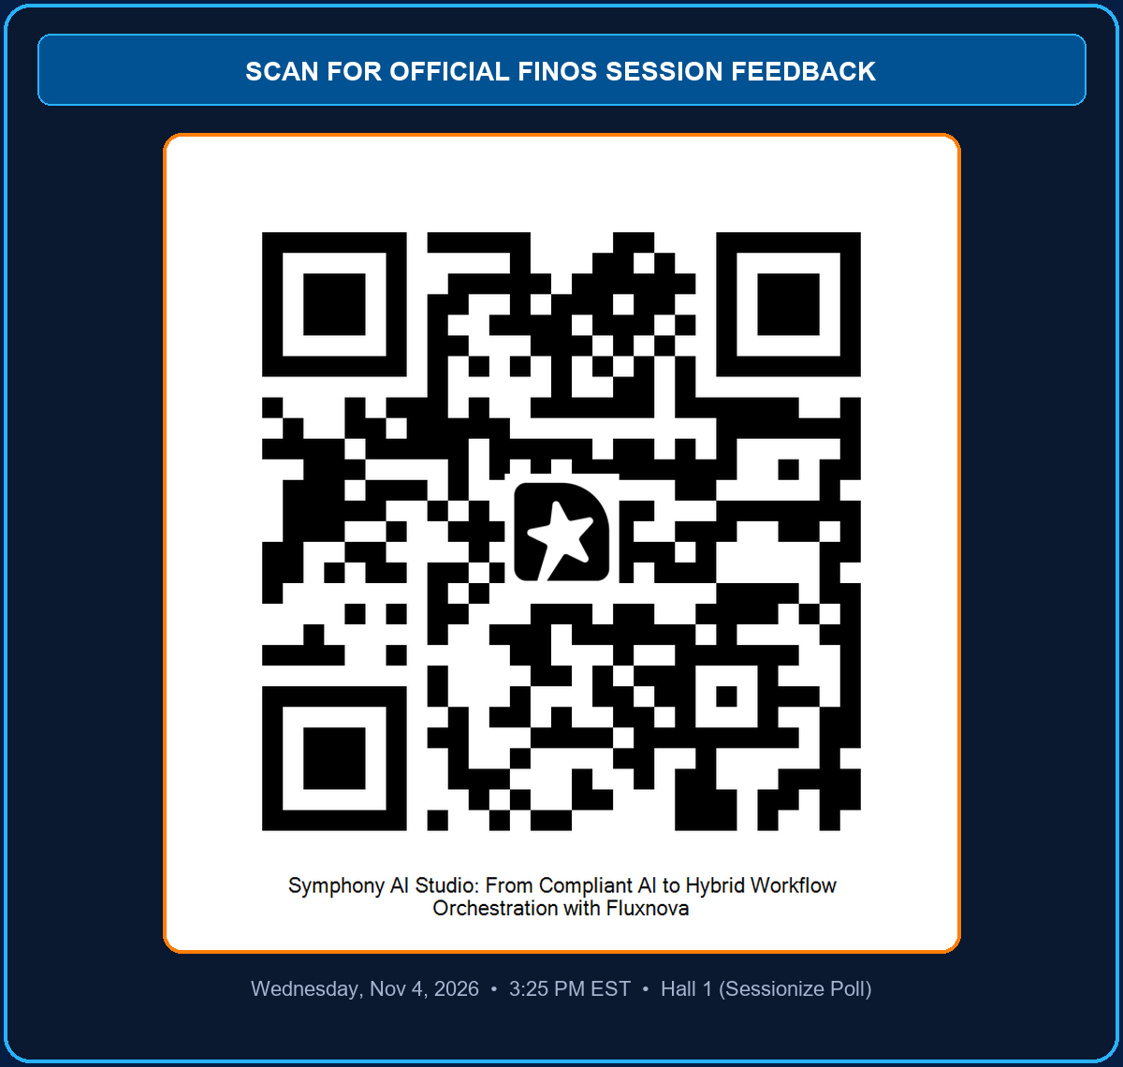
KEY TAKEAWAYS, Q&A
Probabilistic Intelligence Inside. Deterministic Governance Outside.
Scan the FINOS Sessionize QR code to rate this session · Reach out directly at richard.ring@symphony.com
01
Preventative control: FINOS Fluxnova BPMN 2.0 owns the state machine, timers, and exclusive gateways.
02
Bounded AI reasoning: Symphony AI Studio & MCP tasks synthesize unstructured chat without owning state.
03
Open standard execution: Portable BPMN 2.0 XML and FINOS BDK 2.0 with full Compliance Archive retention.
DIRECT CONTACT
Richard Ring · richard.ring@symphony.com
© 2026 Symphony Communication Services, LLC - Proprietary and Confidential
6
Notes:
We will leave this slide up as a backdrop during Q&A so everyone can scan the official FINOS Sessionize QR code on the right to share feedback on the session. The core takeaway is simple: keep probabilistic intelligence inside the task, and enforce deterministic FINOS Fluxnova governance on the outside. Let's open it up for questions.

